Slide 1
A Generic View of Process
Software Engineering: A Practitioner’s Approach
by Roger S. Pressman

Slide 2
Chapter Overview
What? A software process - a series of predictable steps that leads to a timely, high-quality product.
Who? Managers, software engineers, and customers.
Why? Provides stability, control, and organization to an otherwise chaotic activity.
Steps? A handful of activities are common to all software processes, details vary.
Work product? Programs, documents, and data.
Correct process? Assessment, quality deliverable.
Notes:
How does software differ from the artifacts produced by other engineering disciplines?
Answer (Section 1.1):
Software is both a product and a vehicle for delivering a product. As a product, software is an information transformer. As a vehicle for delivering a product, software serves as a basis for computer control, communication, and creation of other programs.
How do software characteristics differ from hardware characteristics?
Answer (Section 1.2):
Software is developed, not manufactured. Software does not wear out, but it can deteriorate when changes are made. Most software is custom built, not assembled out of components.
What is the difference between software that is determinate and software that is indeterminate?
Answer (Section 1.3):
Software is determinate is the order and timing of its inputs, processing, and outputs is predictable and it is indeterminate if the order and timing of its input, processing, and outputs is not predictable in advance.
Final Exam Question
Explain what is wrong with the notion that computer software does not need to evolve over time.
Answer (Section1.4):
Computer software must be revised as errors are discovered and corrected. Software must be updated to accommodate changes in the computing environment. Many times a customer will request changes to add new functions to an existing product or to accommodate changes in the business environment. Sometimes an older system will need to be reengineered to provide benefits to the user in a modern context. The bottom line is that software that does not evolve will eventually become unusable.

Slide 3
Content
Software Engineering – A Layered Technology
A Process Framework
CMMI
Process Patterns
Process Technology

Slide 4
SW Process and SW Engineering
Software is assets and knowledge
Software is a process for the tasks required to build high quality software, is to define the methods in SW develop
But Software engineering encompasses technologies populated the process—technological method and automated tools

Slide 5
Software Engineering
Software Engineering:
The establishment and use of sound engineering principles in order to obtain economically software that is reliable and works efficiently on real machines.

Slide 6

Software Engineering
Software Engineering:
(1) The application of a systematic, disciplined, quantifiable approach to the development, operation, and maintenance of software; that is, the application of engineering to software.
(2) The study of approaches as in (1).
- IEEE Standard 610.12-1990

Slide 7
A Layered Technology
Software Engineering
tools
methods
process model
a “quality” focus

Slide 8
Quality Focus
Is a bedrock to support SW engineering
Is a organizational commitment to software
Is a customer’s needs
Need a continuous process improvement
BACK

Slide 9
Process
A collection of activities ,actions , and tasks that a performed when some work product is to be created
Is the foundation of SW engineering to hold technology together to build software timely and rationally
Defines a framework as a road map for software development
Forms a basis for software management control
BACK
Notes:
活动主要实现宽泛的目标,与应用领域，项目大小、结果复杂性无直接关系（如沟通）
Action（动作，如体系结构设计）包含了主要工作产品（体系结构模型）生产过程中的一系列tasks
Task关注小而明确的目标，能够产生实际产品（如构建一个单元测试）

Slide 10
SW engineering method
Provide the technology :how to build software
Including many methods: communication, requirement analysis, design modeling, program construction, testing and support
Modeling activity and descriptive techniques
BACK

Slide 11
Software engineering tools
For methods
For processes
Tools are integrated for stakeholder
Computer aided software engineering (CASE)

Slide 12
Process Framework
Software Process
Process framework
Umbrella Activities
Framework activity #1
Software Engineering action #1.1
work tasks
work products
milestones & deliverables
QA checkpoints
.
.
Software Engineering action #1.k
.
.
.
Framework activity #n
Software Engineering action #n.1
work tasks
work products
milestones & deliverables
QA checkpoints
.
.
Software Engineering action #n.m
© 2010 Sichuan University All rights reserved. | Confidential

Slide 13
A Process Framework
Process framework
Framework activities
work tasks
work products
milestones & deliverables
QA checkpoints
Umbrella Activities

Slide 14

Generic Framework Activities
Communication
Planning
Modeling
Analysis of requirements
Design
Construction
Code generation
Testing
Deployment
© 2010 Sichuan University All rights reserved. | Confidential

Slide 15
Umbrella Activities
Software project management
Formal technical reviews
Software quality assurance
Software configuration management
Work product preparation and production
Reusability management
Measurement
Risk management
© 2010 Sichuan University All rights reserved. | Confidential

Slide 16
The Process Model: Adaptability
The framework activities will always be applied on every project ... BUT
The tasks (and degree of rigor) for each activity will vary based on:
the type of project
characteristics of the project
common sense judgment; concurrence of the project team

Slide 17
Example:
Task set for Requirement gathering
in Communication activity
Make a list of stakeholders for the project
Invite all stakeholders to an informal meeting
Ask each stakeholder to make a list of features and functions required
Discuss requirements and build a final list
Prioritize requirements
Note areas of uncertainty
small, relatively simple project
© 2010 Sichuan University All rights reserved. | Confidential

Slide 18
Example:
Task set for Requirement gathering
in Communication activity
Make a list of stakeholders for the project
Interview each stakeholder separately to determine overall wants and needs
Build a preliminary list of functions and features based on stakeholder input
Schedule a series of facilitated requirements gathering meetings
Conduct meetings
Produce informal user scenarios as part of each meeting
Reline user scenarios based on stakeholder feedback
Build a revised list of stakeholder requirements
Use quality function deployment (QFD) techniques to prioritize requirement
Package requirements so that they can be delivered incrementally
Note constraints and restrictions that will be placed on the system
Discuss methods for validating the system
large, more complex project
© 2010 Sichuan University All rights reserved. | Confidential

Slide 19
Software process assessmenet
ISO:
SEI:CMM (Capaility maturity Model)
CMMI (Capaility maturity Model Intergration)

Slide 20
Sw-CMM Overview
Level
Characteristics
Management visibility
Prediction of performance
Optimized
5
The management
focuses on the continuous
improvement of the process
O
I
Probability
Managed
4
Product and process
are managed quantitatively
Target
Time/$
I
O
Probability
Target
Time/$
Defined
3
The software is managed
in accordance with
a well-defined process
I
O
Probability
Target
Time/$
Repeatable
2
A project management
system is in place;
broad visibility over
the process exists (Milestones).
I
O
Probability
Target
Time / $
Initial
1
No visibility inside the
development process
I
O
Probability
Target
Time/$

Slide 21
KEY PROCESS AREAS (KPA) BY MATURITY LEVEL
Level
Key Process Areas
Quality and
productivity
5
Defects prevention
Technology change management
Process change management
4
Quantitative process management
Software quality management
3
Peer reviews
Inter-group coordination
Software product engineering
Integrated software management
Training program
Organization process definition
Organization process focus
2
Software project planning
Software project tracking & oversight
Software configuration management
Software subcontract management
Requirements management
Software quality assurance
1
Successes depends on individuals !
Risk

Slide 22
The CMMI(The Capability Maturity Model Integration)能力成熟度模型集成
CMMI represents a process meta-model in two different ways:
(1) as a continuous model;
(2) as a staged model;
CMMI Website

Slide 23
CMMI
The CMMI defines each process area in terms of “specific goals” and the “specific practices” required to achieve these goals.
Specific goals establish the characteristics that must exist if the activities implied by a process area are to be effective.
Specific practices refine a goal into a set of process-related activities.

Slide 24
Levels of CMMI
Level 0: Incomplete
Level 1: Performed
Level 2: Managed
Level 3: Defined
Level 4: Quantitatively managed
Level 5: Optimized

Slide 25
CMMI Staged Maturity Level
All level 4 criteria have been satisfied.
Focus on continues process improvement.
Level 5
Optimized
All level 3 criteria have been satisfied.
Process quantitatively measured and
controlled.
Level 4
Quantitatively
Managed
Level 3
Defined
All level 2 criteria have been satisfied.
Process characterized for
Organization and is proactive.
Level 2
Managed
All level 1 criteria have been satisfied.
Process characterized for projects and is managed.
Level 1
Preformed
All of the specific goals of the process area (as defined by CMMI)
have been satisfied.
© 2010 Sichuan University All rights reserved. | Confidential

Slide 26
Project Planning’ SG
SG1: Establish estimates;
SG2: Develop a project plan
SG3: Obtain commitment to the plan

Slide 27
Example :SP for SG
Establish estimates
SP1.1-1 Estimate the scope of the project
SP1.2-2 Establish estimates of work product and task attributes
SP1.2-3 Define project life cycle
SP1.2-4 Determine estimates of effort and cost

Slide 28
Personal Software Process (PSP)
Recommends five framework activities:
Planning
High-level design
High-level design review
Development
Postmortem
Stresses the need for each software engineer to identify errors early and as important, to understand the types of errors

Slide 29
Team Software Process (TSP)
Each project is “launched” using a “script” that defines the tasks to be accomplished
Teams (of 2 to 20 engineers) are self-directed:
Plan and track work, set goals, own processes and plans
Measurement is encouraged
Measures are analyzed with the intent of improving the team process (through coaching, motivation, …)

Slide 30
Process Patterns
Process patterns define a set of activities, actions, work tasks, work products and/or related behaviors
A template is used to define a pattern
Typical examples:
Customer communication (a process activity)
Analysis (an action)
Requirements gathering (a process task)
Reviewing a work product (a process task)
Design model (a work product)

Slide 31
A Template of Process Pattern
Pattern Name
Intent
Type
Task patterns
Stage patterns
Phase patterns
Initial Context
Problem
Solution
Resulting Context
Related Patterns
Known Uses/Example
© 2010 Sichuan University All rights reserved. | Confidential

Slide 32
Process Pattern
Pattern Name | Communication
Intent | To establish a collaborative relationship with the customer in an effort to define project scope, business requirements and other project constraints.
Type | Staged pattern
Initial Context | (1) Appropriate stakeholders have been identified and are willing to participate in communication (2) Stakeholders agree that a problem exists and that software may provide a solution
Problem | Requirements must be elicited from stakeholders and organized in a way that can be used by software engineers. All stakeholders must collaborate to define requirements and to identify those areas where requirements are uncertain.
Solution | Each stakeholder must develop a description of the functions, features, information and behavior that are exhibited by the software. To accomplish this, a structured, facilitated meeting is conducted.
Resulting Context | When this pattern has been successfully completed, basic information required for the development of an analysis model has been acquired and documented in some manner. Use-cases (user scenarios) have been developed, along with basic descriptions of system function and behavior and the data objects that are to be manipulated and/or produced.
Related Pattern | Conducted a meeting; requirement gathering; developing use-cases; building a mini-spec; negotiating requirements, prioritization.
Known Uses/Example | Communication is mandatory at the beginning of every software project; is recommended throughout the software project; and is mandatory once the deployment activity is underway.
© 2010 Sichuan University All rights reserved. | Confidential

Slide 33

Process Assessment
The process should be assessed to ensure that it meets a set of basic process criteria that have been shown to be essential for a successful software engineering.
Many different assessment options are available:
SCAMPI
CBA IPI
SPICE
ISO 9001:2000

Slide 34
Assessment and Improvement

Slide 35
The Primary Goal of Any Software Process: High Quality
Remember:
High quality ⇒ project timeliness
Why?
Less rework!

Slide 36
Process Technology
Process technology tools
Build an automated model of the common process framework
Allocate, monitor, control tasks defined in process framework
Coordinate the use of other computer-aided software engineering tools
Representative Tools
Igrafx Process Tools
www.igrafx.com/products/process
Objexis Team Portal
www.objexis.com
© 2010 Sichuan University All rights reserved. | Confidential

Slide 37
Exercise
Which of the items listed below is not one of the software engineering layers? Answer: b
Process
Manufacturing
Methods
Tools
Software engineering umbrella activities are only applied during the initial phases of software development projects. Answer: b
True
False
Which of these are the 5 generic software engineering framework activities? Answer: a
communication, planning, modeling, construction, deployment
communication, risk management, measurement, production, reviewing
analysis, designing, programming, debugging, maintenance
analysis, planning, designing, programming, testing
Which of these terms are level names in the Capability Maturity Model? Answer: e
Performed
Repeated
Reused
Optimized
Both a and d

Slide 38
Exercise
5. Which of the items listed below is not one of the process patterns. Answer: d
a. Intent
b. Solution
c. Resulting Context
d. Output
6. Process technology tools allow software organizations to compress schedules by skipping unimportant activities. Answer: b
a. True
b. False
7. It is generally accepted that one cannot have weak software processes and create high quality end products. Answer: a
True
False
8. The tasks (and degree of rigor) for each activity are always unchanged.
Answer: b
True
False
© 2010 Sichuan University All rights reserved. | Confidential

Slide 39
Question for Chapter 2
List three areas in which process models may differ from one another.
What are the names of the six levels of the SEI Capability Maturity Model Integration (CMMI)? In your own words, briefly describe each.
Why has the Personal Software Process has not been widely adopted by industry?
Describe the “plan-do-check-act” cycle from in the ISO 9001:2000 standard as it is applied to assessing the quality management elements of a software project.
Notes:
1.List three areas in which process models may differ from one another.
Answer (Section 2.2):
Overall flow and level of interdependencies among tasks
Degree to which work tasks are defined within each framework activity
Degree to which work products are identified and required
Manner in which quality assurance activities are applied
Manner in which project tracking and control activities are applied
Overall degree of detail and rigor of process description
Degree to which stakeholders are involved in the project
Level of autonomy given to project team
Degree to which team organization and roles are prescribed
2.What are the names of the six levels of the SEI Capability Maturity Model Integration (CMMI)? In your own words, briefly describe each.
Answer (Section 2.3):
Level 0 - incomplete, process area not performed or does not achieve Level 1 goals and objectives
Level 1 - performed, all work tasks required to produce work products are being conducted
Level 2 - managed, people doing work have access to adequate resources to get job done, stakeholders are actively involved, work tasks and products are monitored, reviewed, and evaluated
Level 3 – defined, management and engineering processes documented, standardized, and integrated into organization-wide software process
Level 4 – quantitatively managed, there is a serious emphasis on measurements and also a serious attempt to use this data to manage the process
Level 5 - optimized, best practices exist at almost all levels and there is a continuing attempt to improve
2.Why has the Personal Software Process has not been widely adopted by industry?
Answer: (Section 2.6.2)
PSP is intellectually challenging and demands a level of commitment (e.g. lengthy and costly training required) that is not always possible to obtain. In addition the required level of measurement is culturally hard for many software practitioners.
Final Exam Question
3.Describe the “plan-do-check-act” cycle from in the ISO 9001:2000 standard as it is applied to assessing the quality management elements of a software project.
Answer (Section 2.5):
Plan – establishes the process objectives, activities, and tasks needed to create high quality software and customer satisfaction
Do – implements the software framework and umbrella activities
Check – monitors and measure process to ensure quality management requirements are met
Act – initiates continuous software process improvement activities

Slide 40
Process Models
Software Engineering: A Practitioner’s Approach
by Roger S. Pressman

Slide 41

Content
Prescriptive process models
Waterfall Model
Incremental process models
Incremental model
RAD model
Evolutionary process models
Prototyping model
Spiral model
Concurrent development model
Specialized process models
Component-Based development model
Formal methods model
Aspect-Oriented software development model
Unified Process
© 2010 Sichuan University All rights reserved. | Confidential

Slide 42
Introduction
What is process model?

Slide 43
Software process model
Attempt to organize the software life cycle by
defining activities involved in software production
order of activities and their relationships
Goals of a software process
Standardization
Predictability
Productivity
high product quality
ability to plan time and budget requirements

Slide 44
How to develop software? Code & Fix
The earliest approach
Write code
Fix it to
eliminate any errors that have been detected,
to enhance existing functionality, or
to add new features
Source of difficulties and deficiencies
impossible to predict
impossible to manage

Slide 45
Models are needed
Software crisis
scheduled time and cost exceeded
user expectations not met
poor quality
The size and economic value of software applications required appropriate "process models"

Slide 46
What is Process model?
Determine the order of stages involved in software development and evolution;
Establish the transition criteria for progressing from one stage to the next;
Addresses the following software project questions:
What shall we do next?
How long shall we continue to do it?"
(B. Boehm 1988)

Slide 47
Process as a "black box"
Quality?
Uncertain /
Incomplete
requirement
In the beginning

Slide 48
Problems
The assumption is that requirements can be fully understood prior to development
Interaction with the customer occurs only at the beginning (requirements) and end (after delivery)
Unfortunately the assumption almost never holds!

Slide 49
Process as a "white box"

Slide 50
Advantages
Reduce risks by improving visibility
Allow project changes as the project progresses
The changes based on feedback from the customer

Slide 51

The main activities of software production Advantages
They must be performed of the model independently
The model simply affects the flow among activities

Slide 52
Prescriptive Process Models

Slide 53
Waterfall Model (Classic lift cycle)
Communication
project initiation
requirements gathering
Planning
estimating
scheduling
tracking
Modeling
analysis
design
Construction
code
test
Deployment
delivery
Support
feedback
© 2010 Sichuan University All rights reserved. | Confidential

Slide 54
Assumptions
1. The requirements are knowable in advance of implementation.
2. The requirements have no unresolved, high-risk implications
e.g., risks due to COTS choices, cost, schedule, performance, safety, security, user interfaces, organizational impacts
3. The nature of the requirements will not change very much
During development; during evolution
4. The requirements are compatible with all the key system stakeholders’ expectations
e.g., users, customer, developers, maintainers, investors
5. The right architecture for implementing the requirements is well understood.
6. There is enough calendar time to proceed sequentially.

Slide 55
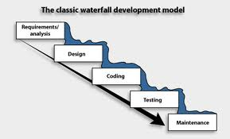
Waterfall Model: Pros and Cons
Merits
Save as a useful process model in situation where requirements are fixed and work is to proceed to completion in a linear manner.
Demerits
Real projects rarely follow the sequential flow.
Changes can cause confusion as the project team proceeds.
The model requires customer to state all requirements explicitly and has difficulty accommodating the natural uncertainty that exits at the beginning of many project.
A working version of the program will not be available until late in the project time-span.
The customer must have patience.
© 2010 Sichuan University All rights reserved. | Confidential

Slide 56

Process for Offshore?
Analysis
Design
Construct
System test
Accept. test
Deploy

Slide 57
The V Model
If we rely on testing alone, defects created first are detected last
User
Need
Product
Release
System
Requirements
system test plan
System
Testing
Software
Requirements
software test plan
Software
Testing
Software
Design
integration plan
Integration
Testing
unit plan
Software
Implementation
Unit
Testing
time

Slide 58
Incremental Model
© 2010 Sichuan University All rights reserved. | Confidential

Slide 59
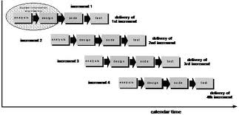
Incremental Model
Merits
Useful for unavailable staffing for complete
implementation by the business deadline.
Useful for planning to manage technical risks.
Demerits
Focus on the delivery of an operational product with each
increment. Early increments would be “ignored” easily.
© 2010 Sichuan University All rights reserved. | Confidential

Slide 60
RAD Model
RAD: Rapid Application Development
© 2010 Sichuan University All rights reserved. | Confidential

Slide 61
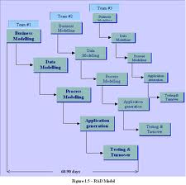
RAD Model: Pros and Cons
Merits
Enable a development team to create a “fully functional
system” with in very short time period.
Demerits
For large, but scalable projects, RAD requires sufficient human resource to create the right number of RAD teams.
RAD project will fail, if developers and customers are not committed to the rapid-fire activities in tight time.
Building components necessary for RAD will be problematic, if a system cannot be properly modularized.
The RAD approach may not work, if high performance is an issue, and performance is to be achieved through tuning the interfaces to system components.
RAD may not be appropriate, when technical risks are high.
© 2010 Sichuan University All rights reserved. | Confidential

Slide 62
Evolutionary Models: Prototyping
© 2010 Sichuan University All rights reserved. | Confidential

Slide 63
Prototyping Model: Pros and Cons
Merits
Serves as a mechanism for assisting developers and customers to better understand what is to be build when requirements are fuzzy.
Demerits
Customers always ask developers to make the prototype a working product, which makes software development
management relented.
Developers often make implementation compromises in order to get a prototype working quickly. Finally, the less-than-ideal choices has now become an integral part of the system.
© 2010 Sichuan University All rights reserved. | Confidential

Slide 64
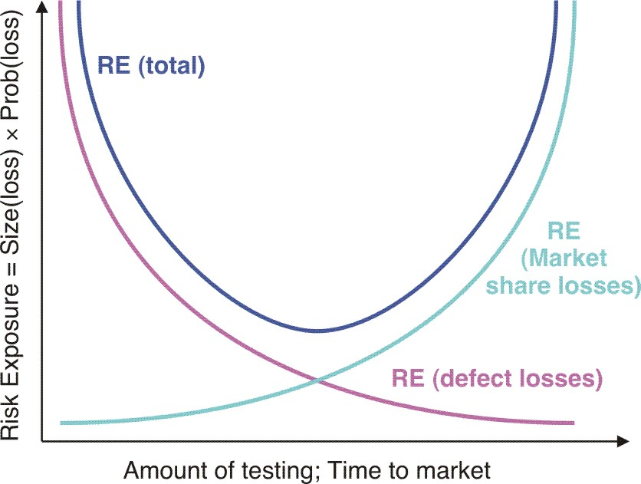
Risk Exposure

Slide 65
Evolutionary Models: Spiral Model
© 2010 Sichuan University All rights reserved. | Confidential

Slide 66
Spiral Model: Pros and Cons
Merits
Uses prototyping as a risk reduction mechanism, furthermore enables the developer to apply the prototyping approach at any stage in the evolution of product.
Demerits
It may be difficult to convince customers that the evolutionary approach is controllable.
If a major risk is not uncovered and managed, problems will undoubtedly occur.

Slide 67
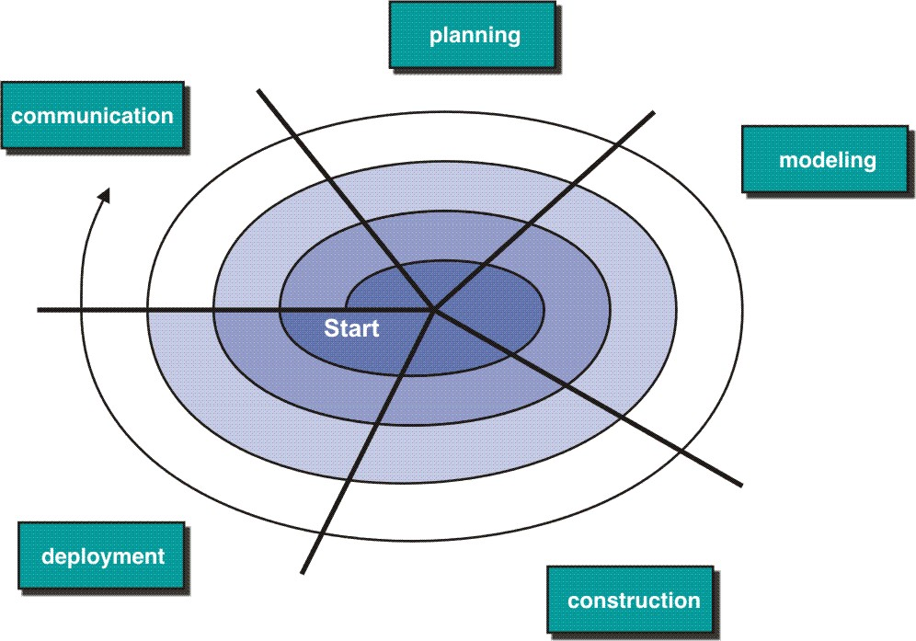
The Spiral Model(Risk-driven process model)

Slide 68
Distinguishing Features
A cyclic approach for incrementally growing a system’s degree of definition and implementation while decreasing its degree of risk;
A set of anchor point milestones for ensuring stakeholder commitment to feasible and mutually satisfactory system solutions.

Slide 69
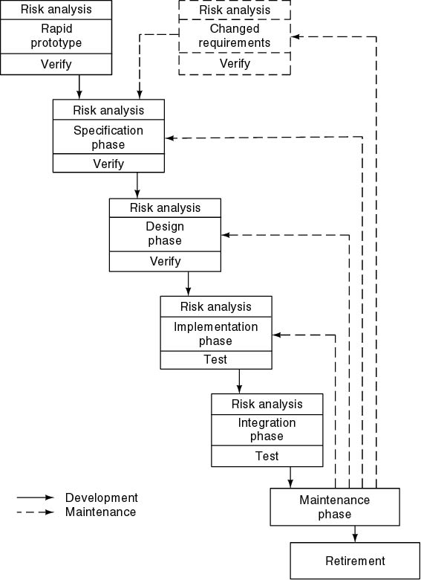
Spiral Model
Simplified form
Waterfall model plus risk analysis
Precede each phase by
Alternatives
Risk analysis
Follow each phase by
Evaluation
Planning of next phase

Slide 70
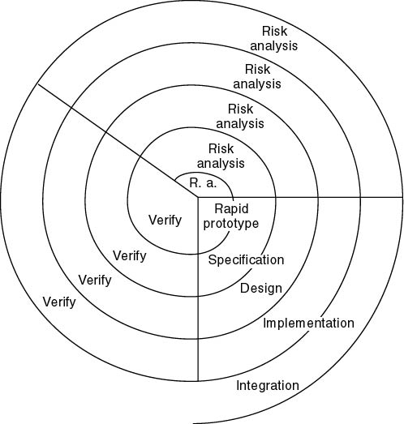
Simplified Spiral Model
If risks cannot be resolved, project is immediately terminated

Slide 71
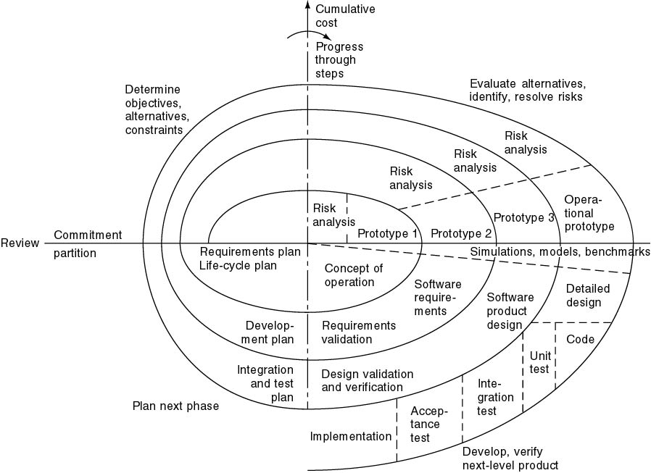
Full Spiral Model (contd)

Slide 72

Analysis of Spiral Model
Strengths
Easy to judge how much to test
No distinction between development,
maintenance
Weaknesses
For large-scale software only
For internal (in-house) software only

Slide 73
Evolutionary Models: Concurrent
© 2010 Sichuan University All rights reserved. | Confidential

Slide 74

Concerns of Evolutionary Software Process
Prototyping poses a problem to project planning because of the uncertain number of cycles required to construct the product;
Evolutionary software processes do not establish the maximum speed of the evolution;
Software processes should be focused on flexibility and extensibility rather than on high quality;

Slide 75
Other Process Models
Component based development
The process to apply when reuse is a development objective
Formal methods
Emphasizes the mathematical specification of requirements
AOSD
provides a process and methodological approach for defining, specifying, designing, and constructing aspects
Unified Process
A “use-case driven, architecture-centric, iterative and incremental” software process closely aligned with the Unified Modeling Language (UML)
© 2010 Sichuan University All rights reserved. | Confidential

Slide 76
Specialized Process Models

Slide 77
Component-Based Development
The Component-Based Development
Software Reuse（软件重用）!

Slide 78
Formal Methods Model（形式化方法）
Emphasizes the mathematical specification of requirements
Rigorous mathematical notation used to specify, design, and verify computer-based systems

Slide 79
Why are they not widely used?
The development of formal models is time-consuming and expensive;
Extensive developers training is required;
It is difficult to use the models as a communication mechanism for customers;

Slide 80
Unified Process Model

Slide 81
Unified Process Model
A software process that is:
use-case driven
architecture-centric
iterative and incremental
Closely aligned with the
Unified Modeling Language (UML)

Slide 82
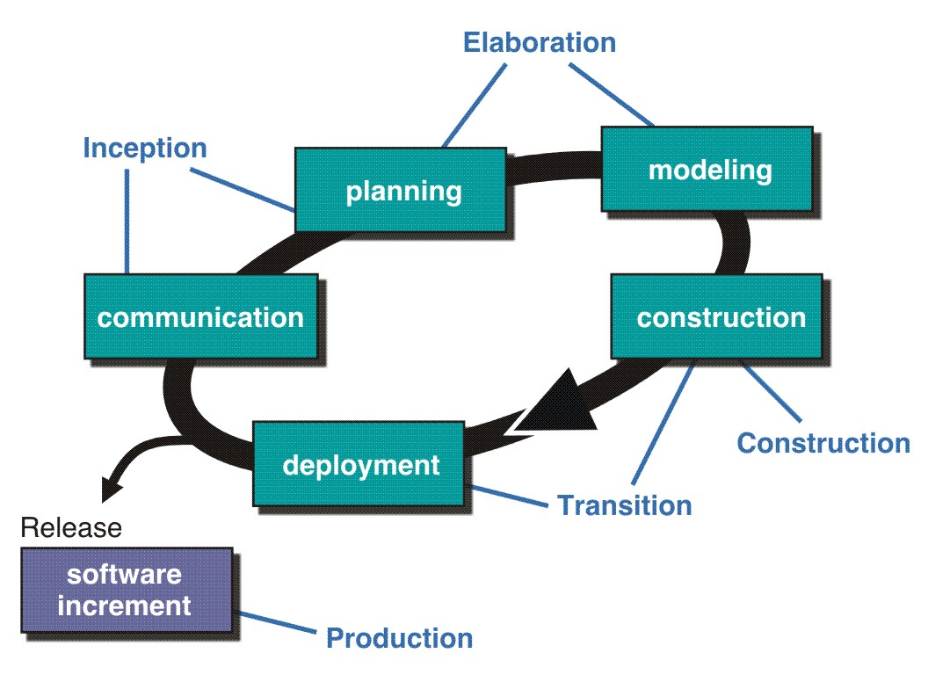
The Unified Process (UP)
inception

Slide 83
Use Case
Course Management
Course
selection
Student
Course
management
Course manager
Classroom
management
Course
Scheduling
Teacher
Grade
management
© 2010 Sichuan University All rights reserved. | Confidential

Slide 84
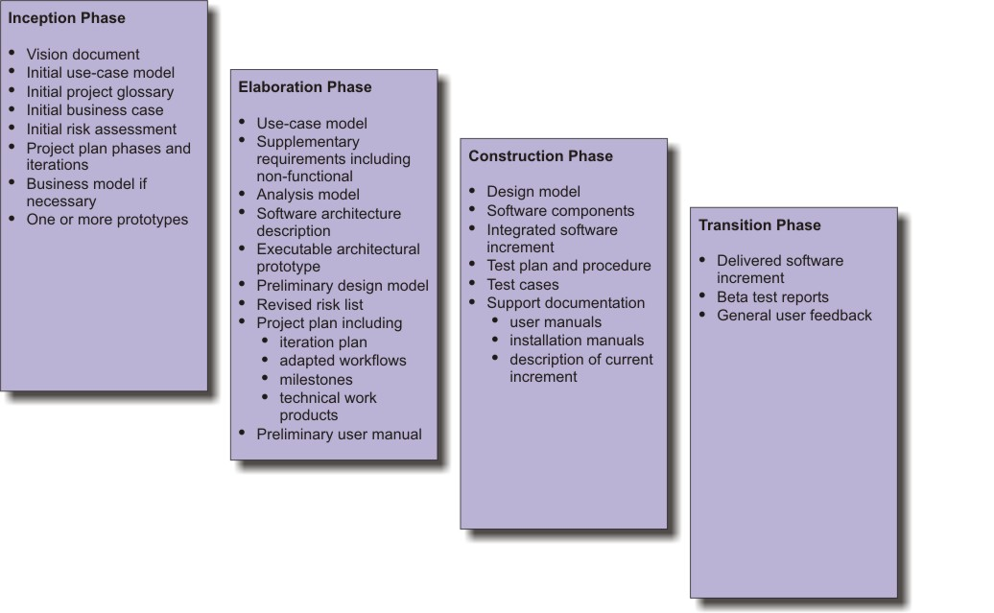
UP Work Products
inception

Slide 85
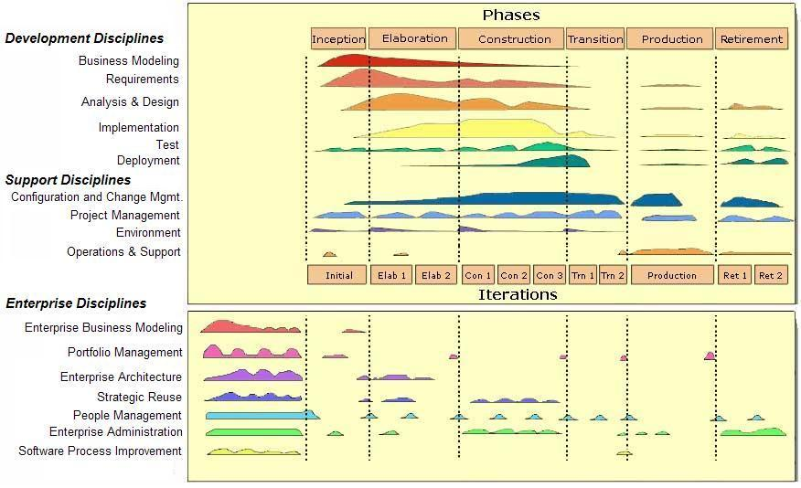
Lifecycle for Enterprise Unified Process
inception

Slide 86
Synchronize-and Stabilize Model
Microsoft’s life-cycle model
Requirements analysis—interview potential customers
Draw up specifications
Divide project into 3 or 4 builds
Each build is carried out by small teams working in parallel

Slide 87
Synchronize-and Stabilize Model (contd)
At the end of the day—synchronize (test and debug)
At the end of the build—stabilize (freeze build)
Components always work together
Get early insights into operation of product

Slide 88
Conclusions
Different life-cycle models
Each with own strengths
Each with own weaknesses
Criteria for deciding on a model include
The organization
Its management
Skills of the employees
The nature of the product
Best suggestion
“Mix-and-match” life-cycle model

Slide 89
Summary
Prescripive SW process models have been applied for many years in an effort to bring order and structure to SW devlopment
Each of these models suggests a somewhat different process flow,but all perform the same set of generic framework activities: communication, planning, modeliing, costruction and deployment

Slide 90
Summary
The waterfall model suggests a linear progression of framework activities ,it is applicable in situations where requirement are well-defined an stable
Incremental SW process models produce software as a series of increment releases.The RAD model is designed for larger projects that must be delivered in tight time.
Evolutionary process models recognize the iterative nature of most SE projects and are designed to accomodate change,such as prototyping, spiral model

Slide 91
Summary
Component-based model emphasizes component reuse and assembly
UP is a "usecase-driven, architecture-centric,iterative and incremental" software process designed as a framework for UML methods and tools,UP is an incremental model in which five phases are defined:inception,elaboration,construction,transition, production

Slide 92
Exercise
The linear sequential model of software development is Answer：a
A reasonable approach when requirements are well defined.
A good approach when a working program is required quickly.
The best approach to use for projects with large development teams.
An old fashioned model that cannot be used in a modern context.
The linear sequential model of software development is also known as the Answer：e
Classical life cycle model
Fountain model
Spiral model
Waterfall model
both a and d
The incremental model of software development is Answer：b
A reasonable approach when requirements are well defined.
A good approach when a working core product is required quickly.
The best approach to use for projects with large development teams.
A revolutionary model that is not used for commercial products.
The rapid application development model is Answer：c
Another name for component-based development.
A useful approach when a customer cannot define requirements clearly.
A high speed adaptation of the linear sequential model.
All of the above.
© 2010 Sichuan University All rights reserved. | Confidential

Slide 93
Exercise
5. Evolutionary software process models Answer：d
Are iterative in nature
Can easily accommodate product requirements changes
Do not generally produce throwaway systems
All of the above
6. The prototyping model of software development is Answer：b
a. A reasonable approach when requirements are well defined.
b. A useful approach when a customer cannot define requirements clearly.
c. The best approach to use for projects with large development teams.
d. A risky model that rarely produces a meaningful product.
7. Which of these is not one of the phase names defined by the Unified Process model for software development? Answer：d
Inception phase
Elaboration phase
Construction phase
Validation phase
8. In the Unified Process model requirements are determined iteratively and may span more than one phase of the process. Answer：a
True
False
© 2010 Sichuan University All rights reserved. | Confidential

