Slide 1
正确的过程产生正确的结果。 完全的有序意味着缺乏可变性。

Slide 2
风清扬-独孤九剑: 以无招胜有招。 张三丰-太极剑: 不拘于形而在于意。

Slide 3
Agile Development
Software Engineering: A Practitioner’s Approach
by Roger S. Pressman

Slide 4
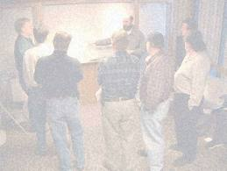
The Manifesto for Agile Software Development
“We are uncovering better ways of developing software by doing it and helping others do it. Through this work we have come to value:
Individuals and interactions over processes and tools
Working software over comprehensive documentation
Customer collaboration over contract negotiation
Responding to change over following a plan
That is, while there is value in the items on the right, we value the items on the left more.” by Kent Beck et al.

Slide 5
Content
What is Agility?
An Agile process
Agile Process Model
Extreme Programming (XP)
Adaptive Software Development (ASD)
Dynamic Systems Development Method (DSDM)
Scrum
Crystal
Feature Driven Development (FDD)
Agile Modeling (AM)

Slide 6
Review
Prescriptive Process Model
Discipline, Systematical , rigor, work products
But changes occur every where in the software development
Requirements
Business Marketing
Peoples
technologies

Slide 7
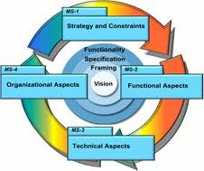
What is “Agility”?
Effective (rapid and adaptive) response to change
Effective communication among all stakeholders
Drawing the customer onto the team
Organizing a team so that it is in control of the work performed
Rapid, incremental delivery of software
© 2010 Sichuan University All rights reserved. | Confidential

Slide 8
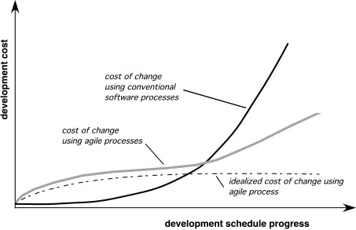
Agility and the Cost of Change

Slide 9
What is “Agility”?
Assumptions
It is difficult to predict in advance which software requirements will persist and which will change. The same to customer priorities.
For many types of software, design and construction are interleaved.
Analysis, design, construction and testing are not predictable as we might like.
© 2010 Sichuan University All rights reserved. | Confidential

Slide 10
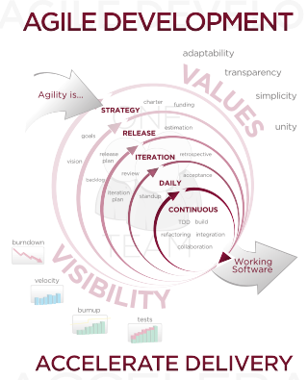

Slide 11
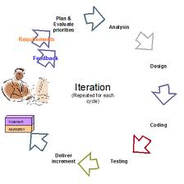
An Agile Process
Is driven by customer descriptions of what is required (scenarios)
Recognizes that plans are short-lived
Develops software iteratively with a heavy emphasis on construction activities
Delivers multiple ‘software increments’
Adapts as changes occur

Slide 12
An Agile Process
Satisfy the customer early and continuous delivery of valuable software. (highest priority)
Welcome changing requirenment
Deliver working software frequently.
Business people and developers must work together.
Build projects around motivated indiviadual.
face to face conversation.

Slide 13
Agile Principle
Working software is the primary measure of progress.
Promote sustainable.
Continous attention totechnical excellence and good design.
Simplicity .
The best architectures, requirements and designes from self-organizing teams.
Teams reflection

Slide 14
Human Factor
Emphasize the importance of “people factors”
Process model adapts team and its members
Key traits of agile team and its members
Competence (自信）
Common focus （共同目标）
Collaboration（精诚合作）
Decision-making ability （决策能力)
Fuzzy problem-solving agility （模糊解决问题能力）
Mutual trust and respect （互相信任和尊重）
Self-organization （自我组织）

Slide 15
Extreme Programming (XP)
The most widely used agile process, originally proposed by Kent Beck
Factors
Comunication
Simplicity
Feedback
Respect
Courage

Slide 16
Extreme Programming (XP)
XP Planning
Begins with the creation of “user stories”
Agile team assesses each story and assigns a cost
Stories are grouped to for a deliverable increment
A commitment is made on delivery date
After the first increment “project velocity” is used to help define subsequent delivery dates for other increments

Slide 17
Extreme Programming (XP)
XP Design
Follows the KIS (Keep It Simple) principle
Encourage the use of CRC (Class-Responsibility Collaborator) cards
For difficult design problems, suggests the creation of
“Spike solutions”— a design prototype
Encourages “refactoring” — an iterative refinement of the internal program design
© 2010 Sichuan University All rights reserved. | Confidential

Slide 18
Extreme Programming (XP)
XP Coding
Recommends the construction of a unit test for a store before coding commences
Encourages “pair programming”
XP Testing
All unit tests are executed daily
“Acceptance tests” are defined by the customer and executed to assess customer visible functionality

Slide 19
Extreme Programming (XP)

Slide 20
Key Points of XP
User stories
Pair-programming
Refactoring
Continuous integration
Incremental delivery

Slide 21
Industrial XP
IXP is an organnic evolutiaon of XP. It is imbued with XP's minimalist, customer-centric, test driven spirit. IXP differs most from the original XP in its greater inclusions of management, its expanded role for customers
Six mew practices
Readiness assessment
Project community
Project chartering
Test-driven mamagement
Retrospectives
Continuous learning

Slide 22
Adaptive Software Development
Originally proposed by Jim Highsmith
ASD — distinguishing features
Mission-driven planning
Component-based focus
Uses “time-boxing”
Explicit consideration of risks
Emphasizes collaboration for requirements gathering
Emphasizes “learning” throughout the process
© 2010 Sichuan University All rights reserved. | Confidential

Slide 23
Adaptive Software Development
Joint Application Development
By Jim Highsmith in 2000

Slide 24
Dynamic Systems Development Method
Promoted by the DSDM Consortium (www.dsdm.org)
DSDM—distinguishing features
Similar in most respects to XP and/or ASD
Guiding principles

Slide 25
Dynamic Systems Development Method
Guiding principles
Active user involvement is imperative.
DSDM teams must be empowered to make decisions.
The focus is on frequent delivery of products.
Fitness for business purpose is the essential criterion for acceptance of deliverables.
Iterative and incremental development is necessary to converge on an accurate business solution.
All changes during development are reversible.
Requirements are baselined at a high level
Testing is integrated throughout the life-cycle.
© 2010 Sichuan University All rights reserved. | Confidential

Slide 26
Dynamic Systems Development Method
DSDM Life Cycle (with permission of the DSDM consortium)

Slide 27
DSDM’s Iterative lifecycle
Feasibility study (additional)
Business Study (additional)
Functional Iteration —function prototypes
Design and build iteration — revisit prototypes
Implementation — place the latest software increment in the operational environment

Slide 28
Scrum
Originally proposed by Schwaber and Beedle
Scrum—distinguishing features
Development work is partitioned into “packets”
Testing and documentation are on-going as the product is constructed
Work occurs in “sprints” and is derived from a “backlog” of existing requirements
Meetings are very short and sometimes conducted without chairs
“demos” are delivered to the customer with the time-box allocated

Slide 29
Scrum
Every 24hrs
15min meeting daily
Basic questions
30days
Blogs
demos

Slide 30
Crystal
Proposed by Cockburn and Highsmith
Crystal—distinguishing features
Actually a family of process models that allow “maneuverability” based on problem characteristics
Face-to-face communication is emphasized
Suggests the use of “reflection workshops” to review the work habits of the team

Slide 31
Feature Driven Development
Originally proposed by Peter Coad et al
FDD—distinguishing features
Emphasis is on defining “features”
a feature “is a client-valued function that can be implemented in two weeks or less.”
Uses a feature template
<action> the <result> <by | for | of | to> a(n) <object>
A features list is created and “plan by feature” is conducted
Design and construction merge in FDD

Slide 32
Feature Driven Development

Slide 33
Agile Modeling
Originally proposed by Scott Ambler
Suggests a set of agile modeling principles
Model with a purpose
Use multiple models
Travel light
Content is more important than representation
Know the models and the tools you use to create them
Adapt locally

Slide 34
Agile Unified Process
AUP adopts a “serial in the large” and “iterative in small” philosophy for building conputer-based system
Each AUP iteration addresses:
Modeling UML
Implementation
Deployment
Configuration and project management
Environment management

Slide 35
Chapter Summary
Four keys stressed by Agile software engineering
Importance of self-organization that control …..
Communication and collaboration
Change recognition
Rapid software delivery satisfies customer

Slide 36
Chapter Summary
XP is the most widely used agile process
Planning
Design
Coding
Testing

Slide 37
Chapter Summary
ASD stresses: human collaboration and Team self-organization
Framework encompasses:
Speculation
Collaboration
Learning

Slide 38
Chapter Summary
DSDM defines three different iterative cycles: functional model, Design and implementation
Including two additional life cycles activity: Feasibility and business study
DSDM suggests: use time-boxing scheduling

Slide 39
Chapter Summary
Scrum emphasizes:
use a set of software process pattern
For project:
tight timeless, changing requirements, business critically
Each process pattern defines
a set of development tasks and allow scrum team to construct a process adapted to the project needs

Slide 40
Chapter Summary
Crystal is family of agile process model
Adapted to the specific project’s characristics
Crystal process uses iterative approaches

Slide 41
Chapter Summary
FDD is somewhat “ formal ” than other agile method
Focus on the development feature with project team to keep the agility
Greater emphasis on project and quality management

Slide 42
Exercise
Agility is nothing more than the ability of a project team to respond rapidly to change.
True
False
Which of the following is not necessary to apply agility to a software process?
Eliminate the use of project planning and testing
Only essential work products are produced
Process allows team to streamline tasks
Uses incremental product delivery strategy
How do you create agile processes to manage unpredictability?
Requirements gathering must be conducted very carefully
Risk analysis must be conducted before planning takes place
Software increments must be delivered in short time periods
Software processes must adapt to changes incrementally
Both c and d
Answer:
Which of the following traits need to exist among the members of an agile software team?
Competence
Decision-making ability
Mutual trust and respect
All of the above.
Answer:

Slide 43
Exercise
5. All agile process models conform to a greater or lesser degree to the principles stated in the "Manifesto for Agile Software Development".
True
False
6. What are the four framework activities found in the Extreme Programming (XP) process model?
a. analysis, design, coding, testing
b. planning, analysis, design, coding
c. planning, analysis, coding, testing
d. planning, design, coding, testing
7. What are the three framework activities for the Adaptive Software Development (ASD) process model?
analysis, design, coding
feasibility study, functional model iteration, implementation
requirements gathering, adaptive cycle planning, iterative development
speculation, collaboration, learning
8. Which is not one of the key questions that is answered by each team member at each daily Scrum meeting? Answer:
What did you do since the last meeting?
What obstacles are you encountering?
What is the cause of the problems you are encountering?
What do you plan to accomplish at the next team meeting?

Slide 44
1-B
2-A
3-E
4-D
5-A
6-D
7-D
8-C

