Slide 1
System Engineering
Software Engineering: A Practitioner’s Approach
by Roger S. Pressman

Slide 2

Part Two: Software Engineering Practice
How does system engineering lead to effective software engineering?
What is requirements engineering, and what are the underlying concepts that lead to good requirements analysis?
How is the analysis model created, and what are its elements?
What is design engineering, and what are the underlying concepts that lead to good design?
© 2010 Sichuan University All rights reserved. | Confidential

Slide 3
Part Two: Software Engineering Practice
What concepts, models, and methods are used to create architectural, interface, and component-level designs?
What strategies are applicable to software testing?
What methods are used to design effective test cases?
What measures and metrics can be used to assess the quality of analysis and design models, source code, and test cases?

Slide 4
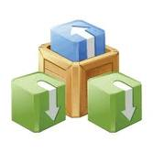
Content
Computer-Based Systems
The System Engineering Hierarchy
Business Process Engineering: An Overview
Product Engineering: An Overview
System Modeling
Hatley-Pirbhai Modeling
System Modeling with UML

Slide 5
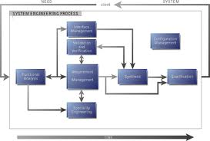
System Engineering
Elements of a computer-based system
Software
Hardware
People
Database
Documentation
Procedures
Systems
A hierarchy of macro-elements

Slide 6
System Engineering Hierarchy

Slide 7
System Modeling
Define the processes that serve the needs of the view under consideration.
Represent the behavior of the processes and the assumptions on which the behavior is based.
Explicitly define both exogenous and endogenous input to the model.
Exogenous inputs link one constituent of a given view with other constituents at the same level or other levels; endogenous input links individual components of a constituent at a particular view.

Slide 8
System Modeling
Represent all linkages (including output) that will enable the engineer to better understand the view.
Assumptions: reduce the number of possible permutations（排列） and variations.
Simplifications: enable the model to be created quickly.
Limitations: help to bound the system.
Constraints: guide the manner in which the model is created and implemented
Preferences: indicate the preferred architecture for all data, functions, and technology.

Slide 9
Business Process Engineering
Goal: define architecture that will enable a business to use information effectively.
The enterprise
Information
Strategy planning
(world view)
Business area
Business
Area analysis
(Domain view)
Processing requirement
Business system
design
(Element view)
Software
Engineer
Construction (Detailed view)
© 2010 Sichuan University All rights reserved. | Confidential

Slide 10
Business Process Engineering: Example
University
Administration
Academic program
Faculty
Doctor
education
Master
education
Undergraduate
education
Professional
education
Continue
education
Education
Status
management
Course management
Activity
management
Software
Engineer
Class room
Student
records
Teacher
records
Course
records

Slide 11
System Architectures
Three different architectures must be analyzed and designed within the context of business objectives and goals:
data architecture
applications architecture
technology infrastructure
data architecture provides a framework for the information needs of a business or business function
application architecture encompasses those elements of a system that transform objects within the data architecture for some business purpose
technology infrastructure provides the foundation for the data and application architectures, eg. Computers, OS, Network, Communication link, Storage

Slide 12
Product Engineering
Goal: translate the customer’s desire for a set of defined capabilities into a working product.

Slide 13
Product Engineering : Example
Safe Home
Security guard
Hardware
Software
PCs
Control
Panels
Sensor
device
Controls
requirement
Data
Function
Behavior
Software
Engineer
Home surveillance
functions
Home management
functions
Communication management
functions
Home security
functions

Slide 14
Hatley-Pirbhai Modeling
SCD: System Context Diagram
© 2010 Sichuan University All rights reserved. | Confidential

Slide 15
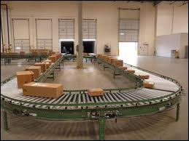
CLSS: Conveyor Line Sorting System
Boxes move along a conveyor line.
Boxes are identified and sorted into one of six bins.
A bar code is printed on the side of box.
Boxes pass in random order and are evenly spaced.
The conveyor line is moving slowly

Slide 16
SCD for CLSS

Slide 17
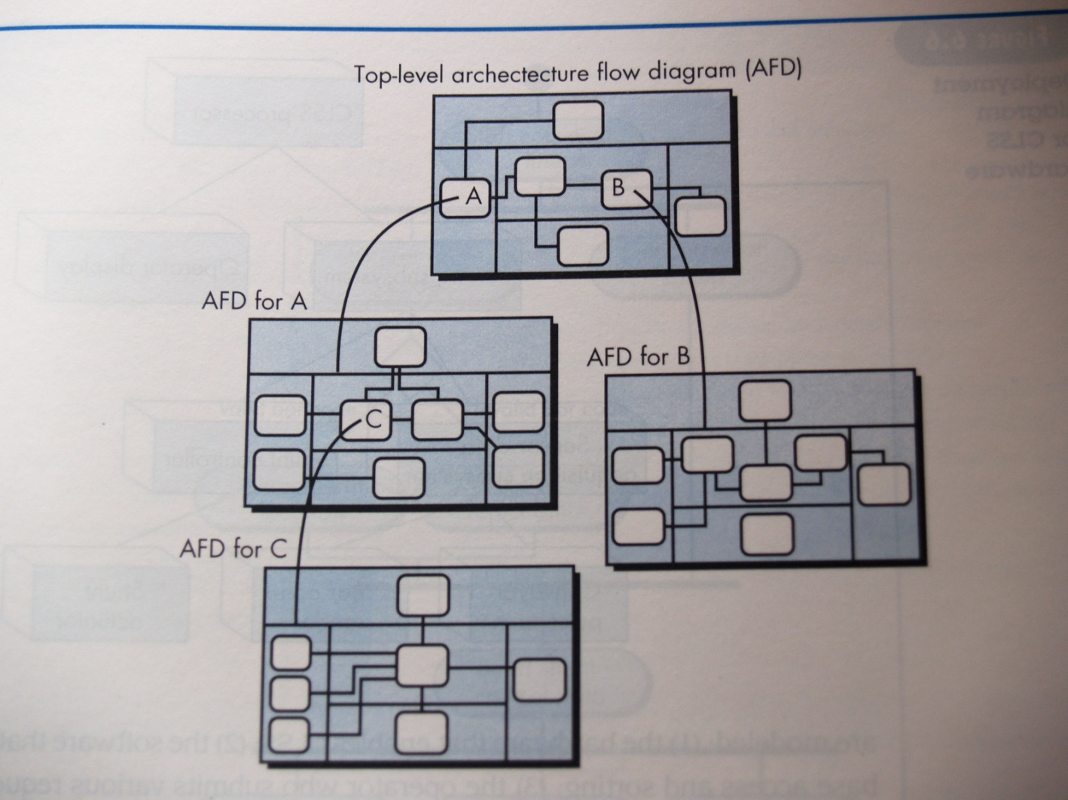
Layered SCD

Slide 18
System Modeling with UML
Deployment diagrams
Each 3-D box depicts a hardware element that is part of the physical architecture of the system
Activity diagrams
Represent procedural aspects of a system element
Class diagrams
Represent system level elements in terms of the data that describe the element and the operations that manipulate the data
These and other UML models will be discussed later
© 2010 Sichuan University All rights reserved. | Confidential

Slide 19
Deployment Diagram

Slide 20
Activity Diagram

Slide 21
Class Diagram
© 2010 Sichuan University All rights reserved. | Confidential

Slide 22
Use-case Diagram
Request bar code
Request shunt
control status
Request box
processing report
CLSS operator
Update product
database
Run system
diagnostics

Slide 23
Exercise
Which of the following can be elements of computer-based systems?
documentation
software
hardware
people
all of above
To construct a system model the engineer should consider which of the following restraining factors assumptions
budget
constraints
schedule
both a and c
During business process engineering, three different architectures are examined. applications, data, technology infrastructure
communications, organization, financial infrastructure
network, database, reporting structure
systems, requirements, data structure
The goal of product engineering is to translate the customer's desire for a set of defined capabilities into a working product.
True
False

Slide 24
Exercise
5. UML notations that can be used to model the hardware and software elements of a system are
Activity diagrams
Class diagrams
Deployment diagrams
Use-case diagrams
a, b, and c
6. The system model template contains which of the following elements
a. input
b. output
c. user interface
d. all of above
7. The top level of the hierarchical model of a system is known as the
AFD
DFD
SCD
SFD

Slide 25
Exercise
8. Select any large system or product with which you are familiar. Define the set of domains that describe the world view of the system or product. Describe the set of elements that make up one or two domains. For one element, identify the technical components that must be engineered.

Slide 26
1-E
2-E
3-A
4-A
5-E
6-D
7-C
8.
BPE (Business Process Engineering)
world view: bank
domains: loans, savings, foreign exchange
elements of savings: Window service, Online service, ATM service
technical components of Online service: customer identify (security), communication, database
Product Engineering
world view: smart phone
domains: chipset, software
elements of software: OS, application platform
technical components of application platform:
communication, security, utility (telephone book, calendar)

