Slide 1
Requirement Analysis
Software Engineering: A Practitioner’s Approach
by Roger S. Pressman

Slide 2
Content
An overview of requirements analysis
Analysis Modeling Approaches
Data Modeling
Flow-Oriented Modeling
Object-Oriented Analysis
Scenario-Based Modeling
Class-Based Modeling
Creating a behavioral model
Specification guidelines

Slide 3
What do you think after construction?
“I know you believe you understood
what you think I said, but I am not
sure you realise that what you heard
is not what I meant……”

Slide 4
WHAT IS A REQUIREMENT ?
Requirement:
contractual condition and/or capability (external customer(*))
industrial constraint (system engineering group, marketing, ...)
states WHAT the system/software item must do, not HOW it does it.
Specification: a list of technical requirements
Requirement traceability, necessary to ensure development coherence
SwReq_1: The item shall ...
SwReq_2: ...
…..
SwReq_X: ...

Slide 5
TYPES OF SYSTEM REQUIREMENTS
Non-functional technical requirements
Operational security
Safety
Availability
Reliability
Maintainability
Ergonomics
Performance
Constraints
Non-technical requirements
Contractual milestones
Required methods and techniques
2
3
Functional technical requirements
Capabilities
Dynamic behaviour
Data manipulation
1

Slide 6
What is Software Requirements Analysis?
To understand the specific requirements that must be achieved to build high quality software.
The results of requirements analysis are analysis models and requirements specification.
The analysis model and requirements specification provide a means for assessing quality once the software is built.

Slide 7
Requirements Analysis
Requirements analysis
specifies software’s operational characteristics
indicates software's interface with other system elements
establishes constraints that software must meet
Requirements analysis allows the software engineer (called an analyst or modeler in this role) to:
elaborate on basic requirements established during earlier requirement engineering tasks
build models that depict user scenarios, functional activities, problem classes and their relationships, system and class behavior, and the flow of data as it is transformed.
© 2010 Sichuan University All rights reserved. | Confidential

Slide 8
Software Requirements Analysis as a Bridge
System Engineering
Software
Requirements
Analysis
Software Design
Requirements analysis is a software engineering task that bridges the gap between system level requirements engineering and software design.

Slide 9

Software Requirements Analysis
The objectives of analysis modeling:
to describe what the customer requires;
to establish a basis for the creation of a software design;
to define a set of requirements that can be validated;
Software requirements analysis may be divided into five areas of effort:
Problem recognition
Evaluation and synthesis
Modeling
Specification
Review

Slide 10
Rules of Thumb
The model should focus on requirements that are visible within the problem or business domain. The level of abstraction should be relatively high.
Each element of the analysis model should add to an overall understanding of software requirements and provide insight into the information domain, function and behavior of the system.
Delay consideration of infrastructure and other non-functional models until design.
Minimize coupling throughout the system.
Be certain that the analysis model provides value to all stakeholders.
Keep the model as simple as it can be.
© 2010 Sichuan University All rights reserved. | Confidential

Slide 11
Domain Analysis
What? The identification, analysis, and specification of common requirements;
Why? For reuse on multiple projects in the domain;
How?
Input: technical literature, existing applications, customer surveys, expert advice, current/future requirements;
Output: Class taxonomies, reuse standards, functional models, domain language;
- John Locke

Slide 12
The input and output for Domain Analysis
Source of
domain knowledge
Domain
Analysis
model
Technical literature
Existing application
Customer surveys
Expert advice
Current /future req.
Domain
Analysis
Class taxonomies
Reuse standards
Functional models
Domain language

Slide 13
Domain Analysis
Define the domain to be investigated.
Collect a representative sample of applications in the domain.
Analyze each application in the sample.
Develop an analysis model for the objects.
© 2010 Sichuan University All rights reserved. | Confidential

Slide 14
The Software requirements Analysis Process
build a
prototype
requirements
elicitation
develop
Specification
the problem
Review
create
analysis
models

Slide 15
The Phases of Analysis
identify the “customer” and work together to negotiate “product-level” requirements
build an analysis model
focus on data
define function
represent behavior
give out prototype areas of uncertainty
develop a specification that will guide design
conduct formal technical reviews

Slide 16
What Are the Real Problems of Analysis?
the customer has only a vague idea of what is required
the developer is willing to proceed with the "vague idea" on the assumption that "we'll fill in the details as we go"
the customer keeps changing requirements
the developer is “racketed（敲诈）" by these changes, making errors in specifications and development
and so it goes ...

Slide 17
Analysis Modeling Approaches
Structured Analysis
Data and Processes
Object-oriented Analysis
Classes and Unified Process (UML)
Analysis Model
Combine features of above both approaches
Scenario-based
elements
Flow-oriented
elements
Use-cases text
Use-case diagrams
Activity diagrams
Swim lane diagrams
Data flow diagrams
Control flow diagrams
Processing diagrams
Analysis Model
Class-based
elements
Behavioral
elements
Class diagrams
Analysis packages
CRC models
Collaboration diagrams
State diagrams
Sequence diagrams
© 2010 Sichuan University All rights reserved. | Confidential

Slide 18
The Analysis Model
Data Model
Functional
Model
Behavioral
Model

Slide 19
Analysis Principle I: Model the Data Domain
Define data objects
Describe data attributes
Establish data relationships

Slide 20
Analysis Principle 2: Model Function
Identify functions that transform data objects
Indicate how data flow through the system
Represent producers and consumers of data

Slide 21
Analysis Principle 3: Model Behavior
Indicate different states of the system
Specify events that cause the system to change state

Slide 22
Analysis Principle 4: Partition the Models
Refine each model to represent lower levels of abstraction
Refine data objects
Create a functional hierarchy
Represent behavior at different levels of detail

Slide 23
Analysis Principle 5: Essence（要素）
Begin by focusing on the essence of the problem without regard to implementation details

Slide 24

Notes of Requirements Analysis
Understand the problem before you begin to create the analysis model.
Develop prototypes that enable a user to understand how human-machine interaction will occur.
Record the origin and the reason for every requirement.
Use multiple views of requirements.
Prioritize requirements.
Work to eliminate ambiguity.

Slide 25
What is a Specification ?
Its main objective is to lay down the foundations of the agreement to be ratified by the customer and the manufacturer
It consists in a list of technical requirements which the system/software must meet
It ensures, as far as possible, the feasibility of the system / software.

Slide 26
The Objective of Specification is to Analysis and Understand
Final
Step
First
Step
Reports
Iterative
Steps
Specification
Document(s)

Slide 27
The Objective of Specification is to Communicate
ORGANISATION
DIFFERENT POINTS OF VIEW:
DIFFERENT POSSIBLE
INTERPRETATION
DEVELOPER
CUSTOMER

Slide 28
The Objective of Specification is to Ensure the Feasibility
Logical Feasibility:
The availability of all required information must be guaranteed,
The complements required to ensure such availability must be identified.
Technical Feasibility:
Complementary studies
Prototypes
Mock-up
Economic Feasibility
Respect cost & delay

Slide 29
The Objective of Specification is to Ensure the Feasibility
A major specification goal:
System Requirements versus Software Requirements
Software Requirements versus Software Design
Software Requirements versus Software Qualification

Slide 30
The Objective of Specification is to Prepare the Design
Specification
Document
(WHAT?)
Requirements Analysis & Specification
Architectural Design
Detailed Design
Design
Document
(HOW?)
Implementation
Unit Test
Integration
Validation Qualification

Slide 31
The Objective of Specification is to Qualify the Software Product
Specification
Document(s)
From
Specified Requirements
To
Test Cases
Qualification
Documents
STP - STD

Slide 32
The Objective of Specification is to Organise & Manage the Development
Consolidation of the cost
Specification enables refining of initial estimations: size, costs, lead times.
Definition of increments
Where the incremental development approach is adopted.

Slide 33
Specification Principles
1. Separate functionality from implementation.
2. Develop a model of the desired behavior of a system.
3. Establish the context of software operates.
4. Define the environment of system operates.
5. Create a cognitive model（认知模型）.
6. Recognize that “the specification must be tolerant of incompleteness and augment-able（可扩充）.”
7. Establish the content and structure of a specification.

Slide 34
Software Context
System
Sub-system
Sub-system
Hardware
item
Software
item
Software
item
Interface
Specification
Hardware
item
Software
item
Software
item

Slide 35
The Steps of Creating a Specification
The steps of creating a specification of requirements:
Representation
The Software Requirements Specification
Specification Review

Slide 36
Analysis Modeling:Where to Begin?
A statement of scope can be acquired from:
the system (FAST) working document
A set of use-cases
The statement of scope must be “parsed” to extract data, function and behavioral domain information.

Slide 37
Statement of Scope
A relatively brief description of the system to be built
Indicates data that are input and output and basic functionality
Indicates conditional processing (at a high level)
Implies certain constraints and limitations

Slide 38
Identifying Objects and Operations
Define “objects” by underlining all nouns in the written statement of scope
producers / consumers of data
places where data are stored
“composite” data items
Define “operations” by double underlining all active verbs
processes relevant to the application
data transformations
Consider other “services” that will be required by the objects

Slide 39
Requirements Analysis Methods
Structured Analysis and Design Technique (SADT);
Data
Object Oriented Analysis and Design Technique (OOAD);
Object

Slide 40
Structured Analysis
Structured analysis is a model building activity:
The products of analysis must be highly maintainable.
The size of problems must be controlled.
Graphics have to be used whenever possible.
We have to differentiate between logical and physical.

Slide 41
SADT Analysis Model
Entity Relation Diagram (ERD);
Data Dictionary (DD);
Data Object Description (DOD);
Data Flow Diagram (DFD);
State Transition Diagram (STD);
Process Specification (PSPEC);
Control Specification (CSPEC);

Slide 42
Data Modeling
Entity Relation Diagram (ERD);
Data Dictionary (DD);
Data Object Description (DOD);

Slide 43
Data Modeling
Why Data Modeling?
examines data objects independently of processing
focuses attention on the data domain
creates a model at the customer’s level of abstraction
indicates how data objects relate to one another
© 2010 Sichuan University All rights reserved. | Confidential

Slide 44
What is a Data Object?
Data Object: something that is described by a set of attributes (data items) and that will be manipulated within the software (system)
each instance of an object (e.g., a book) can be identified uniquely (e.g., ISBN #)
each plays a necessary role in the system i.e., the system could not function without access to instances of the object
each is described by attributes that are themselves data items
© 2010 Sichuan University All rights reserved. | Confidential

Slide 45
Typical Data Objects
external entities (printer, user, sensor)
things (e.g. reports, displays, signals)
occurrences or events (e.g. interrupt, alarm)
roles (e.g. manager, engineer, salesperson)
organizational units (e.g. division, team)
places (e.g. manufacturing floor)
structures (e.g. employee record)
© 2010 Sichuan University All rights reserved. | Confidential

Slide 46
Data Objects and Attributes
A data object contains a set of attributes that act as an aspect, quality, characteristic, or descriptor of the object
object: automobile
attributes:
Make
Model
ID number
Body type
Color
Owner

Slide 47
What is a Relationship?
Relationship: indicates “connectedness”; a "fact" that must be "remembered" by the system and cannot or is not computed or derived mechanically
several instances of a relationship can exist
data objects can be related in many different ways
owns
Person
Car
Insured to drive
© 2010 Sichuan University All rights reserved. | Confidential

Slide 48
ERD Notation
object
1
1
1
relationship
object
2
object
1
n
1
relationship
object
2
object
n
m
1
relationship
object
2
© 2010 Sichuan University All rights reserved. | Confidential

Slide 49
Building an ERD
Level 1—model all the data objects (entities)
Level 2—model all the relationships among entities
Level 3—model all attributes of entities

Slide 50
The ERD: An Example
Customer
order
Product
1
n
1
Company
consists
of
m
Parts
1
selected
from
p
k
workers
produced
by
w
© 2010 Sichuan University All rights reserved. | Confidential

Slide 51
The ERD: An Example
President
management
University
1
1
1
a
n
Course
belong-to
Department
k
1
1
Hold
Lecturer
w
1
engage
Student
i
study
Select
b

Slide 52
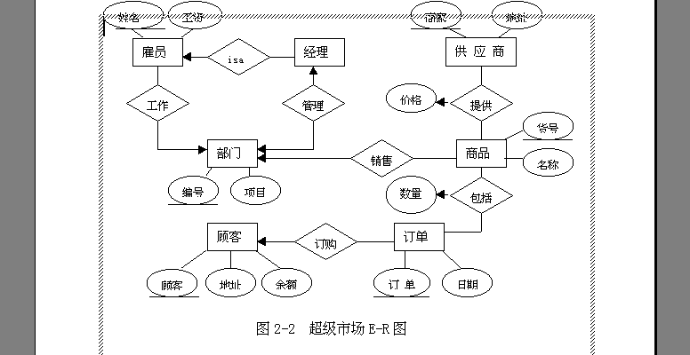

Slide 53
The Data Dictionary
a quasi-formal grammar for describing the content of data that the software will process and create.
a notation for describing control data and the values that control data can take, e.g., "on," or "off".
a repository that also contains "where-used" / "how used" information.
a notation that can be represented manually, but is best developed using CASE tools.

Slide 54
Building a Data Dictionary

Slide 55
Data Dictionary Notation

Slide 56
Data Dictionary Example

Slide 57
Flow-Oriented Modeling
Represents how data objects are transformed at they move through the system
A data flow diagram (DFD) is the diagrammatic form that is used
Considered by many to be an ‘old school’ approach, flow-oriented modeling continues to provide a view of the system that is unique—it should be used to supplement other analysis model elements
© 2010 Sichuan University All rights reserved. | Confidential

Slide 58
The Flow Model
Every computer-based system is an
information transform ....
computer
based
system
input
output
© 2010 Sichuan University All rights reserved. | Confidential

Slide 59
Flow Modeling Notation
external entity
process
data flow
data store
© 2010 Sichuan University All rights reserved. | Confidential

Slide 60
External Entity
A producer or consumer of data
Examples: a person, a device, a sensor
Another example: computer-based
system
Data must always originate somewhere
and must always be sent to something
© 2010 Sichuan University All rights reserved. | Confidential

Slide 61
Process
A data transformer (changes input
to output)
Examples: compute taxes, determine area,
format report, display graph
Data must always be processed in some
way to achieve system function
© 2010 Sichuan University All rights reserved. | Confidential

Slide 62
Data Flow
Data flows through a system, beginning
as input and be transformed into output.
base
compute
triangle
area
area
height
© 2010 Sichuan University All rights reserved. | Confidential

Slide 63
Data Stores
Data is often stored for later use.
sensor #
sensor #, type,
location, age
look-up
sensor
data
report required
type,
location, age
sensor number
sensor data
© 2010 Sichuan University All rights reserved. | Confidential

Slide 64
Data Flow Diagramming: Guidelines
all icons must be labeled with meaningful names
the DFD evolves through a number of levels of detail
always begin with a context level diagram (also called level 0)
always show external entities at level 0
always label data flow arrows
do not represent procedural logic
© 2010 Sichuan University All rights reserved. | Confidential

Slide 65
Constructing a DFD —I
review the data model to isolate data objects and use a grammatical parse to determine “operations”
determine external entities (producers and consumers of data)
create a level 0 DFD
© 2010 Sichuan University All rights reserved. | Confidential

Slide 66
Level 0 DFD Example
processing
request
user
requested
video
signal
digital
video
processor
monitor
video
source
NTSC
video signal
© 2010 Sichuan University All rights reserved. | Confidential

Slide 67
Level 0 DFD Example
Display information
Control panel display
Control panel
User commands and data
Safe-Home software
Alarm type
alarm
sensors
Sensor status
Telephone number tones
Telephone line

Slide 68
Constructing a DFD—II
write a narrative describing the transform
parse to determine next level transforms
“balance” the flow to maintain data flow continuity
develop a level 1 DFD
use a 1:5 (approx.) expansion ratio
© 2010 Sichuan University All rights reserved. | Confidential

Slide 69
The Data Flow Hierarchy
a
b
x
P
y
level 0
a
c
p2
f
p1
p4
b
d
p5
p3
e
g
level 1
© 2010 Sichuan University All rights reserved. | Confidential

Slide 70
Level 1 DFD Example
Control panel
User commands and data
Configure system
Configuration data
Configuration request
Interact with user
Configuration information
Start/ stop
Activate/
deactivate system
Configuration data
password
Control panel display
Msg.
Display messages and status
Display information
Process password
Valid id msg.
Configuration data
alarm
Sensor information
Alarm type
sensors
Sensor status
Monitor sensors
telephone line
Telephone number tones

Slide 71
Level 2 DFD Example
Configuration information
Configure system
Sensor information
Alarm type
Configuration data
Sensor id type, location
Alarm data
Generate alarm signal
Assess against setup
Telephone number
Read sensors
Sensor id type
Display messages and status
Telephone number tones
Sensor status

Slide 72
Level 3 DFD Example
Sensor information
Sensor status
Configuration information
Configuration data
Formated id, type, location
Generate display
Read sensors
Format display
Sensor id, setting
Acquire response info
Alarm type
Sensor id type, location
Alarm condition code, sensor id, timing information
Alarm data
Generate alarm signal
Establish alarm conditions
List of number
Select phone number
Telephone number tones
Set up connection to phone net
Telephone number
Generate pulses to line
Tone ready telephone number

Slide 73
Flow Modeling Notes
each bubble is refined until it does just one thing
the expansion ratio decreases as the number of levels increase
most systems require between 3 and 7 levels for an adequate flow model
a single data flow item (arrow) may be expanded as levels increase (data dictionary provides information)
© 2010 Sichuan University All rights reserved. | Confidential

Slide 74
DFDs: A Look Ahead
analysis model
Maps into
design model

Slide 75
First-level Factoring Example
Monitor sensors executive
Alarm conditions controller
Alarm output controller
Sensor input controller

Slide 76
Second-level Factoring Example
Monitor sensors executive
Sensor input controller
Alarm conditions controller
Alarm output controller
Format display
Set up connection to phone net
Generate alarm signal
Generate display
Generate pulses to line

Slide 77
“First Iteration” Program Structure
Monitor sensors executive
Sensor input controller
Alarm conditions controller
Alarm output controller
Acquire response info
Establish alarm conditions
Select phone number
Format display
Set up connection to phone net
Generate alarm signal
Generate display
Generate pulses to line
Read sensors

Slide 78
Behavioral Modeling
State Transition Diagram (STD) Control Specification (CSPEC) Process Specification (PSPEC)

Slide 79
Behavioral Modeling
events
behavior
Outside
world
Application

Slide 80
The States of a System
state—a set of observable circum-stances that characterizes the behavior of a system at a given time
state transition—the movement from one state to another
event—an occurrence that causes the system to exhibit some predictable form of behavior
action—process that occurs as a consequence of making a transition

Slide 81
State Transition Diagram Notation
state
event causing transition
action that occurs
new state

Slide 82
The Steps of Modeling
make a list of the different states of a system (How does the system behave?)
indicate how the system makes a transition from one state to another (How does the system change state?)
indicate event
indicate action
draw a state transition diagram

Slide 83
An Example of State Transition Diagram
full and start
invoke manage-copying
reading
operator
commands
full
copies done
invoke read-op-input
invoke read-op-input
making copies
reloading paper
empty
invoke reload paper
jammed
invoke problem-diagnosis
not jammed
problem state
invoke read-op-input

Slide 84
The State Transition Diagram of SafeHome
Read user input
On / Off Switch
surveillance and control system
Out of tome
user interaction
Sensor events
surveillance and control system
Monitor system state
Sensor event behaviors
Sensor events
display info. and state
Sensor events
display info. and state
Sensor events
surveillance and control system
twinkle
display info. and state
Display user feedback
Display actions state
user interaction

Slide 85
Creating Control Specification (CSPEC)

Slide 86
Control Flow Diagrams
Represents “events” and the processes that manage events
An “event” is a Boolean condition that can be ascertained by:
listing all sensors that are "read" by the software.
listing all interrupt conditions.
listing all "switches" that are actuated by an operator.
listing all data conditions.
recalling the noun/verb parse that was applied to the processing narrative, review all "control items" as possible CSPEC inputs/outputs.
© 2010 Sichuan University All rights reserved. | Confidential

Slide 87
The Control Model
the control flow diagram is "superimposed" on the DFD and shows events that control the processes noted in the DFD
control flows—events and control items—are noted by dashed arrows.
a vertical bar implies an input to or output from a control spec (CSPEC) — a separate specification that describes how control is handled.
a dashed arrow entering a vertical bar is an input to the CSPEC
a dashed arrow leaving a process implies a data condition
a dashed arrow entering a process implies a control input read directly by the process control flows do not physically activate/deactivate the processes—this is done via the CSPEC

Slide 88
Control Flow Diagram
beeper on/off
copies done
full
manage
copying
read
operator
input
start
problem light
reload
process
empty
create
user
displays
perform
problem
diagnosis
jammed
display panel enabled

Slide 89
Control Specification (CSPEC)
The CSPEC can be:
state transition diagram
(sequential spec)
state transition table
combinatorial spec
decision tables
activation tables

Slide 90
Guidelines for Building a CSPEC
list all sensors that are "read" by the software
list all interrupt conditions
list all "switches" that are actuated by the operator
list all data conditions
recalling the noun-verb parse that was applied to the software statement of scope, review all "control items“as possible CSPEC inputs/outputs
describe the behavior of a system by identifying its states; identify how each state is reach and defines the transitions between states
focus on possible omissions ... a very common error in specifying control, e.g., ask: "Is there any other way I can get to this state or exit from it?"

Slide 91
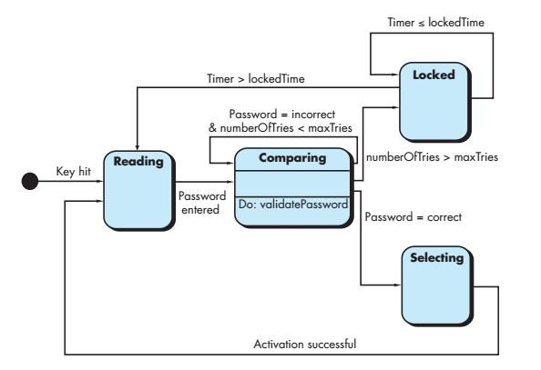

Slide 92
Creating Process Specification (PSPEC)

Slide 93
Process Specification (PSPEC)
bubble
PSPEC
narrative
pseudocode (PDL)
equations
tables
diagrams and/or charts

Slide 94
A Design Note
PSPEC
one or more ”components"
in the software design

Slide 95
Creating Mini-Specs
Software
Specification

Slide 96
Process Model
Control Model
E-R
DIAGRAM
CONTROL
CONTEXT
DIAGRAM
RESPONSE TIME
SPECIFICATIONS
DATA
CONTROL
FLOW
FLOW
DIAGRAMS
DIAGRAMS
PROCESS
CONTROL
SPECIFICATIONS
SPECIFICATIONS
textual
DICTIONARY
decision tables,
activation tables
automata
Textual / graphic

Slide 97
Summary: Structured Analysis Modeling
Data Modeling
Entity Relation Diagram (ERD);
Data Dictionary (DD);
Data Object Description (DOD);
Function Modeling
Data Flow Diagram (DFD);
Behavior Modeling
State Transition Diagram (STD);
Process Specification (PSPEC);
Control Specification (CSPEC);

Slide 98
The Objective of OO Analysis
The objective of OO analysis is to develop a model that describes computer software as it works to satisfy a set of customer-defined requirements.

Slide 99
Object-Oriented Concepts
Must be understood to apply class-based elements of the analysis model
Key concepts:
Classes and objects
Attributes and operations
Encapsulation and instantiation
Inheritance
© 2010 Sichuan University All rights reserved. | Confidential

Slide 100
OOA- A Generic View
Define use cases
Extract candidate classes
Identify attributes for each class
Specify methods that service the attributes
Define a class hierarchy
Establish basic class relationships
Indicate how classes/objects are related
Build a behavioral model
Iterate on the first five steps

Slide 101
Classes
Attributes
a collection of data values that describe a class
Class
encapsulates the data and procedural abstractions required to describe the content and behavior of some real world entity.
Objects
instances of a specific class
Operations
also called methods and services
Superclass
also called a base class, is a generalization of classes that are related to it.
Subclass
a specialization of the superclass
© 2010 Sichuan University All rights reserved. | Confidential

Slide 102
Building a Class
© 2010 Sichuan University All rights reserved. | Confidential

Slide 103
What is a Class?
occurrences
roles
things
organizational units
places
external entities
structures
class name
attributes:
operations:
© 2010 Sichuan University All rights reserved. | Confidential

Slide 104
Encapsulation/Hiding
The object encapsulates
both data and the logical
procedures required to
manipulate the data
method
# 1
method
# 2
data
method
# 3
method
# 6
method
# 5
method
# 4
Achieves “information hiding”

Slide 105
Class Hierarchy
PieceOfFurniture (superclass)
Table
Chair
Desk
Bed
subclasses of the
instances of Chair
© 2010 Sichuan University All rights reserved. | Confidential

Slide 106
Methods (a.k.a. Operations, Services)
An executable procedure that is encapsulated in a class and is designed to operate on one or more data attributes that are defined as part of the class.
A method is invoked via message passing.
© 2010 Sichuan University All rights reserved. | Confidential

Slide 107
Scenario-Based Modeling
Writing use-case
Use-cases are simply an aid to defining what exists outside the system and what should be performed by the system.
a scenario that describes a “thread of usage” for a system
actors represent roles people or devices play as the system functions
users can play a number of different roles for a given scenario
© 2010 Sichuan University All rights reserved. | Confidential

Slide 108

Developing a Use-Case
What are the main tasks or functions that are performed by the actor?
What system information will the actor acquire, produce or change?
Will the actor have to inform the system about changes in the external environment?
What information does the actor desire from the system?
Does the actor wish to be informed about unexpected changes?
© 2010 Sichuan University All rights reserved. | Confidential

Slide 109
Use-Case Diagram
© 2010 Sichuan University All rights reserved. | Confidential

Slide 110
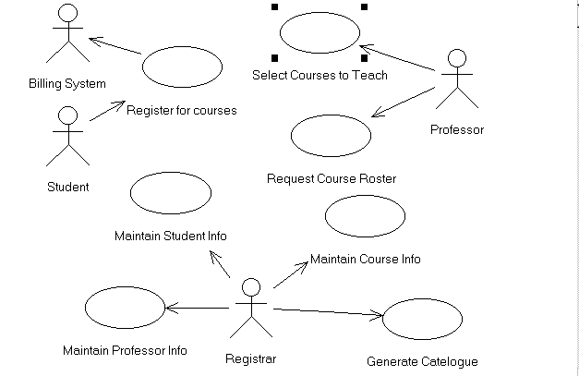
例子：Use Case View

Slide 111
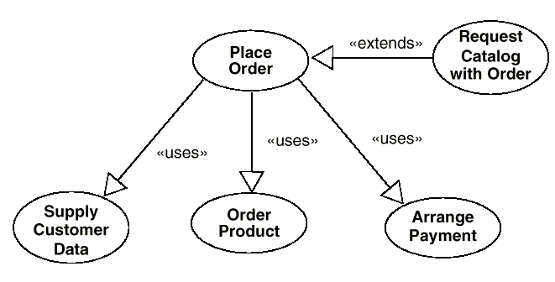
可能继承
自定义关联

Slide 112
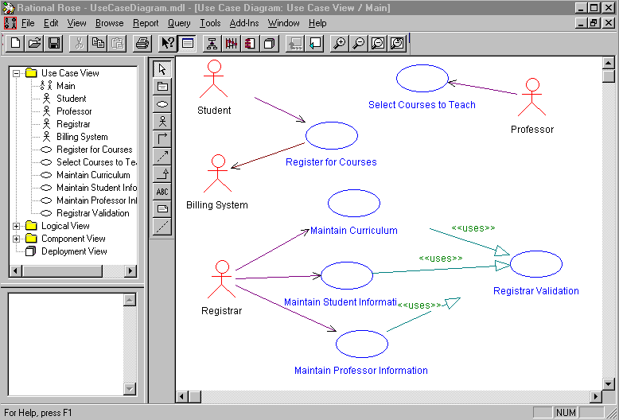
单向关联
使用用例
使用者
共享继承
自定义关联

Slide 113
ACS-DCV Use Case
ACS-DCV: access camera surveilliance-dispaly camera views
Write use case

Slide 114
ACS-DCV Description
Use case: access camera surveillance-display
Actor: homeowner
1. The homeowner logs on to the Safehome Products web site
The homeowner enters his or her use ID
The homeowner enters two pwd (each at least eight char in length)
The system displays all major functions buttons
The homeowner selects the “surveillance” from the major function buttons
The homeowner selects “pick a camera”
The system displays the floor plan of the house
The homeowner selects a camera icon from the floor plan
The homeowner selects the “View” button
The system displays a viewing window that is identified by the camera ID
The system displays video output within the viewing window at one frame per second

Slide 115
Considering step 6 and 7
6.The homeowner selects “pick a camera”
7.The system displays the floor plan of the house
Question:
If floor plan with camera icons never configured
these abnormal condition will be treated in a separate use case “Alarm condition encountered”

Slide 116
Use case Template for ACS-DCV
Use case: access camera surveillance-display (ACS-DCV)
Primary Actor: homeowner
Goal in context: To view output of camera placed throughout the house from any remote location via Internet
Precondition: System must be fully configured; Appropriate User ID and Pwd must be obtained
Trigger: The homeowner decides to take a look inside the house while away

Slide 117
Use case Template for ACS-DCV
Scenario:
1. The homeowner logs on to the Safehome Products web site
The homeowner enters his or her use ID
The homeowner enters two pwd (each at least eight char in length)
The system displays all major functions buttons
The homeowner selects the “surveillance” from the major function buttons
The homeowner selects “pick a camera”
The system displays the floor plan of the house
The homeowner selects a camera icon from the floor plan
The homeowner selects the “View” button
The system displays a viewing window that is identified by the camera ID
The system displays video output within the viewing window at one frame per second

Slide 118
Use case Template for ACS-DCV
Exception:
1:ID or PWD are incorrect or not recognized—see use case: ”Validate ID and passwords”
2: Surveillance function not configured for this system— system displays appropriate error message; see use case : “configure surveillance function”
3: Homeowner selects “View thumbnail snapshots for all cameras” – see use case “View thumbnail snapshots for all cameras”
4: A floor plan is not available or has not been configured – displays appropriate error message and see use case “configure floor plan”
5: An alarm condition is encountered –see use case “alarm condition encountered”

Slide 119
Use case Template for ACS-DCV
Priority: Moderate priority , to be implemented after basic functions
When available: third increment
Frequency: Infrequent
Channel to actor: Via PC-based browser and internet connection to Safehome website
Secondary actor: System administrator, camera
Channels to secondary actors: 1. System administrator: PC-based system; 2. Camera: wireless connectivity

Slide 120
Use case Template for ACS-DCV
Open issues:
1.What mechanisms protects unauthorized use of this capability by employees of the company
2. Is security sufficient? Hacking into this feature would represent a major invasion of privacy?
3. Will system response via the internet be acceptable given the bandwidth required for camera views?
4. Will we develop a capability to protect video at a higher frames-per-second rate when high bandwidth connection are available?

Slide 121
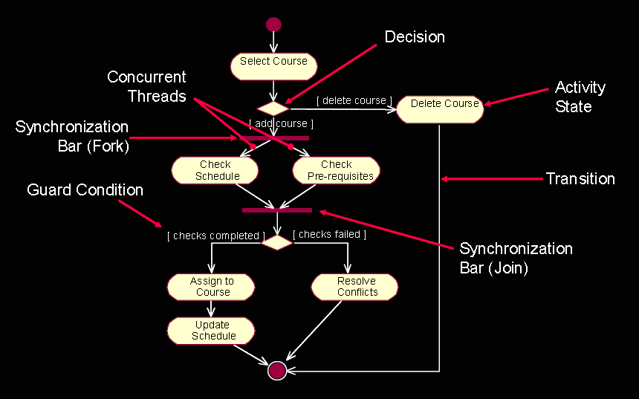
Activity Diagram
Supplements the use-case by providing a diagrammatic representation of procedural flow

Slide 122
Activity Diagram
Supplements the use-case by providing a diagrammatic representation of procedural flow
© 2010 Sichuan University All rights reserved. | Confidential

Slide 123
Swimlane Diagrams
Allows the modeler to represent the flow of activities described by the use-case and at the same time indicate which actor (if there are multiple actors involved in a specific use-case) or analysis class has responsibility for the action described by an activity rectangle
© 2010 Sichuan University All rights reserved. | Confidential

Slide 124
Class-Based Modeling
Identify analysis classes by examining the problem statement
Use a “grammatical parse” to isolate potential classes
Identify the attributes of each class
Identify operations that manipulate the attributes
© 2010 Sichuan University All rights reserved. | Confidential

Slide 125
Analysis Classes
External entities (e.g., other systems, devices, people) that produce or consume information to be used by a computer-based system.
Things (e.g, reports, displays, letters, signals) that are part of the information domain for the problem.
Occurrences or events (e.g., a property transfer or the completion of a series of robot movements) that occur within the context of system operation.
Roles (e.g., manager, engineer, salesperson) played by people who interact with the system.
Organizational units (e.g., division, group, team) that are relevant to an application.
Places (e.g., manufacturing floor or loading dock) that establish the context of the problem and the overall function of the system.
Structures (e.g., sensors, four-wheeled vehicles, or computers) that define a class of objects or related classes of objects.
© 2010 Sichuan University All rights reserved. | Confidential

Slide 126
Selecting Classes—Criteria
retained information
needed services
multiple attributes
common attributes
common operations
essential requirements
© 2010 Sichuan University All rights reserved. | Confidential

Slide 127
Class Diagram
Class name
attributes
operations
© 2010 Sichuan University All rights reserved. | Confidential

Slide 128
Class Diagram
© 2010 Sichuan University All rights reserved. | Confidential

Slide 129
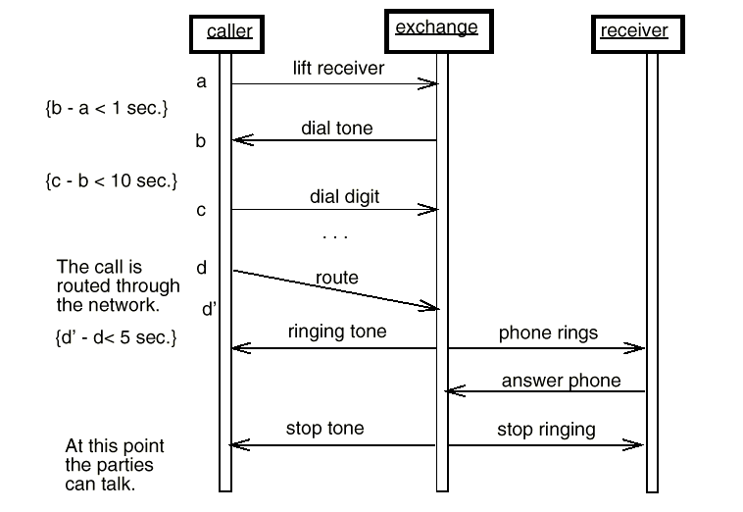
Sequence Diagram
对象: 类
事件流
及其方向
各种说明和
标记说明
不同的类
时间

Slide 130
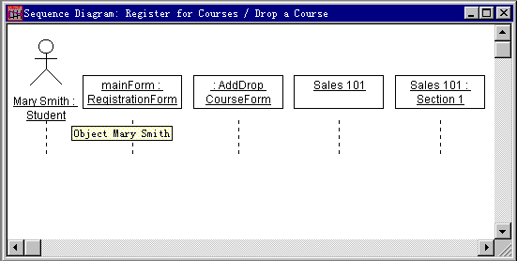
Actor
对象
和类
类
对象

Slide 131
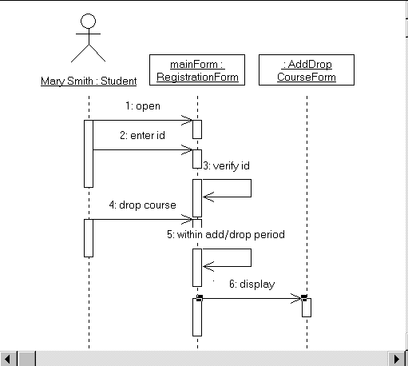
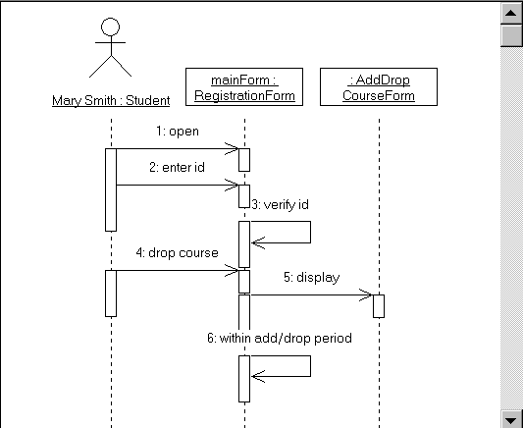

Slide 132
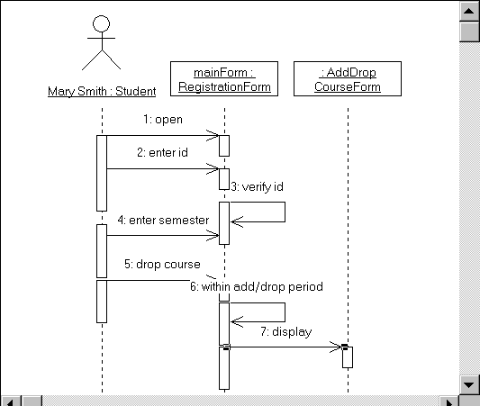

Slide 133
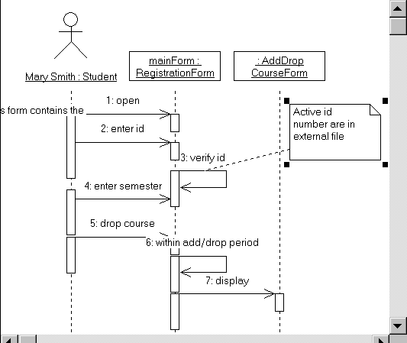

Slide 134
Class-Responsibility-Collaborator(CRC) Modelling
Analysis classes have “responsibilities”
Responsibilities are the attributes and operations encapsulated by the class
Analysis classes collaborate with one another
Collaborators are those classes that are required to provide a class with the information needed to complete a responsibility.
In general, a collaboration implies either a request for information or a request for some action.
© 2010 Sichuan University All rights reserved. | Confidential

Slide 135

Class-Responsibility-Collaborator(CRC) Modelling
A CRC model is really a collection of standard index cards that represent classes.
The name of class;
The class responsibilities;
The collaborators;

Slide 136
CRC Modelling
© 2010 Sichuan University All rights reserved. | Confidential

Slide 137
Class Types
Entity classes, also called model or business classes, are extracted directly from the statement of the problem (e.g., FloorPlan and Sensor).
Boundary classes are used to create the interface (e.g., interactive screen or printed reports) that the user sees and interacts with as the software is used.
Controller classes manage a “unit of work” [UML03] from start to finish. That is, controller classes can be designed to manage
the creation or update of entity objects;
the instantiation of boundary objects as they obtain information from entity objects;
complex communication between sets of objects;
validation of data communicated between objects or between the user and the application.
© 2010 Sichuan University All rights reserved. | Confidential

Slide 138
Analysis Class
Analysis Class is refered as stereotype(构造型)

Slide 139
The Role of a Boundary Class
<<control>>
<<boundary>>
<<boundary>>
Actor 1
Actor 2
<<entity>>
<<entity>>
Model interaction between the system and its environment.

Slide 140
The Role of a Control Class
<<control>>
<<boundary>>
<<boundary>>
Actor 1
Actor 2
<<entity>>
<<entity>>
Coordinate the use-case behavior.

Slide 141
Responsibilities
System intelligence should be distributed across classes to best address the needs of the problem
Each responsibility should be stated as generally as possible
Information and the behavior related to it should reside within the same class
Information about one thing should be localized with a single class, not distributed across multiple classes.
Responsibilities should be shared among related classes, when appropriate.
© 2010 Sichuan University All rights reserved. | Confidential

Slide 142

Collaborations
Classes fulfill their responsibilities in one of two ways:
A class can use its own operations to manipulate its own attributes, thereby fulfilling a particular responsibility, or
A class can collaborate with other classes.
Collaborations identify relationships between classes
Collaborations are identified by determining whether a class can fulfill each responsibility itself
Three different generic relationships between classes [WIR90]:
the is-part-of relationship
the has-knowledge-of relationship
the depends-upon relationship
© 2010 Sichuan University All rights reserved. | Confidential

Slide 143
Relationships between classes
Player
Aggregate (is-part-of)
PlayerHead
PlayerBody
PlayerArms
PlayerLegs
ControlPanel
Sensor
Associate (has-knowledge-of)
Determine-sensor-status()
get-status()
DisplayWindow
Camera
<<access>>
Dependency (depends-upon)
{password}
© 2010 Sichuan University All rights reserved. | Confidential

Slide 144
Generalization relationship between Class
“Is a kind of” relationship
Is a special kind of association relationship
Represents different level of abstraction between classes
Yields inheritance

Slide 145
Reviewing the CRC Model
All participants in the review (of the CRC model) are given a subset of the CRC model index cards.
Cards that collaborate should be separated (i.e., no reviewer should have two cards that collaborate).
All use-case scenarios (and corresponding use-case diagrams) should be organized into categories.
The review leader reads the use-case deliberately.
As the review leader comes to a named object, she passes a token to the person holding the corresponding class index card.
© 2010 Sichuan University All rights reserved. | Confidential

Slide 146
Reviewing the CRC Model
When the token is passed, the holder of the class card is asked to describe the responsibilities noted on the card.
The group determines whether one (or more) of the responsibilities satisfies the use-case requirement.
If the responsibilities and collaborations noted on the index cards cannot accommodate the use-case, modifications are made to the cards.
This may include the definition of new classes (and corresponding CRC index cards) or the specification of new or revised responsibilities or collaborations on existing cards.
© 2010 Sichuan University All rights reserved. | Confidential

Slide 147
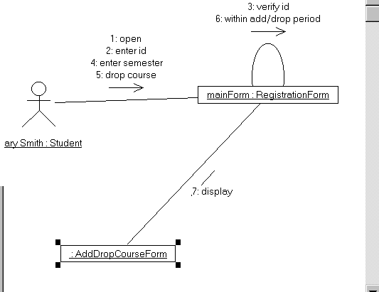
Collaborations Diagram

Slide 148
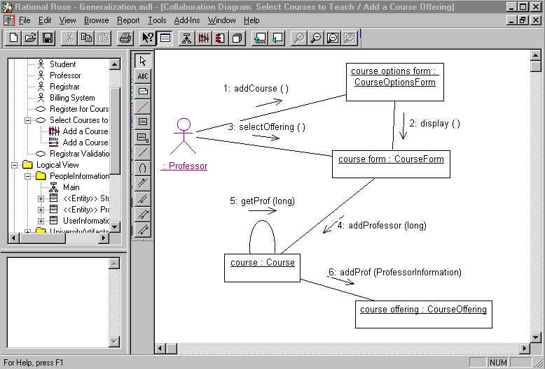

Slide 149
Associations and Dependencies
Two analysis classes are often related to one another in some fashion
In UML these relationships are called associations
Associations can be refined by indicating multiplicity (the term cardinality is used in data modeling
In many instances, a client-server relationship exists between two analysis classes.
In such cases, a client-class depends on the server-class in some way and a dependency relationship is established
© 2010 Sichuan University All rights reserved. | Confidential

Slide 150
Multiplicity
© 2010 Sichuan University All rights reserved. | Confidential

Slide 151
Dependencies
© 2010 Sichuan University All rights reserved. | Confidential

Slide 152
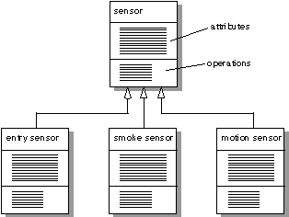
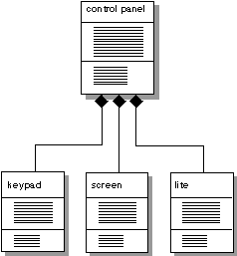
Defining Structures and Hierarchies
UML: Class Diagrams
Generalization-specialization
Composite aggregates

Slide 153
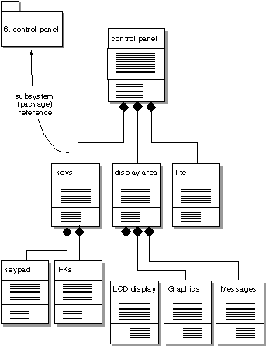
Defining Subjects and Subsystems
UML: Package Reference

Slide 154
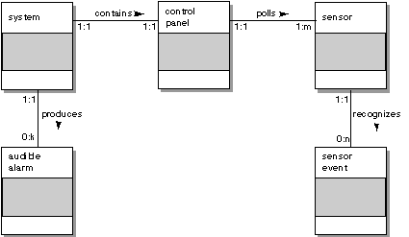
The Object-Relationship Model
Relationships between Objects:

Slide 155
Analysis Packages
Various elements of the analysis model (e.g., use-cases, analysis classes) are categorized in a manner that packages them as a grouping
The plus sign preceding the analysis class name in each package indicates that the classes have public visibility and are therefore accessible from other packages.
Other symbols can precede an element within a package. A minus sign indicates that an element is hidden from all other packages and a # symbol indicates that an element is accessible only to packages contained within a given package.
© 2010 Sichuan University All rights reserved. | Confidential

Slide 156
Analysis Packages
© 2010 Sichuan University All rights reserved. | Confidential

Slide 157
Behavioral Modeling
The behavioral model indicates how software will respond to external events or stimuli. To create the model, the analyst must perform the following steps:
Evaluate all use-cases to fully understand the sequence of interaction within the system.
Identify events that drive the interaction sequence and understand how these events relate to specific objects.
Create a sequence for each use-case.
Build a state diagram for the system.
Review the behavioral model to verify accuracy and consistency.
© 2010 Sichuan University All rights reserved. | Confidential

Slide 158
State Representations
In the context of behavioral modeling, two different characterizations of states must be considered:
the state of each class as the system performs its function and
the state of the system as observed from the outside as the system performs its function
The state of a class takes on both passive and active characteristics
A passive state is simply the current status of all of an object’s attributes.
The active state of an object indicates the current status of the object as it undergoes a continuing transformation or processing.
© 2010 Sichuan University All rights reserved. | Confidential

Slide 159
State Diagram for the ControlPanel Class
© 2010 Sichuan University All rights reserved. | Confidential

Slide 160
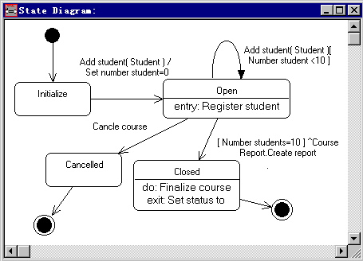
State Diagram

Slide 161
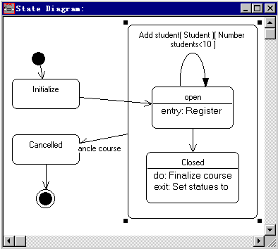

Slide 162
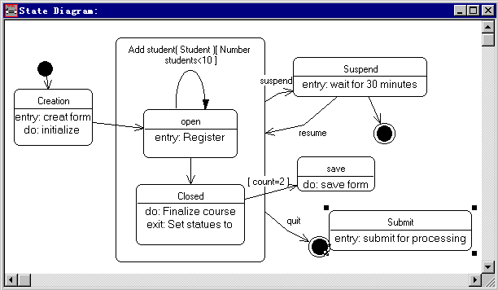

Slide 163
Sequence Diagram
UML Sequence diagram: indicates how events cause transitions
from object to object.
© 2010 Sichuan University All rights reserved. | Confidential

Slide 164
Writing the Software Specification
Everyone knew exactly what had to be done until someone wrote it down!
© 2010 Sichuan University All rights reserved. | Confidential

Slide 165
用UML建立学籍管理过程模型
上海交通大学想开发一个学籍管理系统，包括下列内容：
研究生院/教务处建立一个本学期的课程目录
一种课程可能有不同的时间、地点和听课对象的安排
有不同的数据库来管理有关课程，学生和教师的不同信息
每个学生可选4门必修课和2门选修课
一旦学生进行了选课注册，学校财务系统根据学生的注册和奖学金状态向学生发出交款通知
学生可以利用这个系统在注册后的一段时间内修改选课计划
教授们可以用这个系统查询他要上的课程的注册情况
系统的每一个用户通过他自己的口令验证来访问系统

Slide 166
确定系统用户
系统用户是人或其它外部系统他/它将在系统开发和运行过程中和系统进行交互、对话。
Administrators
Professors
Students
Billing System

Slide 167
使用用例
使用用例描述了系统对外表现的特征和性能
每个使用用例是由系统用户通过对话框进行的一系列相关活动
对每个系统用户进行分析，抽象他和系统之间可能的交互方法
系统管理员－维护课程数据库，学生数据库和教师数据库
教授－选课，课程注册情况查询
学生－注册，浏览，增加，删除具体课程
财务系统－接受注册情况、计算注册费用，发出交款通知
Maintain Curriculum
Request Course Roster
Maintain Schedule

Slide 168
通过顺序事件流描述说明每一个使用用例
对每一个使用用例，从系统用户的角度，写出它的正常事件流
具体说明为了执行这样一个使用用例，系统需要经历哪些过程内容
典型的过程内容包括：
使用用例的激发和停止方法
正常事件流
其它可能的正常事件流
所有的异常事件流

Slide 169
确定不同事件间的相关关系
我们从学生注册开始。为了注册，他需要先行登录到学籍管理系统中来。首先，他先要输入他的口令进行身份验证。系统在验证了身份之后将检查他的注册状态：如果没有注册，弹出对话框请他选课注册；如果已经注册了，提示他选择对现有的课程目录做些什么改动
如果选择的操作是增加，那么加课的子事件流将被激发。
如果选择的操作是删除，那么删除课程的子事件流将被激发。
如果选择的操作是浏览，那么浏览的子事件流将被激发。
如果选择的操作是退出，那就标志着该事件流的结束，注册管理员将自动退出系统。
...

Slide 170
Use Case 图
Use case图用来描述系统用户和使用用例之间的关系
Request Course Roster
Students
Professors
Maintain Schedule
Billing System
Maintain Curriculum
Administrators

Slide 171
Uses and Extends Use Case Relationships
随着使用用例的细化，我们将发现更多的使用用例之间的关系
«uses»关系可用来描述某一个特性可能为一个或多个其它使用用例所共有。
« extends »关系描述的是可能扩展（ optional ）的特性
<<uses>>
Register for courses
<<uses>>
Logon validation
Maintain curriculum

Slide 172
使用用例之间的关系
使用用例描述了系统的外在特性
交互过程图描述了不同的使用用例的执行过程和不同对象之间的关系。
UML提供了两种不同的交互过程图
事件顺序图（Sequence diagrams）
对象合作图（Collaboration diagrams）

Slide 173
事件顺序图-Sequence Diagram
事件顺序图按事件发生的时间顺序来描述不同对象之间的交互和联系
: Student
registration
math 101
math 101
registration
manager
section 1
form
1: fill in info
2: submit
3: add course(joe, math 01)
4: are you open?
5: are you open?
6: add (joe)
7: add (joe)

Slide 174
对象合作图-Collaboration Diagram
对象合作图以对象为核心来表示各个不同对象之间的连接关系
1: set course info
course form :
2: process
CourseForm
: Registrar
3: add course
aCourse :
theManager :
Course
CurriculumManager
4: new course


Slide 175
类图
类图是系统逻辑视图的表示方法。它用来描述对象的特性以及不同对象之间的关系
UML通过类图来描述下列基本元素
不同的类以及它们的属性 (attribute) 和行为特性 (behavior)
不同类之间的关联 (association)、聚合 (aggregate)、相关 (dependence) 和继承 (inheritance) 关系
类的实例数量特性（Multiplicity）和边历方向（ navigation indicators）
角色名（Role names）

Slide 176
类（Classes）
类是具有相同结构，相同特性，相同关系和相同语义的对象的集合
类是通过考察事件顺序图和对象合作图中的对象总结、抽象出来的
类用一个分成三部分的矩形来表示
类应该用特定领域的通用词汇来命名
应该建立一个类名的命名规范
如：可以规定所有的类都用第一个字母大写的名词或名词组合来命名。在名词组合中，要求每一个单词的第一个字母大写

Slide 177
类举例（Classes）
RegistrationForm
ScheduleAlgorithm
RegistrationManager
Course
Student
Professor
CourseOffering

Slide 178
操作（Operations）
类的活动特性是由它的操作来定义的
类的操作可以有观察交互过程图来确定
registration
registration
form
manager
RegistrationManager
3: add course(joe, math 01)
addCourse(Student,Course)

Slide 179
属性（Attributes）
类的静态结构是通过它的属性来描述的
类的属性可以通过观察类的定义，问题的需求定义和通过领域知识的分析来逐步确定
CourseOffering
Each course offering
has a number, location
and time
number
location
time

Slide 180
类的三部分的描述方法
RegistrationForm
ScheduleAlgorithm
RegistrationManager
Course
name
numberCredits
addStudent(Course, StudentInfo)
open()
addStudent(StudentInfo)
Professor
CourseOffering
Student
name
name
location
tenureStatus
major
open()
addStudent(StudentInfo)

Slide 181
对象间关系（Relationships）
对象之间的关系为不同对象之间通信通过了一条通道
可以通过对事件顺序图/对象合作图的观测来确定两个对象是否存在关系，如果有，属于哪一类关系
UML规定了三种关系
关联
聚合
相关

Slide 182
对象间关系（Relationships）
关联描述了两个类之间的双向联系
关联是用连接两个类的一根实线来描述的
聚合描述的是一种比较紧密的相关关系。它描述的整体和部分之间的关系
聚合用一根实线来连接相关的类。在表示整体的一端有一个菱形记号
相关关联（ dependency relationship）表示的是一种弱相关关系。她表示的是类似客户、服务方的关系，其中客户并不了解服务方的语义信息
相关关联用一个虚线从客户方指向服务方

Slide 183
确定不同类之间的关系
类之间的关系主要是通过考察交互过程图来确定的
如果两个对象要通信，它们之间必修存在一个通道（关系）。
Registration
Math 101:
RegistrationManager
Manager
Course
3: add student(joe)
Course

Slide 184
各种关系示例（Relationships）
ScheduleAlgorithm
RegistrationForm
RegistrationManager
addStudent(Course, StudentInfo)
Course
name
Student
numberCredits
name
major
open()
addStudent(StudentInfo)
Professor
name
CourseOffering
tenureStatus
location
open()
addStudent(StudentInfo)

Slide 185
数量修饰和边历方向
数量修饰定义有多少对象参与了这一关联关系
数量修饰是指某个类相对于另一个类的一个实例，这个类可能有的实例的数量
对于每一个关联和聚合关系而言，我们要分别确定关系两端的数量修饰
虽然关联和聚合在缺省情况下都定义成是双向关联的，但在很多情况下我们需要对此缺省值做出调整以确定明确的边历方向
如果有了明确的边历方向，则用箭头来指明边历方向

Slide 186
数量修饰和边历方向应用用例
RegistrationForm
ScheduleAlgorithm
0..*
1
RegistrationManager
addStudent(Course, StudentInfo)
Course
1
0..*
name
numberCredits
Student
open()
major
addStudent(StudentInfo)
1
3..10
Professor
1..*
tenureStatus
4
CourseOffering
1
location
0..4
open()
addStudent(StudentInfo)

Slide 187
继承
继承描述的是父类和子类之间的继承关系
UML中定义了两种不同的继承描述方法:
Generalization
Specialization
通过继承关系，我们可以把系统的类构造成一个具有不同层次关系的结构树。并将其中不同类所共有的属性、操作和关系定义在较高的层次。
继承用一根实线来连接相关的类。在表示父类的一端有一个三角形记号

Slide 188
继承关系的图示
RegistrationForm
ScheduleAlgorithm
RegistrationManager
addStudent(Course, StudentInfo)
Course
RegistrationUser
name
numberCredits
name
Student
open()
major
addStudent(StudentInfo)
Professor
tenureStatus
CourseOffering
location
open()
addStudent(StudentInfo)

Slide 189
继承关系的图示
RegistrationForm
ScheduleAlgorithm
RegistrationManager
addStudent(Course, StudentInfo)
Course
RegistrationUser
name
numberCredits
name
Student
open()
major
addStudent(StudentInfo)
Professor
CourseOffering
tenureStatus
location
open()
addStudent(StudentInfo)

Slide 190
对象的状态
状态变换图描述了
给定类的生命历史
引起状态变换的事件
状态变换带来的新活动
状态变换图是为那些具有显著动态特性的对象而建立的

Slide 191
状态变换图
Add student[ count < 10 ]
Add Student /
Initialization
Set count = 0
Open
do: Initialize course
entry: Register student
exit: Increment count
Cancel
Cancel
[ count = 10 ]
Canceled
do: Notify registered students
Closed
Cancel
do: Finalize course

Slide 192
物理世界的建模
软构件组成图说明了不同软构件之间的组织和依存关系
软构件的可能形式包括
源代码构件
实时构件或
可执行构件

Slide 193
部件结构图
Billing.exe
Register.exe
Billing
System
People.dll
Course.dll
User
Course
Student
Professor
Course
Course
Offering

Slide 194
系统的物理部署图
系统构件的物理部署图描述了系统不同运行过程的配置以及建立在其上的软件的执行过程
物理部署图描述了软件模块在企业的分布情况

Slide 195
物理部署图
Registration
Database
Main
Library
Building
Dorm


Slide 196
Exercise
Which of these is not an element of an object-oriented analysis model?
Behavioral elements
Class-based elements
Data elements
Scenario-based elements
Which of the following is not an objective for building an analysis model?
define set of software requirements that can be validated
describe customer requirements
develop an abbreviated solution for the problem
establish basis for software design
The data flow diagram
depicts relationships between data objects
depicts functions that transform the data flow
indicates how data are transformed by the system
indicates system reactions to external events
both b and c
Which of the following items does not appear on a CRC card?
class collaborators
class name
class reliability
class responsibilities
© 2010 Sichuan University All rights reserved. | Confidential

Slide 197
Exercise
5. For purposes of behavior modeling a state is any
consumer or producer of data.
data object hierarchy.
observable mode of behavior.
well defined process.
6. Attributes cannot be defined for a class until design has been completed.
a. True
b. False
7. Operations are object procedures that are invoked when an object receives a message.
True
False
8. UML activity diagrams are useful in representing which analysis model elements?
a. Behavioral elements
b. Class-based elements
c. Flow-based elements
d. Scenario-based elements
9. Which of the following should be considered as candidate objects in a problem space?
a. events b. people
c. structure d. all of the above
© 2010 Sichuan University All rights reserved. | Confidential

Slide 198
Exercise
10. In a few sentences, try to describe the primary differences between structured analysis and object-oriented analysis.
© 2010 Sichuan University All rights reserved. | Confidential

Slide 199
Answer
C C E C C B A D D
Answer: Structured analysis begins with a consideration of the data objects that the system must manipulate. In structured analysis the data objects are described with a data dictionary and the entity relation diagram (ERD) depicts relationships between data objects. The flow and transformation of data through a system are represented using the data flow diagram (DFD). The structured analysis also incorporates a behavioral modeling notation called the state transition diagram (STD). In the object oriented analysis model, class-based elements model the objects that the system will manipulate, the operations that will be applied to the objects to effect the manipulation, relationships (some hierarchical) between the objects, and the collaborations that occur between the classes that are defined. In addition the OO model represents the behavior of objects and the behavior of the system as a whole.
© 2010 Sichuan University All rights reserved. | Confidential

