Slide 1
Creating An Architectural Design
Software Engineering: A Practitioner’s Approach
by Roger S. Pressman

Slide 2

What is Architectural Design?

Slide 3
What is Architecture?
The architecture of a system is a comprehensive framework that describes its form and structure ------- its components and how they fit together.
The software architecture of a program or computing system is the structure or structures of the system, which comprise software components,
the externally visible properties of those components
the relationships among them.

Slide 4
What is Architecture?
Software Architecture: the structure of the system, which comprise software components, the externally visible properties of those components and the relationships among them.
The architecture is not the operational software. Rather, it is a representation that enables a software engineer to:
analyze the effectiveness of the design in meeting its stated requirements,
consider architectural alternatives at a stage when making design changes is still relatively easy, and
reduce the risks associated with the construction of the software.
© 2010 Sichuan University All rights reserved. | Confidential

Slide 5
What is Architectural Design?
Software architectural design is two levels of the design pyramid:
Data Design
Architectural Design
Data design considers the definitions of components and classes
Architectural design considers following factors:
structure of the components;
properties of the components;
the interrelationships of components;

Slide 6
An Example
customer requirements
"four bedrooms, three baths,
lots of glass ..."
architectural design

Slide 7
Why is Architecture Important?
The architectural model provides a Gestalt （完型）view of the system, allowing the software engineering to examine it as a whole.
An enabler for communication between all subsystem.
The architecture highlights early design decisions and as important as an operation entity.
Architecture “constitutes a relatively small, intellectually graspable model of the system”.

Slide 8
Architecture types
Artificial intelligence
Business and Non-Profit
Communication
Content creation
Device
Game
Industry
Law
medical treatment
Military
Os
Science
Tools
Transport
utility

Slide 9
The Steps of Architectural Design
Data design (Data & Component).
Select architectural styles and patterns.
Architectural Design.
Elaborate an architecture（细化）.

Slide 10
What is Data Design?
Data design ( data architecture ) creates a model of data and/or information.
It is the first step of design.
It is an important part of design.
It has a profound influence over the architecture.

Slide 11
Data Design at There Levels
The data design translates ERD and DD of the requirements model into:
Data structure at the software component level;
Database architecture at the application level;
Data Warehouse at business IT community level;

Slide 12
Data Design
At the architectural level …
Design of one or more databases to support the application architecture
Design of methods for ‘mining’ the content of multiple databases
navigate through existing databases in an attempt to extract appropriate business-level information
Design of a data warehouse—a large, independent database that has access to the data that are stored in databases that serve the set of applications required by a business
© 2010 Sichuan University All rights reserved. | Confidential

Slide 13
Data Design
At the component level …
refine data objects and develop a set of data abstractions
implement data object attributes as one or more data structures
review data structures to ensure that appropriate relationships have been established
simplify data structures as required
© 2010 Sichuan University All rights reserved. | Confidential

Slide 14
Data Design—Component Level
The systematic analysis principles applied to function and behavior should also be applied to data.
All data structures and the operations to be performed on each should be identified.
A mechanism should be established and used to define both data and program design.
Low level data design decisions should be deferred （delayed） until late in the design process.
The representation of data structure should be known only to those modules that must make direct use of the data contained within the structure.
A library of useful data structures and the operations that may be applied to them should be developed.
A software design and programming language should support the specification and realization of abstract data types.
© 2010 Sichuan University All rights reserved. | Confidential

Slide 15
Data Design—Component Level
用于功能和行为的系统分析原则也应用于数据
应该标识所有的数据结构以及其上的操作
应当建立数据字典，并用于数据设计和程序设计
低层的设计决策应该推迟到设计过程的后期
只有那些需要直接使用数据结构内部数据的模块才能看到该数据的表示
应该开发一个由有用的数据结构和应用于其上的操作组成的库
软件设计和程序设计语言应该支持抽象数据类型的规格说明和实现

Slide 16

Data Design at the Application Level
Data Design at the Application Level
Example: Database
Translate the ERD to the model of relational database.
From Entity to Table;
From Attribute to Field;
From Relation to Table;

Slide 17
From ERD to Database Architecture
步骤：
实体集合转换成关系模式，实体集合的属性成为关系的属性，实体集合的关键字成为关系的关键字；
联系转换成关系模式，参加联系的 实体集合关键字成为关系的属性，其关键字按照联系的类型确定：
1:1联系，参加联系的任意一实体集合的关键字成为关系的关键字；
1:N联系，N的一方的实体集合的关键字成为关系的关键字；
N:M联系，参加联系的所有实体集合的关键字成为关系的关键字；

Slide 18
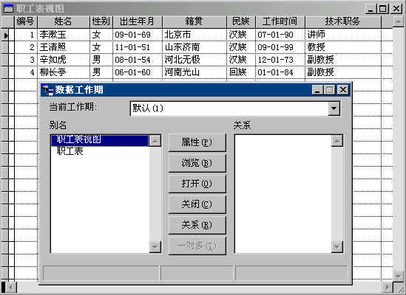
Example
a
d
E1
n
R
m
E2
b
e
c
关系模式：
E1 ( a, b );
E2 ( d, e );
R ( a, d, c );

Slide 19
Data Design at the Business Level
Example: a data warehouse
A data warehouse is a large, independent database that encompasses the data used by a business.
Data warehouse comes from database but not typical database:
Subject Orientation;
Integration;
Time Variances;
Nonvolatility;

Slide 20
What are Architectural Styles?
Each style describes a system category that encompasses:
(1) a set of components (e.g., a database, computational modules) that perform a function required by a system;
(2) a set of connectors that enable “communication, coordination and cooperation” among components;
(3) constraints that define how components can be integrated to form the system;
(4) semantic models that enable a designer to understand the overall properties of a system by analyzing the known properties of its constituent parts.

Slide 21
A Brief Taxonomy of Architectural Styles
Data-centered architectures
Data flow architectures
Call and return architectures
Object-oriented architectures
Layered architectures

Slide 22
Some Common Styles
Traditional, language-influenced styles
Main program and subroutines
Object-oriented
Layered
Virtual machines
Client-server
Data-flow styles
Batch sequential
Pipe and filter
Shared memory
Blackboard
Rule based
Interpreter
Interpreter
Mobile code
Implicit invocation
Event-based
Publish-subscribe
Peer-to-peer
“Derived”（派生） styles
C2
CORBA

Slide 23
Data-centered architectures

Slide 24
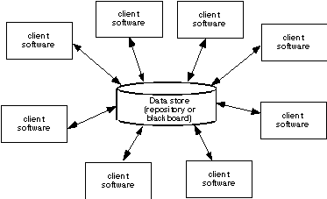
Data-Centered Architecture
© 2010 Sichuan University All rights reserved. | Confidential

Slide 25
Data flow architectures

Slide 26
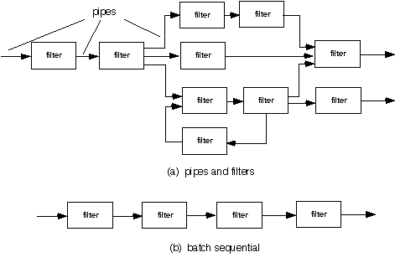
Data Flow Architecture
© 2010 Sichuan University All rights reserved. | Confidential

Slide 27
Data-Flow Styles
Batch Sequential
Separate programs are executed in order; data is passed as an aggregate from one program to the next.
Connectors: “The human hand” carrying tapes between the programs, a.k.a. “sneaker-net ”
Data Elements: Explicit, aggregate elements passed from one component to the next upon completion of the producing program’s execution.
Typical uses: Transaction processing in financial systems. “The Granddaddy of Styles”

Slide 28
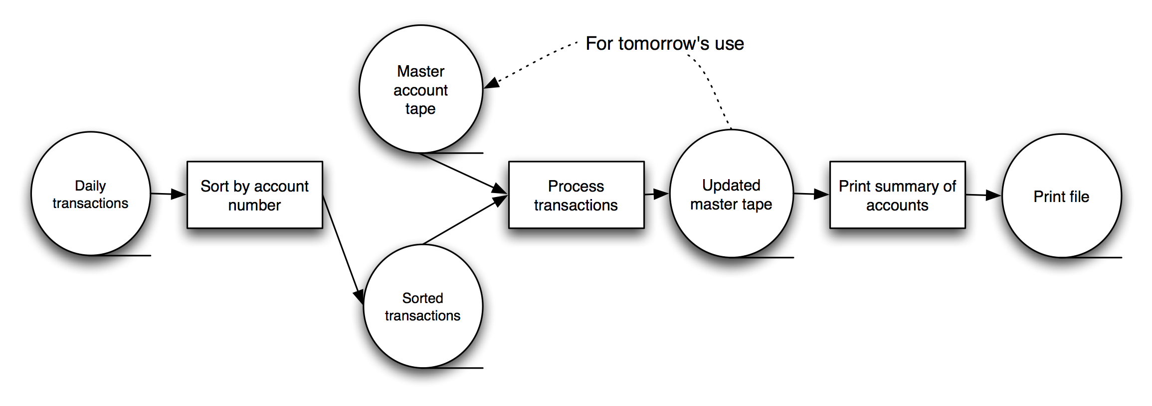
Batch-Sequential: A Financial Application

Slide 29
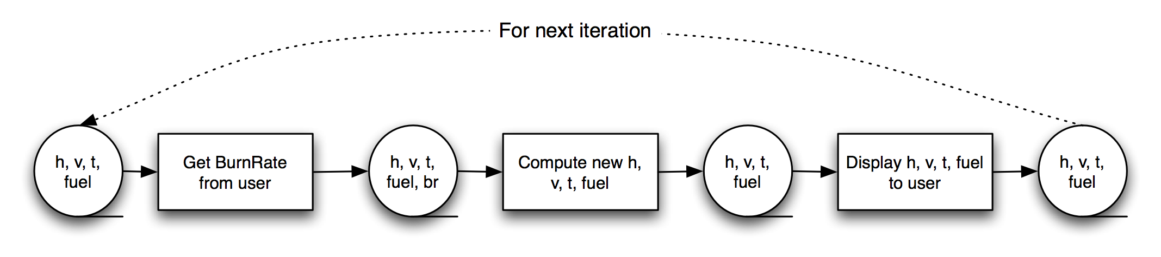
Batch-Sequential LL
Not a recipe for a successful lunar mission!

Slide 30
Pipe and Filter Style
Components are filters
Transform input data streams into output data streams
Possibly incremental production of output
Connectors are pipes
Conduits for data streams
Style invariants
Filters are independent (no shared state)
Filter has no knowledge of up- or down-stream filters

Slide 31
Pipe and Filter Style
Examples
UNIX shell signal processing
Distributed systems parallel programming
Example: ls invoices | grep -e August | sort
Variations
Pipelines — linear sequences of filters
Bounded pipes — limited amount of data on a pipe
Typed pipes — data strongly typed

Slide 32
Pipe and Filter Style
Advantages
System behavior is a succession of component behaviors
Filter addition, replacement, and reuse
Possible to hook any two filters together
Certain analyses
Throughput, latency, deadlock
Concurrent execution
Disadvantages
Batch organization of processing
Interactive applications
Lowest common denominator on data transmission

Slide 33

Pipe and Filter LL
Notes:
GetBurnRate runs continuously on its own, prompting the user for a new burn rate.
In this design the “compute new values” determines how much time has passed. Could alternatively do that in the GetBurnRate filter. Would change semantics a bit.

Slide 34
Traditional, language-influenced styles

Slide 35
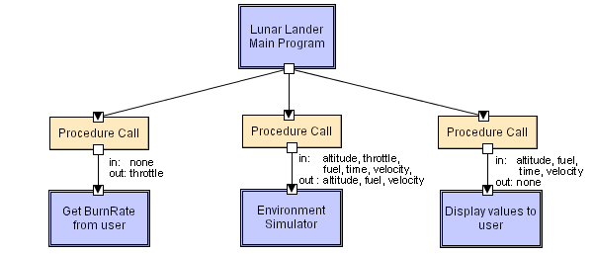
Main Program and Subroutines LL
Notes:
Main program displays greetings and instructions, then enters a loop in which it calls the three subroutines in turn.

Slide 36
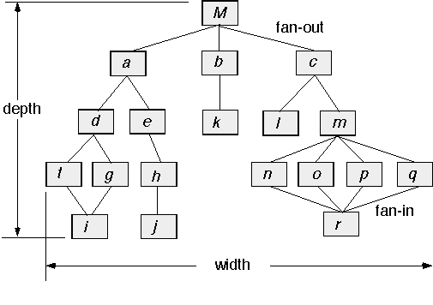
Call and Return Architecture
© 2010 Sichuan University All rights reserved. | Confidential

Slide 37
Object-Oriented Style
Components are objects
Data and associated operations
Connectors are messages and method invocations
Style invariants
Objects are responsible for their internal representation integrity
Internal representation is hidden from other objects
Advantages
“Infinite malleability（无穷的柔性）” of object internals
System decomposition into sets of interacting agents
Disadvantages
Objects must know identities of servers
Side effects （负面影响） in object method invocations

Slide 38
Object-Oriented Architecture
© 2010 Sichuan University All rights reserved. | Confidential

Slide 39
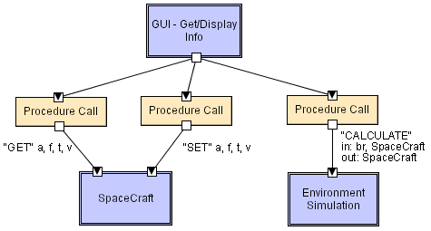
Object-Oriented LL

Slide 40
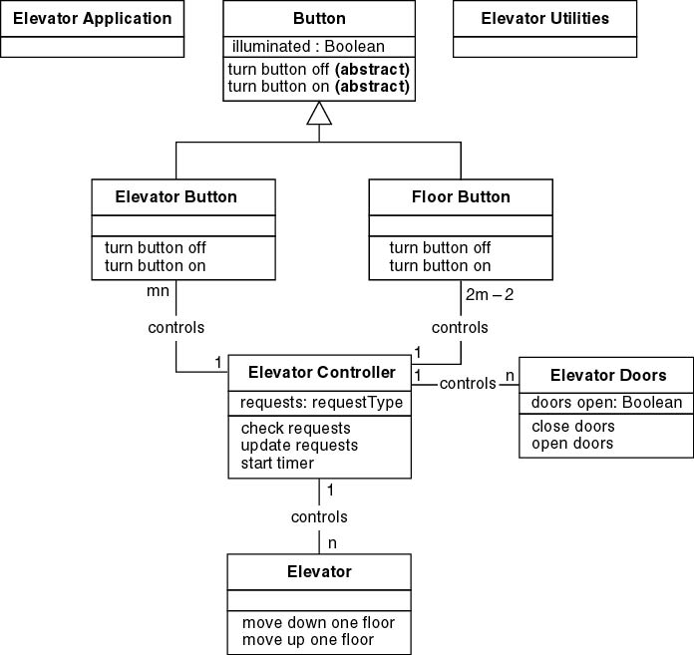
OO/LL in UML

Slide 41
Layered

Slide 42
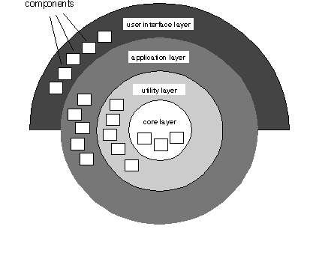
Layered Architecture

Slide 43
Layered Style
Hierarchical system organization
“Multi-level client-server”
Each layer exposes an interface (API) to be used by above layers
Each layer acts as a
Server: service provider to layers “above”
Client: service consumer of layer(s) “below”
Connectors are protocols of layer interaction
Example: operating systems
Virtual machine style results from fully opaque （不透明）layers

Slide 44
Layered Style
Advantages
Increasing abstraction levels
Evolvability
Changes in a layer affect at most the adjacent two layers
Reuse
Different implementations of layer are allowed as long as interface is preserved
Standardized layer interfaces for libraries and frameworks

Slide 45
Layered Style
Disadvantages
Not universally applicable
Performance
Layers may have to be skipped
Determining the correct abstraction level

Slide 46
Typical Layering Approach
Specific functionality
Distinct application subsystems that make up an application — contains the value adding software developed by the organization.
Application
Business specific — contains a number of reusable subsystems specific to the type of business.
Business-Specific
Middleware — offers subsystems for utility classes and platform-independent services for distributed object computing in heterogeneous environments and so on.
Middleware
System software — contains the software for the actual infrastructure such as operating systems, interfaces to specific hardware, device drivers, and so on.
General functionality
System Software
Notes:
This is a repeat of the slide first introduced in Architectural Analysis. It is included here as a review.
During Architectural Analysis, the focus was on the upper-level layers (that is, the application and business-specific layers). During Identify Design Elements, the focus is on the lower-level layers.
The layering principles originally described for packages also apply to subsystems.
This graphic comes from RUP.

Slide 47
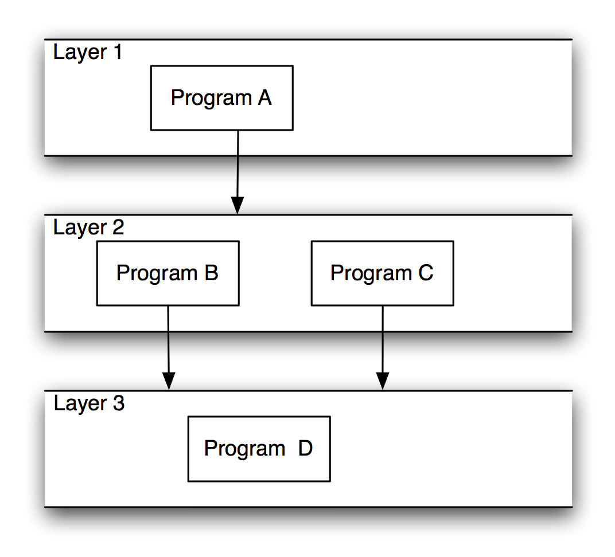
Layered Systems/Virtual Machines

Slide 48
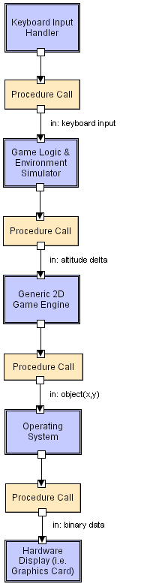
Layered LL

Slide 49
Client-Server Style
Components are clients and servers
Servers do not know number or identities of clients
Clients know server’s identity
Connectors are RPC（远程调用）-based network interaction protocols

Slide 50
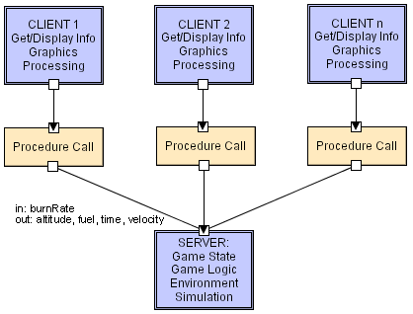
Client-Server LL

Slide 51
Shared memory

Slide 52
Blackboard Style
Two kinds of components
Central data structure — blackboard
Components operating on the blackboard
System control is entirely driven by the blackboard state
Examples
Typically used for AI systems
Integrated software environments (e.g., Eclipse)
Compiler architecture

Slide 53
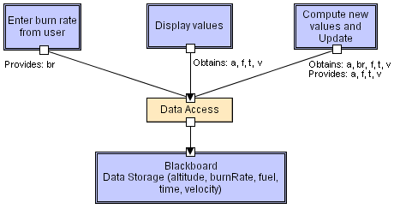
Blackboard LL

Slide 54
Rule-Based Style
Inference engine parses user input and determines whether it is a fact/rule or a query.
If it is a fact/rule, it adds this entry to the knowledge base.
Otherwise, it queries the knowledge base for applicable rules and attempts to resolve the query.

Slide 55
Rule-Based Style
Components: User interface, inference engine, knowledge base
Connectors: Components are tightly interconnected, with direct procedure calls and/or shared memory.
Data Elements: Facts and queries
Behavior of the application can be very easily modified through addition or deletion of rules from the knowledge base.
Caution: When a large number of rules are involved understanding the interactions between multiple rules affected by the same facts can become very difficult.

Slide 56
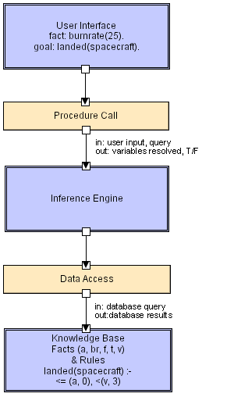
Rule-Based LL

Slide 57
Interpreter

Slide 58
Interpreter Style
Interpreter parses and executes input commands, updating the state maintained by the interpreter
Components: Command interpreter, program/interpreter state, user interface.
Connectors: Typically very closely bound with direct procedure calls and shared state.
Highly dynamic behavior possible, where the set of commands is dynamically modified. System architecture may remain constant while new capabilities are created based upon existing primitives.
Superb for end-user programmability; supports dynamically changing set of capabilities
Lisp and Scheme

Slide 59
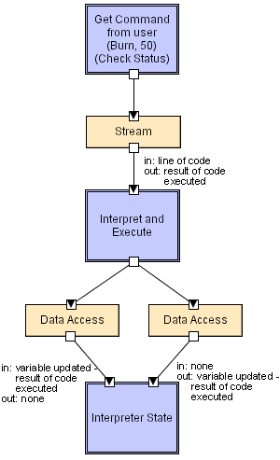
Interpreter LL

Slide 60
Mobile-Code Style
Summary: a data element (some representation of a program) is dynamically transformed into a data processing component.
Components: “Execution dock”, which handles receipt of code and state; code compiler/interpreter
Connectors: Network protocols and elements for packaging code and data for transmission.
Data Elements: Representations of code as data; program state; data
Variants: Code-on-demand, remote evaluation, and mobile agent.

Slide 61
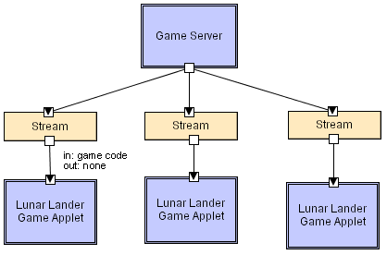
Mobile-Code LL
Scripting languages (i.e. JavaScript,
VBScript), ActiveX control,
embedded Word/Excel macros.

Slide 62
Implicit invocation

Slide 63
Implicit Invocation （隐含引用）Style
Event announcement instead of method invocation
“Listeners” register interest in and associate methods with events
System invokes all registered methods implicitly
Component interfaces are methods and events
Two types of connectors
Invocation is either explicit or implicit in response to events
Style invariants
“Announcers” are unaware of their events’ effects
No assumption about processing in response to events

Slide 64
Implicit Invocation Style
Advantages
Component reuse
System evolution
Both at system construction-time & run-time
Disadvantages
Counter-intuitive system structure
Components relinquish computation control to the system
No knowledge of what components will respond to event
No knowledge of order of responses

Slide 65
Publish-Subscribe（广播-订阅）
Subscribers register/deregister to receive specific messages or specific content.
Publishers broadcast messages to subscribers either synchronously or asynchronously.
Components: Publishers, subscribers, proxies for managing distribution
Connectors: Typically a network protocol is required. Content-based subscription requires sophisticated connectors.
Data Elements: Subscriptions, notifications, published information
Topology: Subscribers connect to publishers either directly or may receive notifications via a network protocol from intermediaries
Qualities yielded: Highly efficient one-way dissemination of information with very low-coupling of components

Slide 66
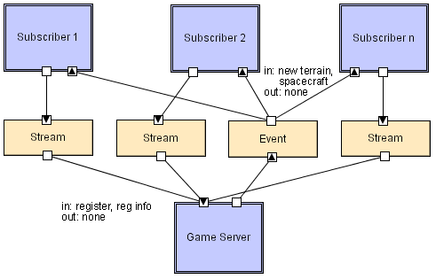
Pub-Sub LL

Slide 67
Event-Based Style
Independent components asynchronously emit and receive events communicated over event buses
Components: Independent, concurrent event generators and/or consumers
Connectors: Event buses (at least one)
Data Elements: Events – data sent as a first-class entity over the event bus
Topology: Components communicate with the event buses, not directly to each other.
Variants: Component communication with the event bus may either be push or pull based.
Highly scalable, easy to evolve, effective for highly distributed applications.

Slide 68
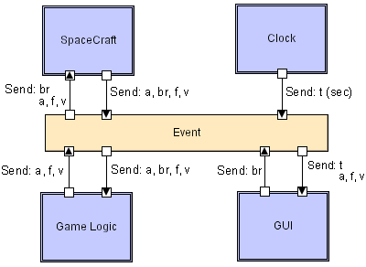
Event-Based LL

Slide 69
Peer-to-peer

Slide 70

Peer-to-Peer Style
State and behavior are distributed among peers which can act as either clients or servers.
Peers: independent components, having their own state and control thread.
Connectors: Network protocols, often custom.
Data Elements: Network messages

Slide 71
Peer-to-Peer Style
Topology: Network (may have redundant connections between peers); can vary arbitrarily and dynamically
Supports decentralized computing with flow of control and resources distributed among peers.
Highly robust in the face of failure of any given node.
Scalable in terms of access to resources and computing power.
But caution on the protocol!

Slide 72
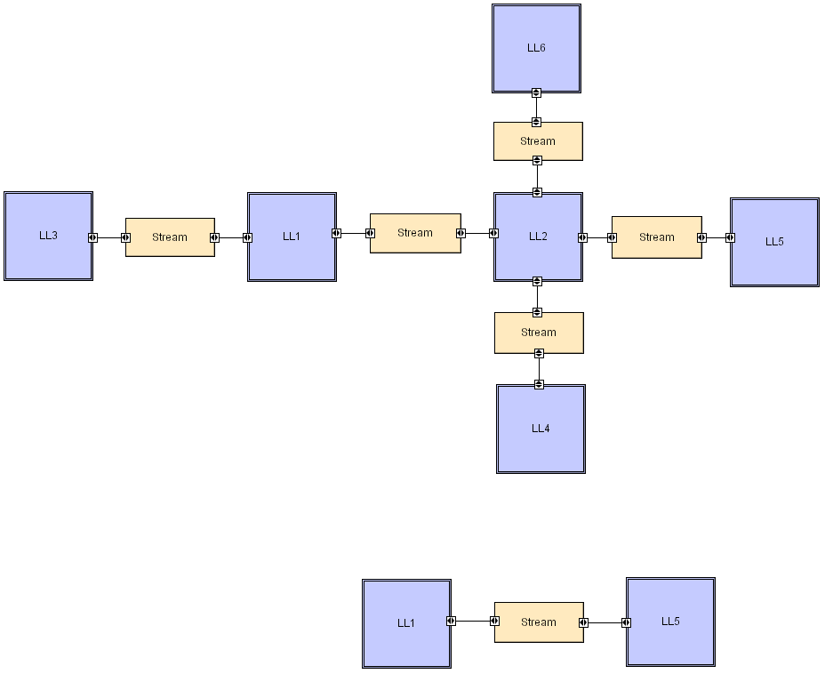
Peer-to-Peer LL

Slide 73
“Derived”（派生） styles

Slide 74
CORBA Style（公共对象请求代理）
The Common Object Request Broker Architecture (CORBA) is a standard defined by the Object Management Group (OMG) that enables software components written in multiple computer languages and running on multiple computers to work together, i.e. it supports multiple platforms.

Slide 75
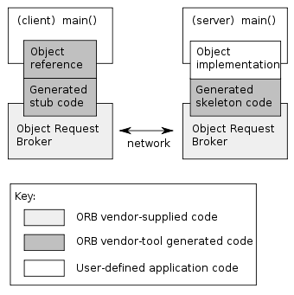
CORBA LL

Slide 76
Architectural Patterns
Concurrency—applications must handle multiple tasks in a manner that simulates parallelism
operating system process management pattern
task scheduler pattern
Persistence—Data persists if it survives past the execution of the process that created it. Two patterns are common:
a database management system pattern that applies the storage and retrieval capability of a DBMS to the application architecture
an application level persistence pattern that builds persistence features into the application architecture
Distribution— the manner in which systems or components within systems communicate with one another in a distributed environment
A broker acts as a ‘middle-man’ between the client component and a server component.
© 2010 Sichuan University All rights reserved. | Confidential

Slide 77
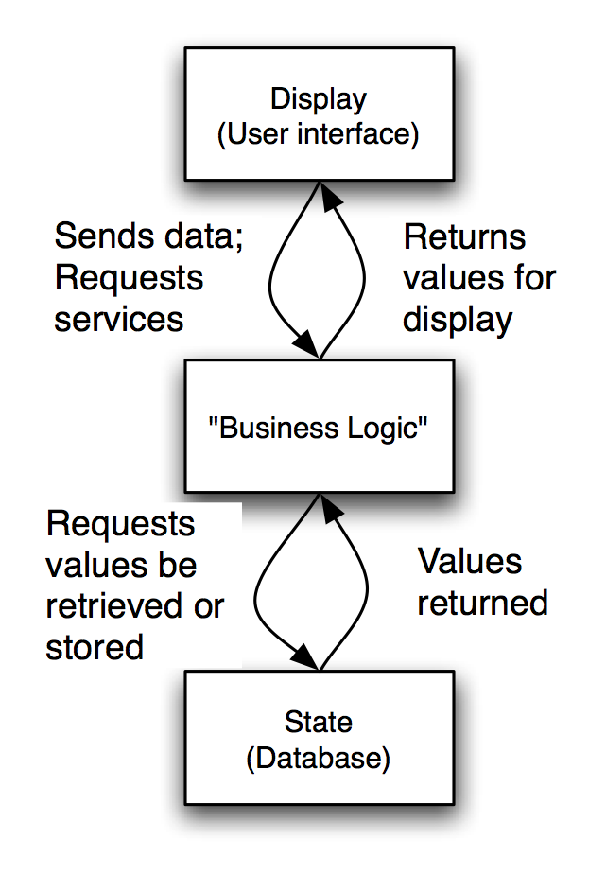
State-Logic-Display: Three-Tiered Pattern
Application Examples
Business applications
Multi-player games
Web-based applications

Slide 78
Model-View-Controller (MVC)
Objective: Separation between information, presentation and user interaction.
When a model object value changes, a notification is sent to the view and to the controller.
Thus, the view can update itself and the controller can modify the view if its logic so requires.
When handling input from the user the windowing system sends the user event to the controller.
If a change is required, the controller updates the model object.

Slide 79
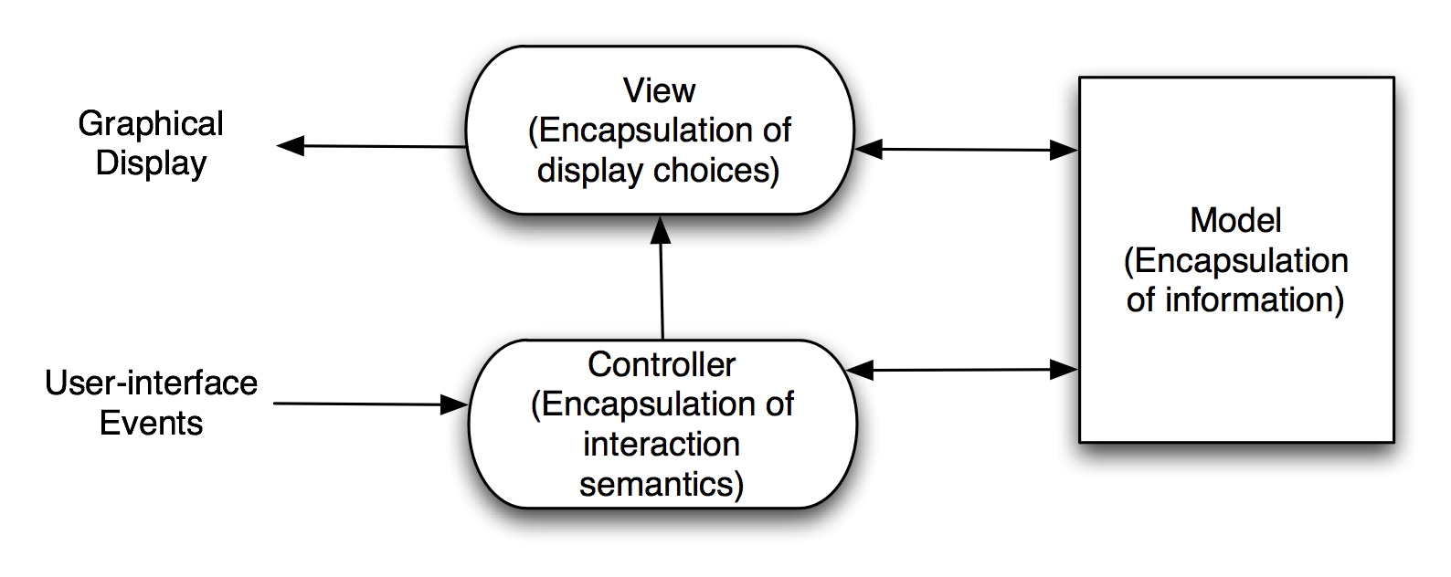
Model-View-Controller (MVC)
Notes:
Draw a graph as an example
Graph drawn as circles and lines
Graph drawn as a bit matrix: a 1 indicates that those two nodes (x, y) are connected

Slide 80
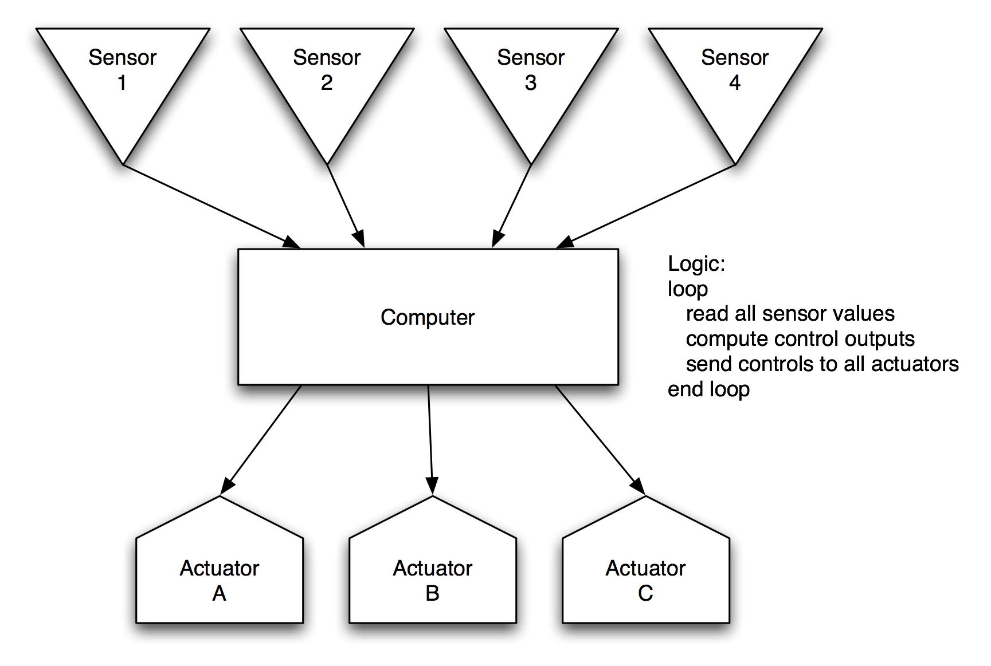
Sense-Compute-Control
Objective: Structuring embedded control applications

Slide 81
The Lunar Lander（登月飞行器）:
A Long-Running Example
A simple computer game that first appeared in the 1960’s
Simple concept:
You (the pilot) control the descent rate of the Apollo-era Lunar Lander
Throttle setting controls descent engine
Limited fuel
Initial altitude and speed preset
If you land with a descent rate of < 5 fps: you win (whether there’s fuel left or not)
“Advanced” version: joystick controls attitude & horizontal motion

Slide 82
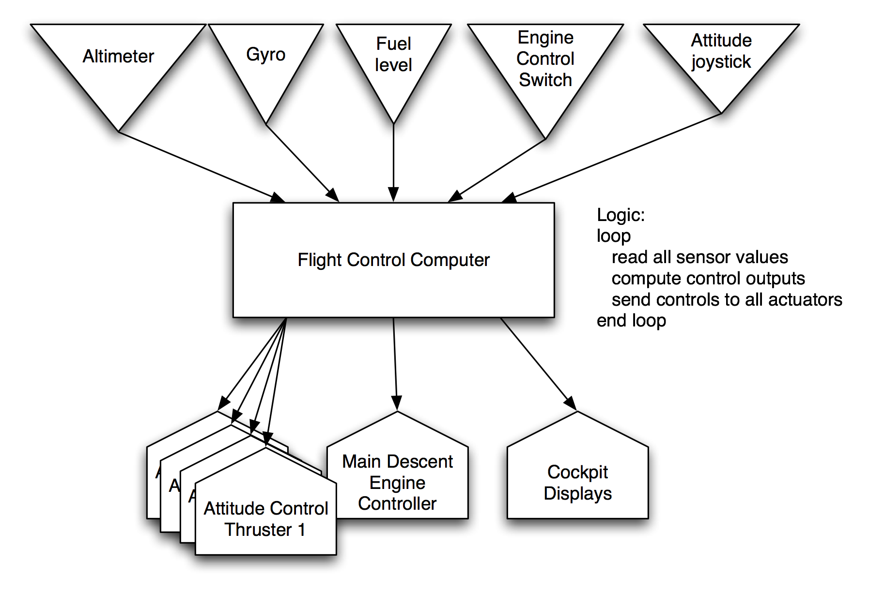
Sense-Compute-Control LL

Slide 83
Architectural Design

Slide 84
Architectural Design
The software must be placed into context
the design should define the external entities (other systems, devices, people) that the software interacts with and the nature of the interaction
A set of architectural archetypes should be identified
An archetype is an abstraction (similar to a class) that represents one element of system behavior, it’s core abstract classes or patterns of system)
The designer specifies the structure of the system by defining and refining software components that implement each archetype
© 2010 Sichuan University All rights reserved. | Confidential

Slide 85
The Steps of Architectural Design
Representing the System in Context
Defining Archetypes
Refining the Architecture into Components
Describing Instantiations of the System

Slide 86
Representing the System in Context
Architectural context represents how the software interacts with entities external to its boundaries
Architectural Context Diagram
Super ordinate Systems
Subordinate Systems
Peer-level Systems
Actors

Slide 87
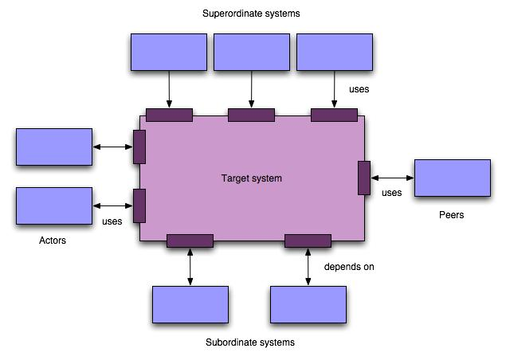
Arch. Context Diagram

Slide 88
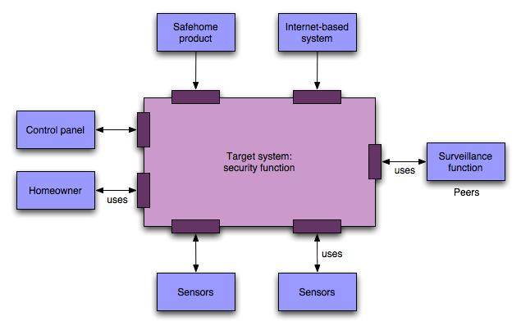
Architectural Context Diagram (ACD)

Slide 89
Defining Archetypes
Archetypes are classes or patterns that represent an abstraction critical to the system
The target system architecture is composed of these archetypes
Archetypes are the abstract building blocks of an architectural design
Node
Detector
Indicator
Controller

Slide 90
Archetypes
© 2010 Sichuan University All rights reserved. | Confidential

Slide 91
Refining the Architecture into Components
Components of the software architecture are derived from three sources:
The application domain;
The infrastructure domain;
The interface domain;
The structure of a software system provides the ecology in which code is born, matures, and dies.
A well-designed habitat allows for the successful evolution of all the components needed in a software system.

Slide 92
Component Structure
© 2010 Sichuan University All rights reserved. | Confidential

Slide 93
Refined Component Structure
© 2010 Sichuan University All rights reserved. | Confidential

Slide 94
Analyzing Architectural Design
1. Collect scenarios.
2. Elicit requirements, constraints, and environment description.
3. Describe the architectural styles/patterns that have been chosen to address the scenarios and requirements:
module view (information hiding degree)
process view (system performance)
data flow view (degree of architecture meeting functions)
4. Evaluate quality attributes by considered each attribute in isolation.
5. Identify the sensitivity of quality attributes to various architectural attributes for a specific architectural style.
6. Critique candidate architectures (developed in step 3) using the sensitivity analysis conducted in step 5.
© 2010 Sichuan University All rights reserved. | Confidential

Slide 95

Architectural Complexity
A useful technique for assessing the overall complexity of a proposed architecture is to consider dependencies between components within the architecture.
Sharing dependencies;
Flow dependencies;
Constrained dependencies;

Slide 96
Structural Design (SD)

Slide 97
What is Structural Design?
objective: to derive a program architecture that is partitioned
approach:
the DFD is mapped into a program architecture
the PSPEC and STD are used to indicate the content of each module
notation: structure chart
DFD → System Hierarchy

Slide 98
The Goals of SD
开发一个模块化的程序结构
表示出模块之间的控制关系
将程序设计和数据结构相结合
为数据在程序中的流动定义接口

Slide 99
The Tasks of SD
采用某种设计方法，将一个复杂的系统按功能划分为模块的层次结构
确定模块之间的调用关系
确定每个模块的功能，建立与已确定的软件需求的对应关系
确定模块之间的接口，即模块间传递的信息，并设计模块接口的信息结构
评估模块划分的质量及导出模块结构的规则

Slide 100
The Process of SD
1. The type of information flow is established;
2. Flow boundaries are indicated;
3. The DFD is mapped into program structure;
4. Control hierarchy is defined;
5. Resultant structure is refined using design measures and heuristics;
6. The architecture description is refined and elaborated;

Slide 101
SC--结构图(Structure Chart )
描述软件系统的层次和分块结构关系。
在结构图中可以看到模块与模块之间的联系与通讯。
基本符号：
结构图的图示符号以用矩形表示的模块
用模块间带箭头的连线表示的调用关系
在调用关系边上用短箭头表示的模块间信息传递关系。

Slide 102
Structure Chart (1)
一般地，在系统结构图中有4种类型的模块：
传入模块 ：从下属模块取得数据，经过某些处理，再将其传送给上级模块。
传出模块 ：从上级模块获得数据，进行某些处理，再将其传送给下属模块。
变换模块 ：即加工模块。它从上级模块取得数据，进行特定的处理，转换成其它形式，再传送回上级模块。大多数计算模块（原子模块）属于这一类。
协调模块 ：对所有下属模块进行协调和管理的模块。
数据传递；
控制信息；
或；
循环.

Slide 103
Structure Chart (2)
例：
注：此图一般不入文档，仅用于检查设计的正确性和模块独立性。
M
A
B
D
C
M1
M2
M3
须检查；
♦ 每个传递的数据是否必须？♦ 完成模块功能所必须的数据是否都传递了？
♦ 传输的数据是否只与单一的功能有关？是否目的明确？

Slide 104
Structure Chart (3)
报表加工
（2）
（6）
（5）
（6）
（5）
（2）
合法性检验
计算
印出报表
（2）
（7）
（9）
（3）
（5）
（8）
信息编辑
检验
印出表头
印出表尾
（2）
（3）
（1）
（8）
（8）
读入
编辑
计算

Slide 105
Structure Chart 使用说明
a.为每一个成分（模块或数据）适当地命名使人们能直观理解。
b.一个模块在结构图中只能出现一次以避免修改时出错成错误。
c.尽可能将整个画在一张纸上以便于整体理解。
d.一般习惯是：输入模块在左，输出模块在右，计算模块居中。
e.结构图和习惯使用的程序流程图是完全不同的。程序有层次性和过程性两方面的特点，通常应该先考虑层次特性，再考虑过程特性。结构图描述的是程序的层次特性，即某个模块负责管理哪些模块，这些模块又依次管理什么模块等。

Slide 106
The Process of SD
精化数据流图
“事务流”
“变换流”
流类型
区分事务中心和数据接收通路
区分输入和
输出分支
映射成事务结构
映射成变换结构
优化的前题是：“Get it to work, then make it fast.”
用启发式设计规则精化软件结构
事物分析
导出接口描述和
全程数据结构
变换分析
复 查
详细设计

Slide 107
Flow Characteristics
Transform flow
Transaction flow

Slide 108
General Mapping Approach
isolate incoming and outgoing flow boundaries; for transaction flows, isolate the transaction center
working from the boundary outward, map DFD transforms into corresponding modules
add control modules as required
refine the resultant program structure using effective modularity concepts

Slide 109
Transform Mapping

Slide 110
The Steps of Transform Mapping
步骤1：复审基本系统模型（0层数据流图和支持信息）
步骤2：复审和细化软件的数据流图
步骤3：确定数据流图中含有变换流特征还是含有事务流特征
步骤4：区分输入流、输出流和中心变换部分，即标明流的边界
步骤5：进行一级“因子化”分解，设计顶层和第一层模块
步骤6：进行二级“因子化”分解，设计中、下层模块
步骤7：利用一些启发式原则来改进系统的初始结构图

Slide 111
启发式原则
① 模块功能的完善化
② 消除重复功能，改善软件结构
③ 模块的作用范围应在控制范围之内
④ 尽可能减少高扇出结构
⑤ 避免或减少使用病态联接
⑥ 模块的大小要适中
⑦ 设计功能可预测的模块，但要避免过分受限制的模块
⑧ 软件包应满足设计约束和可移植性。

Slide 112
Transform Flow
事实上所有信息流都可归结为变换流
External representation
Incoming
flow
Outgoing
flow
Information
Transform flow
Internal representation
Time

Slide 113
Transform Architecture

Slide 114
Transform Analysis
传入部分
变换中心
传出部分
传入
变换
传出
主模块
输入模块
主加工模块
输出模块

Slide 115
Transform Mapping Example

Slide 116
Why Partitioned Architecture?
results in software that is easier to test
leads to software that is easier to maintain
results in propagation of fewer side effects
results in software that is easier to extend

Slide 117
Partitioning the Architecture
“horizontal” and “vertical” partitioning are required

Slide 118
Horizontal Partitioning
define separate branches of the module hierarchy for each major function
use control modules to coordinate communication between functions
function 1
function 3
function 2

Slide 119
Vertical Partitioning: Factoring
design so that decision making and work are stratified
decision making modules should reside at the top of the architecture
decision-makers
workersz

Slide 120
Factoring
© 2010 Sichuan University All rights reserved. | Confidential

Slide 121
First Level Factoring
main
program
controller
input
processing
output
controller
controller
controller
© 2010 Sichuan University All rights reserved. | Confidential

Slide 122
Second Level Mapping
© 2010 Sichuan University All rights reserved. | Confidential

Slide 123
An Example of Transform Mapping(1)
例：汽车数字仪表板的设计
功能：① 通过模 - 数转换实现传感器和微处理机接口；
② 在发光二极管面板上显示数据；
③ 指示每小时英里数(mph),行驶的里程，
每加仑油行驶的英里数(mpg)等等；
④ 指示加速或减速；
⑤ 如果车速超过55mph ,则发出警告铃声。

Slide 124
An Example of Transform Mapping(2)
第一步：DFD的分界，先分出I、P、O三块
旋转信号
读
旋转信号
确定加/减速
箭头指示
SPS
ΔSPS
燃料流
传感器信号
收集和求平均
产生
加/减速显示
上箭头
水平线
读和校核
SPS
下箭头
转换成
转/分
燃烧流
rpm
计算里程
rpm
英里
产生里程显示
计算gph
计算mph,超速值
显示
超速值
gph
发出铃声
mph
mph
计算燃料消耗
铃声
产生mph显示
mpg
mph显示
产生mpg显示
mpg显示

Slide 125
An Example of Transform Mapping(3)
数字仪表板
控制
接收传感器
信号
数据转换
控制
驱动仪表板
一般问题的一级分解方法：
M
I
P
O

Slide 126
An Example of Transform Mapping(4)
第二步：映射
：由边界向回溯，将每个遇到的处理器映成相应的层模块。
M
I
D
A
C
I
B
C
B
P
：每个处理直接对应一个下层模块。
D
A
O
：由边界向外推，方法与 类似
I

Slide 127
An Example of Transform Mapping(5)
数字仪表板
控制
接收传感器
信号
数据转换
控制
驱动仪表板
转换成rpm
计算gph
确定加/减速
计算mph
计算mpg
计算里程
加/减速
显示
显示mpg
显示mph
显示里程
发出铃声
收集sps
读燃料流
读旋转信号
发光二极管显示

Slide 128
An Example of Transform Mapping(6)
第三步：修改 —— 本着高内聚、低耦合的原则。
数字仪表板
控制
注：每个模块应附一简要说明描述
① 进出该模块的信息（接口描述）；
② 模块内部的信息；
③ 过程陈述，包括主要判定点及任务等；
④ 对约束和特殊特点的简短讨论。
接收传感器
信号
数据转换
控制
驱动仪表板
读旋转信号
读燃料流
显示
发出铃声

Slide 129
Transaction Mapping

Slide 130
Transaction Flow
action path
incoming flow
T

Slide 131
Refining the Analysis Model
write an English language processing narrative
for the level 01 flow model
apply noun/verb parse to isolate processes, data
items, store and entities
develop level 02 and 03 flow models
create corresponding data dictionary entries
refine flow models as appropriate
... now, we're ready to begin design!

Slide 132
Deriving Level 1
Processing narrative for " process operator commands"
Processing narrative for " process operator commands"
Process operator command software reads operator commands from
the cell operator. An error message is displayed for invalid commands.
The command type is determined for valid commands and appropriate
action is taken. When fixture commands are encountered, fixture
status is analyzed and a fixture setting is output to the fixture servos.
When a report is selected, the assembly record file is read and a
noun-verb
report is generated and displayed on the operator display screen.
When robot control switches are selected, control values are sent to
parse
the robot control system.
Process operator command software
reads
operator
commands
from
the cell
operator
. An
error message
is
displayed
for
invalid commands
.
The
command type
is
determined
for
valid commands
and appropriate
action is
taken
. When
fixture commands
are
encountered
,
fixture
status
is
analyzed
and a
fixture setting
is
output
to the
fixture servos
.
When a
report
is
selected,
the
assembly record file
is
read
and a
report is
generated
and
displayed
on the operator
display screen
.
When
robot control switches
are
selected
,
control value
s are
sent
to
the
robot control system.

Slide 133
Transaction Mapping Principles
isolate the incoming flow path
define each of the action paths by looking for
the "spokes of the wheel“
assess the flow on each action path
define the dispatch and control structure
map each action path flow individually

Slide 134
The Steps of Transaction Mapping
步骤1：复审基本系统模型
步骤2：复审和细化软件的数据流图
步骤3：确定数据流图中含有变换流特征还是含有事务流特征
步骤4：识别事务中心和每一条操作路径上的流特征
步骤5：将数据流图映射到事务型系统结构图上
步骤6：“因子化”分解和细化该事务结构和每一条操作路径的结构
步骤7：利用一些启发式原则来改进系统的初始结构图

Slide 135
Transaction Flow
Transaction
request
…
T = Call one of the several subroutines depending on the type of the incoming transaction request.
当信息流具有明显的“发射中心”时，可归结为事务流。
T
…
Action paths
…
…
…

Slide 136
Transaction Architecture

Slide 137
Transaction Analysis
接受部分
事务中心
动作
1
接受
事务
分析
动作
2
动作
3
事务控制模块
接受模块
动作发送模块
动作1模块
动作1模块
动作1模块

Slide 138
Transaction Mapping
Data flow model
f
a
e
b
d
mapping
t
x1
g
i
program structure
l
h
k
j
b
t
m
n
a
x2
x3
x4
d
e
f
g
h
x3.1
l
m
n
i
j
k
© 2010 Sichuan University All rights reserved. | Confidential

Slide 139
Transaction Example
fixture setting
fixture
servos
commands
operator
process
report
operator
display
commands
screen
robot control
robot
control
software
assembly
record
in reality, other
commands
would also be shown
© 2010 Sichuan University All rights reserved. | Confidential

Slide 140
Level 1 Data Flow Diagram

Slide 141
Level 2 Data Flow Diagram

Slide 142
Isolate Flow Paths

Slide 143
Map the Flow Model

Slide 144
Refining the Architectural Design
A processing narrative must be developed for each module.
An interface description is provided for each module.
Local and global data structures are defined.
All design restrictions/limitations are noted.
A set of design reviews are conducted.
Refinement is considered ( if required and justified).

Slide 145
Refining the Structure Chart
process
operator
commands
command
determine
input
type
controller
read
validate
produce
fixture
report
send
command
command
error
status
generation
control
message
controller
controller
value
read
determine
format
read
calculate
format
fixture
setting
setting
record
output
report
status
values

Slide 146
Exercise
An architectural style encompasses which of the following elements?
constraints
set of components
semantic models
syntactic models
a, b and c
During the process of modeling the system in context, systems that interact with the target system are not represented as
Peer-level systems
Subordinate systems
Super-ordinate systems
Working systems
When the overall flow in a segment of a data flow diagram is largely sequential and follows straight-line paths, _________ is present.
low coupling
Good modularity
transaction flow
transform flow
When you encounter both transform flow and transaction flow in the same DFD the flow is partitioned and the appropriate mapping technique is used on each part of the DFD
True
False
© 2010 Sichuan University All rights reserved. | Confidential

Slide 147
Exercise
5. When a single item that triggers other data flow along one of many paths of a data flow diagram, ________ characterizes the information flow.
high coupling
poor modularity
transaction flow
transform flow
6. In transaction mapping the first level factoring results in the
creation of CFD.
derivation of control hierarchy
distribution of work modules
refinement of the module view
7. A successful application of transform or transaction mapping to create an architectural design is supplemented by
entity relationship diagram
module interface descriptions
processing narratives for each module
test case for each module
Both b and c
8. The best representation of system architecture is an operational software prototype.
a. True
b. False
© 2010 Sichuan University All rights reserved. | Confidential

Slide 148
Answer: e
Answer: d
Answer: d
Answer: a
Answer: c
Answer: b
Answer: e
Answer: b

