Slide 1
Component-Level Design
Software Engineering: A Practitioner’s Approach
by Roger S. Pressman

Slide 2
Overview
What Is a Component
Designing Class-Based Components
Basic Design Principles
Comp. Level Design Guidelines
Cohesion and Coupling
Conducting Comp. Level Design
Steps of Comp. Level Design
Object Constraint Language
Designing Conventional Components

Slide 3
What is a component?
A modular building block for computer software
“A modular, deployable, and replaceable part of a system that encapsulates implementation and exposes a set of interfaces.”
— OMG UML Specification

Slide 4
Different Views of Component
OO View
A component is a set of collaborating classes.
Analysis modeling and design modeling are both iterative actions.
Elaborating the original analysis class may require additional analysis steps, design modeling to represent the elaborated design class.

Slide 5
Analysis class
Requirements analysis → analysis class of PrintJob
Architecture design → component of PrintJob
Component-level design:
Interfaces: computeJob
initiateJob
Elaborated design class: to guide implementation
Data structure, Algorithmic detail, Interface
Design component
Elaborated design class
computeJob
initiateJob

Slide 6
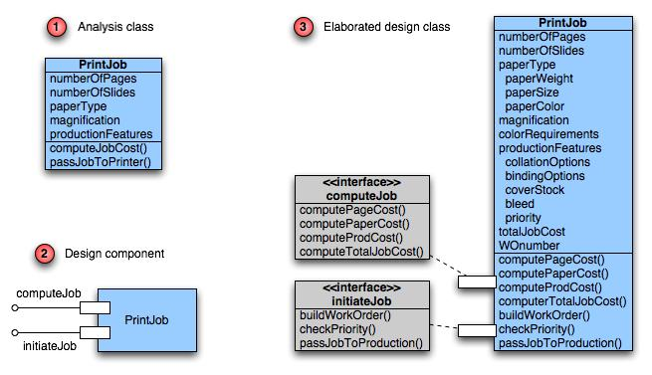
Class Elaboration（求精）

Slide 7
Different Views of Component
Conventional View（传统的观点）
A component is a functional element of a program that incorporates:
processing logic（处理逻辑）
internal data structures（内部数据结构）
an interface（接口）

Slide 8
Conventional Component
Job
Management
system
Read
print job
data
Select
jobmgmt
function
Develop
job cost
Build
work order
Send job
to
production
Compute
page cost
Compute
paper cost
Compute
prod cost
Check
priority
Pass job to
production
© 2010 Sichuan University All rights reserved. | Confidential

Slide 9
Design component
Requirements analysis → data flow diagrams
Architecture design → structure chart
Component-level design:
Each module in structure chart is elaborated
Interface, Data structure, Algorithmic detail, State diagram
getJobData module
accessCostsDB database
Elaborated module
algorithm detail

Slide 10
Different Views of Component
Process Related View
Software is made by using existing component
A component has reusability:
Interface;
Function（s);
Communication and collaboration;

Slide 11
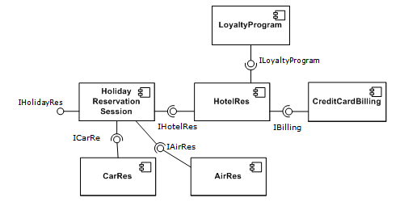

Slide 12
Overview
What Is a Component
Designing Class-Based Components
Basic Design Principles
Comp. Level Design Guidelines
Cohesion and Coupling
Conducting Comp. Level Design
Steps of Comp. Level Design
Object Constraint Language
Designing Conventional Components

Slide 13
What is Comp. Level Design?
A complete set of software components is defined during architectural design. But the details of each component are not represented.
Component-level design defines:
Elaboration of analysis classes
Definition and refinement of infrastructure classes
Detailed description of the attributes, operations and interfaces of classes

Slide 14
Basic Design Principles
There are four basic design principles:
The Open-Closed Principle (OCP)
A module should be open for extension but closed for modification.
The Liskov Substitution Principle (LSP)
Subclasses should be substitutable（可替代） for their base classes.
Dependency Inversion Principle (DIP)
Depend on abstractions. Do not depend on concretions（具体）.
The Interface Segregation Principle (ISP)
Many client-specific interface are better than one general purpose interface.

Slide 15
Basic Design Principles
Additional packaging principles:
The Release Reuse Equivalency Principle (REP)
The granule（粒度） of reuse is the granule of release
The Common Closure Principle (CCP)
Classes that change together belong together.
The Common Reuse Principle (CRP)
Classes that aren’t reused together should not be grouped together.

Slide 16
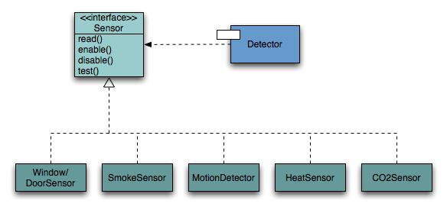
Open-Closed Principle
A module should be open for extension but closed for modification.（模块封装性）

Slide 17
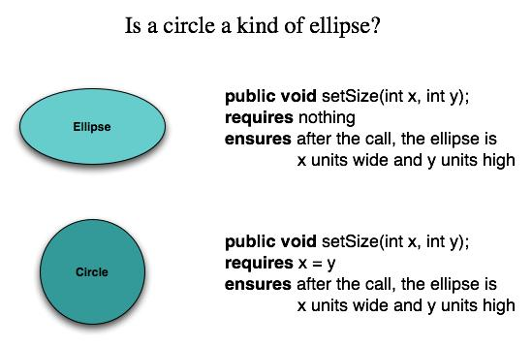
The Liskov Substitution Principle（替代原理）
Subclasses should be substitutable for their base classes

Slide 18
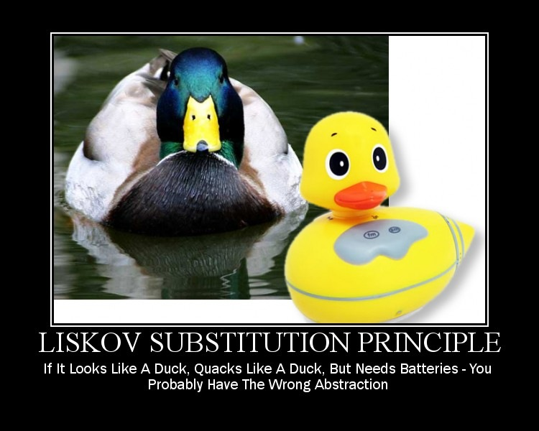
If it looks like a duck, quacks like a duck, but needs batteries – you probably have the wrong abstraction

Slide 19
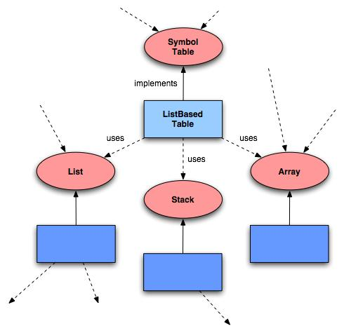
Dependency Inversion Principle
Depend on abstractions（抽象）. Do not depend on concretions（具体）.
A. High-level modules should not depend on low-level modules. Both should depend on abstractions.
B. Abstractions should not depend upon details. Details should depend upon abstractions.

Slide 20

Would you solder a lamp directly to the electrical wiring in a wall?

Slide 21
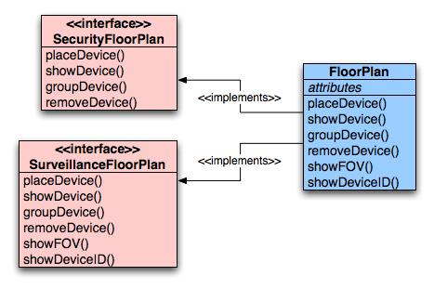
The Interface Segregation（分离） Principle
Many client-specific interfaces are better than one general purpose interface.

Slide 22
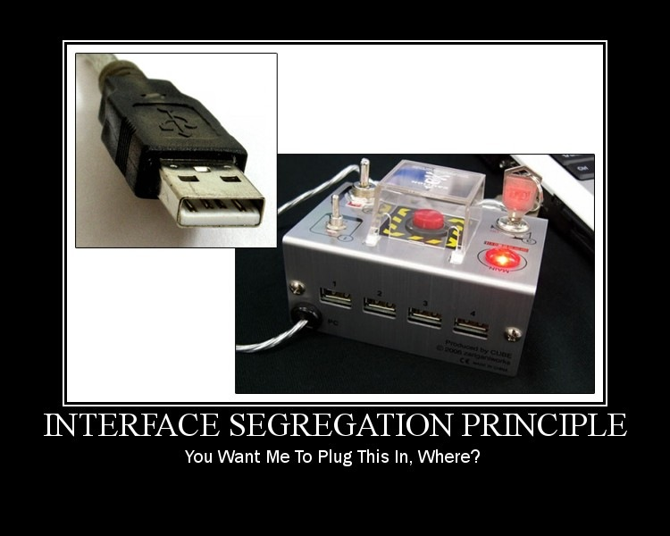
You want me to plug this in, where?

Slide 23
The Release Reuse Equivalency Principle
The granule（粒度） of reuse is the granule of release
Designing components for reuse requires more than good technical design.
It also requires effective configuration control mechanisms.

Slide 24
The Common Closure Principle
Classes that change together belong together.
Classes should be packaged cohesively.
This leads to more effective change control and release management.

Slide 25
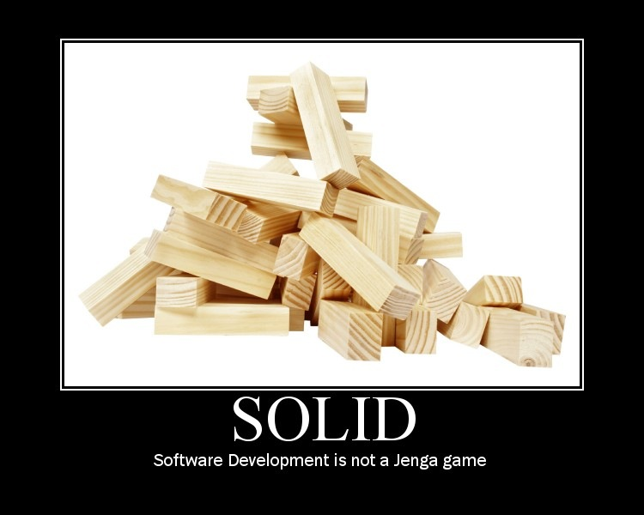
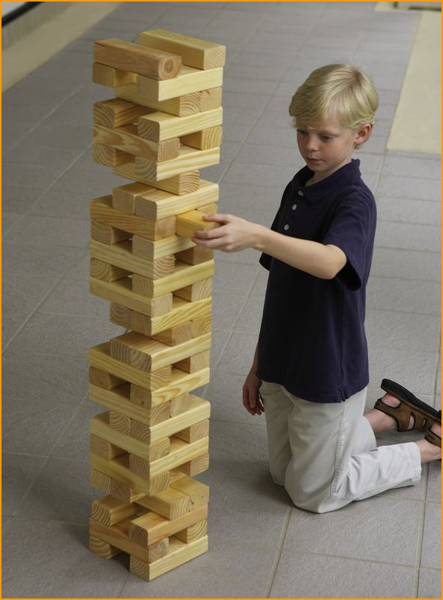
The Common Reuse Principle
Classes that are not reused together should not be grouped together.

Slide 26
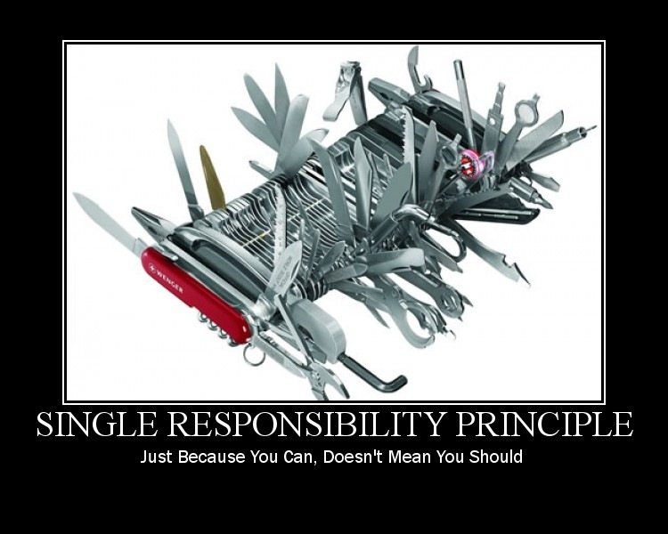
Single Responsibility Principle
Just because you can, doesn’t mean you should.

Slide 27
Component-level Design Guidelines
What should we consider when we name components?
Components
Naming conventions should be established for components that are specified as part of the architectural model and then refined and elaborated as part of the component-level model
Interfaces
Interfaces provide important information about communication and collaboration (as well as helping us to achieve the OCP)
Dependencies and Inheritance
it is a good idea to model dependencies from left to right and inheritance from bottom (derived classes) to top (base classes).

Slide 28
Cohesion
Conventional view:
the “single-mindedness” of a module
OO view:
cohesion implies that a component or class encapsulates only attributes and operations that are closely related to one another and to the class or component itself
Levels of cohesion
Functional
Layer
Communicational
Sequential
Procedural
Temporal
utility
Strong
Weak
© 2010 Sichuan University All rights reserved. | Confidential

Slide 29
The elements of a module are directed to perform the same task.
Goal: as cohesive as possible.

Slide 30
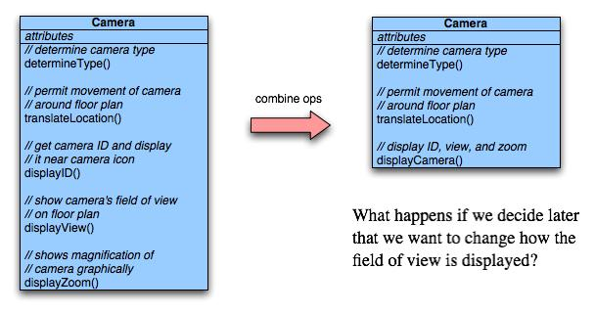
Functional Cohesion
Typically applies to operations. Occurs when a module performs one and only one computation and then returns a result.

Slide 31
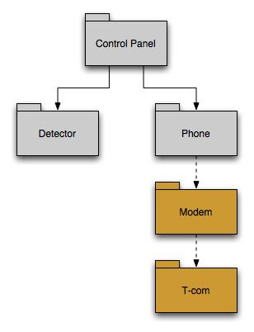
Layer Cohesion
Applies to packages, components, and classes.
Occurs when a higher layer can access a lower layer, but lower layers do not access higher layers.

Slide 32
Communicational Cohesion
All operations that access the same data are defined within one class.
In general, such classes focus solely on the data in question, accessing and storing it.
Example: A Student-Record class that adds, removes, updates, and accesses various fields of a student record for client components.

Slide 33
例1：从同一磁带上读取不相干的数据
—— 可能破坏独立性。
例2：

Slide 34
Coupling
Conventional view:
The degree to which a component is connected to other components and to the external world
OO view:
a qualitative measure of the degree to which classes are connected to one another
Level of coupling
Content
Common
Control
Stamp
Data
Routine call
Type use
Inclusion or import
External
Strong
Weak
© 2010 Sichuan University All rights reserved. | Confidential

Slide 35
Coupling is a measure of interconnection among modules in a software structure. (Yourdon & Constantine,1978)

Slide 36
Content Coupling
Occurs when one component “surreptitiously（秘密地） modifies data that is internal to another component”
Violates information hiding
public class StudentRecord {
private String name;
private int[ ] quizScores;
public String getName() {
return name;
}
public int getQuizScore(int n) {
return quizScores[n];
}
public int[ ] getAllQuizScores() {
return quizScores;
}
….

Slide 37
例1：A访问C的内部数据或不通过正常入口而转入C的内部。
……
A
B
A:
…………
…………
goto C1
…………
…………
C
D
C:
…………
…………
C1:
……
……

Slide 38
例2：部分代码重叠（常出现在汇编程序中）
A
B
A:
………………
………………
entry 1:
………………
………………
entry 2:
………………
………………
例3：一个模块有多个入口（功能）
☹ The least desirable

Slide 39
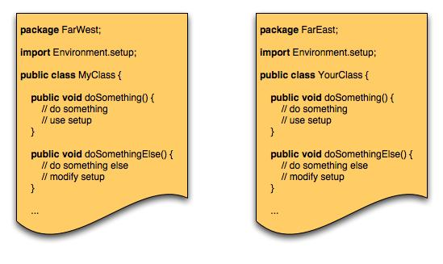
Common Coupling
Occurs when a number of components all make use of a global variable.

Slide 40
Data are accessible from a common data store.
Global : V1
V2
Global : V1
V2
A:
…………
…………
A1=V1+V2
…………
…………
B:
…………
…………
V1=B1
…………
…………
A:
…………
…………
V1++
…………
…………
B:
…………
…………
V2=B1+V1
…………
…………
问题：♣ 公共部分的改动将影响所有调用它的模块；
♣ 公共部分的数据存取无法控制；
♣ 复杂程度随耦合模块的个数增加而增加。

Slide 41
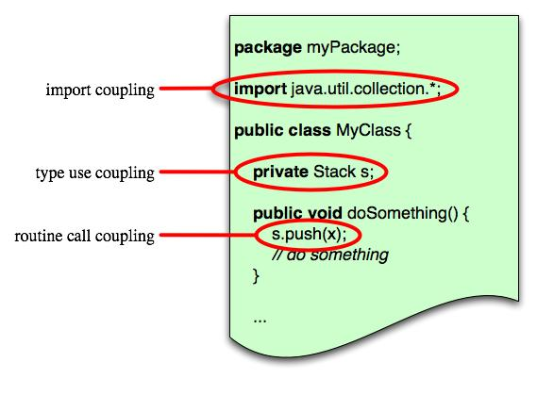
Routine Call Coupling
Certain types of coupling occur routinely in object-oriented programming.
Occurs when one operation invokes another.

Slide 42
Overview
What Is a Component
Designing Class-Based Components
Basic Design Principles
Comp. Level Design Guidelines
Cohesion and Coupling
Conducting Comp. Level Design
Steps of Comp. Level Design
Object Constraint Language
Designing Conventional Components

Slide 43
Component Level Design-I
Step 1. Identify all design classes that correspond to the problem domain.
Step 2. Identify all design classes that correspond to the infrastructure domain.
Step 3. Elaborate all design classes that are not acquired as reusable components.
Step 3a. Specify message details when classes or component collaborate.
Step 3b. Identify appropriate interfaces for each component.
© 2010 Sichuan University All rights reserved. | Confidential

Slide 44
Component Level Design-II
Step 3c. Elaborate attributes and define data types and data structures required to implement them.
Step 3d. Describe processing flow within each operation in detail.
Step 4. Describe persistent data sources (databases and files) and identify the classes required to manage them.
Step 5. Develop and elaborate behavioral representations for a class or component.
Step 6. Elaborate deployment diagrams to provide additional implementation detail.
Step 7. Factor every component-level design representation and always consider alternatives.
© 2010 Sichuan University All rights reserved. | Confidential

Slide 45
Steps 1 & 2 – Identify Classes
Most classes from the problem domain are analysis classes created as part of the analysis model
The infrastructure design classes are introduced as components during architectural design

Slide 46
Step 3 – Class Elaboration
Specify message details when classes or components collaborate
Identify appropriate interfaces for each component
Elaborate attributes and define data structures required to implement them
Describe processing flow within each operation in detail

Slide 47
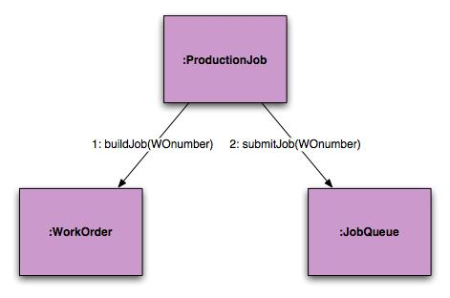
3a. Collaboration Details
Messages can be elaborated by expanding their syntax in the following manner:
[guard condition] sequence expression (return value) :=
message name (argument list)

Slide 48
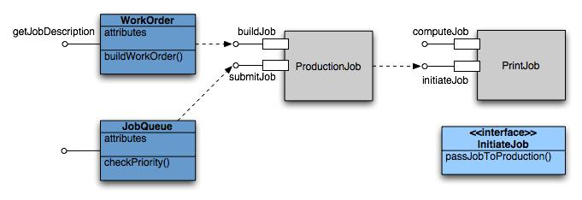
3b. Appropriate Interfaces

Slide 49
3c. Elaborate Attributes
Analysis classes will typically only list names of general attributes (ex. PaperType).
List all attributes during component design.
UML syntax:
name : type-expression = initial-value { property string }
For example, paperType can be broken into weight, size, and color. The weight attribute would be:
paperType-weight: string =
“A” { contains 1 of 4 values – A, B, C, or D }

Slide 50
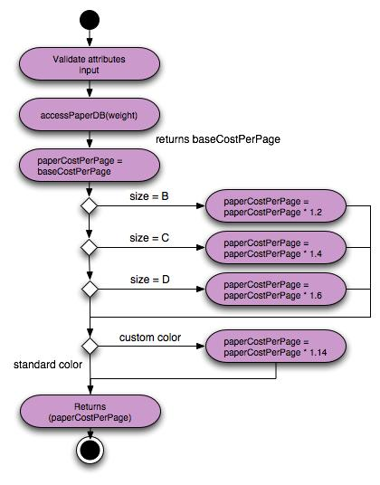
3d. Describe Processing Flow
Activity diagram for computePaperCost( )
computePaperCost (weight, size, color): numeric

Slide 51

Step 4 – Persistent Data
Describe persistent data sources (databases and files) and identify the classes required to manage them.

Slide 52
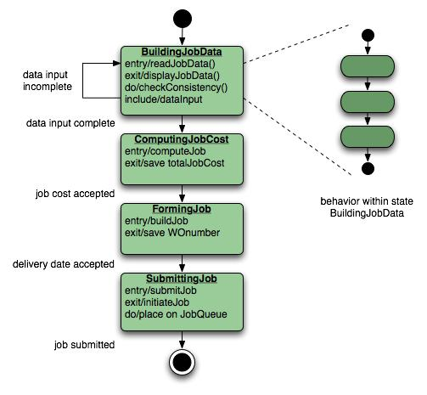
Step 5 – Elaborate Behavior
It is sometimes necessary to model the behavior of a design class.
Transitions from state to state have the form:
Event-name (parameter-list) [guard-condition] / action expression

Slide 53
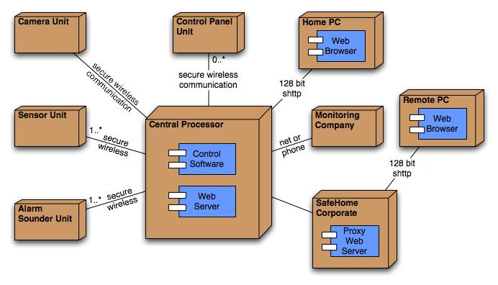
Step 6 – Elab. Deployment
Deployment diagrams are elaborated to represent the location of key packages or components.

Slide 54
Step 7 – Redesign/Reconsider
The first component-level model you create will not be as complete, consistent, or accurate as the n^{th} iteration you apply to the model.
The best designers will consider many alternative design solutions before settling on the final design model.

Slide 55
Overview
What Is a Component
Designing Class-Based Components
Basic Design Principles
Comp. Level Design Guidelines
Cohesion and Coupling
Conducting Comp. Level Design
Steps of Comp. Level Design
Object Constraint Language
Designing Conventional Components

Slide 56
Object Constraint Language (OCL)
complements UML by allowing a software engineer to use a formal grammar and syntax to construct unambiguous statements about various design model elements
simplest OCL language statements are constructed in four parts:
a context that defines the limited situation in which the statement is valid;
a property that represents some characteristics of the context (e.g., if the context is a class, a property might be an attribute)
an operation (e.g., arithmetic, set-oriented) that manipulates or qualifies a property, and
keywords (e.g., if, then, else, and, or, not, implies) that are used to specify conditional expressions.
© 2010 Sichuan University All rights reserved. | Confidential

Slide 57
OCL Example
context PrintJob::validate(upperCostBound : Integer, custDeliveryReq :
Integer)
pre: upperCostBound > 0
and custDeliveryReq > 0
and self.jobAuthorization = 'no'
post: if self.totalJobCost <= upperCostBound
and self.deliveryDate <= custDeliveryReq
then
self.jobAuthorization = 'yes'
endif
© 2010 Sichuan University All rights reserved. | Confidential

Slide 58
Overview
What Is a Component
Designing Class-Based Components
Basic Design Principles
Comp. Level Design Guidelines
Cohesion and Coupling
Conducting Comp. Level Design
Steps of Comp. Level Design
Object Constraint Language
Designing Conventional Components

Slide 59
Algorithm Design
the closest design activity to coding
the approach:
review the design description for the component
use stepwise refinement to develop algorithm
use structured programming to implement procedural logic
use ‘formal methods’ to prove logic
© 2010 Sichuan University All rights reserved. | Confidential

Slide 60
Stepwise Refinement
open
walk to door;
reach for knob;
open door;
repeat until door opens
turn knob clockwise;
walk through;
if knob doesn't turn, then
close door.
take key out;
find correct key;
insert in lock;
endif
pull/push door
move out of way;
end repeat
© 2010 Sichuan University All rights reserved. | Confidential

Slide 61
Algorithm Design Model
represents the algorithm at a level of detail that can be reviewed for quality
options:
graphical (e.g. flowchart, box diagram)
pseudocode (e.g., PDL) ... choice of many
programming language
decision table
conduct walkthrough to assess quality
© 2010 Sichuan University All rights reserved. | Confidential

Slide 62
Structured Programming for Procedural Design
uses a limited set of logical constructs:
sequence
conditional — if-then-else, select-case
loops — do-while, repeat until
leads to more readable, testable code can be used in conjunction with ‘proof of correctness’
important for achieving high quality, but not enough
© 2010 Sichuan University All rights reserved. | Confidential

Slide 63
A Structured Procedural Design

Slide 64
Program Flow Chart (PFC)
Program Flow Chart (PFC)
sequence
case
selection
while loop
until loop

Slide 65
Box Diagram / N-S Chart

Slide 66
An Example

Slide 67
Problem Analysis Diagram ( PAD)

Slide 68
Example: From N-S Chart to PAD(1)

Slide 69
Example: From N-S Chart to PAD (2)

Slide 70
Tabular Design Notation
Decision table organization:
a list of all conditions
a list of all actions
a set of processing rule

Slide 71
Decision Table
© 2010 Sichuan University All rights reserved. | Confidential

Slide 72
The steps of developing a decision table
List all actions that can be associated with a specific procedure;
List all conditions during execution of the procedure
Associate specific sets of conditions with specific actions eliminating impossible combinations of conditions; alternatively, develop every possible permutation of conditions;
Define rules by indicating what action(s) occurs for a set of conditions.

Slide 73
An Example of Decision Table (1)
例：航空行李托运费的算法
按规定：
重量不超过30公斤的行李可免费托运。重量超过30公斤时，对超运部分，头等舱国内乘客收4元/公斤；其它舱位国内乘客收6元/公斤；外国乘客收费为国内乘客的2倍；残疾乘客的收费为正常乘客的1/2。

Slide 74
An Example of Decision Table (2)
Rules
Rule numbers →
Condition rows
Action rows

Slide 75
An Example of Decision Tree
残疾乘客
(W-30) × 2
头等舱
正常乘客
(W-30) × 4
国内乘客
残疾乘客
(W-30) × 3
行李重量W > 30
其他舱
正常乘客
(W-30) × 6
行李费算法
残疾乘客
(W-30) × 4
头等舱
正常乘客
(W-30) × 8
外国乘客
残疾乘客
(W-30) × 6
其他舱
行李重量W ≤ 30
正常乘客
(W-30) × 12
免费
注：判定表与判定树并不适用于作为一种通用的设计工具，通常将之用于辅助测试
用判定树表示计算行李费的算法

Slide 76
Folder
记录模块开发过程的文档。建议各组建立自己的文件夹。
项目名称： 模块名称：
开发人员： 完成日期：
模块简述：

Slide 77
Program Design Language (PDL)
© 2010 Sichuan University All rights reserved. | Confidential

Slide 78
Why Program Design Language?

Slide 79
An Example
Internal
statements
PROCEDURE spell_check IS
BEGIN
Split document into single words
Look up words in dictionary
Display words which are not in dictionary
Create a new dictionary
END spell_check
External
statements

Slide 80
The Attributes of Design Notation
Modularity
Overall simplicity
Ease of editing
Machine readability
Maintainability
Structure enforcement
Automatic processing
Data representation
logic verification
“ Code-to” ability

Slide 81
Comparison of Design Natation
流程图
Ｎ－Ｓ图
ＰＡＤ图
ＰＤＬ语言
决策表
（树）
容易使用
好
好
好
很好
尚好
逻辑表示
尚好
好
好
好
很好
易编码
尚好
好
好
很好
好
易维护
不好
不好
尚好
好
好
自动处理
不好
不好
尚好
很好
很好
结构化构造
不好
很好
好
好
不适用
数据表示
不好
不好
不好
好
不好
块结构
不好
好
尚好
好
不适用
逻辑验证
不好
尚好
尚好
尚好
很好
使用频率
高
低
低
中等
低

Slide 82
Exercise
In the context of object-oriented software engineering a component contains
attributes and operations
instances of each class
roles for each actor (device or user)
a set of collaborating classes
Answer: d
In traditional software engineering, modules must serve in which of the following roles?
Control component
Infrastructure component
Problem domain component
All of the above
Answer: d
Which of the following is not one of the four principles used to guide component-level design?
Dependency Inversion Principle
Parsimonious Complexity Principle
Interface Segregation Principle
Open-Closed Principle
Answer: b
Classes and components that exhibit functional, layer, or communicational cohesion are relatively easy to implement, test, and maintain. Answer: a
True
False
© 2010 Sichuan University All rights reserved. | Confidential

Slide 83
Exercise
5. In component design, elaboration does not require which of the following elements to be described in detail?
Source code
Attributes
Interfaces
Operations
b, c and d
Answer: a
6. In component-level design "persistent data sources" refer to Answer: e
Component libraries
Databases
Files
All of the above
Both b and c
7. The object constraint language (OCL) complements UML by allowing a software engineer to use a formal grammar to construct unambiguous statements about design model elements.
True
False
Answer: a
8. Which of these criteria are useful in assessing the effectiveness of a particular design notation?
a. maintainability b. modularity c. simplicity d. size e. a, b, and c
Answer: e
© 2010 Sichuan University All rights reserved. | Confidential

Slide 84
Performing User Interface Design
Software Engineering: A Practitioner’s Approach
by Roger S. Pressman

Slide 85
Overview
The Golden Rules
User Interface Analysis and Design
Interface Analysis and Design Models
The Process
Interface Analysis
User Analysis
Task Analysis and Modeling
Analysis of Display Content
Analysis of the Work Environment
Interface Design Steps
Design Evaluation

Slide 86
User Interface Design
Design of the interface between a human and the computer
Easy to learn?
Easy to use?
Easy to understand?
© 2010 Sichuan University All rights reserved. | Confidential

Slide 87
User Interface Design
Typical Design Errors
lack of consistency
too much memorization
no guidance / help
no context sensitivity
poor response
Arcane/unfriendly
© 2010 Sichuan University All rights reserved. | Confidential

Slide 88
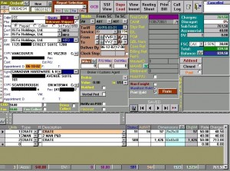
Bad GUI Design!

Slide 89
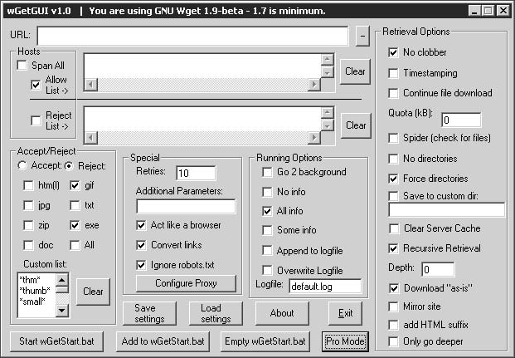
Bad Example - Functional overload (a programmer probably designed this one)
Bad GUI Design!

Slide 90
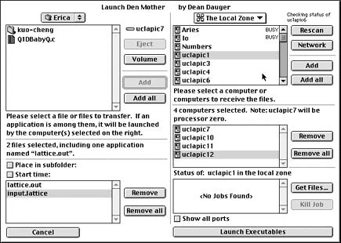
Bad GUI Design!

Slide 91
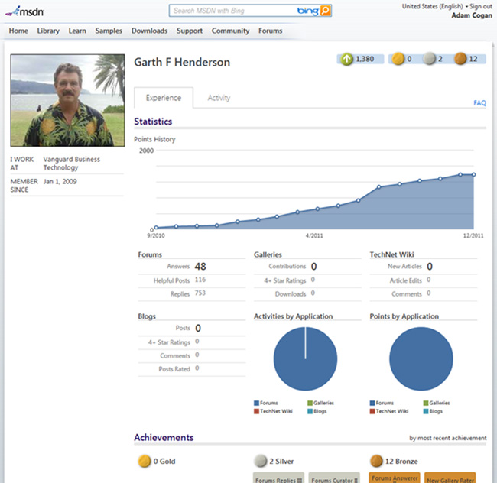
Good GUI Design!

Slide 92

Golden Rules (By Theo Mandel)
Place the user in control
Reduce the user’s memory load
Make the interface consistent
© 2010 Sichuan University All rights reserved. | Confidential

Slide 93
Place the User in Control
是界面控制用户，还是用户控制界面？
Define interaction modes in a way that does not force a user into unnecessary or undesired actions.
Provide for flexible interaction.
Allow user interaction to be interruptible and undoable.
Streamline interaction as skill levels advance and allow the interaction to be customized.
Hide technical internals from the casual user.
Design for direct interaction with objects that appear on the screen.

Slide 94
Reduce the User’s Memory Load
Reduce demand on short-term memory.
Establish meaningful defaults.
Define shortcuts that are intuitive. (Alt+P)
The visual layout of the interface should be based on a real world metaphor.
Disclose information in a progressive fashion.
What should we do to reduce the memory?

Slide 95
Make the Interface Consistent
Allow the user to put the current task into a meaningful context.
Maintain consistency across a family of applications.
If past interactive models have created user expectations, do not make changes unless there is a compelling reason to do so.
© 2010 Sichuan University All rights reserved. | Confidential

Slide 96
Overview
The Golden Rules
User Interface Analysis and Design
Interface Analysis and Design Models
The Process
Interface Analysis
User Analysis
Task Analysis and Modeling
Analysis of Display Content
Analysis of the Work Environment
Interface Design Steps
Design Evaluation

Slide 97
User Interface Design Models
User model — a profile of all end users of the system
Design model — a design realization of the user model
Mental model (system perception) — the user’s mental image of what the interface is
Implementation model — the interface “look and feel” coupled with supporting information that describe interface syntax and semantics
© 2010 Sichuan University All rights reserved. | Confidential

Slide 98
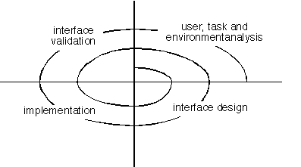
User Interface Design Process
4
1
3
2

Slide 99
Overview
The Golden Rules
User Interface Analysis and Design
Interface Analysis and Design Models
The Process
Interface Analysis
User Analysis
Task Analysis and Modeling
Analysis of Display Content
Analysis of the Work Environment
Interface Design Steps
Design Evaluation

Slide 100
Interface Analysis
Interface analysis means understanding
(1) the people (end-users) who will interact with the system through the interface;
(2) the tasks that end-users must perform to do their work
(3) the content that is presented as part of the interface
(4) the environment in which these tasks will be conducted.

Slide 101
A set of Questions (end-users)
Are users trained professionals, technician, clerical, or manufacturing workers?
What level of formal education does the average user have?
Are the users capable of learning from written materials or have they expressed a desire for classroom training?
Are users expert typists or keyboard phobic?
What is the age range of the user community?
Will the users be represented predominately by one gender?
How are users compensated for the work they perform?
Do users work normal office hours or do they work until the job is done?
Is the software to be an integral part of the work users do or will it be used only occasionally?
What is the primary spoken language among users?
What are the consequences if a user makes a mistake using the system?
Are users experts in the subject matter that is addressed by the system?
Do users want to know about the technology the sits behind the interface?
© 2010 Sichuan University All rights reserved. | Confidential

Slide 102
Task Analysis and Modeling(1)
Task Analysis answers the following questions …
What work will the user perform in specific circumstances?
What tasks and subtasks will be performed as the user does the work?
What specific problem domain objects will the user manipulate as work is performed?
What is the sequence of work tasks—the workflow?
What is the hierarchy of tasks?

Slide 103
Task Analysis and Modeling(2)
Use-cases define basic interaction
Task elaboration refines interactive tasks
Object elaboration identifies interface objects (classes)
Workflow analysis defines how a work process is completed when several people (and roles) are involved
Hierarchical representation

Slide 104
Swimlane Diagram

Slide 105
Analysis of Display Content
Are different types of data assigned to consistent geographic locations on the screen (e.g., photos always appear in the upper right hand corner)?
Can the user customize the screen location for content?
Is proper on-screen identification assigned to all content?
If a large report is to be presented, how should it be partitioned for ease of understanding?
Will mechanisms be available for moving directly to summary information for large collections of data.
Will graphical output be scaled to fit within the bounds of the display device that is used?
How will color to be used to enhance understanding?
How will error messages and warning be presented to the user?
© 2010 Sichuan University All rights reserved. | Confidential

Slide 106
Overview
The Golden Rules
User Interface Analysis and Design
Interface Analysis and Design Models
The Process
Interface Analysis
User Analysis
Task Analysis and Modeling
Analysis of Display Content
Analysis of the Work Environment
Interface Design Steps
Design Evaluation

Slide 107
Interface Design Steps
Using information developed during interface analysis (SEPA, Section 12.3), define interface objects and actions (operations).
Define events (user actions) that will cause the state of the user interface to change. Model this behavior.
Depict each interface state as it will actually look to the end-user.
Indicate how the user interprets the state of the system from information provided through the interface.
© 2010 Sichuan University All rights reserved. | Confidential

Slide 108
Interface Design
Accesses the SafeHome system
Enters an ID and password to allow remote access
Checks system status
Arms or disarms SafeHome system
Displays fl oor plan and sensor locations
Displays zones on fl oor plan
Changes zones on fl oor plan
Displays video camera locations on floor plan
Selects video camera for viewing
Views video images (four frames per second)
Pans or zooms the video camera
© 2010 Sichuan University All rights reserved. | Confidential

Slide 109
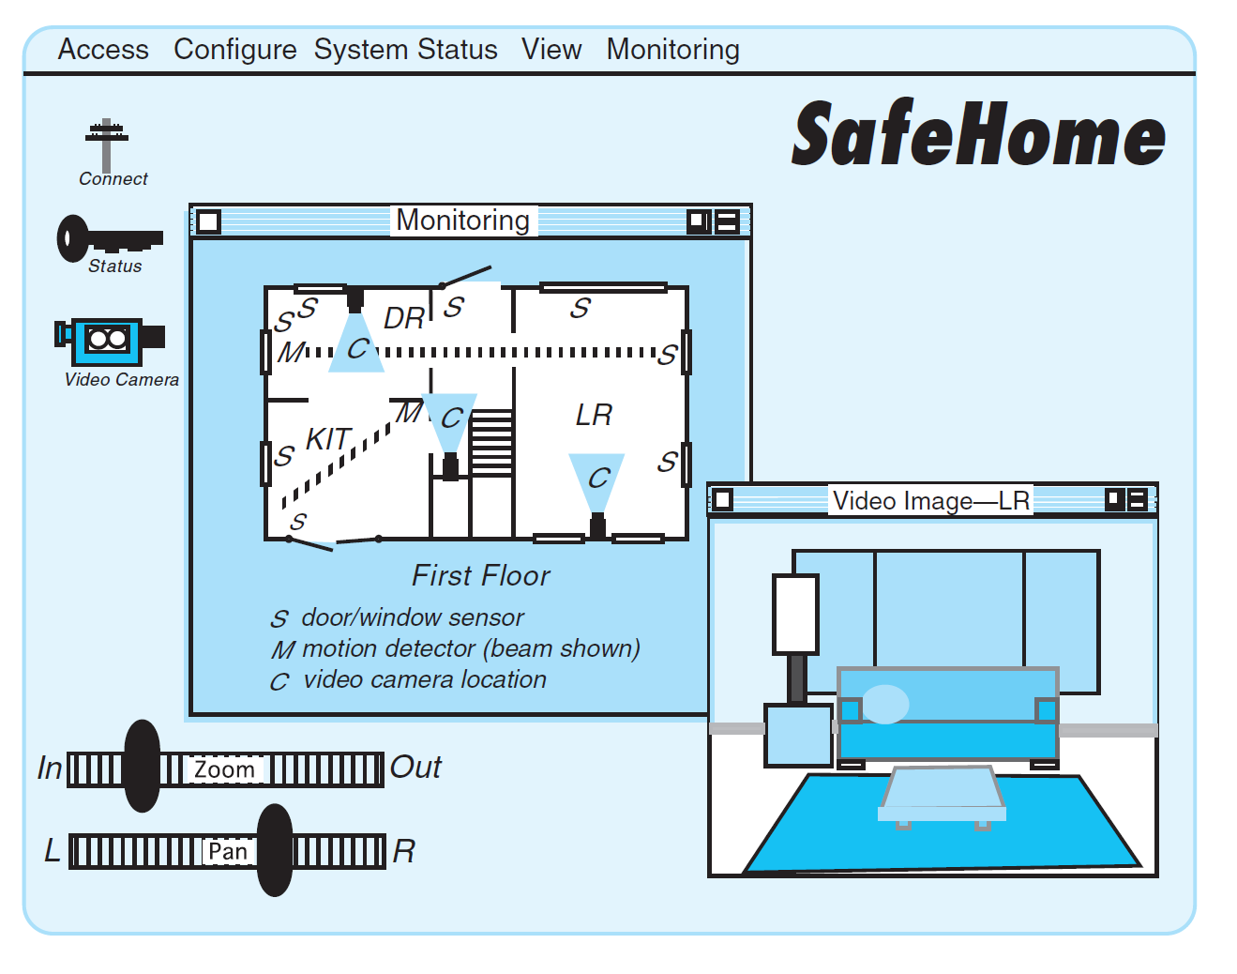

Slide 110
Interface Design Patterns
Patterns are available for
The complete UI
Page layout
Forms and input
Tables
Direct data manipulation
Navigation
Searching
Page elements
e-Commerce
www.hcipatterns.org
© 2010 Sichuan University All rights reserved. | Confidential

Slide 111
Overview
The Golden Rules
User Interface Analysis and Design
Interface Analysis and Design Models
The Process
Interface Analysis
User Analysis
Task Analysis and Modeling
Analysis of Display Content
Analysis of the Work Environment
Interface Design Steps
Design Evaluation

Slide 112
Design Issues
Response time
Help facilities
Error handling
Menu and command labeling
Application accessibility
Internationalization
© 2010 Sichuan University All rights reserved. | Confidential

Slide 113
Design Evaluation Cycle
© 2010 Sichuan University All rights reserved. | Confidential

Slide 114
Evaluation Criteria
The amount of learning required by user of the system
The length and complexity of the written specification of the system and its interface
Interaction time and the overall efficiency of the system
The number of user tasks specified and the average number of actions per task
The memory load on users of the system
The number of actions, tasks, and system states indicated by the design model
the complexity of the interface and the degree to which it will be accepted by the user
Interface style, help facilities, and error handling protocol provide a general indication of

Slide 115
Interface Design Inspiration（灵感）

Slide 116
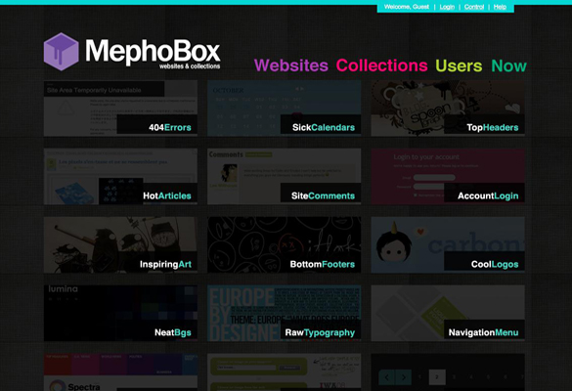

Slide 117
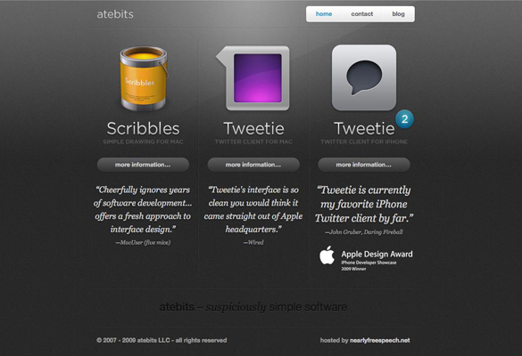

Slide 118


Slide 119
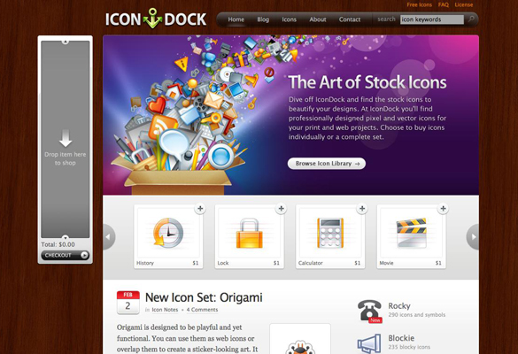

Slide 120
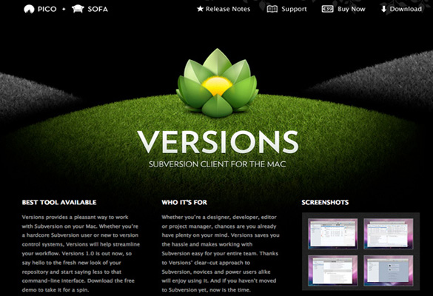

Slide 121


Slide 122
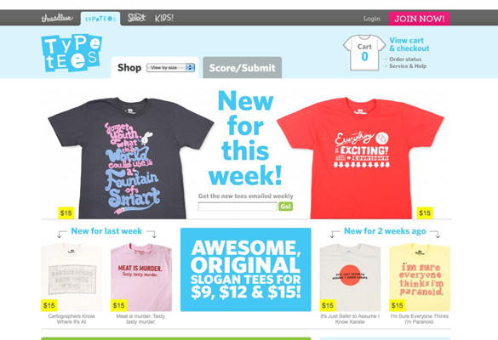

Slide 123


Slide 124


Slide 125
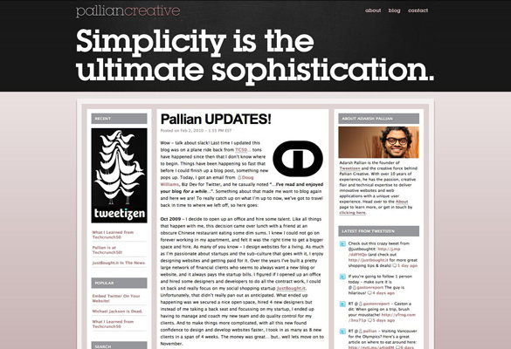

Slide 126
Interface Design Libraries

Slide 127
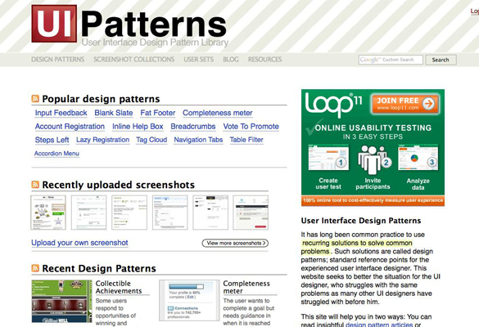
1.) UI Patterns

Slide 128
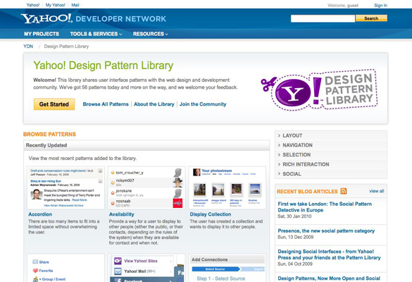
2.) Yahoo! Design Pattern Library

Slide 129
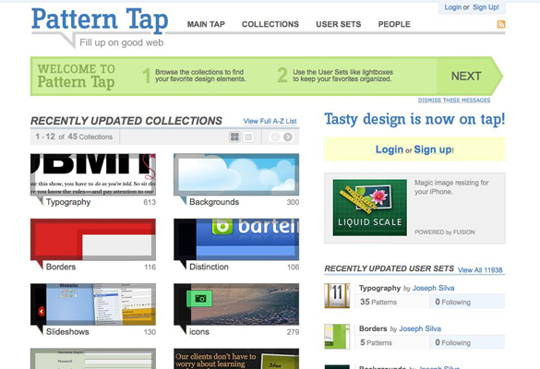
3.) PatternTap

Slide 130
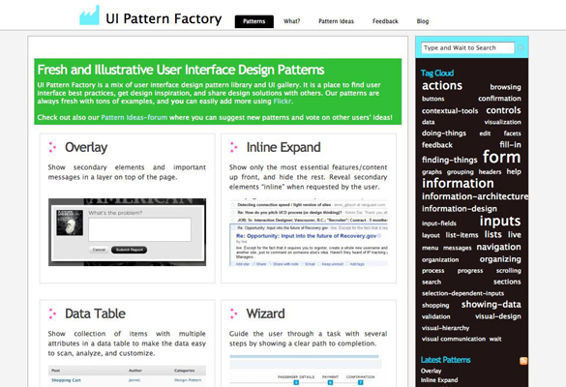
4.) The UI Pattern Factory

Slide 131
GUI Design Tools

Slide 132
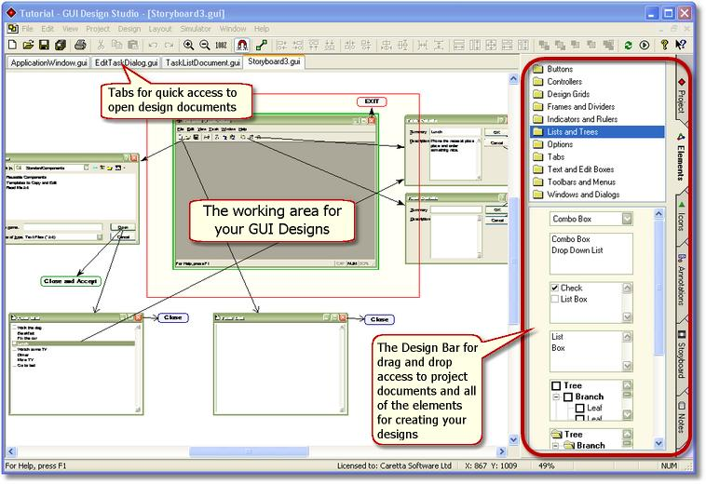
GUI Design Studio

Slide 133
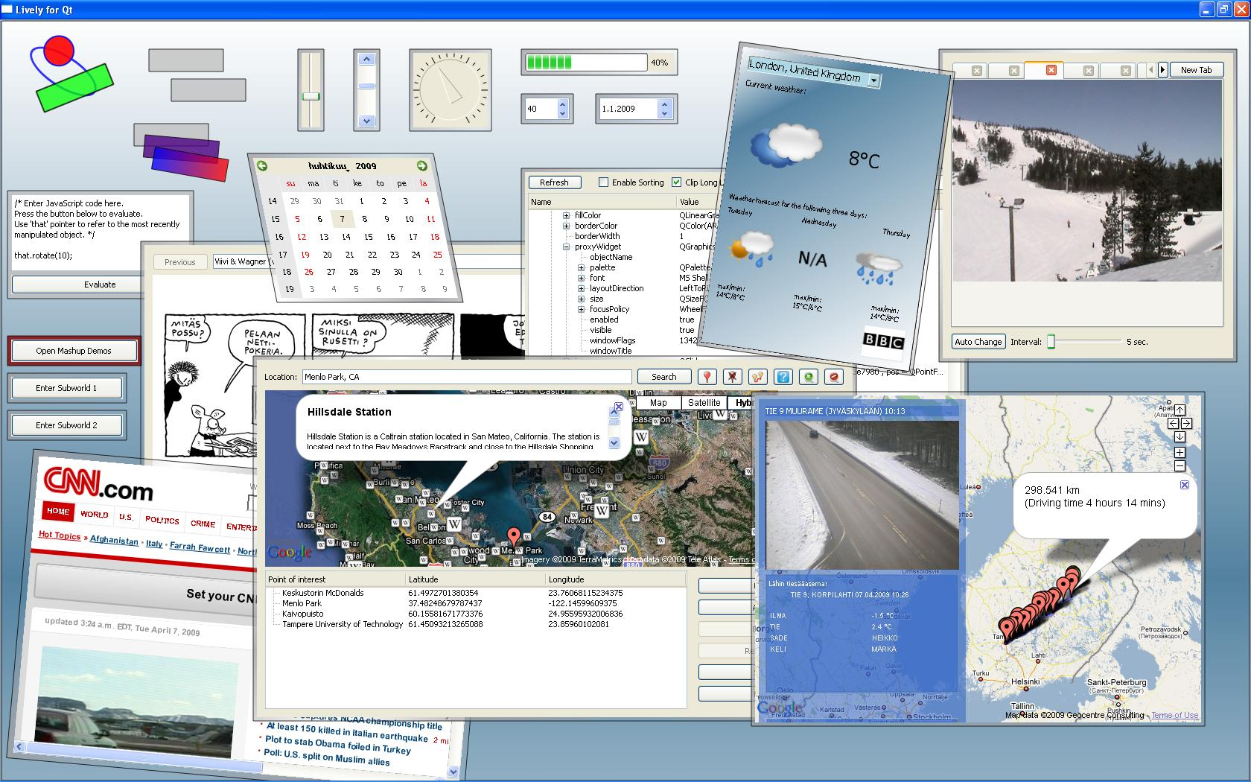
QT / QT Designer

Slide 134
Exercise ( for class 8,9 )
Which of the following interface design principles does not allow the user to remain in control of the interaction with a computer? Answer: d
allow interaction to interruptible
allow interaction to be undoable
hide technical internals from casual users
only provide one defined method for accomplishing a task
Which of the following interface design principles reduces the user's memory load? Answer: e
define intuitive shortcuts
disclose information in a progressive fashion
establish meaningful defaults
provide an on-line tutorial
answers a, b and c
Interface consistency implies that Answer: e
each application should have its own distinctive look and feel
input mechanisms remain the same throughout the application
navigational methods are context sensitive
visual information is organized according to a design standard
both b and d
The reason for reducing the user's memory load is make his or her interaction with the computer quicker to complete. Answer: b
True
False
© 2010 Sichuan University All rights reserved. | Confidential

Slide 135
Exercise (for class 8,9)
5. Which model depicts the profile of the end users of a computer system? Answer: c
design model
implementation model
user model
user's model
6. Which of these framework activities is not normally associated with the user interface design processes? Answer: a
cost estimation
interface construction
interface validation
user and task analysis
7. Which approach(es) to user task analysis can be useful in user interface design? Answer: e
have users indicate their preferences on questionnaires
rely on the judgement of experienced programmers
study existing computer-based solutions
observe users performing tasks manually
both c and d
8. Several usability measures can be collected while observing users interacting with a computer system including Answer: e
a. down time for the application b. number of user errors
c. software reliability d. time spent looking at help materials
e. both b and d
© 2010 Sichuan University All rights reserved. | Confidential

Slide 136
Exercise ( for class 6,7 )
Which of the following interface design principles allow the user to remain in control of the interaction with a computer? Answer: e
allow interaction to interruptible
allow interaction to be undoable
hide technical internals from casual users
only provide one defined method for accomplishing a task
a, b and c
Which of the following interface design principles does not reduce the user's memory load?
define intuitive shortcuts
disclose information in a progressive fashion
establish meaningful defaults
provide an off-line tutorial
answers a, b and c Answer: d
Interface consistency implies that
each application should have its own distinctive look and feel
input mechanisms remain the same throughout the application
navigational methods are context sensitive
visual information is organized according to a design standard
both b and d Answer: e
If past interactive models have created certain user expectations it is not generally good to make changes to the model.
True b. False Answer: a
© 2010 Sichuan University All rights reserved. | Confidential

Slide 137
Exercise (for class 6,7)
5. Which model depicts the image of a system that an end user creates in his or her head?
design model
user model
system model
system perception Answer: d
6. Which of these framework activities is normally associated with the user interface design processes?
cost estimation
interface construction
interface validation
user and task analysis
b, c and d Answer: e
7. Which approach(es) to user task analysis can be useful in user interface design?
have users indicate their preferences on questionnaires
rely on the judgement of experienced programmers
study existing project management
observe users performing tasks manually Answer: d
8. Several common design issues surface for almost every user interface including
a. adaptive user profiles b. error handling resolution of graphics
c. response time d. displays system
e. both b and d Answer: e
© 2010 Sichuan University All rights reserved. | Confidential

