Slide 1
Testing Strategies
Software Engineering: A Practitioner’s Approach
by Roger S. Pressman

Slide 2
Three Examples
防不胜防的软件错误 ——
例1：1963年, 美国, 飞往火星的火箭爆炸, 损失$ 10 million.
原因:
FORTRAN循环 DO 5 I = 1, 3
误写为 DO 5 I = 1.3

Slide 3
Three Examples
例2：1996年，美国 Washington Post 报导
Dallas, Aug. 23 — 美国航空公司一架直升飞机撞上山崖，造成163人死亡。
原因：飞行目的地代码输入错误。
驾驶Boeing 757的机长认为他输入了目的地Cali的单字符代码，而在南美的航空资料中， Cali的单字符代码和Bogota的一样，所以系统将目的地处理成了Bogota。但在大多数计算机数据库中Cali和Bogota的代码是不同的。

Slide 4
Three Examples
例3：[摘自Pfleeger 书中的“REAL-TIME EXAMPLE”]
European Space Agency (ESA) 的Ariane-5航空运载火箭在June 4, 1996她第一次飞行中远程失控，造成火箭本身和4棵卫星损失，$500 million
原因：
其前身Ariane-4声誉良好，在开发Ariane-5时，忽略了一个需求细节， Ariane-5与Ariane-4的轨道不同。

Slide 5

Content
Software testing
Testing strategy
A testing strategy for conventional software architecture
A testing strategy for object-oriented architectures
Smoke test and high order test
Debugging strategy
© 2010 Sichuan University All rights reserved. | Confidential
5
Notes:
5

Slide 6
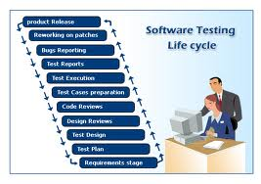
Software Testing
Testing is the process of exercising a program with the specific intent of finding errors prior to delivery to the end user.
© 2010 Sichuan University All rights reserved. | Confidential
6
Notes:
6

Slide 7
Software Testing
Software testing is a critical element of software quality assurance and represents the ultimate review of specification, design, and code generation.
© 2010 Sichuan University All rights reserved. | Confidential
7
Notes:
7

Slide 8
Why? Testing Objectives
Testing is a process of executing a program with the intent of finding an error.
A good test case is one that has a high probability of finding an as-yet （至今为止）undiscovered error.
A successful test is one that uncovers an as-yet undiscovered error.

Slide 9
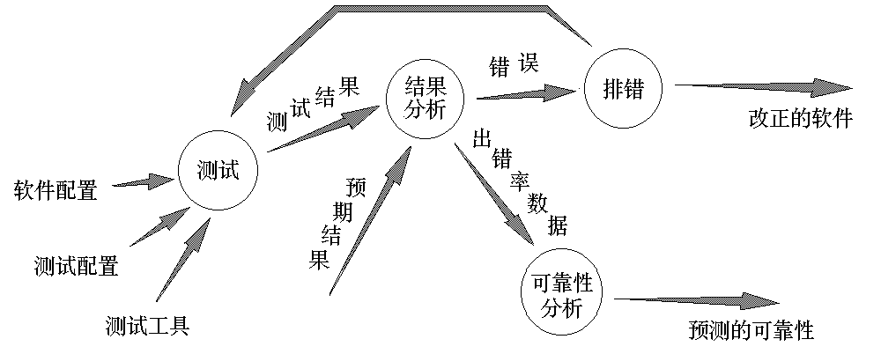
The Flow of Software Testing

Slide 10
What Testing Shows
errors
requirements conformance
performance
an indication
of quality
© 2010 Sichuan University All rights reserved. | Confidential
10
Notes:
10

Slide 11
Testing Principles
All tests should be traceable to customer requirements.
Tests should be planned long before testing begins.
The Pare-to (80% to 20%) principle applies to software testing.
Testing should begin “ in the small” and progress toward testing “ in the large”.
Exhaustive testing is not possible.
To be most effective, testing should be conducted by an independent third party.

Slide 12
Some Words Related to Testing
Defect 缺点
Fault 谬误
Problem 问题
Error 错误
Incident 毛病
Anomaly 异常
Variance 偏差
Failure 失败
Inconsistency 矛盾
Feature 特点
Bug 缺陷

Slide 13
Verification and Validation
Verification（验证） : the set of activities that ensure that software correctly implements a specific function.
Question: Are we building the product right?
Validation（确认） : a different set of activities that ensure that the software that has been built is traceable to customer requirements.
Question: Are we building the right product?

Slide 14
Software Quality Assurance (SQA)
Verification and validation encompasses a wide array of SQA activities:
Formal Technical Review
Software Engineering Methodology
Measurement
Quality
Standard and Process
Testing
SCM & SQA

Slide 15
Who Tests the Software?
developer
independent tester
Understands the system
Must learn about the system,
but, will test "gently"
but, will attempt to break it
and, is driven by "delivery"
and, is driven by quality
Notes:
15

Slide 16
Organizing for Software Testing
Software Developer:
to test the individual units of the program;
to do integration testing;
Independent Test Group (ITG):
to find errors as possible as;
Misconceptions:
The developer should do no testing at all.
The software should be tested by strangers.
The tester need not join the project before testing.

Slide 17
Software Testing Strategy and Steps
System Engineering/Information System
System Test
Software Requirements Analysis
Validation Test
Design
Integration Test
Coding
Unit Test
Software Engineering Process
Software Testing Process

Slide 18
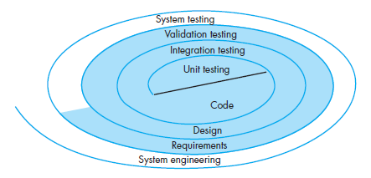
Software Testing Strategy and Steps

Slide 19
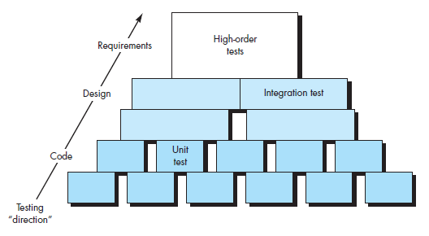
Software Testing Strategy and Steps

Slide 20
Testing Strategy
unit test
integration
test
system
test
validation
test
Notes:
20

Slide 22
Criteria for Completion of Testing
You’re never done testing; the burden simply shifts from you to your customer;
You’re done testing when you run out of time or you run out of money;
You’re done sufficient testing to say with 95% confidence ( Using statistical modeling and software reliability models );

Slide 23
Testing Strategy
We begin by ‘testing-in-the-small’ and move toward ‘testing-in-the-large’
For conventional software
The module (component) is our initial focus
Integration of modules follows
For OO software
our focus when “testing in the small” changes from an individual module (the conventional view) to an OO class that encompasses attributes and operations and implies communication and collaboration
Notes:
23

Slide 24
Strategic Issues
Specify product requirements in a quantifiable manner long before testing commences
State testing objectives explicitly.
Understand the users of the software and develop a profile for each user category.
Develop a testing plan that emphasizes “rapid cycle testing.”
Build “robust” software that is designed to test itself
Use effective formal technical reviews as a filter prior to testing
Conduct formal technical reviews to assess the test strategy and test cases themselves.
Develop a continuous improvement approach for the testing process.
Notes:
24
（1）显示陈述测试目的：使用可以测量的术语来陈述：测试的有效性/测试覆盖率/故障出现的平均时间/发现和改正缺陷的开销/允许剩余的缺陷的密度/回归测试的工作时间
（2）描述每一类用户的交互场景的Usecase通过侧重测试产品的实际用途，减少整个测试的工作量
（3）GILB建议软件工作团队”学会以对客户有用功能添加或和质量改进的快速循环测试方法进行测试（用2%的项目工作量）
（4）软件具有防错的功能，设计应当包括自动测试和回归测试
（5）持续质量改进，强调数据的收集并进行统计

Slide 25
Unit Testing

Slide 26
Questions!
What errors are commonly found during unit testing?
What errors should test case uncover?
What potential errors should be tested?

Slide 27
Unit Testing (for Conventional Software)
module
to be
tested
results
software
engineer
test cases
© 2010 Sichuan University All rights reserved. | Confidential
27
Notes:
27
以软件测试为指南，对重要的控制路径进行测试以发现模块内部的错误

Slide 28
Unit Testing (for Conventional Software)
Unit Testing
consideration
module
to be
tested
interface
local data structures
boundary conditions
independent paths
error handling paths(antibugging)
test cases
© 2010 Sichuan University All rights reserved. | Confidential
28
Notes:
28

Slide 29
Unit Test Environment
driver
interface
local data structures
Module
boundary conditions
independent paths
error handling paths
stub
stub
test cases
RESULTS
Notes:
29

Slide 30
Integration Testing

Slide 31
Integration Testing Strategies ( for conventional software)
Options:
the “big bang” approach
an incremental construction strategy
© 2010 Sichuan University All rights reserved. | Confidential
31
Notes:
31

Slide 32
Top Down Integration
A
top module is tested with
stubs
B
F
G
stubs are replaced one at
a time, "depth first"
C
as new modules are integrated,
some subset of tests is re-run
D
E
© 2010 Sichuan University All rights reserved. | Confidential
32
Notes:
32

Slide 33
The Steps of Top Down Testing (1)
第1步：测试顶端模块，用存根程序(stub)代替直接附属的下层模块
Stub: to simulate the activity of the component which is not yet tested.
M
S₁
S₂

Slide 34
The Steps of Top Down Testing (2)
第2步：根据深度优先或宽度优先的策略，每次用一个实际模块代换一个stub。
M
S₁
S₂
S₃
S₄
第3步：在结合进一个模块的同时进行测试。
第4步：回归测试(regression testing)——全部或部分地重复以前做过的测试。

Slide 35
Notes
优点：在早期即对主要控制及关键的抉择进行检验。
问题：Stub只是对低层模块的模拟，测试时没有重要的数据自下往上流，许多重要的测试须推迟进行，而且在早期不能充分展开人力。

Slide 36
Bottom-Up Integration
A
B
F
G
drivers are replaced one at a
time, "depth first"
C
worker modules are grouped into
builds and integrated
D
E
cluster
Notes:
36

Slide 37
The Steps of Bottom-Up Testing (1)
第1步：把低层模块组合成族，每族实现一个子功能。
第2步：用驱动程序(Driver)协调测试数据的I\O，测试子功能族。
Driver: to call a particular component and passes a test case to it.
D
M₁
M₂

Slide 38
The Steps of Bottom-Up Testing (2)
第3步：去掉Driver，自下而上把子功能族合成更大的子功能族。
D
M
注意：两种策略的优、缺点刚好互补，但单用其中任一种都不实际，通常根据软件的特点将二者混用。
D
D
M
M
M
D
M
D
D
M
M
M
M
M
M
M

Slide 39
Regression Testing
The re-execution testing that has already been conducted to ensure that changes have not propagated unintended side effects.
A representative sample of tests that will exercise all software function.
Additional tests that focus on software functions that are likely to be affected by the change.
Tests that focus on the software components that have been changed.
Notes:
39

Slide 40
Smoke Testing
A common approach for creating “daily builds” for product software
Smoke testing steps:
Software components that have been translated into code are integrated into a “build.”
A build includes all data files, libraries, reusable modules, and engineered components that are required to implement one or more product functions.
A series of tests is designed to expose errors that will keep the build from properly performing its function.
The intent should be to uncover “show stopper” errors that have the highest likelihood of throwing the software project behind schedule.
The build is integrated with other builds and the entire product (in its current form) is smoke tested daily.
The integration approach may be top down or bottom up.
Notes:
40
Smoke testing是一种集成测试方法，设计为一种时间关键的项目的步进机制，允许软件小组经常性地评估其软件项目。
好处：集成风险被最小化 终端产品的质量的改善 简化错误诊断和修改 进展容易评估

Slide 41
Smoke Testing
Integration risk is minimized.
The quality of the end product is improved.
Error diagnosis and correction are simplified.
Progress is easier to assess.
Notes:
41
Smoke testing是一种集成测试方法，设计为一种时间关键的项目的步进机制，允许软件小组经常性地评估其软件项目。
好处：集成风险被最小化 终端产品的质量的改善 简化错误诊断和修改 进展容易评估

Slide 42
Sandwich Testing
A
Top modules are
tested with stubs
B
F
G
C
Worker modules are grouped into
builds and integrated
D
E
cluster
Notes:
42

Slide 43
Object-Oriented Testing
begins by evaluating the correctness and consistency of the OOA and OOD models
testing strategy changes
the concept of the ‘unit’ broadens due to encapsulation
integration focuses on classes and their execution across a ‘thread’ or in the context of a usage scenario
validation uses conventional black box methods
test case design draws on conventional methods, but also encompasses special features
Notes:
43

Slide 44
OOT Strategy
class testing is the equivalent of unit testing
operations within the class are tested
the state behavior of the class is examined
integration applied three different strategies
thread-based testing—integrates the set of classes required to respond to one input or event
use-based testing—integrates the set of
classes required to respond to one use case
cluster testing—integrates the set of classes required to demonstrate one collaboration
Notes:
44

Slide 45
High Order Testing
Validation testing
Focus is on software requirements
System testing
Focus is on system integration
Alpha/Beta testing
Focus is on customer usage
Recovery testing
forces the software to fail in a variety of ways and verifies that recovery is properly performed
Security testing
verifies that protection mechanisms built into a system will, in fact, protect it from improper penetration
Stress testing
executes a system in a manner that demands resources in abnormal quantity, frequency, or volume
Performance Testing
test the run-time performance of software within the context of an integrated system
Notes:
45

Slide 46
Acceptance Testing

Slide 47
Two Kinds of Acceptance Testing
Validation Testing:
Validation Test Criteria;
Configuration Review;
Alpha and Beta Testing;
System Testing:
Recovery Testing;
Security Testing;
Stress Testing;
Performance Testing;

Slide 48
Validation Test Criteria
All functional requirements are satisfied;
All behavioral characteristics are achieved;
All performance requirements are attained;
All documentation is correct;
Usability and other requirements are met;

Slide 49
Configuration Review ( Audit )
All elements of the software configuration have been:
properly developed
are cataloged
have the necessary detail to bolster

Slide 50
α测试和β测试
Focus is on customer usage
软件是为多个用户开发的
α测试：一个用户以开发者的身份实施，
开发者通过用户来观察开发的软件， 是在受控的环境下进行的，在开发环境下进行
β测试：最终用户以一个或多个用户的身份进行的，开发者不在现场，在用户环境下进行

Slide 51
恢复测试（recovery testing)
forces the software to fail in a variety of ways and verifies that recovery is properly performed
在系统出故障后，系统能否从故障中恢复过来，并在预定的时间间隔内从新开始处理
强使软件出现故障，系统应自动恢复
如需人工干预，应估算出修复的平均时间，确定出是否可接受

Slide 52
安全性测试（security testing)
verifies that protection mechanisms built into a system will, in fact, protect it from improper penetration
系统的预防机制（预防非法入侵:窃贼，报复，非法牟利……)
安全性测试，验证系统的预防机制
测试者扮演期望侵入系统的角色，通过一切可能的措施侵入系统
测试开销可能很大

Slide 53
压力测试（stress testing)
executes a system in a manner that demands resources in abnormal quantity, frequency, or volume
在一个非正常数量，频率或容量方式下运行系统
测试者想办法破坏程序
1. 运行要求最大内存或其他资源的程序
2. 按大小递增的顺序改变输入数据的速率，看系统怎样响应
…………..

Slide 54
性能测试(performance testing)
test the run-time performance of software within the context of an integrated system
测试软件被组装进系统的环境下运行时的性能
性能测试覆盖测试过程中的每一步

Slide 55
Debugging

Slide 56
Failure and Fault
Failure（外错误）is the departure of a system from its required behavior.
Fault（故障、内错误、error、bug）is resulted by human error in some software product.
A program’s failure is clear symptom of the presence of a fault ; but not every fault corresponds to a failure , since the conditions under which a fault results in system failure may never be met.

Slide 57
The Art of Debugging
A Diagnostic Process:
Debugging Approaches:
Brute Force（强力）;
Backtracking（反向跟踪）;
Cause Elimination（排除）;

Slide 58
The Debugging Process
test cases
Execution of cases
new test
cases
results
regression
tests
suspected
causes
corrections
Debugging
identified
causes

Slide 59
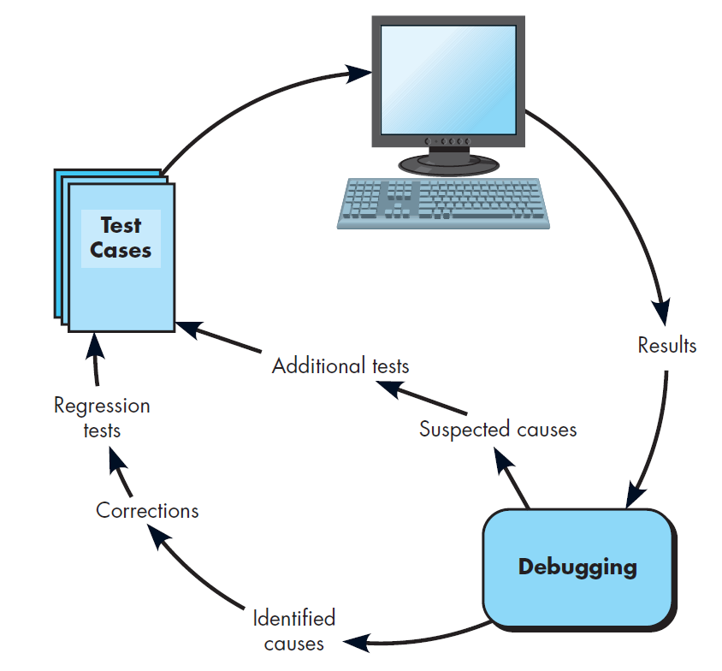
The Debugging Process

Slide 60
Debugging Effort
time required
to diagnose the
symptom and
determine the
cause
time required
to correct the error
and conduct
regression tests
Notes:
60

Slide 61
Outcome of the Debugging Process
the cause will be found and corrected
the cause will not be found. In the latter case, the person performing debugging may suspect a cause, design a test case to help that suspicion, and work toward error correction in an iterative fashion.

Slide 62
Symptoms & Causes
symptom and cause may be
geographically separated
symptom may disappear when
another problem is fixed
cause may be due to a
combination of non-errors
cause may be due to a system
or compiler error
symptom
cause may be due to
cause
assumptions that everyone
believes
symptom may be intermittent
© 2010 Sichuan University All rights reserved. | Confidential
62
Notes:
62

Slide 63
Symptoms & Causes
1. The symptom and the cause may be geographically remote. That is, the symptom may appear in one part of a program, while the cause may actually be located at a site that is far removed. Highly coupled components exacerbate this situation.
2. The symptom may disappear (temporarily) when another error is corrected.
3. The symptom may actually be caused by nonerrors (e.g., round-off inaccuracies).
4. The symptom may be caused by human error that is not easily traced

Slide 64
Symptoms & Causes
5. The symptom may be a result of timing problems, rather than processing problems.
6. It may be difficult to accurately reproduce input conditions (e.g., a real-time application in which input ordering is indeterminate).
7. The symptom may be intermittent. This is particularly common in embedded systems that couple hardware and software inextricably.
8. The symptom may be due to causes that are distributed across a number of tasks running on different processors.

Slide 65
Consequences of Bugs
infectious
damage
catastrophic
extreme
serious
disturbing
mild
annoying
Bug Type
Bug Categories:
function-related bugs,
system-related bugs, data bugs, coding bugs,
design bugs, documentation bugs, standards
violations, etc.
Notes:
65

Slide 66
Debugging Strategies
debugging has one overriding objective—to find and correct the cause of a software error or defect.
The objective is realized by a combination of systematic evaluation, intuition, and luck

Slide 67
Debugging Techniques
brute force（强力） / testing
Back tracking（反向跟踪）
Induction（归纳）
Deduction（推理）

Slide 68
Automated Debugging.
Integrated development environments (IDEs) provide a way to capture some of the language-specific predetermined errors (e.g., missing end-of-statement characters, undefined variables, and so on) without requiring compilation
A wide variety of debugging compilers, dynamic debugging aids (“tracers”), automatic test-case generators, and cross-reference mapping tools
tools are not a substitute for careful evaluation based on a complete design model and clear source code.

Slide 69
Debugging Tools
Objective: These tools provide automated assistance for those who must debug software problems. The intent is to provide insight that may be difficult to obtain if approaching the debugging process manually.
Mechanics: Most debugging tools are programming language and environment specific.

Slide 70
Debugging Tools
Representative Tools:
Borland Silkt
Coverty Development Testing Platform
C++Test
CodeMedic
GNATS

Slide 71
Correcting the Error
Is the cause of the bug reproduced in another part of the program?
What “next bug” might be introduced by the fix I'm about to make?
What could we have done to prevent this bug in the first place?

Slide 72
Debugging: Final Thoughts
1.
Don't run off half-cocked,
think
about the
symptom you're seeing.
2.
Use tools
(e.g., dynamic debugger) to gain
more insight.
3.
If at an impasse,
get help
from someone else.
4.
Be absolutely sure to
conduct regression tests
when you do "fix" the bug.
© 2010 Sichuan University All rights reserved. | Confidential
72
Notes:
72

Slide 73
Exercise
What is the normal order of activities in which traditional software testing is organized?
integration testing, unit testing, system testing, validation testing
validation testing, unit testing, integration testing, system testing
unit testing, integration testing, validation testing, system testing
system testing, validation testing, integration testing, unit testing
Which of the following strategic issues needs to be addressed in a successful software testing process?
conduct formal technical reviews prior to testing
specify requirements in a quantifiable manner
use independent test teams
wait till code is written prior to writing the test plan
answers a and b
Which of the following need to be assessed during unit testing?
algorithmic performance
code stability
error handling
execution paths
both c and d
Drivers and stubs are not needed for unit testing because the modules are tested independently of one another.
True
False
© 2010 Sichuan University All rights reserved. | Confidential
73
Notes:
73

Slide 74
Exercise
5. Top-down integration testing has as it‘s major advantage(s) that
low level modules never need testing
major decision points are tested early
no drivers need to be written
no stubs need to be written
both b and c
6. Bottom-up integration testing has as it's major advantage(s) that
major decision points are tested early
no drivers need to be written
no stubs need to be written
regression testing is not required
7. The OO testing integration strategy involves testing
groups of classes that collaborate or communicate in some way
single operations as they are added to the evolving class implementation
operator programs derived from use-case scenarios
none of the above
8. Which of the following is an approach to debugging?
a. backtracking
b. cause elimination
c. brute force
d. code restructuring
e. a, b and c
© 2010 Sichuan University All rights reserved. | Confidential
74
Notes:
74

Slide 75
Answer:c
Answer:e
Answer:e
Answer:b
Answer:e
Answer:c
Answer:a
Answer:e

