Slide 1
Level of Requirements
业务需求
项目视图与范围文档
用户需求
质量属性
其他
非功能需求
用例文档
系统需求
功能需求
约束条件
软件需求规格说明

Slide 2
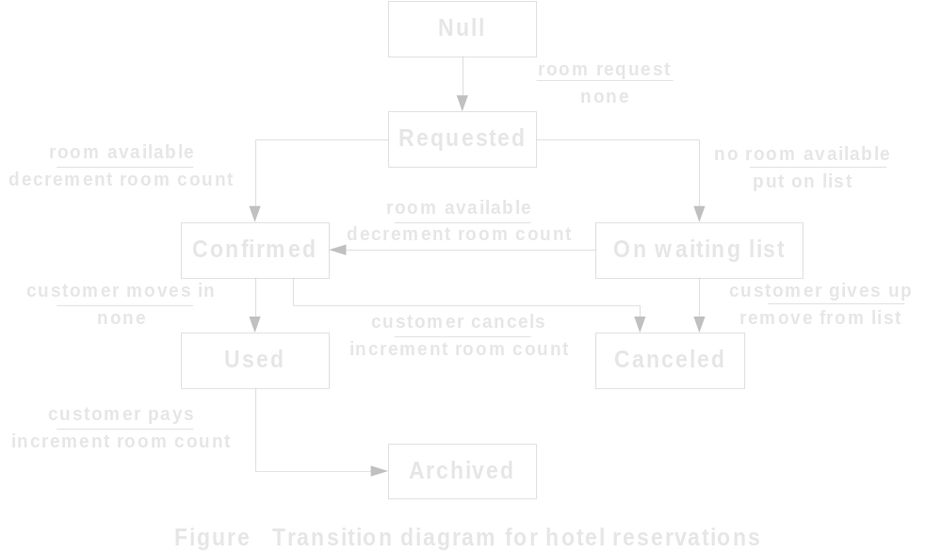
The Example of STD

Slide 3
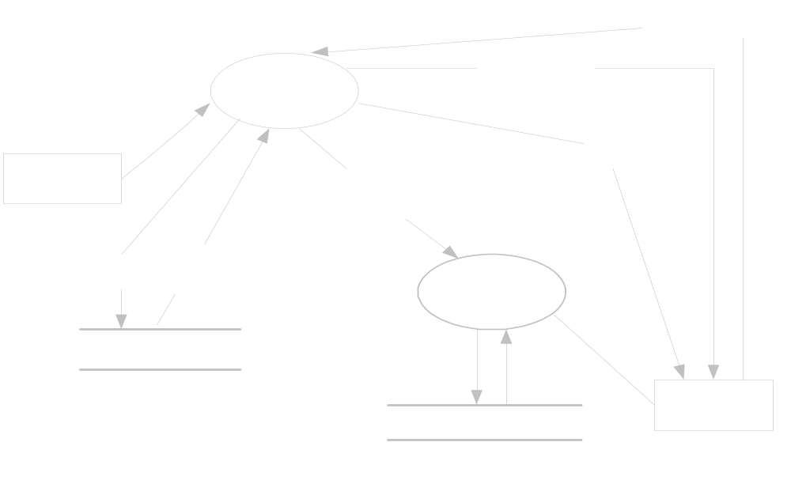
The Example of DFD
Data Flow Diagrams

Slide 4
Use Case Example
View Report Card
Student
Register for Courses
Course Catalog
Select Courses to Teach
Professor
Submit Grades
Maintain Professor Information
Login
Maintain Student Information
Registrar
Close Registration
Billing System

Slide 5
Requirements Specification Template（1）
一 引言
1 目的
2 文档约定
3 预期的读者和阅读建议
4 产品范围
5 参考文献
二 综合描述
1 产品的前景
2 产品的功能
3 用户类和特征
4 运行环境
5 设计和实现上的限制
6 假设和依赖

Slide 6
Requirements Specification Template（2）
三 外部接口需求
1 用户界面
2 硬件接口
3 软件接口
4 通信接口
四 系统特性
1 说明和优先级
2 激励/响应序列
3 功能需求

Slide 7
Requirements Specification Template（3）
五 其他非功能需求
1 性能需求
2 安全设施需求
3 安全性需求
4 软件质量属性
5 业务规则
6 用户文档
六 其他需求
附录A 词汇表
附录B 分析模型
附录C 待确定问题的列表

Slide 8
§3.概念模型和规范化
例：
Title
I D #
I D #
Name
Name
Sex
Instructor
Student
Sex
……
……
Instructor ID
Teach
Enrolled in
Grade
Class ID
Student ID
Class
Class ID
Subject
I D #
Credit

Slide 9
Example
开发一个学生成绩管理系统
  学生可以随时查询自己的成绩单
  教务人员可以通过该系统维护学生信息、课程信息和成绩信息
  系统必须提供必要的安全措施以防非法存取
步骤
  创建实体关系图
  创建数据流模型
  编写数据字典
  创建行为模型
  编写加工规格说明

Slide 10
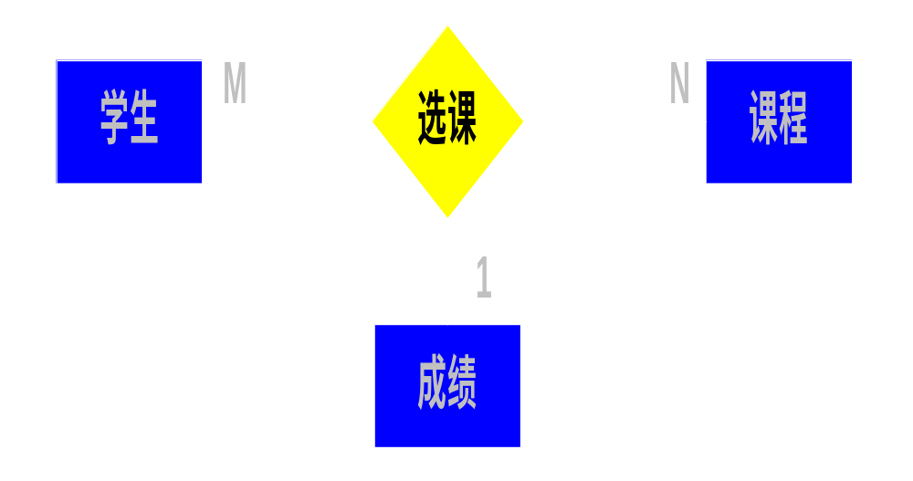
Structured Analysis Process (1)
数据建模
  实体：学生、课程、成绩
  属性：
  学生：学号、姓名、性别、出生日期、入学年月
  课程：课程编号、课程名称、课程学分、课程描述
  成绩：学号、课程编号、分数、考核日期
  ERD

Slide 11
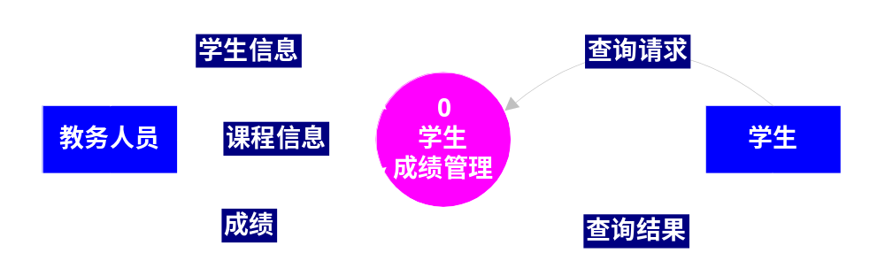
Structured Analysis Process (2)
功能建模
  第0层DFD
  教务人员维护学生信息和课程信息，并登录学生的选课成绩；
  学生查询自己的成绩单。

Slide 12
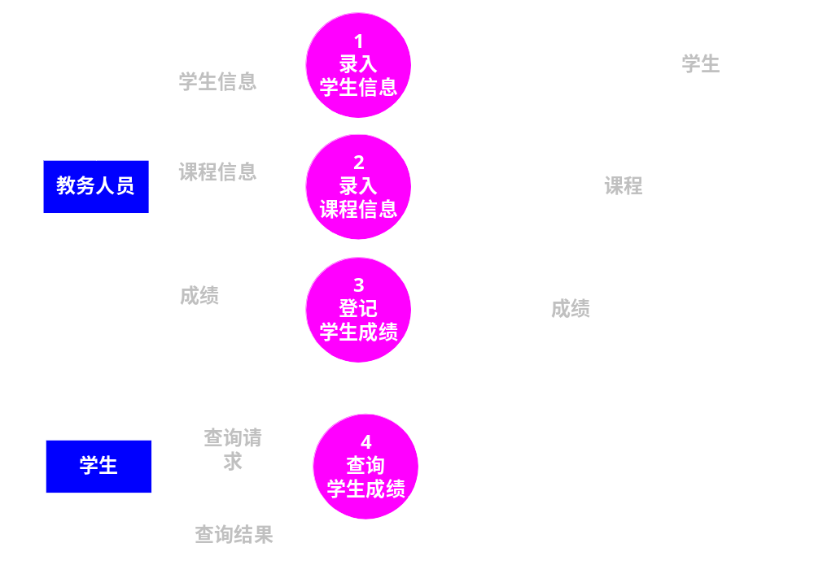
Structured Analysis Process (3)
  第1层DFD
  对第0层DFD图中的一个加工“学生成绩管理”进行展开。

Slide 13
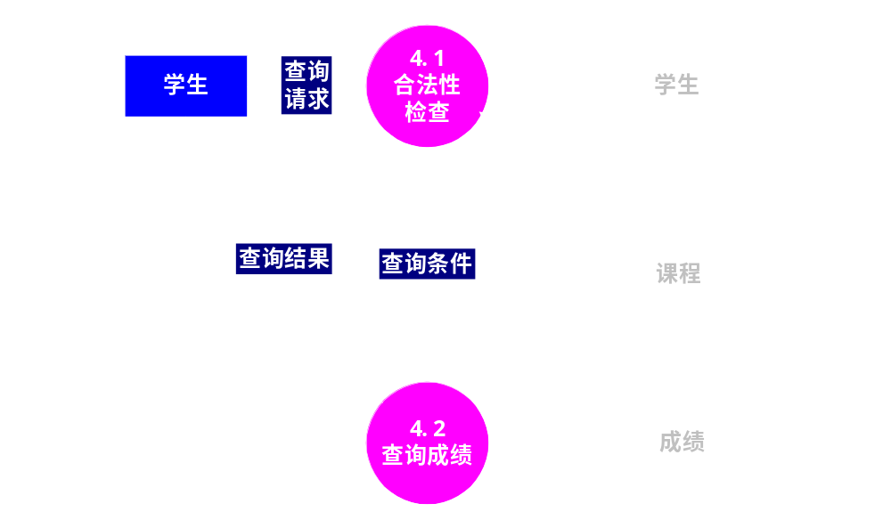
Structured Analysis Process (4)
  第2层DFD
  对第1层DFD图中的一个加工“查询学生成绩”进行展开。

Slide 14
Structured Analysis Process (5)
根据以上实例和经验，绘制数据流图应当遵循以下原则：
  分层时，子图的输入、输出数据流必须和父图中相应加工的输入、输出数据流一致；
  加工的编号应该唯一且具有层次性；
  加工不应该只有输入或只有输出，通常既有输入又有输出；
  数据流图不应反映处理的顺序；
  加工之间应通过数据存储进行通信，避免从一个加工直接流到另一个加工；
  数据应通过加工进行流动，避免从一个数据存储直接流到另一个数据存储；
  数据流图中所有元素的命名应当对客户有意义，且与业务相关；
不要在一个图中绘制7个以上的加工，否则难于绘制和理解。

Slide 15
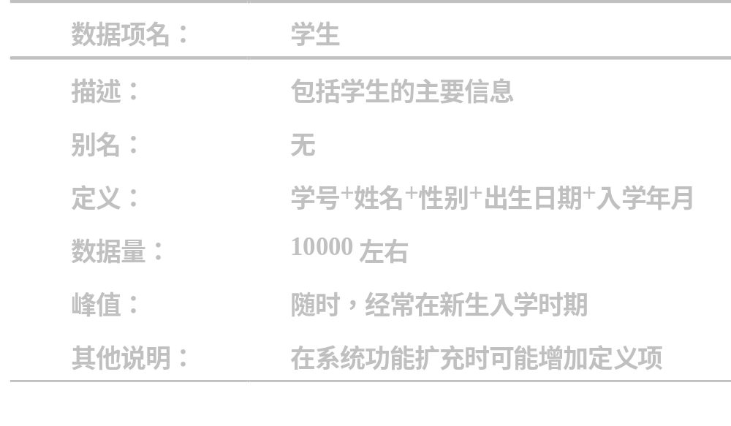
Structured Analysis Process (6)
编写数据字典
  学生

Slide 16
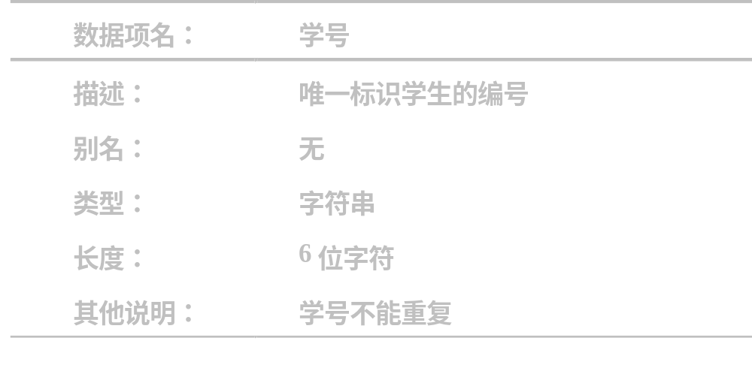
Structured Analysis Process (7)
  学号

Slide 17
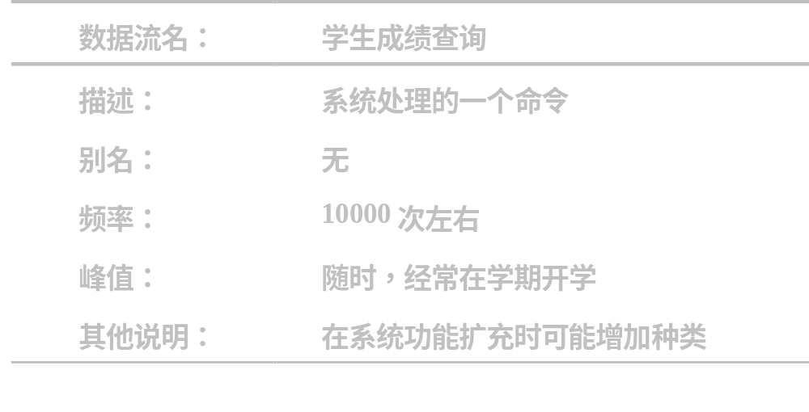
Structured Analysis Process (8)
  学生成绩查询

Slide 18
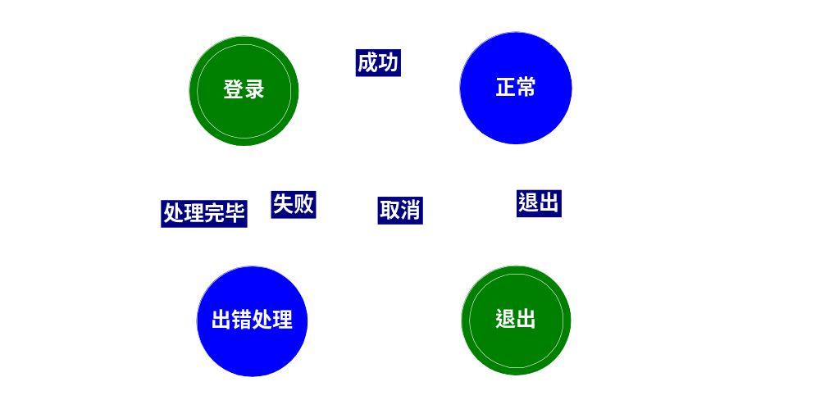
Structured Analysis Process (9)
行为建模
  学生成绩信息需要采取安全措施，可以采取登录方法避免非法使用系统。这样，该系统存在“登录”、“正常”和“出错”等状态的转换。

Slide 19
DATA CONTEXT DIAGRAM
object
returned
coins
customer
selection
0*
Vend
product
customer
customer
slug
product
Notes:
Context diagram describes the system function and defines the system scope
Only one process bubble
At least one input and one output flow
At least one terminator
All terminators are connected to at least one input or output flow
No data exchanged between terminators

Slide 20
DFD 0: VEND PRODUCT
object
coins
1*
Get
customer
payment
5*
Dispense
change
payment
returned
coins
slug
change
due
3p
Validate
payment
price
product
valid
selection
6p
Dispense
product
2p
Get
product
price
valid
selection
price table
4p
Get
valid
selection
customer
selection
products
Notes:
Data Flow Diagrams are used for process decomposition
Every process is decomposed in other processes (within a DFD) or in one PSPEC (outside a DFD)
Rule of 5 +/- 2 is used:
Balance between lack of information (3 or less) and too much (more than 7)
Up to 4 levels of decomposition
Each Data Flow Diagram specifies the decomposition of its parent bubble
REMARK: There is no limit given by the technique itself. These limits are given by quality criteria (simplicity, …)

Slide 21
DFD 1: GET CUSTOMER PAYMENT
coins_parameters
object
1.5p
Deposit
coins
1.1p
Validate
coins
coin
1.4p
Accumulate
coins
slug
coin
held_coins
coin_value
1.2p
Clear
payment
1.3p
Accumulate
payment
payment
current_payment
Notes:
Processes are the active elements in the model
Process performs a transformation:
if and only if ALL input information is available
production of all information is IMMEDIATE, I.e. all processing is done in zero delay
The output from the process should be a function of the input to it
Data flows allow transit of data within the system
Store is a place where information is preserved

Slide 22
DFD 5: DISPENSE CHANGE
change due
5.1
Get
change
coin
change coins
coin
coin
5.2
Get
payment
coin
payment
coins
payment

Slide 23
PSPEC
DFD 0: VEND PRODUCT (PARTLY)
object
coins
1*
Get
customer
payment
5*
Dispense
change
returned
coins
payment
slug
change
due
3p
Validate
payment
price
2p
Get
product
price
PSPEC 3
price table
PSPEC 2
valid
selection
Notes:
PSPEC’s are the lowest abstraction level
Make a PSPEC approximately 1/2 page long
Shows the relation between process input and output flows
Any form of specification may be used:
Drawings
Math equations
Structured English
PSPEC 3: Validate payment
Inputs:
payment : data in
price : data in
Outputs:
change due : data out
sufficient payment: control out
Body:
if payment >= price
change due = payment - price
sufficient payment = yes
otherwise
sufficient payment = no

Slide 24
SUMMARY
0*
Context Diagram
DFD 0
1*
3*
2*
DFD 1
DFD 2
DFD 3
1.1*
1.2p
2.1p
2.2p
3.1*
3.2p
3.3*
DFD 1.1
DFD 3.1
DFD 3.3
PSPEC
PSPEC
PSPEC
PSPEC
PSPEC
PSPEC
PSPEC
PSPEC
PSPEC
PSPEC
PSPEC

Slide 25
CONTROL CONTEXT DIAGRAM - CCD
coin
return
request
0*
Vend
product
customer
customer
product
available
Data flow Control flow
Carries information needed Carries information that
by a process to perform is to be interpreted for
transformations changing system behavior
and/or activating processes
Notes:
Control Context Diagram describes the system function and defines the system scope (same as for data)
Control Context Diagram defines the external control interface of the system

Slide 26
DATA/CONTROL CONTEXT DIAGRAM
object
returned
coins
customer
selection
0*
Vend
product
customer
product
available
customer
coin return
request
product
slug

Slide 27
CFD 0: VEND PRODUCT
coin return
request
coin
detected
coins
1*
Get
customer
payment
5*
Dispense
change
sufficient
payment
3p
Validate
payment
product
dispensed
product
available
6p
Dispense
product
2p
Get
product
price
product
available
price table
4p
Get
valid
selection
product
available
products
Notes:
Control Flow Diagram (CFD) is coupled to the equivalent level DFD and shares the same processes
Control Flow Diagram shows control flows instead of data flows
The control processing is described in the Control Specification (CSPEC)
The CSPEC is represented by a bar
At most one CSPEC for each DFD/CFD

Slide 28
DFD/CFD 0: VEND PRODUCT
coin return
request
coin
detected
object
coins
1*
Get
customer
payment
5*
Dispense
change
payment
returned
coins
sufficient
payment
change
due
slug
3p
Validate
payment
price
product
dispensed
product
available
valid
selection
6p
Dispense
product
2p
Get
product
price
valid
selection
product
price table
4p
Get
valid
selection
product
available
products
customer
selection
product
available

Slide 29
CFD 1: GET CUSTOMER PAYMENT
coins_parameters
coin
detected
1.5p
Deposit
coins
1.1p
Validate
coins
sufficient
payment
1.4p
Accumulate
coins
1.2p
Clear
payment
1.3p
Accumulate
payment

Slide 30
DFD/CFD 1: GET CUSTOMER PAYMENT
coins_parameters
object
1.5p
Deposit
coins
coin
detected
1.1p
Validate
coins
coin
1.4p
Accumulate
coins
slug
coin
held_coins
sufficient
payment
coin_value
1.2p
Clear
payment
1.3p
Accumulate
payment
payment
current_payment

Slide 31
CFD 5: DISPENSE CHANGE
coin
return
request
5.1p
Get
change
coin
product
available
5.2p
Get
payment
coin

Slide 32
DFD/CFD 5: DISPENSE CHANGE
coin
return
request
change due
5.1p
Get
change
coin
change coins
product
available
coin
coin
5.2p
Get
payment
coin
payment
coins
payment

Slide 33
CSPEC - 3 LOGICAL BLOCKS
ICF4
ICF5
ICF1
Event Logic
Sequential
logic
Action1
Action Logic
Out1
Event1
Action2
ICF2
Event2
Out2
Action3
Out3
ICF3
Event3
ICF1
ICF2
Out1
ICF: Input Control Flow
Out: CSPEC Control output
ICF3
Out2
ICF4
Out3
ICF5

Slide 34
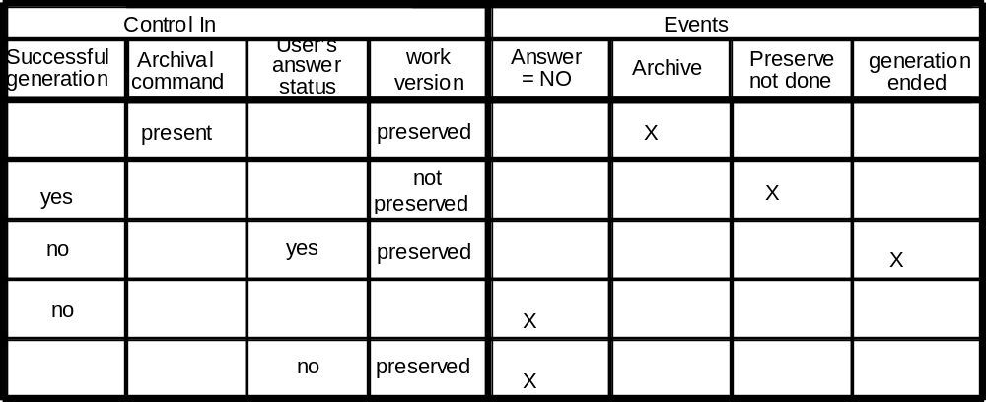
EVENT LOGIC
Is specified in an event logic table:
Notes:
Only pertinent events combinations are showed
One combination defines only one event
Several distinct combinations may define the same event

Slide 35
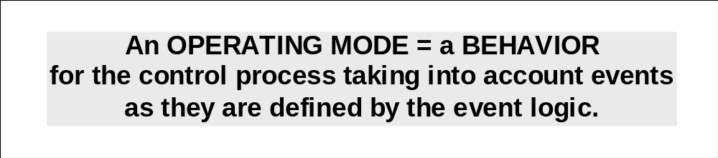
SEQUENTIAL LOGIC
It means to manage the historical aspect of events,
It keeps memory of past events for the current abstraction level
It describes the system OPERATING MODES
It does not define the status of the processes represented on the current control diagram
Notes:
Process behavior is defined by:
Operating modes
Transitions : from an operating mode to an other
Events : switch on transitions and/or actions
Actions : activities associated to events
3 (exclusive) representations types may be used :
State/Transition diagrams :
State/Transition tables
State/Events matrices

Slide 36
CSPEC 0: STATE TRANSITION DIAGRAM
initial
accept new coin
Waiting
for a coin
coin detected
accept customer
request
coin return request
return payment
product available=no
return payment
product dispensed
accept new coin
Waiting
for selection
sufficient payment
dispense product
Dispensing
of product
Notes:
Action
Event
OPERATING MODE
TRANSITION ARC
EVENT/ACTION
Waiting for
selection

Slide 37
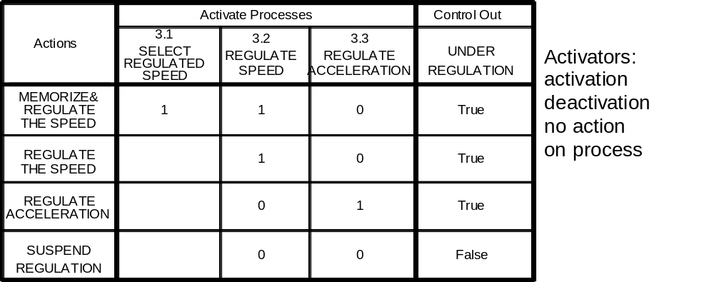
ACTION LOGIC
Is defined in a logic table
Notes:
When a CSPEC result is only made of activators, no ”control out” part is necessary
It is a good idea to group processes of the same activity type (pulse or permanent) in adjacent columns

Slide 38
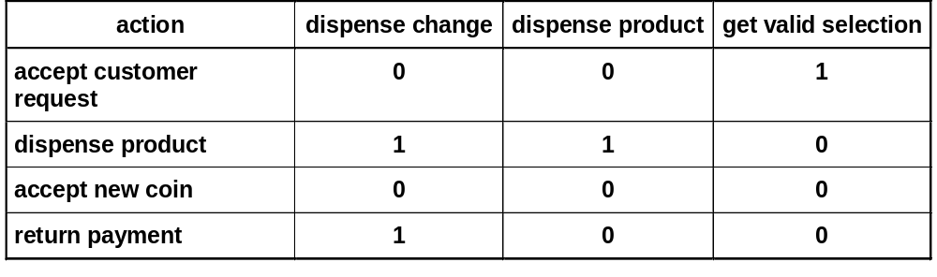
CSPEC 0: PROCESS ACTIVATION MATRIX

Slide 39
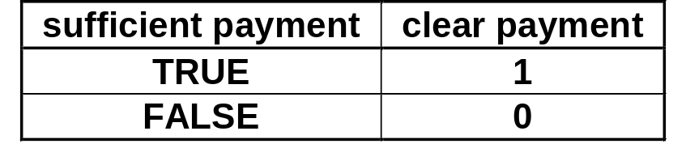
CSPEC1: PROCESS ACTIVATION MATRIX
coins_parameters
coin
detected
1.5p
Deposit
coins
1.1p
Validate
coins
sufficient
payment
1.4p
Accumulate
coins
1.2p
Clear
payment
1.3p
Accumulate
payment

Slide 40
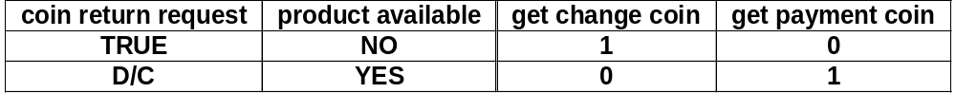
CSPEC 5 - PROCESS ACTIVATION MATRIX
coin
return
request
5.1p
Get
change
coin
product
available
5.2p
Get
payment
coin

Slide 41
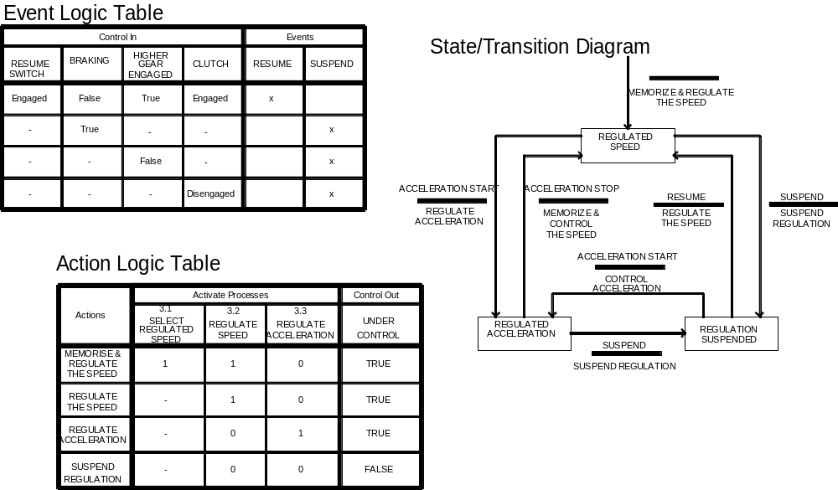
BEHAVIOUR REPRESENTATION

Slide 42
EXAMPLE OF REQUIREMENTS DICTIONARY (PARTLY)
Name Composed of Type
……… ……… …...
object [coin | slug] data
product [soda | gum | candy] data
coin 0{[quarter | nickel | dime]}8 data
product available [“yes” | “no”] control
……… ……… ……
quarter * 25 cents US currency*

