Slide 1
SART WORKSHOP
Modeling exercises
Notes:
REAL-TIME SOFTWARE ENGINEERING - C005

Slide 2
DESCRIPTION OF EXERCISES
Make a requirements model for the exercises described here-after

Slide 3
EXERCISE 1 - TRANSMISSION SYSTEM
Notes:
REAL-TIME SOFTWARE ENGINEERING - C005

Slide 4
TRANSMISSION SYSTEM
Construct the data context diagram (DCD) and the data flow diagram (DFD0) based on the following statement:
The system to be modeled is used to send messages between a transmitter system and a receiver system.
The transmitter will send the message text along with its own identification and also that of the receiver. This transmission system calculates the parity of the message and sends it back to the transmitter. Then it uses the receiver’s identification to find the message format along possible formats. Based on this information, it breaks the message into packets and sends these packets to the receiving system.
Notes:
REAL-TIME SOFTWARE ENGINEERING - C005

Slide 5
DATA CONTEXT DIAGRAM (DCD)
0*
send
messages
message
transmitter
receiver
packets
parity
Notes:
REAL-TIME SOFTWARE ENGINEERING - C005

Slide 6
DATA/CONTROL FLOW DIAGRAM 0
message
1p
calculate
the
parity
3p
divide
message
into
packets
packets
parity
receiver_id
transmission
format
2p
search
format
CSPEC0
format_OK
3
possible formats
OK
NOK
1
0
format OK
Notes:
REAL-TIME SOFTWARE ENGINEERING - C005

Slide 7
EXERCISE 2 - MAKING PANCAKES

Slide 8
MAKING PANCAKES
A customer can order an apple- or a natural pan cake. The customer’s order will be forwarded to the cook. The cook can only handle one pancake at a time. If the ordered pancake is ready, the cook puts it onto a plate and the cook is ready. If the batter is finished, the cook will make new.
Recipe for pancakes (about 12):
  1 cup of plain flour
  sprinkle of salt
  1 egg
  1 1/4 cups of milk
  a little oil to grease frypan
  1 apple cut into slices.
Put flour and salt into into mixing bowl. Add egg and milk. Whisk and whisk till smooth. Gently heat a lightly greased 20 cm frypan. Pour about 3 tablespoons of batter into pan. Tilt pan to spread it all over evenly. In case of an apple pancake add apple slices. When golden, lift edges with a knife, flip it over and cook the other side.
Notes:
REAL-TIME SOFTWARE ENGINEERING - C005

Slide 9
DATA/CONTROL CONTEXT DIAGRAM
cook
0*
Make
pancake
order
customer
ingredients
pancake
Notes:
REAL-TIME SOFTWARE ENGINEERING - C005

Slide 10
DATA/CONTROL FLOW DIAGRAM 0 AND CSPEC0
flour
salt
1p
Whisk
ingredients
Oil
batter
2p
Crease
frypan
egg
milk
greased_frypan
7p
Control
batter
3p
Add
batter
batter_finished
6p
Flip and
bake other
side
pancake
batter_in_pan
4p
Add
apple
one-side-
golden
CSPEC 0
apple_slices
raw pancake
5p
Bake
one side
batter_finished
true
false
1 2 3 4 5 6 7
1 0 0 0 0 0 0
0 1 1 1 1 1 1
order
Notes:
REAL-TIME SOFTWARE ENGINEERING - C005

Slide 11
DATA/CONTROL FLOW DIAGRAM 4 AND CSPEC4
4.1p
Do nothing
batter_in-pan
raw_pancake
CSPEC 4
order
natural
apple
4.1
1
0
4.2
0
1
4.2p
Add apple
slices
raw_pancake
order
apple_slices
Notes:
REAL-TIME SOFTWARE ENGINEERING - C005

Slide 12
EXERCISE 3 - COMBINATIONAL LOGIC
control
data
0*
Serve
one
drink
drink
control
system
passen-
gers
payment
Notes:
REAL-TIME SOFTWARE ENGINEERING - C005

Slide 13
COMBINATIONAL LOGIC
Define a DFD/CFD 0 and the CPEC 0 using the following text:
“Subscribers have the right to a free drink, but only if the flight time is longer than one hour. If the plane is more than one hour late taking off, all the passengers can have a free non-alcoholic drink. Of course, if a subscriber takes an alcoholic drink or asks for a second drink, he must pay for it.”
The DCD/CCD here-below is proposed
control
data
0*
Serve
one
drink
drink
control
system
passen-
gers
payment
Notes:
REAL-TIME SOFTWARE ENGINEERING - C005

Slide 14
DATA/CONTROL FLOW DIAGRAM 0
passenger type
1p
Serve a
free drink
drink
alcohol
first drink
long flight
2p
Request
payment
of drink
payment
long delay
Notes:
REAL-TIME SOFTWARE ENGINEERING - C005

Slide 15
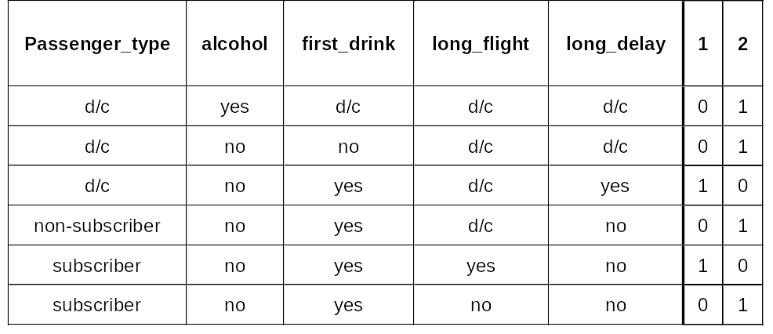
CSPEC 0
Notes:
REAL-TIME SOFTWARE ENGINEERING - C005

Slide 16
EXERCISE 4 - TELEGRAM PROCESSING
Notes:
REAL-TIME SOFTWARE ENGINEERING - C005

Slide 17
TELEGRAM PROCESSING
Make a requirements model consisting of a DCD/CCD, a DFD/CFD0, the CSPEC0 and all the PSPECs for a program to process a series of telegrams.
The series has the form of a character flow (letters, numbers, blanks) on any input mechanism. The series has the following characteristics:
  two adjacent words are separated by one or more blanks
  each telegram ends with the word “ZZZZ”
  the series of telegrams ends with “STOP”
For each telegram, the client wishes to be able to:
  calculate the price based on the number of billable words (other than “ZZZZ” and “STOP”)
  detect words which are to long (any word with more than 12 char. will be cut off)
  send the (filtered) telegram and print it on a dedicated printer
The printing of a telegram must comply with the following constraints:
  the telegram is printed line by line, each line can have 30 char. maximum
  each word must appear entirely on one line
  the words of the telegrams are separated by blanks or “CR”
  the text of the telegram is followed by the price and a message indicating the presence of truncated words.
Notes:
REAL-TIME SOFTWARE ENGINEERING - C005

Slide 18
DCD/CCD
transmitting
device
0*
Process
telegrams
truncated
word
telegrams
character
printer
printed
line
Notes:
REAL-TIME SOFTWARE ENGINEERING - C005

Slide 19
DATA/CONTROL FLOW DIAGRAM 0
CSPEC0
CSPEC 0
end
fale
true
5
1
0
6
0
1
character
constructed word
1p
Recognize
word
max word length
truncated
word
word
5p
construct
line
2p
truncate
word
text
line
end
word
free words
unit price
4p
Recognize
end
truncation
constructed line
max length of line
3p
Calculate
price
6p
Print
last
line
end
line
end word
price
Notes:
REAL-TIME SOFTWARE ENGINEERING - C005

Slide 20
PSPEC1 : RECOGNIZE WORD
Inputs :
character,constructed_word: data in
Outputs :
word,constructed_word: data out
Body :
IF character <> blank THEN
OUTPUT constructed_word := constructed_word + character
OTHERWISE
IF constructed_word <> empty_word THEN
OUTPUT word := constructed_word
OUTPUT constructed_word := empty_word
Notes:
REAL-TIME SOFTWARE ENGINEERING - C005

Slide 21
PSPEC2 : TRUNCATE WORD
Inputs :
word,max_word_length: data in
Outputs :
truncated_word,truncation: data out
Body :
IF length(word) > max_word_length THEN
OUTPUT truncated_word := word, truncation, max_word_length
OTHERWISE
OUTPUT truncated_word := word
Notes:
REAL-TIME SOFTWARE ENGINEERING - C005

Slide 22
PSPEC3 : CALCULATE PRICE
Inputs :
word, price, free_words, unit_price: data in
Outputs :
price: data out
Body :
IF word is not in free_words THEN
OUTPUT price := price + unit_price
Notes:
REAL-TIME SOFTWARE ENGINEERING - C005

Slide 23
PSPEC4 : RECOGNIZE END
Inputs :
word, end_word: data in
Outputs :
end: control out
Body :
IF word = end_word THEN
OUTPUT end := TRUE
OTHERWISE
OUTPUT end := FALSE
Notes:
REAL-TIME SOFTWARE ENGINEERING - C005

Slide 24
PSPEC5 : CONSTRUCT LINE
Inputs :
constructed_line, max_length_of_line, truncated_word: data in
Outputs :
constructed_line, text_line: data out
Body :
IF length(constructed_line) + length(word) > max_length_of_line THEN
OUTPUT text_line := constructed_line
OUTPUT constructed_line := word
OTHERWISE
OUTPUT text_line := constructed_line + blank + word
Notes:
REAL-TIME SOFTWARE ENGINEERING - C005

Slide 25
PSPEC6 : PRINT LAST LINE
Inputs :
constructed_line, max_length_of_line, truncation, price: data in
Outputs :
constructed_line, end_line: data out
Body :
OUTPUT end_line := constructed_line + price + truncation
OUTPUT constructed_line := blank
OUTPUT price := 0
OUTPUT truncation := FALSE
Notes:
REAL-TIME SOFTWARE ENGINEERING - C005

Slide 26
EXERCISE 5 - DIGITAL WATCH
Notes:
REAL-TIME SOFTWARE ENGINEERING - C005

Slide 27
DIGITAL WATCH
Make a requirements model for a digital watch which shows only the hours and the minutes and has a resetting capability.
The watch has three functions (buttons):
  one to choose between normal mode and reset mode
  one to choose between the type of reset: hours or minutes
  one to increment the hours or minutes (according to reset type).
When the battery is inserted the watch is in normal mode. In normal mode, the first button will set the watch to hour-reset mode. The reset mode display shows only the field of modification, in flashing mode. The normal time display (with two fields, hours and minutes, and without flashing) will resume when the user switches back to normal mode. When reset mode is requested, the normal time-count continues until the first increment is requested. When at least one increment has been carried out, service is resumed with the seconds reset to zero. When you switch to the reset mode and don’t do anything for a certain amount of time, you will return to normal mode.
Notes:
REAL-TIME SOFTWARE ENGINEERING - C005

Slide 28
Data/Control Context Diagram
0*
Indicate
time
display
user
commands
Notes:
REAL-TIME SOFTWARE ENGINEERING - C005

Slide 29
Data/Control Flow Diagram 0
2p
Increment
hours
3p
Increment
minutes
type
mode
1p
Count
time
6*
Display
mode
7p
Supervise
modification
time
elapsed
time
display in
modification
4p
Reset
seconds
to zero
5p
Display
time
normal
display
increment
Notes:
REAL-TIME SOFTWARE ENGINEERING - C005

Slide 30
CSPEC 0 : State Transition Diagram
put in battery
watch alive
mode/elapsed time
return without
modification
mode/elapsed time
return with modification
normal mode
mode
modif. of hours
in wait
increment
increment hours
increment
increment hours
wait for modification
of hours
modification
of hours
type
modif. of hours
in wait
type
modif. of min.
in wait
type
modif. of hours
type
modif. of min.
wait for modifcation
of minutes
modification
of minutes
increment
increment min.
increment
increment min.
Notes:
REAL-TIME SOFTWARE ENGINEERING - C005

Slide 31
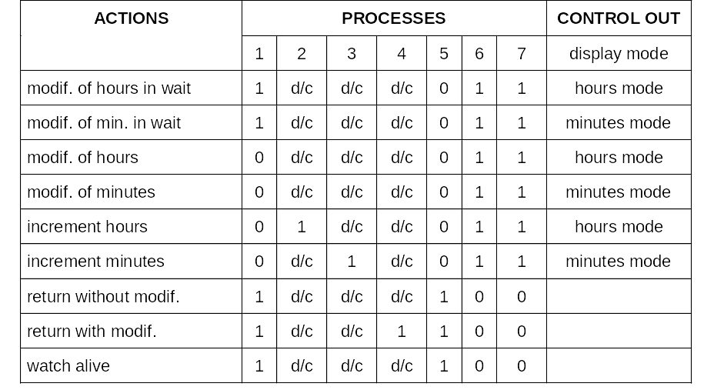
CSPEC 0 : Process Activation Table
Notes:
REAL-TIME SOFTWARE ENGINEERING - C005

Slide 32
PSPECs
PSPEC2 : Increment hours
Inputs :
time: data in
Outputs :
time: data out
Body :
IF hours = 23 THEN hours := 0
OTHERWISE
hours := hours + 1
OUTPUT time
PSPEC1 : Count time
Inputs :
time: data in
Outputs :
time: data out
Body :
WAIT one second
OUTPUT time := NOW
Notes:
REAL-TIME SOFTWARE ENGINEERING - C005

Slide 33
PSPECs
PSPEC3 : Increment minutes
Inputs :
time: data in
Outputs :
time: data out
Body :
IF minutes = 59 THEN minutes := 0
OTHERWISE
hours := hours + 1
OUTPUT time
PSPEC4 : Reset seconds to 0
Inputs :
time: data in
Outputs :
time: data out
Body :
seconds := 0
OUTPUT time
Notes:
REAL-TIME SOFTWARE ENGINEERING - C005

Slide 34
PSPECs
PSPEC5 : Display time
Inputs :
time: data in
Outputs :
normal display: data out
Body :
OUTPUT normal display := time
PSPEC7 : Monitor modification
Inputs :
Outputs :
elapsed time: control out
Body :
WAIT one minute
OUTPUT elapsed time
Notes:
REAL-TIME SOFTWARE ENGINEERING - C005

Slide 35
Data/Control Flow Diagram 6 and CSPEC6
6.1p
Display
modification
hours
display mode
hours
display in
modification
of hours
6.2p
Display
modification
minutes
CSPEC 6
minutes
display in
modification
of minutes
display mode
hours mode
minutes mode
6.1
1
0
6.2
0
1
Notes:
REAL-TIME SOFTWARE ENGINEERING - C005

Slide 36
PSPECs
PSPEC6.1 : Display hours modification
Inputs :
hours: data in
Outputs :
display in modification of hours: data out
Body :
OUTPUT display in modification of hours := hours, flashing
PSPEC6.2 : Display minutes modification
Inputs :
minutes: data in
Outputs :
display in modification of minutes: data out
Body :
OUTPUT display in modification of minutes:= minutes, flashing
Notes:
REAL-TIME SOFTWARE ENGINEERING - C005

Slide 37
EXERCISE 6 - CHEMICAL REACTOR
Notes:
REAL-TIME SOFTWARE ENGINEERING - C005

Slide 38
CHEMICAL REACTOR
Make a requirements model for a simple industrial system whose context is specified by the text below and the diagram enclosed.
Start the filling of the reactor when the “begin filling” command is given. When the liquid level in the reactor reaches value N, stop filling and turn on the heating element.
Start the timer as soon as the temperature of the liquid reaches value H. Keep the temperature of the reactor at a constant value H for a period of time T. As soon as time T elapses, turn off the heating element and drain the liquid from the reactor into an external storage tank.
Note: the filling of the reactor cannot begin if the level in the tank is not at minimum value M. In this case, the system must detect the insufficient level as early as possible and produce an alarm in response to the “begin filling” command.
filling valve
tank
timer
reactor
drain valve
heating
element
tank
Notes:
REAL-TIME SOFTWARE ENGINEERING - C005

Slide 39
DCD/CCD
timer
operator
reactor
alarm
begin
filling
reactor
parameters
Elapsed time
duration
tank
0*
Control a
chemical
reaction
heating
element
tank level
heating
element
command
fill valve
command
Drain valve
command
filling
valve
drain
valve
Notes:
REAL-TIME SOFTWARE ENGINEERING - C005

Slide 40
DFD0/CFD0
tank level
1p
Verify
initial
conditions
alarm
fill valve
command
M
2p
Fill the
reactor
reactor level
N
reactor
not
ready
reactor
full
elapsed
time
reactor
temp
3*
Heat the
reactor
heating element
command
duration
reactor
level
4p
Drain
the
reactor
begin
filling
reaction ended
reactor empty
drain valve
command
Notes:
REAL-TIME SOFTWARE ENGINEERING - C005

Slide 41
CSPEC0: State Transition Diagram
stand-by
reactor not ready
stop
begin filling
start
reactor empty
stop
reaction on
course
reactor full
heat
begin reaction
filling
reaction ended
drain
Notes:
REAL-TIME SOFTWARE ENGINEERING - C005

Slide 42
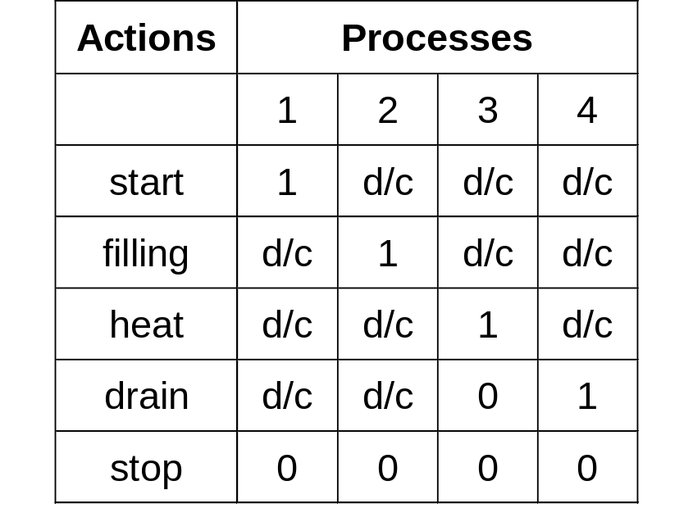
CSPEC0: Process Activation Table
Notes:
REAL-TIME SOFTWARE ENGINEERING - C005

Slide 43
PSPECs
PSPEC1 : Check initial conditions
Inputs :
M, tank_level: data in
Outputs :
alarm: data out
reactor_not_ready: contol out
Body :
IF tank_level < M THEN
OUTPUT alarm
OUTPUT reactor_not_ready
PSPEC2 : Fill the reactor
Inputs :
N, reactor_level: data in
Outputs :
reactor_full, fill_valve_command: control out
Body :
OUTPUT open_filling_valve
WAIT reactor_level > N
OUTPUT close_filling_valve
OUTPUT reactor_full
Notes:
REAL-TIME SOFTWARE ENGINEERING - C005

Slide 44
PSPECs
PSPEC4: Drain the reactor
Inputs:
reactor_level: data in
Outputs:
drain_valve_command: control out
reactor_not_ready: control out
Body:
OUTPUT open_drain_valve
WAIT reactor_level = 0
OUTPUT close_drain_valve
OUTPUT reactor_empty
Notes:
REAL-TIME SOFTWARE ENGINEERING - C005

Slide 45
DFD3/CFD3
heating
element
command
3.1p
Monitor
temperature
rise
elapsed time
temperature exceeded
reaction end
3.2p
Monitor low
temperature
temperature
too low
reactor
temp
H
reactor temp
3.3p
Start
monitoring
T
duration
Notes:
REAL-TIME SOFTWARE ENGINEERING - C005

Slide 46
CSPEC3 : State Transition Diagram
heating
rise until level H
elapsed time
total halt
temperature exceeded
switch to regulator
temperature too low
heating
heat regulator off
heat regulator on
elapsed time
total halt
elapsed time
total halt
temperature exceeded
stop heating
Notes:
REAL-TIME SOFTWARE ENGINEERING - C005

Slide 47
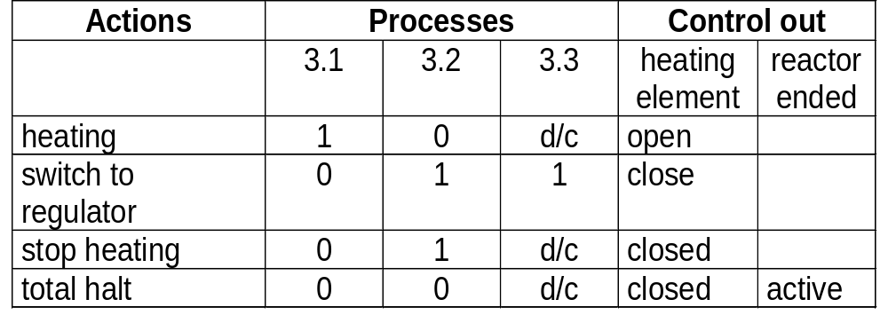
CSPEC3 : Process Activation Table
Notes:
REAL-TIME SOFTWARE ENGINEERING - C005

Slide 48
PSPECs
PSPEC3.1 : Monitor temperature rise
Inputs :
H, reactor_temp : data in
Outputs :
temperature_exceeded : control out
Body :
IF reactor_temp > H THEN
OUTPUT temperature_exceeded
PSPEC3.2 : Monitor low temperature
Inputs :
H, reactor_temp : data in
Outputs :
temperature_too_low : control out
Body :
IF reactor_temp < H THEN
OUTPUT temperature_too_low
PSPEC3.3 : Start monitoring
Inputs :
T : data in
Outputs :
duration : data out
Body :
OUTPUT duration := T
Notes:
REAL-TIME SOFTWARE ENGINEERING - C005

Slide 49
EXERCISE 7 -TICKET DISPENSING SYSTEM
Notes:
REAL-TIME SOFTWARE ENGINEERING - C005

Slide 50
TICKET DISPENSING SYSTEM
An airline company wants to install automatic ticket dispensing machines at airports and in hotels. The system would basically offer remote services to a customer, substituting an airline reservations agent. The systems major functionality includes:
  providing help to the customer in how to use the system
  allowing the customer to make flight inquiries
  allowing the customer to make seat inquiries on a selected flight
  allowing customer to purchase ticket(s)
  the system interacts with the airline main reservation system. It supplies flight numbers and numbers of passengers
  the system interacts with a credit system to verify customer credit. The system has to provide a credit code and cost of tickets
  the system will issue tickets upon flight and credit conformation.
Notes:
REAL-TIME SOFTWARE ENGINEERING - C005

Slide 51
EXERCISE 7 -TICKET DISPENSING SYSTEM (CONT.)
A description of what happens between customer and system.
The customer initiates the process by making a selection of what mode of operation is required.
The customer has a choice of selecting a flight inquiry or a help mode. The customer can be in any state abort the whole operation. Additionally, the system when in any mode will wait a maximum of 1 minute for a customer response and then automatically abort.
If the customer selects flight inquiry mode of operation the customer is given the opportunity to enter flight date, origin and destination. The system is to contain a flight information database. The system pulls out the schedules for travel between those cities and displays it to the customer.
This database is the same one that the airline has in their reservation system. Except that the airline one has additional information in it, hence the database in the airline ticket dispenser is a subset of that database.
The system displays the appropriate information to the customer. The customer then has to make a selection or abort the operation. If the customer decides to proceed then the customer responds by selecting the desired flight number, and provides the system with other information, such as: number of passengers, class of flight and one way or round trip tickets. If the customer wants round trip tickets, the above operation is repeated with return flight information. Hence the customer has to make a choice of flight number, number of passengers, class of return flight.
Notes:
REAL-TIME SOFTWARE ENGINEERING - C005

Slide 52
EXERCISE 7 - TICKET DISPENSING SYSTEM (CONT.)
Once customer information is obtained the information is sent into the airlines main reservation computer and conformation is sought. The reservation system responds by sending two pieces of information: flight status (availability or non-availability of the flight) and a flight confirmation code.
If no seat is available the system must show the customer a reduced schedule and ask for another flight number. If the customer aborts the operation the system must cancel the reservation made.
If the customer inputs a ticket request upon receiving conformation of seats, then the system has to accept the credit code from the customer which is the code for a credit card, such as MasterCard.
The system then transmits the credit code along with the price of the ticket(s) to the banks central computer. The credit computer responds with two pieces of information, the credit status and a credit approval code that it must print on the ticket. If the credit is valid, the system proceeds to issue the tickets.
The system provides help to the customer in three possible places. At start-up, when the customer initiates the whole system by entering a start command, the customer has available a help option that will display the operation of the whole system. Additionally, the system can also provide specific help during the flight inquiry state and the reservation state.
Notes:
REAL-TIME SOFTWARE ENGINEERING - C005

Slide 53
DCD/CCD
flight info to AMS
airline
main system
customer
abort
selection
flight particulars
0*
Dispense
tickets
flights fares
ticket
credit card
particulars
info
flight confirmation code
credit
code
credit
status
price
credit
approval
bank
Notes:
REAL-TIME SOFTWARE ENGINEERING - C005

Slide 54
DFD/CFD 0
mode selection
flight particulars
abort inquiry flight
3*
Inquire
flight
info
1p
Select
mode
flight info to AMS
inquiry menu selection
flight status
flight confirmation code
mode
ticket
flight infos
price
credit code
startup
abort
5p
Issue
tickets
abort
4p
Make
reservation
2p
Display
startup
helpinfo
tickets particulars
reservation
menu selection
startup
helpinfo
credit
status
startup help
credit
approval
credit card
particulars
Notes:
REAL-TIME SOFTWARE ENGINEERING - C005

