Slide 1
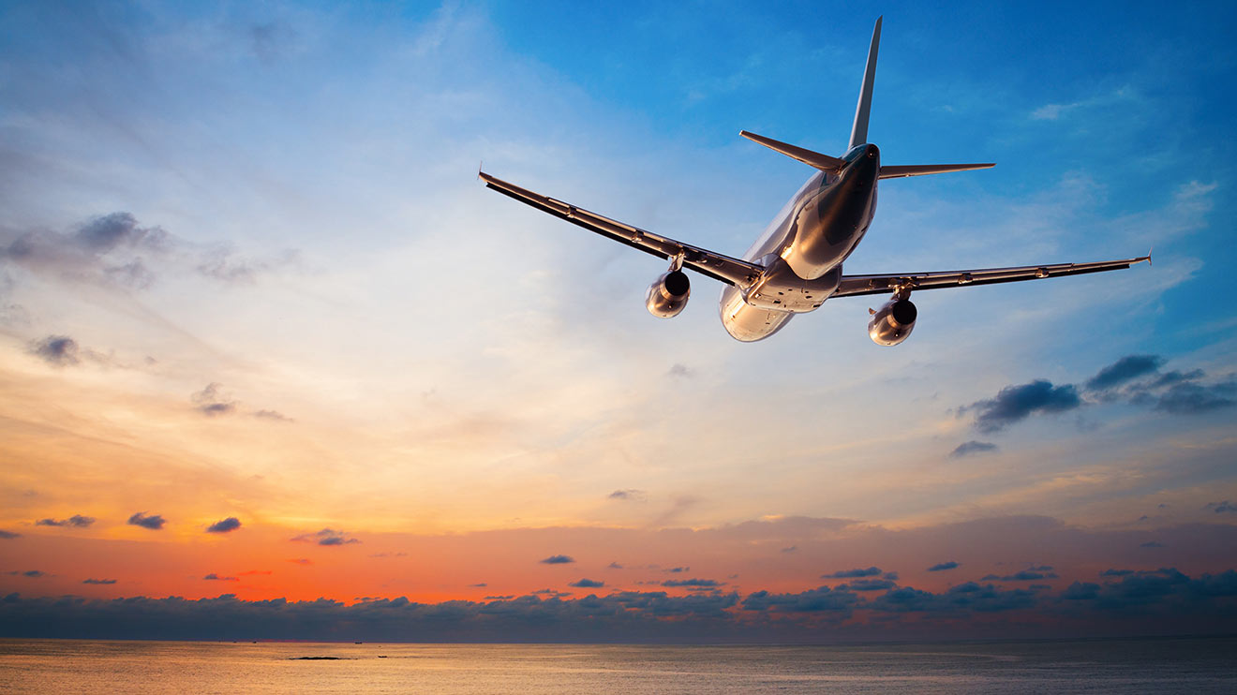
DELIVER THE BEST FLIGHT
A Case study Done determine optimum flight routes, schedule and More
- Harshvardhan Pandey
03/31/2017

Slide 2
Problem Overview
A top national airline provider wants to:
Better Optimize its Flight Schedule
Gain competitive advantage over its competitors.

Slide 3
Examining the problem
Evaluating year-round air traffic for 2013
Refine insights from key information, such as:
Most flown route
Most flown carrier
Departure delays
Popular travel days
Offer recommendations
Better optimize air schedules
More

Slide 4
Evaluating year-round traffic Following key evaluations found after TranStats data for the year 2013:
A total of 6369482 flight journeys were initiated, 6273470 were completed and 96012 flights were cancelled.
Number of flights cancelled is much higher for short distance flights.
Next we will analyze more about on this data and understand more flight patterns.

Slide 5
Most Flown Routes Travel routes with most number of flights in 2013
From | To | Round trips
San Francisco, CA | Los Angeles, CA | 15404
Los Angeles, CA | San Francisco, CA | 15357
Kahului, HI | Honolulu, HI | 11663
Honolulu, HI | Kahului, HI | 11615
Los Angeles, CA | Las Vegas, NV | 11448
Las Vegas, NV | Los Angeles, CA | 11418
New York, NY | Los Angeles, CA | 11194
Los Angeles, CA | New York, NY | 11186
New York, NY | Atlanta, GA | 10063
Atlanta, GA | New York, NY | 10059
Los Angeles, CA | Phoenix, AZ | 9451
Phoenix, AZ | Los Angeles, CA | 9428
Los Angeles, CA | San Diego, CA | 9317
San Diego, CA | Los Angeles, CA | 9296
Orlando, FL | Atlanta, GA | 8868
The most flown route was between San Francisco to Los Angeles.
The 15th most flown route was Orlando to Atlanta with a total of 8868 completed round trips
Note: This is evaluated only for flights that completed their journey excluding all the cancelled flights. Source: TranStats data

Slide 6
Most Flown Carriers Top 10 carriers with the most number of trip in 2013
Southwest Airlines topped the chart with the most number of flights in 2013.
Airline with the 3rd highest number of flights was ExpressJet Airways with a total of 727389 flights in 2013
Note: This is evaluated only for flights that completed their journey excluding all the cancelled flights. Source: TranStats data

Slide 7
Longest Departure Delays Originating airports with longest overall departing delay in minutes
10th longest delay was observed at Redding Municipal Airport in Redding, CA.
Note: This is evaluated only for flights that completed their journey using Dep_Delay and excluding all the cancelled flights. Source: TranStats data

Slide 8
Popular Travel Days Total number of flights flying each day of the week in 2013
2nd most popular travel day in a week was Monday.
Looking at the pattern of flight departure schedules it’s quite evident that people fly to their destinations usually on Friday evenings and return from their long weekend holidays on Mondays early morning through evening.
Average number of flights on any given day were a little over 2400.
Note: This is evaluated only for flights that completed their journey excluding all the cancelled flights. Source: TranStats data

Slide 9
Recommendations: 1. Optimizing Flight Schedules Accommodating more weekend Flights to popular destinations.
Flight patterns shown earlier points out few key insights:
Saturdays are the least busy day of the week.
Below are the most popular travel destinations:
Opportunity:
Increasing the number flights on
Early Saturday mornings (00 - 6:00 hrs); short distance flights.
Increasing the number of flights on Friday night (18:00 – 24:00 hrs); both short and long distance.
Low delay in departure means:
More flights can be accommodated without letting people suffer their flight experiences.
Expected daily roundtrips per flight:
San Francisco, CA | Los Angeles, CA
Los Angeles, CA | San Francisco, CA
Chicago, IL | New York, NY
New York, NY | Chicago, IL
Chicago, IL | Atlanta, GA
Atlanta, GA | Chicago, IL
New York, NY | Atlanta, GA
Atlanta, GA | New York, NY
New York, NY | Washington, DC
Average Departure Delay across these destinations are around 13 minutes or less
Average number of passenger seats in an airline[1] | Distance (miles) | Possible roundtrips | Total passengers
150-200 | 0-1000 | 4 | 1200-1600
200-250 | 2000+ | 2 | 800-1000

Slide 10
Recommendations: 2. Experience Improving the customer experience in long distance flights.
3. Beat The Best Airfare Increasing flight bandwidth lower the fares
Airlines are expecting 31% rise in passenger demand by 2017. ^{[3]}
In-flight services remain the lowest among all customer satisfaction factors. ^{[2]}
Increased frequency of flights as recommended earlier and improving in-flight services will attract more passengers.
Possible areas to cater: Free in-flight internet, improving food options.
Opportunity:
Improve customer experience in long distance flights.
Price continues to be the most important factor in basing travel plans. Source: Expedia viewfinder.
Customers are likely to forgive scant in-flight service for better savings on price when it comes to short distance flights.
Opportunity:
Offer more savings to the passenger and expand flight frequency on short distance flights.

Slide 11
References
http://www.ponderweasel.com/how-many-people-can-fit-on-a-plane/
http://www.jdpower.com/press-releases/2016-north-america-airline-satisfaction-study
IATA : http://www.iata.org/pressroom/pr/Pages/2013-12-10-01.aspx
Expedia: https://viewfinder.expedia.com/img/HLG-ARC-Booklet.pdf?mcicid=social.vf
Data Source: Transtats Date (provided with the case)
Note:
All question provided were solved while Cancelled is set to 0.00.
While picking the departure delay I have opted for Dep_Delay instead of Dep_Delay new since I was not sure which one to use.

