Slide 1

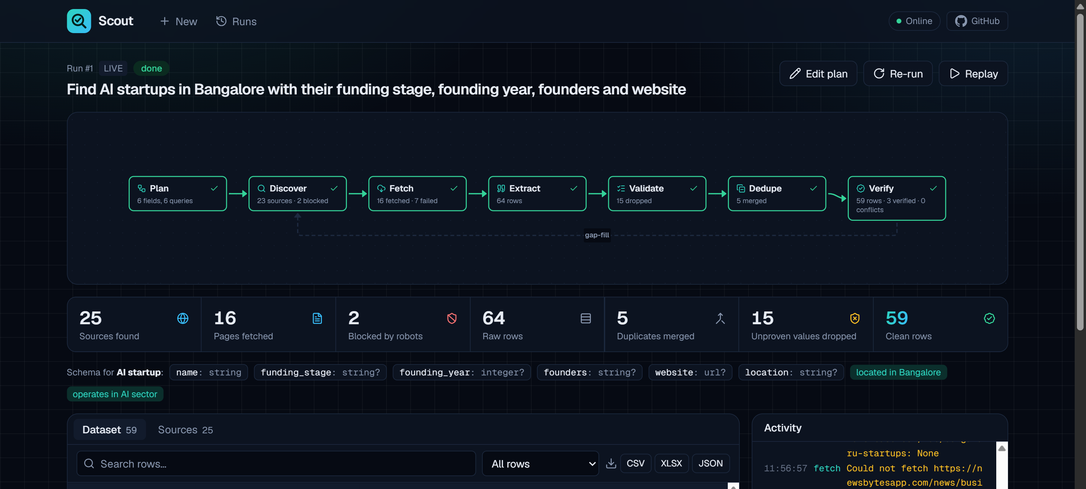
Scout
Describe the data. Scout proves every value.
An AI-powered data intelligence platform that turns a plain-English request into a clean, source-backed dataset.
Code Cubicle 6.0 · Problem Statement 01
scout-online.vercel.app · github.com/geekksv/scout
Notes:
Scout turns a plain-English request into a clean, structured dataset, and proves every single value with the exact sentence it came from. Built for Code Cubicle 6.0, problem statement 01.

Slide 2



Web data is easy to scrape — and hard to trust
Teams need leads, jobs, sponsors and market lists from the web every week.
A scraper for every question
LLM scrapers hallucinate
Nothing can be verified
Each requirement means new code, new selectors and new maintenance when sites change.
Language models return confident values — funding rounds, founders, sizes — that no source ever stated.
Without the source sentence, nobody can check a value, so the dataset can't be used for real decisions.
A dataset you cannot verify is a dataset you cannot use.
Notes:
Every data question today means building another scraper. LLMs make that faster, but they hallucinate values no page ever stated. Without the source sentence you can't check anything, so the data can't be trusted.

Slide 3





From one sentence to a proven dataset
Scout designs and runs a custom collection workflow for every request.
Prompt “Find AI startups in Bangalore with their funding stage, founding year, founders and website”
01
02
03
04
05
Plan
Collect
Prove
Verify
Deliver
AI designs fields, types, filters, region and queries. Fully editable.
Searches the web, checks robots.txt, reads only permitted pages.
Every value needs a verbatim quote from its page — or it's dropped.
Merges duplicates, cross-checks fields across independent sites.
Live dataset with evidence, insights, history and export.
If too few rows are found, a gap-fill loop writes new queries and goes back to Collect.
Notes:
One sentence in. The AI plans the dataset and you can edit it. Scout collects only from permitted pages, extracts each value with a verbatim quote, merges and cross-checks across sites, and delivers a live, searchable dataset. A gap-fill loop searches again if it finds too few rows.

Slide 4
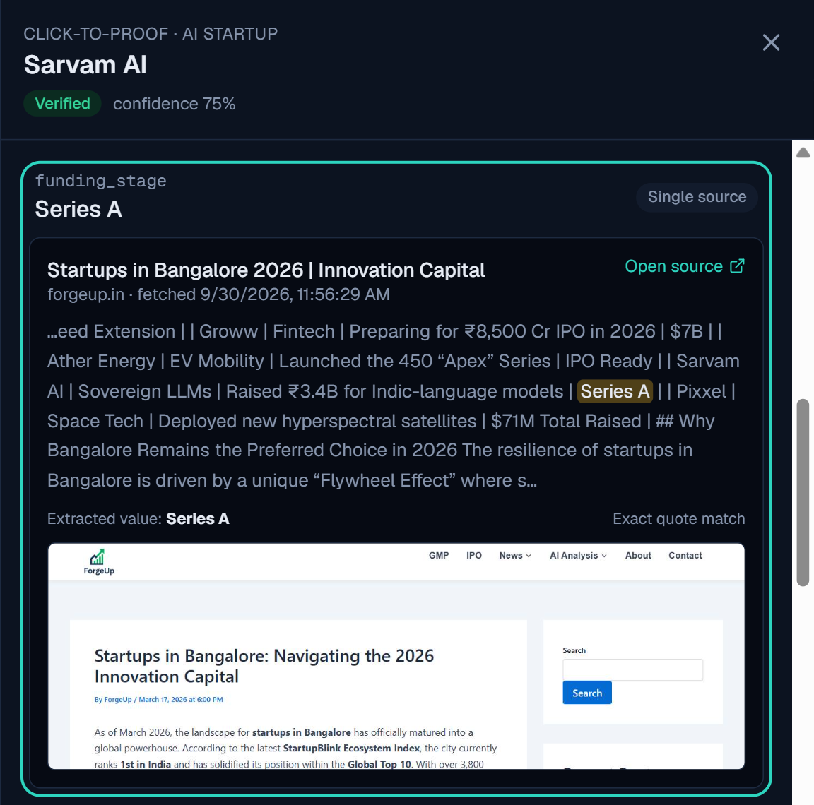


No quote, no value
The trust layer is what makes Scout different from every other scraper.
Verbatim quote check
A value is kept only if its quote is really on the page and the value is in the quote. “Series C” is rejected when the page says “Series A”.
Cross-source verification
Each field is compared across independent domains: verified, single source, or conflict — resolved by a person in one click.
Click-to-Proof
Click any cell to see the exact sentence highlighted in its source page, with the URL, fetch time and a screenshot.
Notes:
Every value must come with a verbatim quote that really appears on the page, and the value must be inside that quote. Unproven values are dropped and counted. Fields are cross-checked across independent sites, and Click-to-Proof shows the exact sentence, source and screenshot for any cell.

Slide 5

Real run, real numbers
“AI startups in Bangalore with funding stage, founding year, founders and website”
59
~1 min
15
25
clean rows
end to end
values rejected
sources checked
from 64 raw rows after merging 5 duplicates
plan, search, read, extract and verify
unproven: the quote was not on the page
robots.txt respected for every page
Hosted on free tiers, same request: 56 clean rows with screenshots and evidence at scout-online.vercel.app. Every row links to its sources; single-source rows are labelled as such instead of hidden.
Notes:
On a real request Scout produced 59 clean rows in about a minute, merged 5 duplicates, and rejected 15 values whose quotes were not on the page. The hosted free-tier version produced 56 rows for the same request.

Slide 6




Everything PS 01 asks for
Each requirement maps to a working feature you can try in the live app.
Natural-language → plan
Dynamic live workflow
Permitted sources only
Entity, typed fields, filters, search region and queries — editable before running.
Per-request pipeline shown as a live graph over SSE, with a gap-fill loop.
robots.txt per page (RFC 9309); social, login-only and ad links always blocked.
Clean · validate · dedupe
Dashboard & export
History, diff & replay
Type coercion for numbers, money, URLs and dates; fuzzy entity merging.
Per-cell trust markers, insights, filters; CSV, XLSX and JSON export.
Every run stored; re-run and compare (+new / ~changed / −removed); replay offline.
Notes:
Every requirement of problem statement 01 is implemented: natural-language planning, dynamic workflows, permitted multi-source collection, cleaning and deduplication, source-backed traceability, task monitoring, an interactive dashboard, history, and search, filter and export.

Slide 7




Built on a lean, free stack
Designed to run end to end on free tiers — with caching so repeat runs cost almost nothing.
Frontend
Backend
AI
Data & hosting
Next.js 15 · React 19
TypeScript · Tailwind v4
React Flow live graph
Auto-wakes a sleeping API
Python 3.12 · FastAPI
Async pipeline + SSE
Persisted, replayable events
46 offline tests
Groq free tier
gpt-oss-120b plans
qwen3 extracts
Auto model fallback on 429
Tavily / ddgs search
Playwright or Jina Reader
SQLite · Postgres
Vercel + Render
Free to run: Groq · Tavily · Jina Reader · Vercel · Render — every LLM answer, search and page is cached, so repeat runs cost almost nothing.
Notes:
The frontend is Next.js with a live React Flow graph. The backend is FastAPI with an async pipeline that streams events. Groq's free models do the planning and extraction, with automatic fallback when rate-limited. It runs entirely on free tiers: Vercel and Render with Postgres.

Slide 8


No quote, no value.
Try Scout with your own question.
Live app
Source code
Demo video
scout-online.vercel.app
github.com/geekksv/scout
GitHub release v1.0.0
Built by geekksv · Code Cubicle 6.0 · Problem Statement 01
Notes:
Scout: no quote, no value. The live app, source code and demo video are all linked here. Thank you.

