Slide 1

Everything To Know about AWS LAMBDA
geek.nomads

Slide 2
What is AWS LAMBDA ?
Lambda is a compute service that lets you run code without provisioning or managing servers. Lambda runs your code on a high-availability compute infrastructure and performs all of the administration of the compute resources, including server and operating system maintenance, capacity provisioning and automatic scaling, and logging. With Lambda, you can run code for virtually any type of application or backend service. All you need to do is supply your code in one of the languages that Lambda supports.
Source: AWS

Slide 3
AWS Lambda Features
Concurrency & Scalability
Availability
Provides default https endpoints to access lambda directly
Can be integrated with other AWS services
Pay Per Use

Slide 4
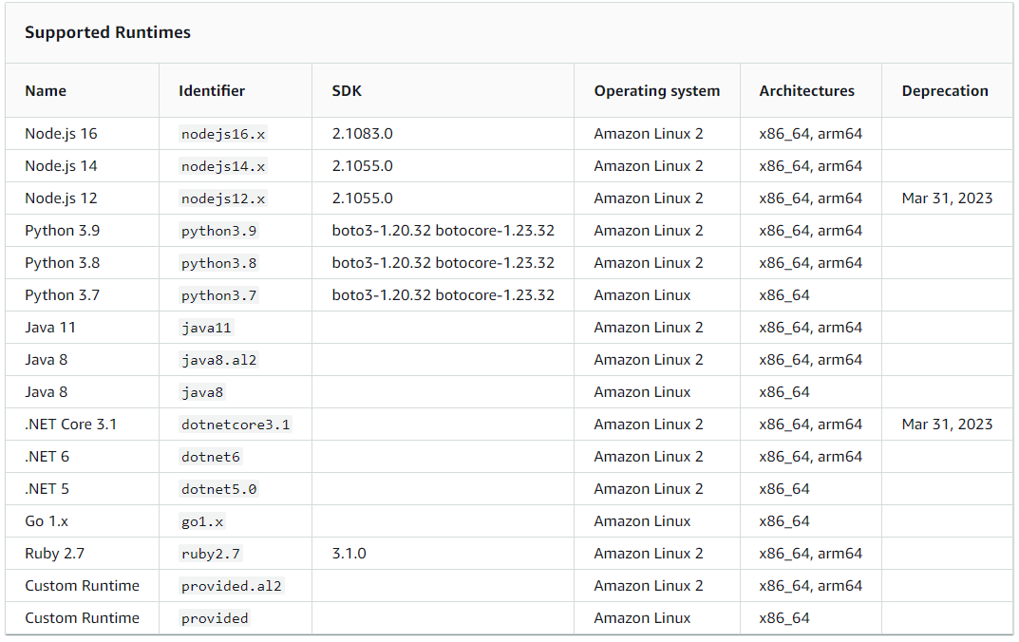
AWS LAMBDA runtime

Slide 5
When Not to Use AWS Lambda
Lambda timeout in 15 min / 900 seconds
Cold Start Issues
Memory cannot exceed 10,240 MB
Invocation Payload cannot exceed
6 MB (synchronous)
256 KB (asynchronous)

Slide 6
Demo
1. Create your first hello world lambda

