Slide 1



辯士與蘇格拉底
國立台灣大學哲學系教授苑舉正
【本著作除另有註明外，採取創用CC「姓名標示－非商業性－相同方式分享」台灣3.0版授權釋出】
本作品轉載自Microsoft Office 2007多媒體藝廊，依據Microsoft服務合約及著作權法第46、52、65條合理使用

Slide 2
The Sophists may be said to be the first Greek sceptics. The materialism of the Atomists, the idealism of the Eleatics, and the doctrine of universal change with which Heraclitus (Ephesians) was associated — all these tendencies resulted in a condition of unrest, out of which philosophy could not advance to a more satisfactory state until an enquiry was made into the problem of the value of knowledge. The Sophists did not undertake that enquiry, but they called attention to the existence of knowledge at all.

Slide 3
In brief, the Sophistic method was different from the Socratic method by being the method of strife (Eristic method) in contrast to the Socratic method of discovery (Heuristic method). Sophism is of great importance historically, because it was the evil influence of the Sophists that inspired Socrates with the idea of refuting them by showing the conditions of true knowledge.

Slide 4
什麼是辯士？什麼是詭辯學派？
辯士或詭辯學派(Sophism)都是只同一批人，但是在稱謂上具有不同價值的認定。
我們知道有這一批人的存在，主要原因來自於柏拉圖與亞里斯多德。
「蘇柏亞」對於這批人的道德判斷很低，但弔詭的地方在於，蘇格拉底本人在古代雅典被當作頭號的sophist。
因此，我們可以推想，蘇與他們只有一線之隔。

Slide 5
這是什麼「線」呢？
讓我們先看看有哪些有名的sophists?
Protagoras:個人主義者。
Gorgias: 虛無主義者。
Hippias: 博學主義者。
Prodicus: 道德主義者。

Slide 6
Protagoras of Abdera (same as Democritus and learned philosophy from the Atomist),
called the Individualist (for Plato, relativist) because he says rather famously: "Man is the measure of all things: of things which are, that they are, and of things which are not, that they are not”.

Slide 7
Gorgias was called the Nihilist because of his doctrine:
Nothing exists;
Even if something exists, nothing can be known about it; and
Even if something can be known about it, knowledge about it can't be communicated to others.
Even if it can be communicated, there is no incentive to do so.

Slide 8
Hippias was called the Polymathist because he was a man of very extensive knowledge, and he occupied himself not only with rhetorical, philosophical and political studies, but was also well versed in poetry, music, mathematics, painting and sculpture, and he claimed some practical skill in the ordinary arts of life, for he used to boast of wearing on his body nothing that he had not made himself with his own hands.
On the other hand, his knowledge always appears superficial as he does not enter into the details of any particular art or science, and is satisfied with certain generalities, which enabled him to speak on everything without a thorough knowledge of any.

Slide 9
Prodicus, called the Moralist because in his discourses, especially in that which he entitled "Hercules at the Cross-roads" (concerning the stake of selecting either virtue or vice), he strove to inculcate moral lessons, although he did not attempt to reduce conduct to principles, but taught rather by proverb, epigram, and illustration. He is the only sophist being somewhat praised by Socrates and Plato and the reason is clearly that his teaching contained moral lessons to take. But he still collect a handsome amount of money for offering lectures.

Slide 10
Gorgias by Plato
Gorgias: Rhetoric, Socrates, is my art.
Socrates: Then I am to call you a rhetorician?
Gorgias: Then pray do.
Socrates: And are we to say that you are able to make other men rhetoricians?
Gorgias: Yes, that is exactly what I profess to make them, not only at Athens, but in all places.

Slide 11
Socrates: Then why, if you call rhetoric the art which treats of discourse, and all the other arts treat of discourse, do you not call them arts of rhetoric?
Gorgias: Because, Socrates, the knowledge of the other arts has only to do with some sort of external action, as of the hand; but there is no such action of the hand in rhetoric which works and takes effect only through the medium of discourse. And therefore I am justified in saying that rhetoric treats of discourse.
Socrates: But there are other arts which work wholly through the medium of language, and require either no action or very little, as, for example, the arts of arithmetic, of calculation, of geometry, and of playing draughts.
Gorgias: Exactly.

Slide 12
Gorgias: If you have the power of uttering this word, you will have the physician your slave, and the trainer your slave, and the money-maker of whom you talk will be found to gather treasures, not for himself, but for you who are able to speak and to persuade the multitude.
Socrates: Now I think, Gorgias, that you have very accurately explained what you conceive to be the art of rhetoric that rhetoric is the artificer of persuasion, having this and no other business, and that this is her crown and end. Do you know any other effect of rhetoric over and above that of producing persuasion?
Gorgias: No: the definition seems to me very fair, Socrates; for persuasion is the chief end of rhetoric.

Slide 13
Socrates: You, Gorgias, like myself, have had great experience of disputations, and you must have observed that disagreements are apt to arise; somebody says that another has not spoken truly or clearly; and then they get into a passion and begin to quarrel. But I cannot help feeling that you are now saying what is not quite consistent or accordant with what you were saying at first about rhetoric. And I am afraid to point this out to you that I speak, not for the sake of discovering the truth.

Slide 14
Now if you are one of my sort, I should like to cross-examine you, but if not I will let you alone. And what is my sort? I am one of those who are very willing to be refuted if I say anything which is not true, and very willing to refute any one else who says what is not true, and quite as ready to be refuted as to refute. For I imagine that there is no evil which a man can endure so great as an erroneous opinion about the matters of which we are speaking and if you claim to be one of my sort, let us have the discussion out, but if you would rather have done, no matter-let us make an end of it.

Slide 15
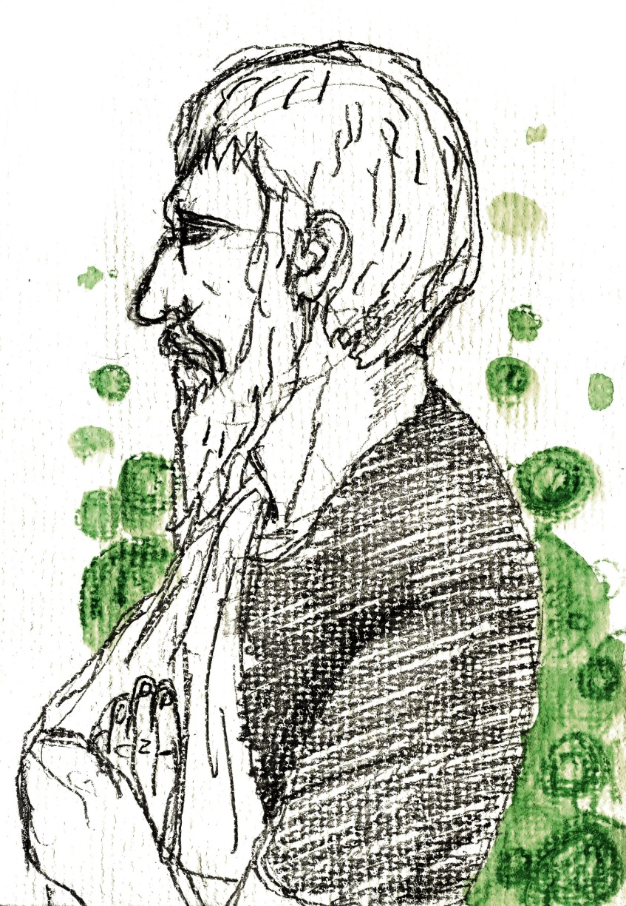


一個述而不作的哲學家，說出的話是什麼？
蘇格拉底最著名的兩句話是：
“An unexamined life is not worth living!”
一個未經檢驗的生命是不值得活的！
“The only thing I know is that I do not know anything!”
我唯一知道的東西就是我什麼也不知道！

Slide 16
蘇格拉底在哪裡說這兩句話？
在柏拉圖的《辯護篇》。
他為什麼要說這兩句話？
因為，他蒙受誤解，尤其是艾利托芬尼的劇作《雲》。

Slide 17
Aristophanes的《雲》寫於西元前423年。
蘇格拉底鼓勵年輕人研究從昆蟲到天文的自然世界，論證的技巧，反對所有雅典傳統中視為恰當的事物。
在戲劇中，男主角帶著蘇格拉底的面具，嘲弄雅典的神祉的行為，不但受到年輕人的學習，還對於雅典人奉為神蹟的現象，提出自然的解釋。
最糟糕的是，蘇格拉底還教導年輕人耍賴不還債的技巧，並且還鼓勵他們以暴力讓父母屈服。

Slide 18
Someone will say: Yes, Socrates, but cannot you hold your tongue, and then you may go into a foreign city, and no one will interfere with you?
Now I have great difficulty in making you understand my answer to this. For if I tell you that this would be a disobedience to a divine command, and therefore that I cannot hold my tongue, you will not believe that I am serious; and if I say again that the greatest good of man is daily to converse about virtue, and all that concerning which you hear me examining myself and others, and that the life which is unexamined is not worth living - that you are still less likely to believe. And yet what I say is true, although a thing of which it is hard for me to persuade you.

Slide 19
At last I went to the artisans, for I was conscious that I knew nothing at all, as I may say, and I was sure that they knew many fine things; and in this I was not mistaken, for they did know many things of which I was ignorant, and in this they certainly were wiser than I was. But I observed that even the good artisans fell into the same error as the poets; because they were good workmen they thought that they also knew all sorts of high matters, and this defect in them overshadowed their wisdom - therefore I asked myself on behalf of the oracle, whether I would like to be as I was, neither having their knowledge nor their ignorance, or like them in both; and I made answer to myself and the oracle that I was better off as I was.

Slide 20
蘇格拉底的審判與處死(399 BC)是他一生中最為後人所談及的「哲學議題」，也成為柏拉圖《對話錄》當中，有關蘇格拉底最重要的部分。依照柏拉圖的觀點，其實無論是審判或是處死都是「莫須有」罪名下所導致的結果，因此都是不正義的。蘇格拉底自己也在辯護中說，如果他放棄哲學，轉而回鄉處理私人事業的話，那麼他將免於受到審判的折磨。即是在被判死刑之後，蘇格拉底依然有機會在友人的資助下，逃離雅典。
那麼，為什麼他沒有選擇做出一般人多半會作的選擇呢？這個問題的答案，不但構成柏拉圖《對話錄》中多篇著作的討論主題，本身也因為涉及一個人如何看待生命中的理想與現實，成為西洋哲學中最具道德意義的議題。

Slide 21
蘇格拉底認為： 人人都應作一個負責任的公民
蘇格拉底被柏拉圖塑造為一位忠於國家的人，因為他因捍衛國家法律的尊嚴，接受「蠱惑青年」的罪名，判處死刑。
在蘇格拉底的教育中，他鄙視感官上的滿足，卻因為提升美感而感到高興。
他將其一身的經歷，均奉獻給雅典公民，在市中心的廣場，不斷與來往的人進行對話，探討各種哲學理念。
蘇格拉底被公認為西洋哲學的奠基者，也是這種思想的實踐者。

Slide 22
蘇格拉底對於哲學最重要的貢獻：
他為哲學的思考模式提供了批判的原則與方法。但是，因為蘇格拉底本人「述而不作」的緣故，所以所有有關他的思想，完全來自於他的學生，柏拉圖的《對話錄》。
在《對話錄》中，柏拉圖將蘇格拉底以老師的形象呈現。蘇格拉底不承認自己有知識可以傳授給學生，他只是依照心靈中的智慧，不斷地從事於一個理性人應當作的對話。
與蘇格拉底對話的人，總是在一開始覺得自己知道一些事物，然後受到蘇格拉底的質疑，舉證歷歷地說出他的思路中，其實包含許多前後不一致的地方。這些不一致的地方，往往會迫使這個與蘇格拉底對話的人，覺得自己必須坦承，他其實對於自己宣稱所知的事物，其實是一無所知的。

Slide 23
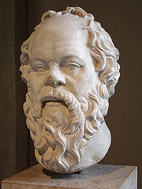

蘇格拉底與其他哲學家有什麼不同？
一、思考的對象，應為人性本質，而非自然本質。
二、透過語言的對話，可以突顯人類獲得真理的限制。
三、張揚具有理想性格的知識份子。
四、人人皆應作一個遵守國家法律的公民。

Slide 24
二、語言的敘述，無法充分展現真理
蘇格拉底哲學中最重要的部分（反詰法）：提問與回答。
提問的目的是什麼？答案：進行對話交流。
提問的意義是什麼？答案：進行捍衛對抗。
提問的效用是什麼？答案：進行反諷啟發。
提問的結果是什麼？答案：承認無知
對話、捍衛與反諷之間的循環，構成學習的過程，其目的在於討論表面與真實之間的差別。
哲學就是一個否定表面認知，探究真實本質的活動。

Slide 25
蘇格拉底的反詰法反對什麼？
它反對傳統中的信念與偏見。
它反對權威中的盲從與欺騙。
它反對群眾中的情緒與反智。
它反對內心中的怯懦與冷漠。

Slide 26
蘇格拉底的反詰法有什麼用處？
它可以，維持一個真正的民主，擁有自由的社會。
為什麼？
因為，我們所需要的民主制度，是一個有反思能力與審議機制的民主，不是一個由各種利益團體所組成的市場。
我們需要的民主是，真正能夠為公眾利益進行思考的民主。

Slide 27
蘇格拉底的反詰法有什麼用處？
在這樣的民主機制中，我們才能夠產生出那種具有蘇格拉底理智能力的公民。
這種公民能夠對於他們的信念提出問題，質疑這些信念的真實性。
如果一個國家的國民將各種政論節目中所獲得的資訊，轉化成為投票的理由時，那麼這種對於他人言論深信不疑的態度，將無助於民主的發展。

Slide 28
蘇格拉底的反詰法有什麼用處？
缺乏批判性思考的國家，即使擁有民主制度，國民只是各自表達信念，但缺乏真正的對話。
在這種情況中，好的論證不存在，而且偏見將很容易地誤認為是理性。
為了去除偏見以確保正義，我們需要論證的精神與力量，因為這是維護公民自由中最關鍵的工具。

Slide 29
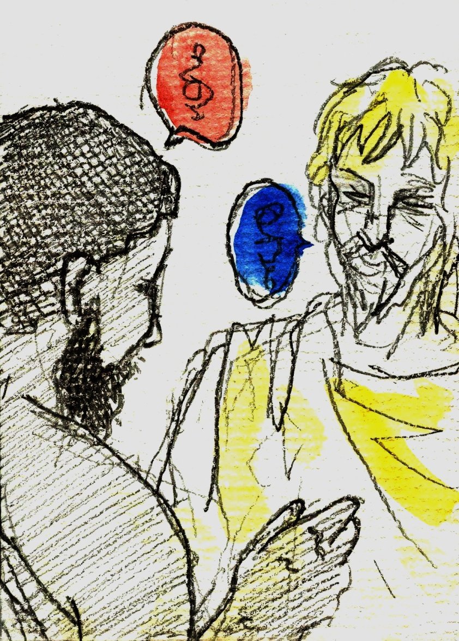
蘇格拉底反詰法的意義
以問答為主要進行方式的蘇格拉底詰問法，使用諷刺的方法目的是為了能夠深入語言的本質，探討概念所指涉的對象，不是感覺中的印象，而是不斷深入思考的理解。
我們每一個人在對話過程中，自己都應該去面對自己因無知或者混淆所導致的事實。

Slide 30
蘇格拉底哲學之道德意義
1.想要活出有意義的生命，就必須檢驗生命的本質，實現生命的目的，堅持生命的理想。
2.這些有關為什麼活著的問題，都不是個人主觀判斷的結果，而是客觀的原則，也正是思考的對象。
3.人人從事於類似的哲學思考，皆可以從他們的內心中，感受到擁有真理的喜悅。
4.如何從事哲學思考：提出問題、進行對話、啟發心靈、自我檢驗。

Slide 31
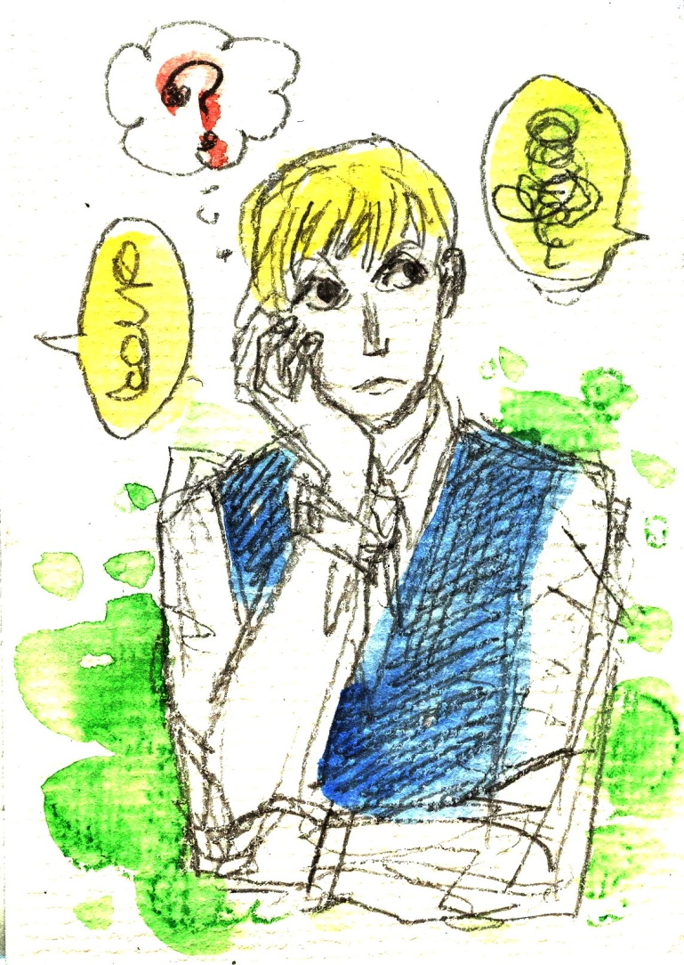
結論
作為西方哲學中探討人性本質最重要的一位位哲學家，蘇格拉底認為，哲學是一個批判性的自我檢驗過程，而從事這個檢驗的目的，是為了要能夠達成作判斷、選擇，以及行動的正確原則。

Slide 32


版權聲明
頁碼 | 作品 | 版權圖示 | 來源/作者
1 |  |  | 本作品轉載自Microsoft Office 2011 PowerPoint for Mac 設計主題範本-黑色，依據Microsoft 服務合約及著作權法第46、52、65條合理使用。
1 |  |  | WIKIPEDIA，Photograph by Greg O‘Beirne.，Cropped by Tomisti，http://en.wikipedia.org/wiki/File:UWASocrates_gobeirne_cropped.jpg ， 瀏覽日期：2012/10/3。
15 |  |  | 台灣大學 苑舉正
13 | An unexamined life is not worth living |  | Socrates ( 469 BC – 399 BC )
13 | The only thing I ……know anything |  | Socrates ( 469 BC – 399 BC )

Slide 33
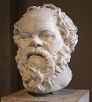
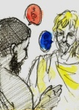
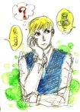
版權聲明
頁碼 | 作品 | 版權圖示 | 來源/作者
23 |  |  | WIKIMEDIA COMMONS， Lysippos-Portrait of Socrates ， Photographer by Eric Gaba, July 2005。 http://commons.wikimedia.org/wiki/File:Socrates_Louvre.jpg
29 |  |  | 台灣大學 苑舉正
31 |  |  | 台灣大學 苑舉正

