Slide 1
Triangulation of eIDSR and Lab AFP cases
Robinson

Slide 2
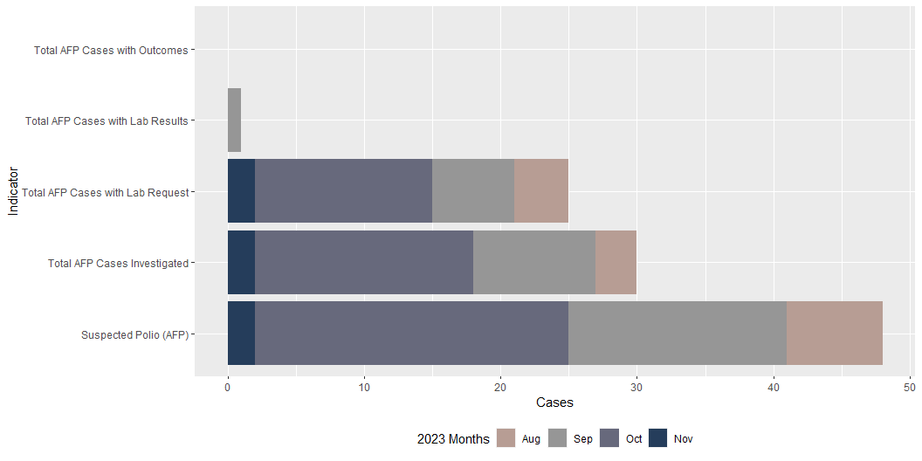
eIDSR national level AFP cases data by indicator

Slide 3
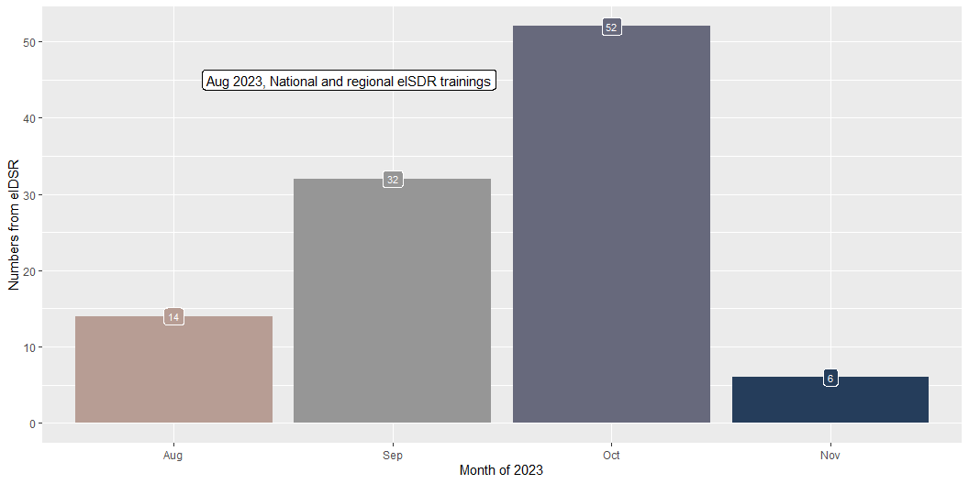
eIDSR national AFP cases reported by month

Slide 4
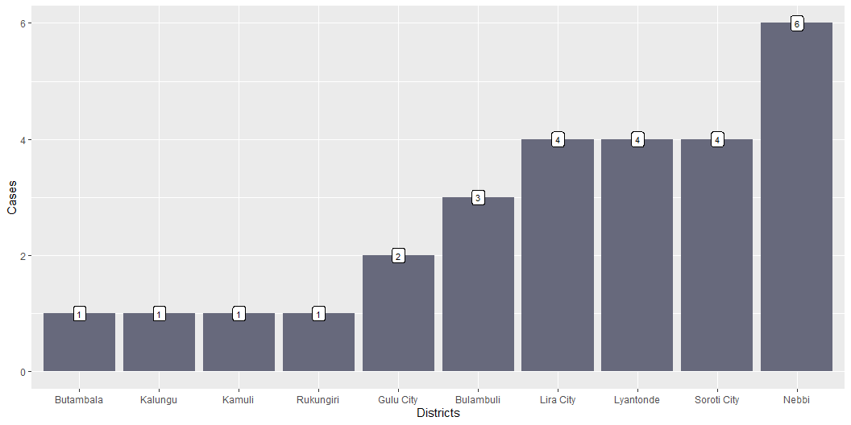
eIDSR District level AFP cases investaged from Sep to Nov 2023

Slide 5
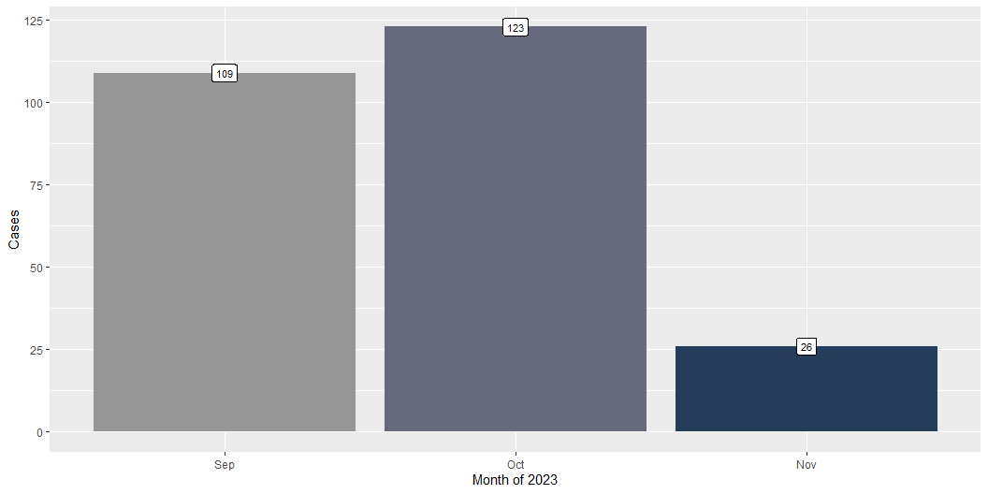
Lab National level AFP cases investigated by month

Slide 6
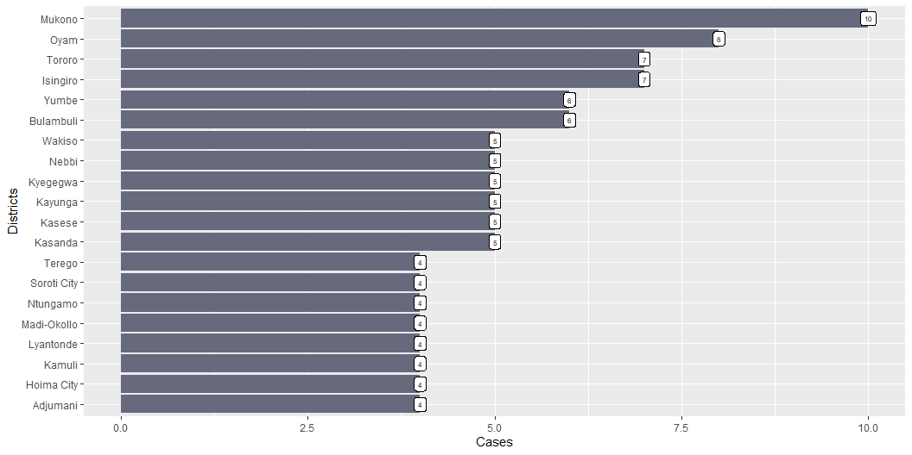
Lab District (20) level AFP cases investigated from Sep to Oct 2023

Slide 7
AFP cases investigated and reported to the Lab vs eIDSR by District
organisationunitname | eIDSR | Lab
Bulambuli | 3 | 4
Butambala | 1 | 0
Gulu City | 2 | 2
Kalungu | 1 | NA
Kamuli | 1 | 3
Lira City | 4 | 2
Lyantonde | 4 | 4
Nebbi | 6 | 5
Rukungiri | 1 | NA
Soroti City | 4 | 4

