Slide 1
Triangulation of eIDSR and Lab MR cases
Robinson

Slide 2
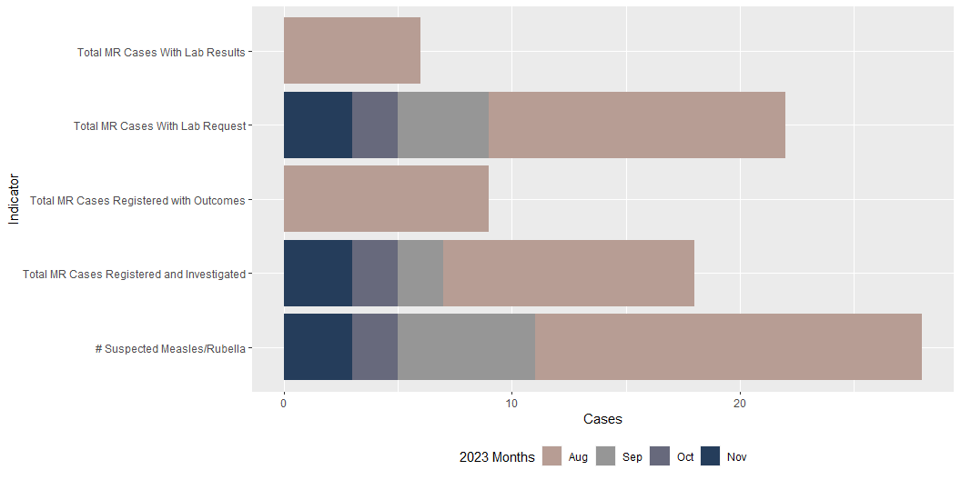
eIDSR national level MR data by indicator

Slide 3
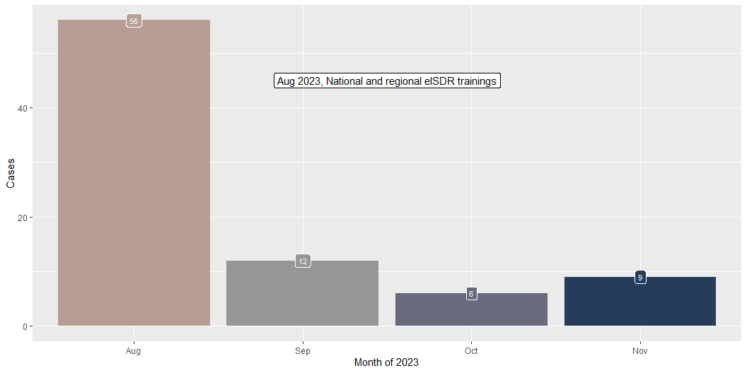
eIDSR national MR cases reported by month

Slide 4
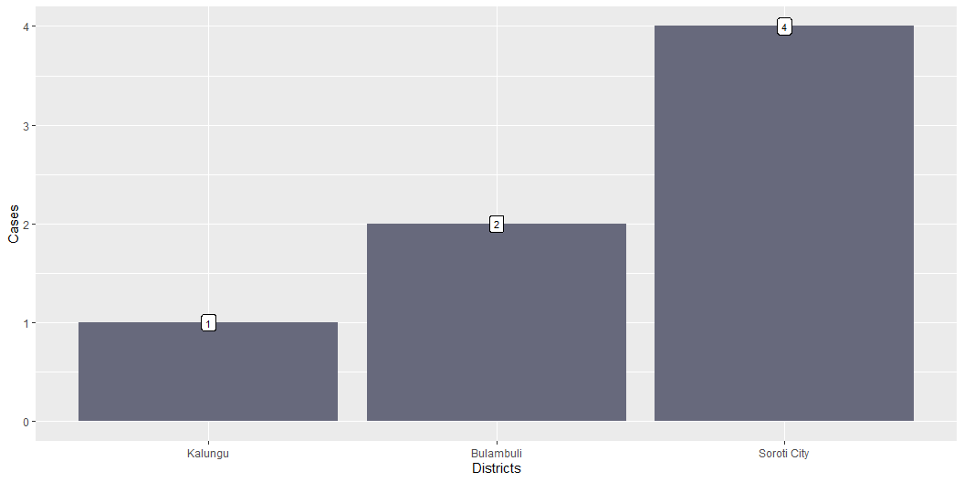
eIDSR District level MR cases investaged from Sep to Nov 2023

Slide 5
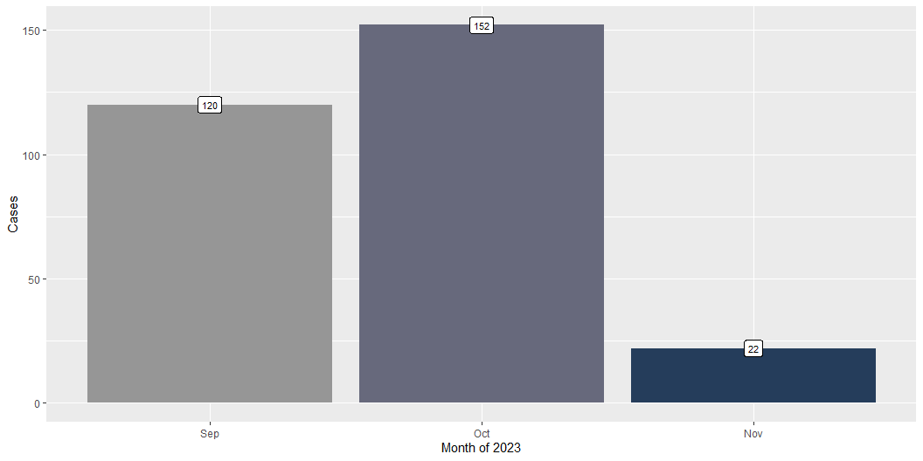
Lab - National level MR cases investigated by month

Slide 6
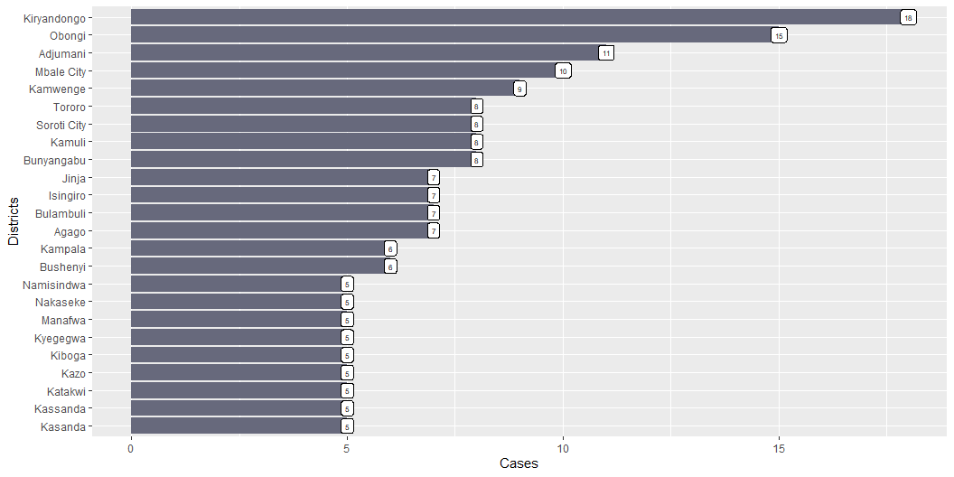
Lab - District (20) level AFP cases investigated from Sep to Oct 2023

Slide 7
AFP cases investigated and reported to the Lab vs eIDSR by District
organisationunitname | eIDSR | Lab
Bulambuli | 2 | 7
Kalungu | 1 | 1
Soroti City | 4 | 6

