Slide 1
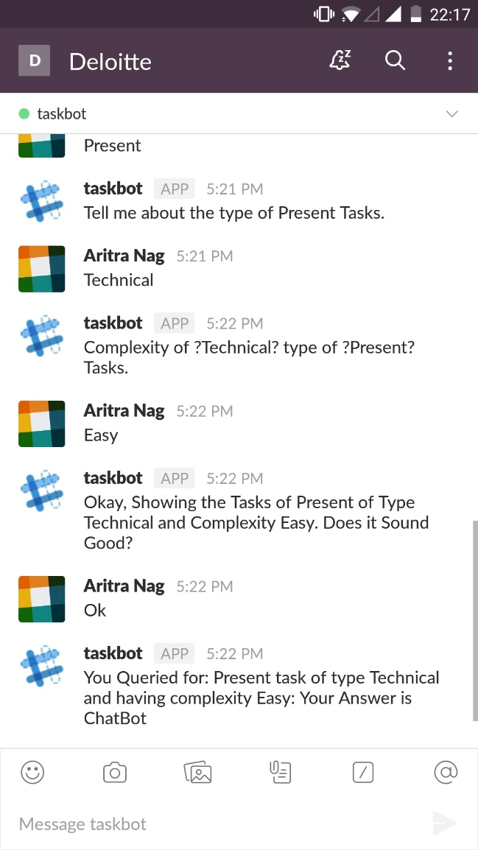
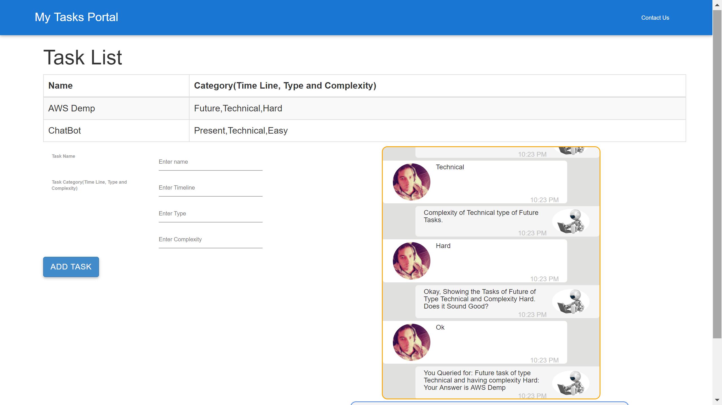
Task Management Portal – End User Capabilities
Task Bot Using Slack
Task Portal for Web Browser
Store the Data’s
Related to Task

