Slide 1
College Name Here
Topic: Memory and its Types
Submitted by:
Abc
Class : xyz-1st Year
Roll No. : 123456789
Submitted to:
Mrs. Abx
Assistant Professor of .....

Slide 2
Memory:
Memory is the most essential element of a computing system
Without it computer can’t perform any tasks.
Basically, memory is used to store Data, Information and Programs.
Data, Information and Programs these are stored in the form of 0 or 1 bit

Slide 3
Types of Memory:
Primary Memory:
Secondary Memory:
Also known as volatile memory.
It is temporary memory.
Data cannot store permanently in primary memory.
In primary memory contents lost when we turn off our Computer
Example: RAM(Random Access Memory)
Also known as non-volatile memory.
It is permanent memory.
Data cans be store permanently in secondary memory.
No data lose in the case of power off.
Example: Magnetic Disk, Optical Disk, etc.

Slide 4
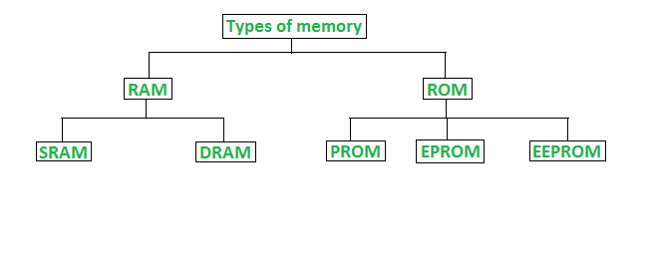
Primary Memory:

Slide 5
RAM
Also called as the Main Memory or the Primary Memory.
RAM stands for Random Access Memory
The programs and data during execution of a program are stored in this memory.
It is a volatile memory as the data loses when the power is turned off.
RAM is further classified into two types- SRAM (Static Random Access Memory) and DRAM (Dynamic Random Access Memory).

Slide 6
Types of RAM
SRAM
Stand for Static RAM.
It is faster than the DRAM.
It is more expensive and more power consuming.
No require of refreshing and cannot store many bits per chip.
Generates more heat.
Used for main cache memory.
DRAM
Stand for Dynamic RAM.
It is slower than the SRAM.
It is cheapen than SRAM and less power consuming.
Required of refreshing and can store many bits per chip.
Generates less heat.
Used for main memory.

Slide 7
ROM
ROM stands for Read Only Memory.
It is not volatile.
Always retains its data.
In ROM a user cannot change instructions.
Used in calculators and peripheral devices.
ROM further classified into 3 types: PROM, EPROM, and EEPROM.

Slide 8
Types of ROM
PROM
Stand for Programmable Read Only Memory.
It can be programmed by the user.
In PROM instructions are burned only once.
Data and Instructions cannot changed.
EPROM
Stand for Erasable Programmable Read Only Memory.
EPROM can be reprogrammed.
It can be erased by exposure.
Also called ultraviolet EPROM.
To reprogram it, erase all the previous data.
EEPROM
Stand for Electrically Erasable Programmable Read Only Memory.
The data can be electrically erased, then rewritten electrically.
No need of ultra violet light while erasing.

Slide 9
Secondary Memory
Types Secondary Memory
Sequential
Access
Optical
Disk
Flash
Memory
Magnetic
Disk

Slide 10
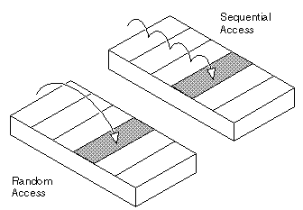
Sequential Access
Information in the file is processed in order, one record after the other.
Data can be read sequentially.
When we use write command, it will allocate memory and move the pointer to the end of the file
Such a method is reasonable for tape.

Slide 11
Magnetic Disk
A magnetic disk uses a magnetization process to read, write, rewrite and access data.
The Magnetic disk is made of a set of circular platters.
The data in the magnetic disk is randomly accessed.
Hard disks, zip disks, are common examples of magnetic disks.
The number of bits stored on each track does not

Slide 12
Optical Disk
An optical disk uses optical storage techniques and technology to read and write data.
In the optical disk, the data is sequentially accessed.
In optical disk, optical (light) energy is used
. It stores data digitally and uses laser beams to read and write data.
It uses the optical technology in which laser light is centred to the spinning disks.

Slide 13
Flash Memory
It is sometimes called flash RAM, and non-volatile types memory.
It can be electrically erased and reprogrammed.
It is used to transfer data between PC & Digital device.
Flash memory basically, found in USB flash drives, MP3 Players.

