Slide 1

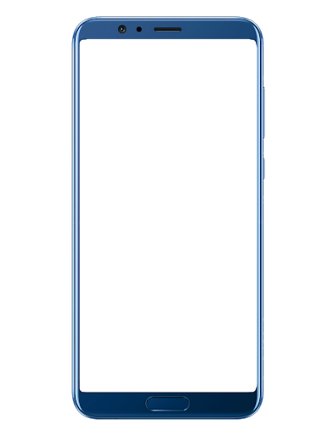
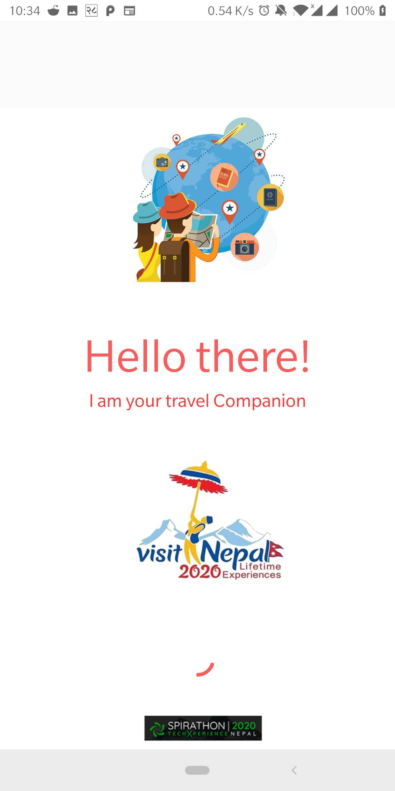
Virtual Guide Application
Your Personal Guide in your Pocket
Team BSM
- Bipin Maharjan
- Sachin Maharjan - Mohit Joshi

Slide 2
PROBLEMS

Slide 3
SOLUTION

Slide 4






FEATURES
Place
Reccomendation
Vocal
Information
Transportation
Infomation
Experience
like Locals
Price Range
Information
Emergency
Contacts

Slide 5
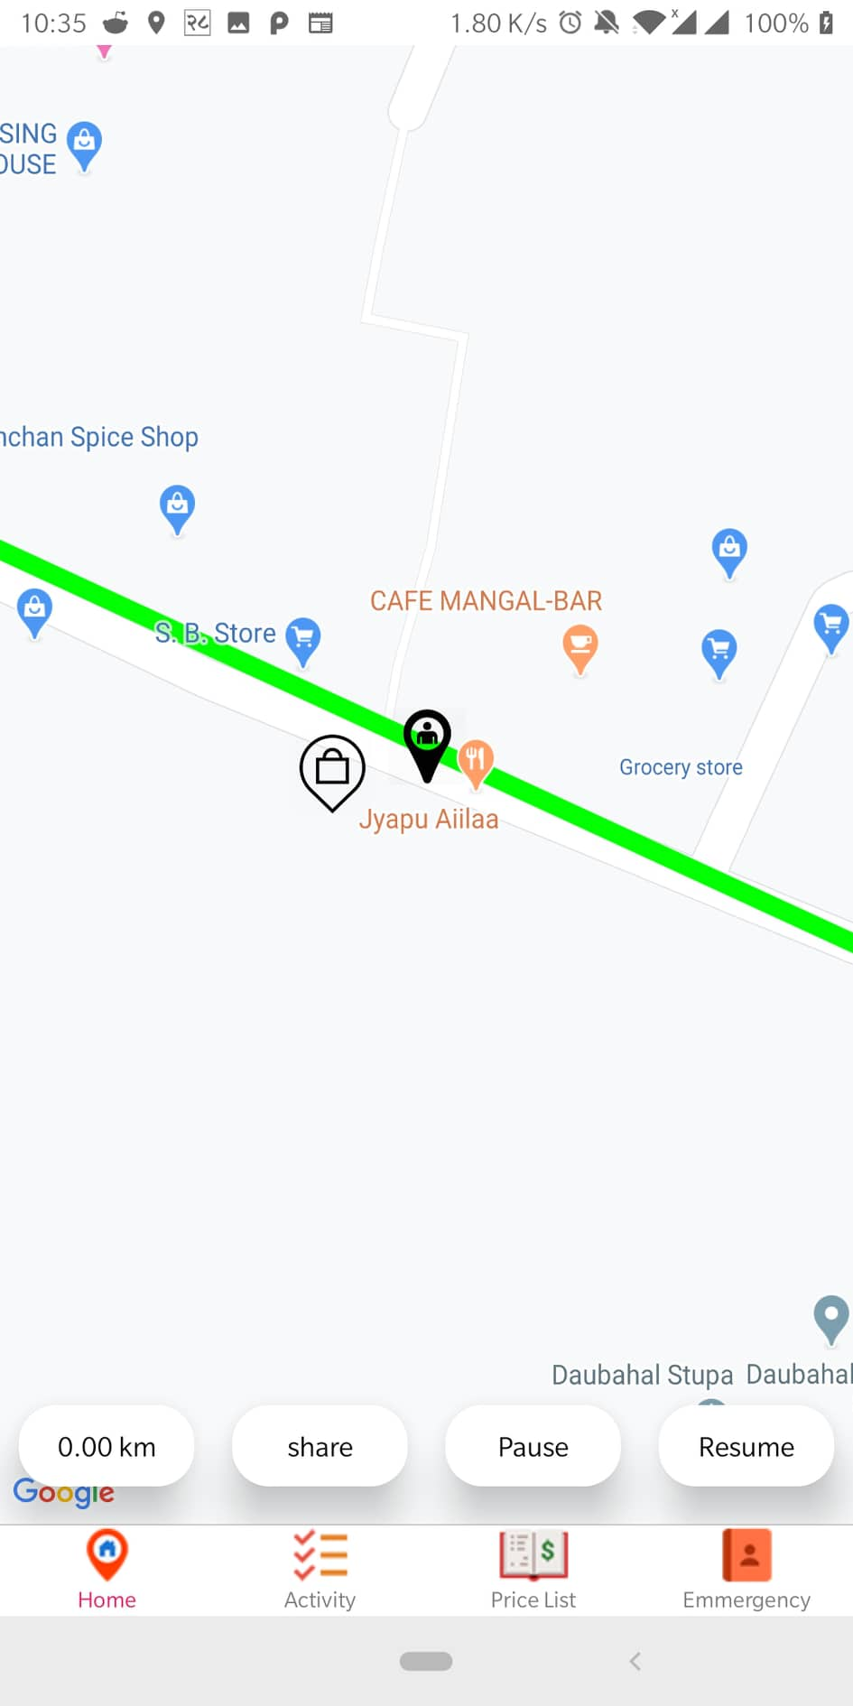
Voice Over

Slide 6
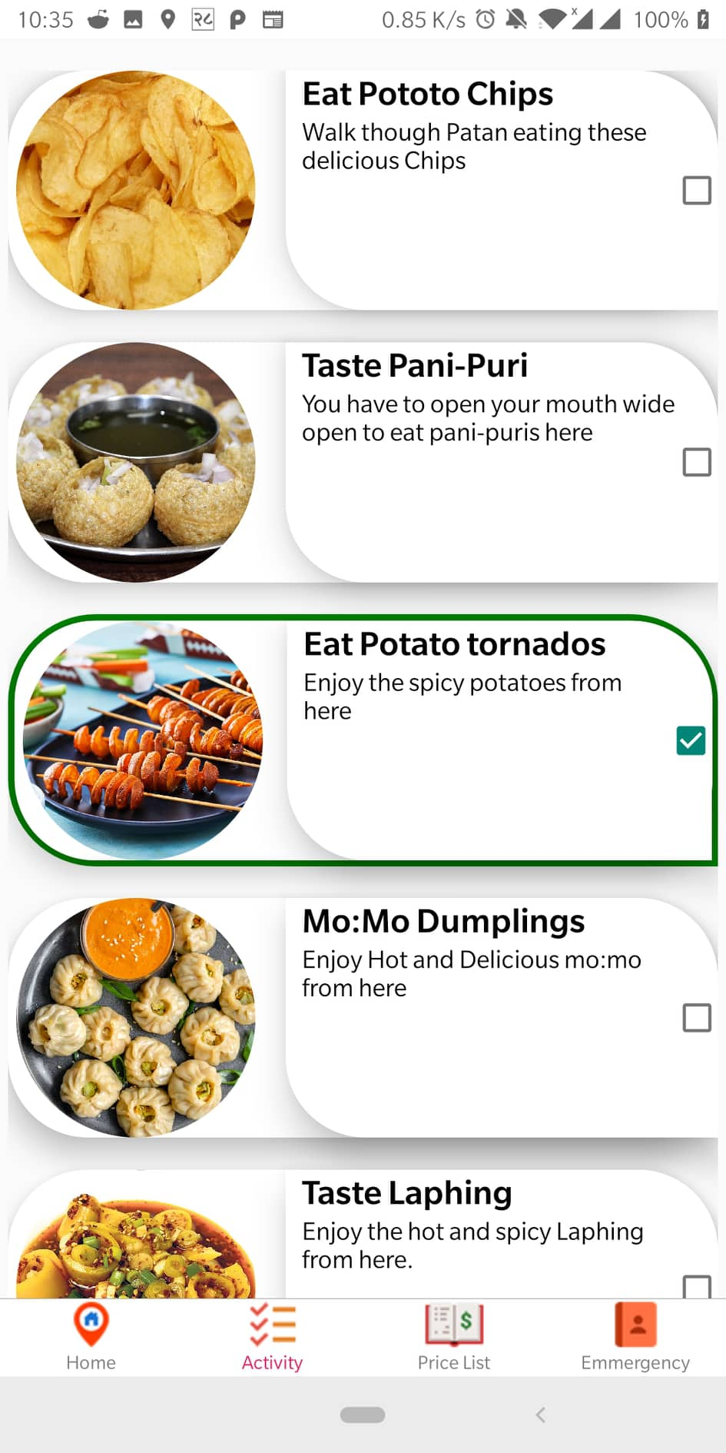
Recommendation

Slide 7
Transportation

Slide 8
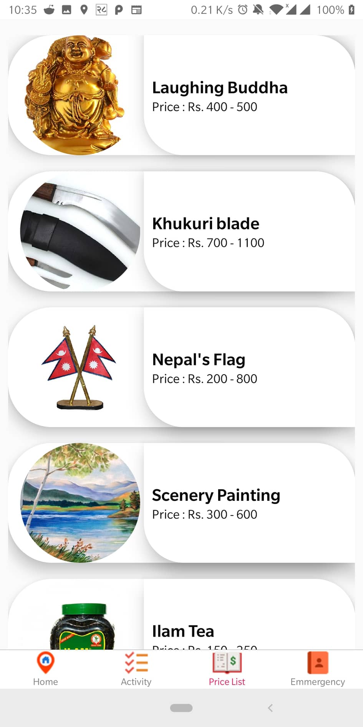
Price Range

Slide 9
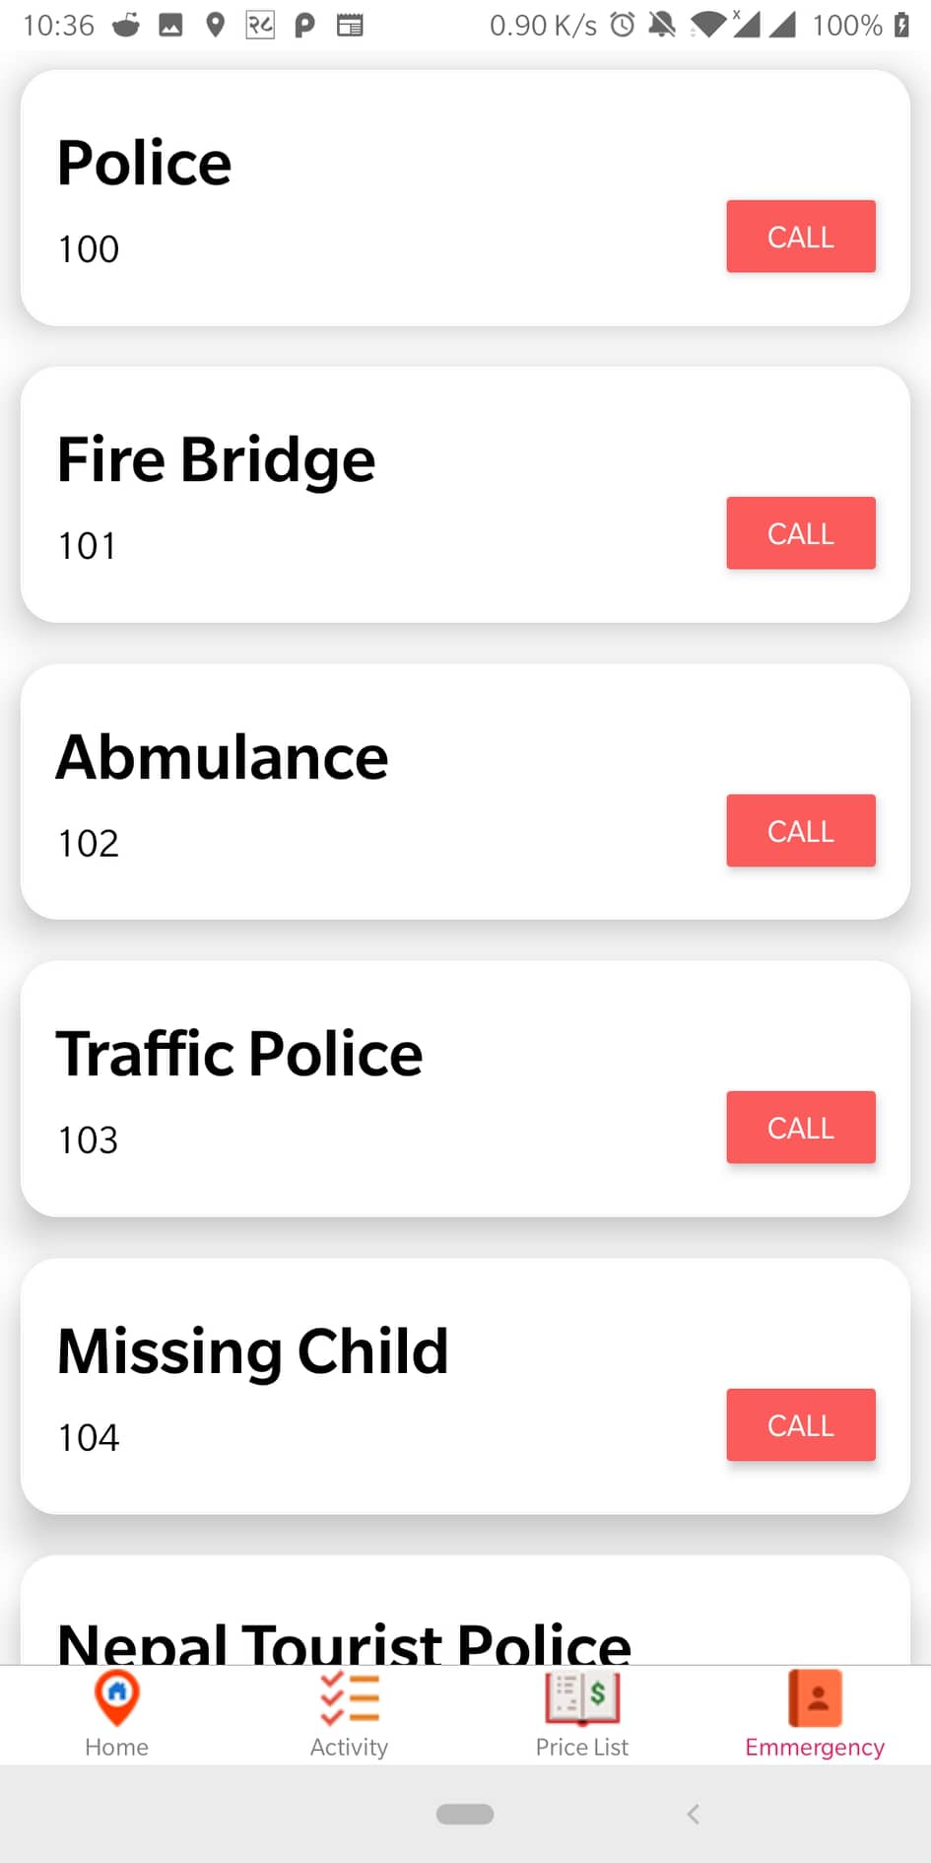
Emmergency
Contacts

Slide 10
FUTURE
ENCHANCEMENT

Slide 11
BUSINESS VALUE

Slide 12
THANK
YOU

