Slide 1
Liferay Application Development

Slide 2
Agenda
Introducing Liferay
Why Liferay?
Plugins overview
Architecture view
Jsr spec

Slide 3
Introducing Liferay
Liferay is the open souce leader for enterprise portal technology
#1

Slide 4
Why Liferay
Multiple technologies brings portal best of of it.
Fully featured content management system.
Built in User management and Security management cut the development time
More than 60+ out-of-box portlet
Choice of application servers and database servers
Open source
#2

Slide 5
Liferay plugins
Portlet
  Major java frameworks support to develop portlets as per defined specification.
Hook
  more out-of-the-box portlets can be customized using hot deployable bundle.( property files too.)
Theme
  Built in platform to render your application (Default responsive theme support.)
Layout
  Portlet arrangements on the portal page.
Ext
  Customaization on core portal behaviour
#3

Slide 6
Liferay documentation
Liferay Developer Network
  https://dev.liferay.com//develop
Github source
  https://github.com/liferay/liferay-plugins
  https://github.com/liferay/liferay-portal
#4

Slide 7
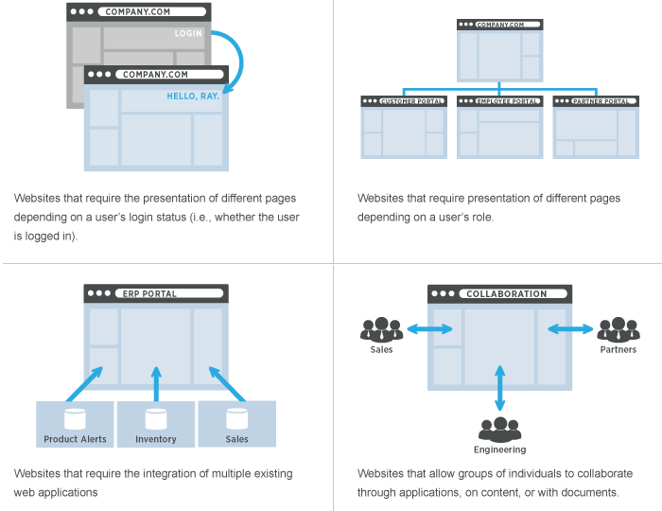
What is portal?
Software platform for building website and web application
#5

Slide 8
How does a Portal Work?
Portal build websites by assembling portlets
or gadgets on a portal page
#6

Slide 9
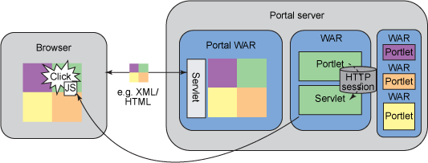
Java Portal Architecture
#7

Slide 10
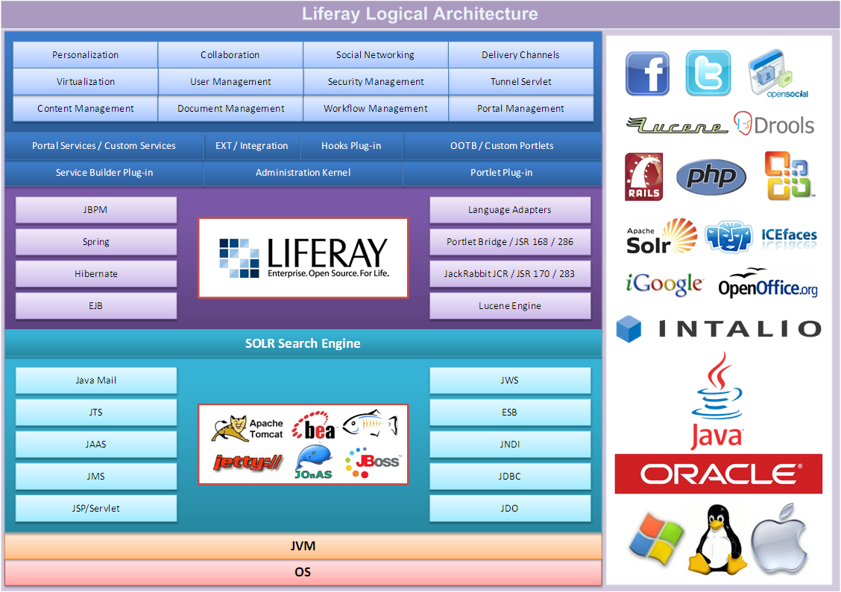
Liferay Architecture
#8

Slide 11
JSR Specification
JSR-168
JSR-286
#9

Slide 12
Popular Use cases
Web publishing and content mangement
Intranet application
Social & Collabration paltform
#10

Slide 13
Portal Features
Simplified UI Development
Flexible Enterprise Integration Framework
Out-of-the-box Tools
Secure Single Sign On (SSO)
Custom Fields
Workflow and Rule engine
User Groups, Organizations and Sites
User Personalization
Multi-language Support
#11

Slide 14
Portlet Lifecycle
init
render
processAction
processEvent
serveResource
destroy
#12

Slide 15
GenericPortlet
Annotation
  @ProcessAction
  @ProcessEvent
  @RenderMode
#13

Slide 16
Render
Controller method
  void render(RenderRequest request, RenderResponse response)
JSP
  <portlet:renderURL var=”myURL”/>
#14

Slide 17
Action
Controller method
  void processAction(ActionRequest request, ActionResponse response)
JSP
  <portlet:actionURL var=”myURL” name=”process”/>
#15

Slide 18
Serve Resource
Controller method
  void serveResource(ResourceRequest request, ResourceResponse response)
JSP
  <portlet:resourceURL var=”myResourceUrl”/>
#16

Slide 19
Software requirements
Eclipse luna
Liferay IDE 2.2.2 GA3
  http://releases.liferay.com/tools/ide/latest/stable/
Liferay-portal-6.2-ce-ga2
Liferay-plugins-sdk-6.2
Java7
#17

