Slide 1


Slide 2
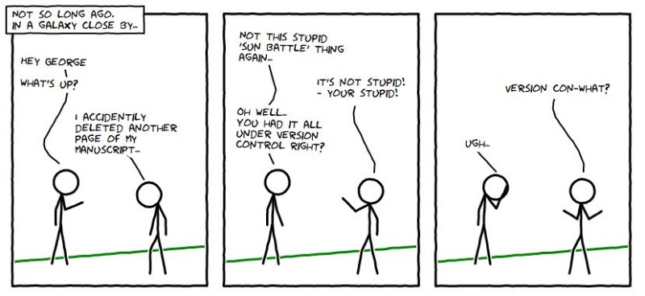

Slide 3

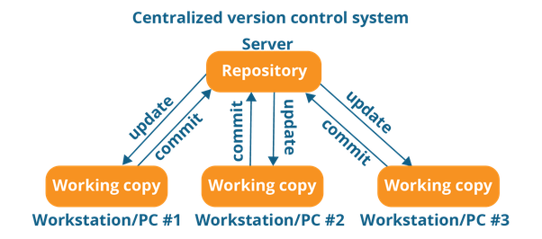
l
Version Control System
Central Version Control System (CVCS)

Slide 4
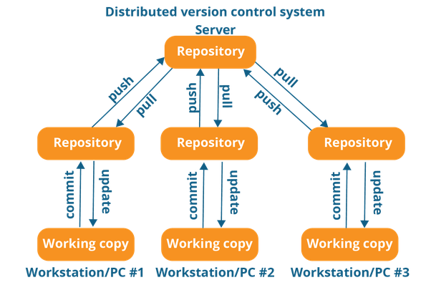
Git | Brief Intro
Git is a distributed version control system (DVCS) to track the changes in source code, but it can be used to track changes in any set of files
.
Distributed Version Control System (DVCS)

Slide 5
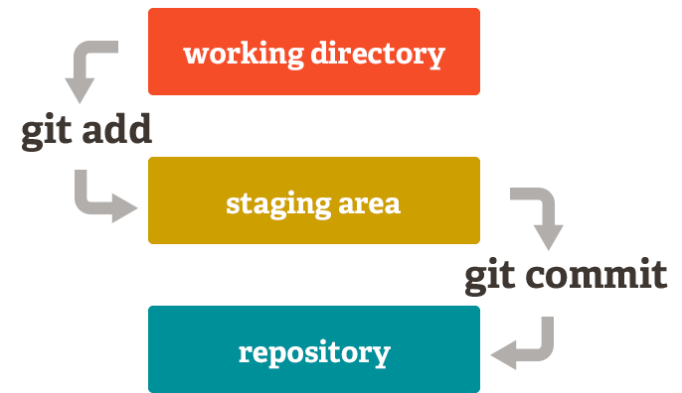
Git: Three Stage Architecture

Slide 6
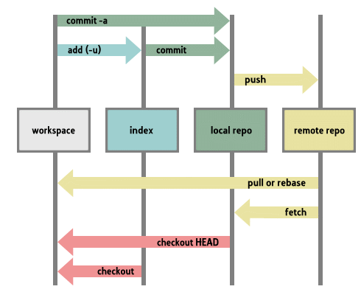
Git Life Cycle

Slide 7
Git Terminology
Repository: Repository is a central location in which data is stored and managed.
Commit: Commit is an operation which saves the changes permanently.
Staging Area: Staging is a step before the commit process in git. That is, a commit in git is performed in two steps: staging and actual commit.
Push: The git push command is used to upload local repository content to a remote repository.
Pull: The git pull command is used to fetch and download content from a remote repository and immediately update the local repository to match that content.
Remote Server: Remote server is a server which is not on a LAN (Local Area Network), it serves the data to the users across the globe.

Slide 8
One step back!
Repository: Repository is a central location in which data is stored and managed.
Commit: Commit is an operation which saves the changes permanently.
Staging Area: Staging is a step before the commit process in git. That is, a commit in git is performed in two steps: staging and actual commit.
Push: The git push command is used to upload local repository content to a remote repository.
Pull: The git pull command is used to fetch and download content from a remote repository and immediately update the local repository to match that content.
Remote Server: Remote server is a server which is not on a LAN (Local Area Network), it serves the data to the users across the globe.

Slide 9
Git Bash:
Bash is a Unix shell and command language, and is the default shell on Linux (Ubuntu etc.) and OS X. In laymen terms, the git which runs on the terminal of any Linux device is known as git bash.
Git CMD:
(Command Line prompt) is the command-line interpreter on Windows operating systems. Sort of an equivalent to the bad-ass terminal in Linux, when you install git on windows and you are used to using command line, one uses cmd to run git commands.
Git GUI:
Essentially aimed at people who don't like the coding on black screens a.k.a the command line. It provides a Graphical user interface to run the git commands you like for eg. if you are commiting some changes from your local repository to the staging queue, you would just have to click a button to commit the changes whereas the git command is 'git commit -m ""

Slide 10
Git Best Command That we will cover Today’s
git config
git init
git clone
git add
git commit
git ignore
git rm
git log
git show
git tag
git branch
git checkout
git merge
git remote
git push
git pull

Slide 11
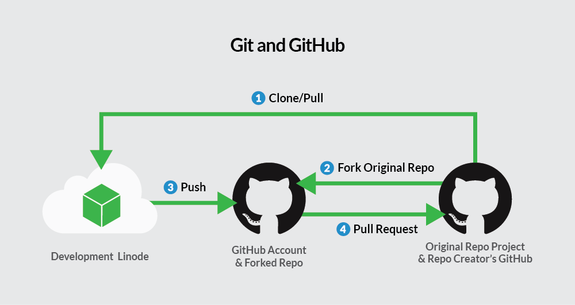

Slide 12
What is GitHub?
GitHub is a Git repository(repository, in short, is termed as a repo) hosting service platform allowing us to store our local repositories and share it with others for collaboration.
Github is home to 28 million active developers and 85 million repositories.
GitHub makes it a lot easier for individuals and teams to use Git for version control and collaboration. GitHub repositories are open for all making the other developers collaborate.
GitHub is free to use for public and open-source projects. On January 7, 2019, GitHub announced unlimited free private repositories.
Public repositories can be seen and cloned by anyone. But no one can change or alter source repositories(called master branch) unless we provide them special permission to do so. So, there is nothing to worry as it is completely safe.

Slide 13
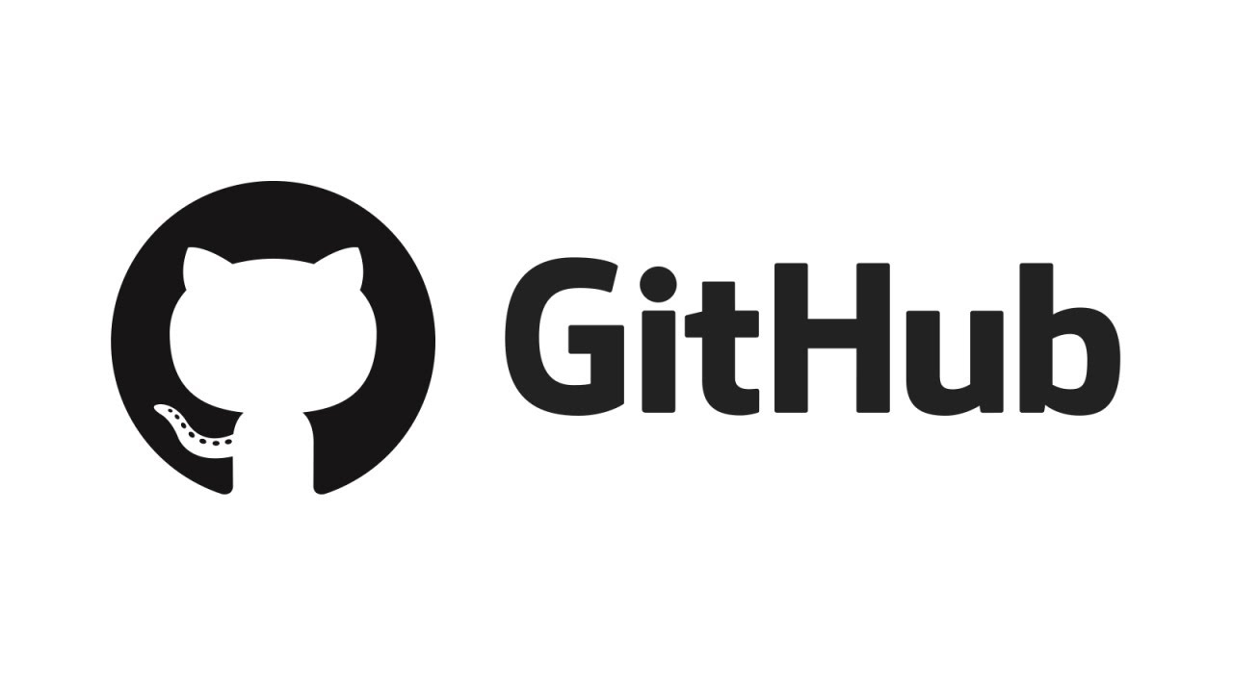
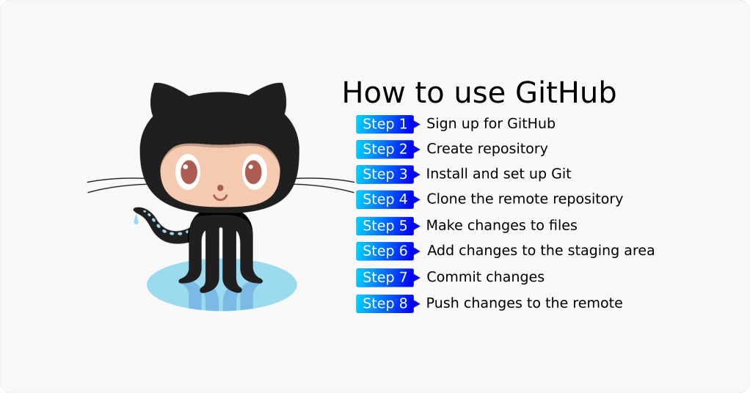

Slide 14
What is the PRO label in my profile?
Solution-
It means you are subcribed to the new Pro plan, as explained in this blog post: https://blog.github.com/2019-01-07-new-year-new-github/

Slide 15
Github Alternative
1. GitLab
2. BitBucket
3. SourceForge
4. AWS CodeCommit
5.Google Cloud Source Repositories

Slide 16
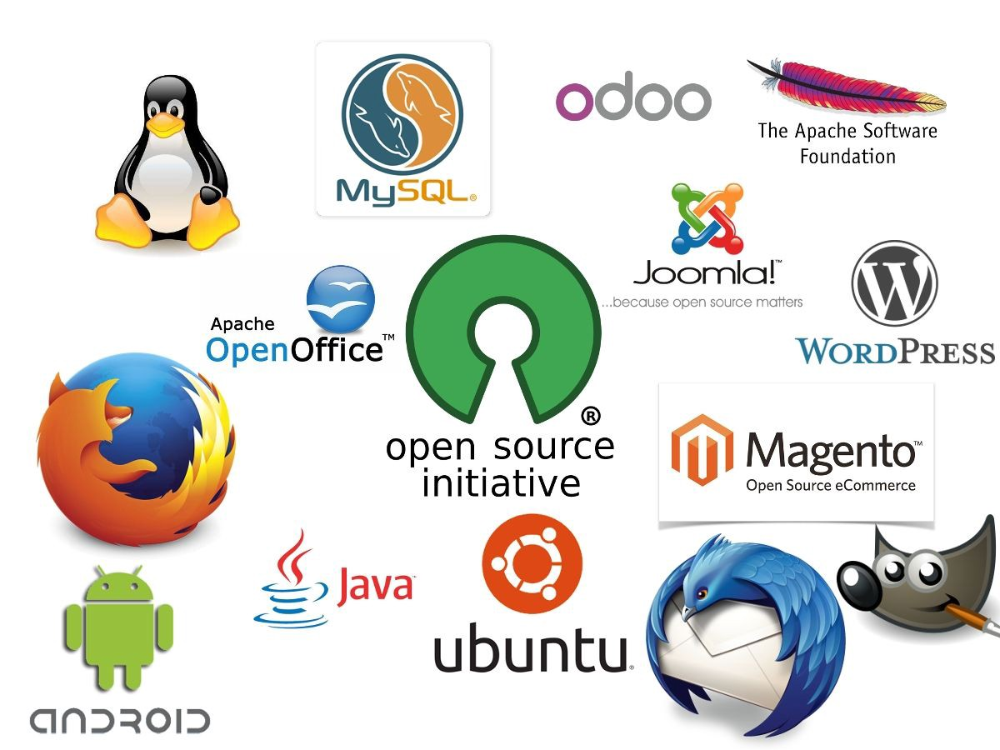

Slide 17
Open_Source and Programms
Open-source software is a type of computer software in which source code is released under a license in which the copyright holder grants users the rights to study, change, and distribute the software to anyone and for any purpose.
Google Summer of Code (GSoC)
Google Summer of Code eligibility: University students who are 18 years and above.
Google Summer of Code stipend: From $3000 to $6600 per student (varies according to your location)
Google Summer of Code date: Look out for Google Summer of Code 2020 application in February.
Google Code-in contest (GCI)
Google Code-in eligibility: Pre-university students from ages 13 to 17.

Slide 18
GCI Prize: A trip for two to Google HQ in Sans Francisco, USA. Moreover, winners receive swag like T-shirts, hoodies, Google Pixel latest phones, gift cards, earbuds, and trophies. If you can’t attend the trip for any reason, you will be offered $2000 plus other prizes.
Google Code-in date: Google Code-in 2019 competition is currently open! It will run from December 2nd to January 21st.
3. Outreachy Internships
Outreachy prize: Full-tuition scholarship for women in stem.
Application date: The 2020 Outreachy application period runs from February to March and September to October.
4. GirlScript Summer of Code (GSSoC)

Slide 19
GirlScript Summer of Code eligibility: Open to everyone, no matter your age, gender, and nationality.
GSSoC Prizes: The top three performers will get cash prize. The top 25 performers receive letters of recommendation and internship opportunities.
The top 50 performers will get T-shirts and other swag. In addition, participants with merged pull requests will get digital certificates.
GirlScript Summer of Code Application date: GirlScript Summer of Code 2020 will commence in January 2020.
Rails Girls Summer of Code (RGSoC)
Rails Girls Summer of Code eligibility: Open to all people with non-binary gender identities or who identify as women (transgender or cisgender).
Prize: The stipend amount is variable. It depends on where the applicant lives, how much their expenses are, and any special circumstances.
Application date: Rails Girls Summer of Code 2020 is expected to start receiving applications in February.

Slide 20
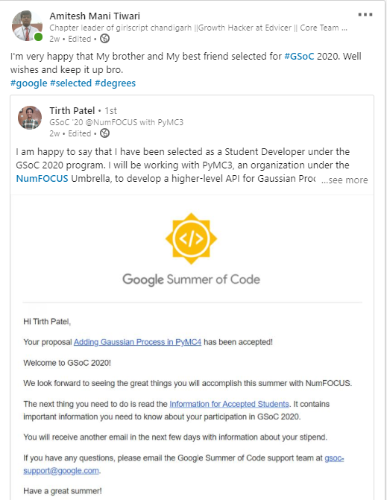
Motivational Story For Google Summer Of Code

Slide 21




 | Amitesh Mani Tiwari (Chapter leader of GirlScript Chandigarh & organizer of “Techincal-X-Factor”) Growth Hacker at Edvicer Pvt Ltd Contact number:- 9354615057
“Life is too short for long-term grudges.” ― Elon Musk

