Slide 1
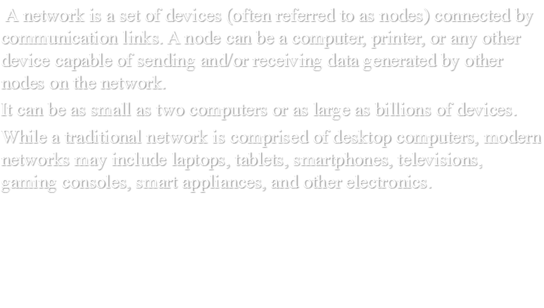

Slide 2
Types/Categories of Networks
when we speak of networks, we are generally referring to two primary categories:
local-area networks (LAN)and
wide-area networks(WAN)
Networks of a size in between are normally referred to as metropolitanarea networks(MAN) and span tens of miles.

Slide 3
LAN
A local area network (LAN) is usually privately owned and links the devices in a single office, building, or campus.
Depending on the needs of an organization and the type of technology used, a LAN can be as simple as two PCs and a printer in someone's home office; or it can extend throughout a company and include audio and video peripherals.
Currently, LAN size is limited to a few kilometers.
LANs are designed to allow resources to be shared between personal computers or workstations. The resources to be shared can include hardware (e.g., a printer), software (e.g., an application program), or data.
Early LANs had data rates in the 4 to 16 megabits per second (Mbps) range. Today,however, speeds are normally 100 or 1000 Mbps.

Slide 4
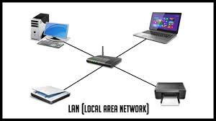
An Isolated LAN connecting 5 devices to a hub in a closet

Slide 5
Wide Area Network(WAN)
A wide area network (WAN) provides long-distance transmission of data, image, audio,and video information over large geographic areas that may comprise a country, a continent, or even the whole world.
A WAN can be as complex as the backbones that connect the Internet or as simple as a dial-up line that connects a home computer to the Internet.
We normally refer to the first as a switched WAN and to the second as a point-to-point WAN
The switched WAN connects the end systems, which usually comprise a router that connects to another LAN or WAN.
The point-to-point WAN is normally a line leased from a telephone or cable TV provider that connects a home computer or a small LAN to an Internet service provider (lSP).
This type of WAN is often used to provide Internet access.

Slide 6
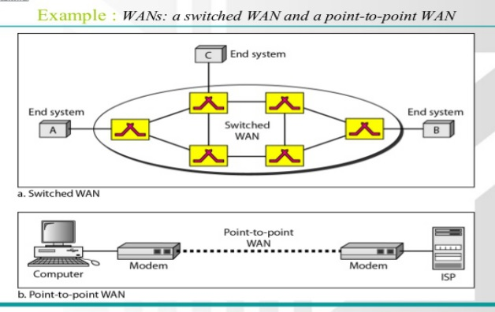
WAN Example

Slide 7
Metropolitan Area Networks(MAN)
A metropolitan area network (MAN) is a network with a size between a LAN and a WAN. It normally covers the area inside a town or a city.
It is designed for customers who need a high-speed connectivity, normally to the Internet, and have endpoints spread over a city or part of city.
A good example of a MAN is the part of the telephone
company network that can provide a high-speed DSL line to the customer. Another example is the cable TV network that originally was designed for cable TV, but today can also be used for high-speed data connection to the Internet.

Slide 8
Network Topology
The term physical topology refers to the way in which a network is laid out physically.
The topology of a network is the geometric representation of the relationship of all the links and linking devices (usually called nodes) to one another.
There are four basic topologies possible: mesh, star, bus, and ring.

Slide 9
Mesh topology:
In a mesh topology, every device has a dedicated point-to-point link to every other device. The term dedicated means that the link carries traffic only between the
two devices it connects.
The number of physical links in a fully connected mesh
network with n nodes is given by relationship:
n(n -1) /2
Advantages:

Slide 10
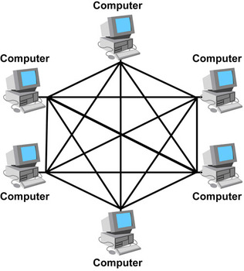
Mesh Topology

Slide 11
Advantages:
the use of dedicated links guarantees that each connection can carry its own data load, thus eliminating the traffic problems that can occur when links must be shared by multiple devices.
Second, a mesh topology is robust. If one link becomes unusable, it does not incapacitate the entire system. Third, there is the advantage of privacy or security. When every message travels along a dedicated line, only the intended recipient sees it. Physical
boundaries prevent other users from gaining access to messages. Finally, point-to-point links make fault identification and fault isolation easy. Traffic can be routed to avoid links with suspected problems. This facility enables the network manager to discover the
precise location of the fault and aids in finding its cause and solution

Slide 12
Disadvantages:
The main disadvantages of a mesh are related to the amount of cabling and the number of I/O ports required. First, because every device must be connected to every other device, installation and reconnection are difficult.
The hardware required to connect each link (I/O ports and cable) can be prohibitively expensive.

Slide 13
Star Topology
In a star topology, each device has a dedicated point-to-point link only to a central controller, usually called a hub.
The devices are not directly linked to one another.
Unlike a mesh topology, a star topology does not allow direct traffic between devices. The controller acts as an exchange.
If one device wants to send data toanother, it sends the data to the controller, which then relays the data to the other connected device

Slide 14
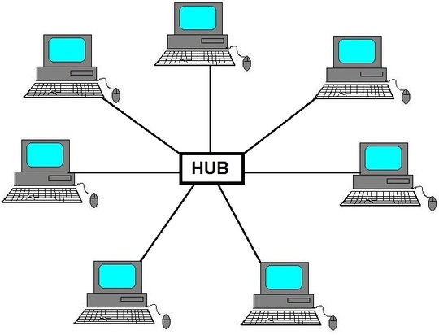
Star topology

Slide 15
Advantages
A star topology is less expensive than a mesh topology. In a star, each device needs only one link and one I/O port to connect it to any number of others. This factor also makes it easy to install and reconfigure.
Far less cabling needs to be housed, and additions, moves, and deletions involve only one connection: between that device and the hub.
Other advantages include robustness. If one link fails, only that link is affected. All other links remain active.

Slide 16
:
Disadvantages
One big disadvantage of a star topology is the dependency of the whole topology on one single point, the hub. If the hub goes down, the whole system is dead.
Although a star requires far less cable than a mesh, each node must be linked to a central hub
For this reason, often more cabling is required in a star than in some other topologies (such as ring or bus)

Slide 17
Bus Topology
The preceding examples all describe point-to-point connections. A bus topology, on the other hand, is multipoint. One long cable acts as a backbone to link all the devices in a network.
Nodes are connected to the bus cable by drop lines and taps. A drop line is a connection running between the device and the main cable.
As a signal travels along the backbone, some ofits energy is transformed into heat. Therefore, it becomes weaker and weaker as it travels farther and farther. For
this reason there is a limit on the number of taps a bus can support and on the distance between those taps

Slide 18
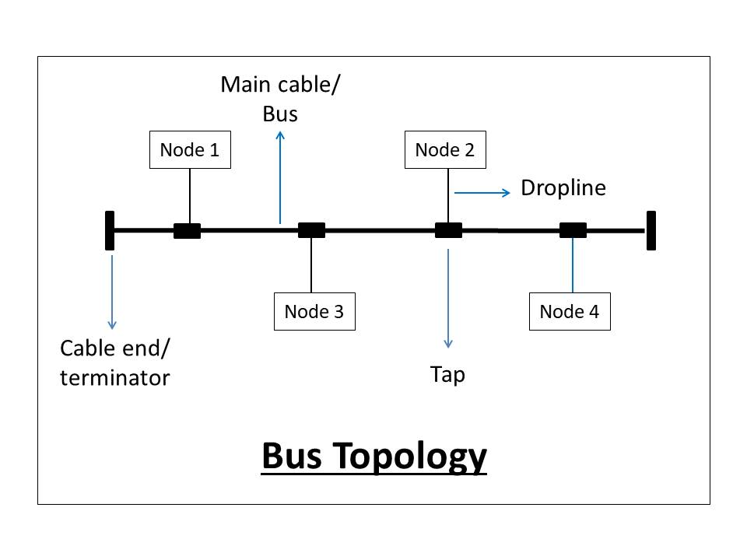

Slide 19
Advantages
Advantages of a bus topology include ease of installation.
Backbone cable can be laid along the most efficient path,In this way, a bus uses less cabling than mesh or star topologies

Slide 20
Disadvantages
Disadvantages include difficult reconnection and fault isolation. A bus is usually designed to be optimally efficient at installation. It can therefore be difficult to add new devices.
Signal reflection at the taps can cause degradation in quality.
In addition, a fault or break in the bus cable stops all transmission.

Slide 21
Ring Topology
In a ring topology, each device has a dedicated point-to-point connection with only the two devices on either side of it.
A signal is passed along the ring in one direction, from device to device, until it reaches its destination.
Each device in the ring incorporates a repeater.
When a device receives a signal intended for another device, its repeater regenerates the bits and passes them along

Slide 22
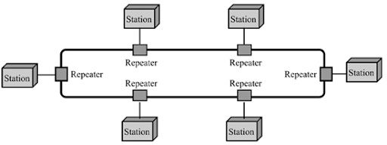
Ring

Slide 23
Advantages
A ring is relatively easy to install and reconfigure.
Each device is linked to only its immediate neighbors (either physically or logically). To add or delete a device requires changing only two connections.

Slide 24
Disadvantages
Unidirectional traffic can be a disadvantage. In a simple ring, a break in the ring can disable the entire network.
This weakness can be solved by using a dual ring or a switch capable of closing off the break.

Slide 25
Hybrid Topology
A network can be hybrid. For example, we can have a main star topology with each branch connecting several stations in a bus topology as shown in next slide.

Slide 26
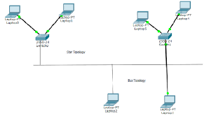
Hybrid Topology

Slide 27
THE OSI MODEL
An ISO standard that covers all aspects of network communications is the Open Systems Interconnection model.
It was first introduced in the late 1970s.
An open system is a set of protocols that allows any two different systems to communicate regardless of their underlying architecture.
The purpose of the OSI model is to show how to facilitate communication between different systems without requiring changes to the logic of the underlying hardware and software.
The OSI model is not a protocol; it is a model for understanding and designing a network architecture that is flexible, robust, and interoperable.
The OSI model is a layered framework for the design of network systems that allows communication between all types of computer systems. It consists of seven separate but related layers, each of which defines a part of the process of moving information across a network

Slide 28
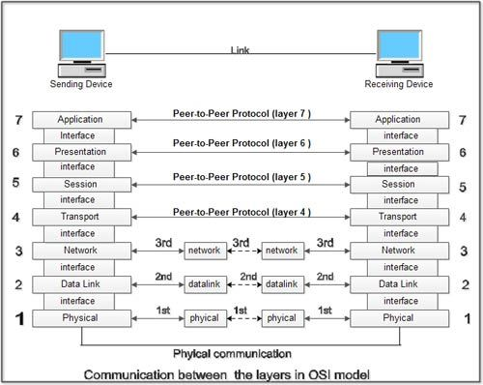
OSI MODEL

Slide 29
1.Physical Layer:
The physical layer coordinates the functions required to carry a bit stream over a physical
medium. It deals with the mechanical and electrical specifications of the interface and transmission medium. It also defines the procedures and functions that physical devices and interfaces have to perform for transmission to Occur.

Slide 30
2.Data Link Layer:
The data link layer transforms the physical layer, a raw transmission facility, to a reliable
link. It makes the physical layer appear error-free to the upper layer (network layer).
Other responsibilities of the data link layer include the following:
i.Framing.
ii.Physical addressing.
iii.Flow control
iv.Error control
v.Access control

Slide 31
3.Network Layer
The network layer is responsible for the source-to-destination delivery of a packet,possibly across multiple networks .
The network layer ensures that each packet gets from its point of origin to its final destination.
If two systems are connected to the same link, there is usually no need for a network layer. However, if the two systems are attached to different networks (links) with connecting devices between the networks (links), there is often a need for the network layer to accomplish source-to-destination delivery.

Slide 32
4.Transport Layer
The transport layer is responsible for process-to-process delivery of the entire message.
A process is an application program running on a host.
Whereas the network layer oversees source-to-destination delivery of individual packets, it does not recognize any relationship between those packets. It treats each one independently, as though each piece belonged to a separate message, whether or not it does.
The transport layer,on the other hand, ensures that the whole message arrives intact and in order, overseeing
both error control and flow control at the source-to-destination level.

Slide 33
5.Session Layer
The services provided by the first three layers (physical, data link, and network) are not sufficient for some processes.
The session layer is the network dialog controller.
It establishes, maintains, and synchronizes the interaction among communicating systems.

Slide 34
6.Presentation Layer
The presentation layer is concerned with the syntax and semantics of the information exchanged between two systems.
Specific responsibilities of the presentation layer include the following:
i.Translation.
ii.Encryption.
iii.Compression.

Slide 35
7.Application Layer
The application layer enables the user, whether human or software, to access the network.
It provides user interfaces and support for services such as electronic mail,remote file access and transfer, shared database management, and other types of distributed information services.

Slide 36
TCP/IP Model
The TCP/IP protocol suite was developed prior to the OSI model. Therefore, the layers in the TCP/IP protocol suite do not exactly match those in the OSI model.
The original TCP/IP protocol suite was defined as having four layers: host-to-network, internet, transport, and application.
when TCP/IP is compared to OSI, we can
say that the host-to-network layer is equivalent to the combination of the physical and data link layers. The internet layer is equivalent to the network layer, and the application layer is roughly doing the job of the session, presentation, and application layers with the transport layer in TCP/IP

Slide 37
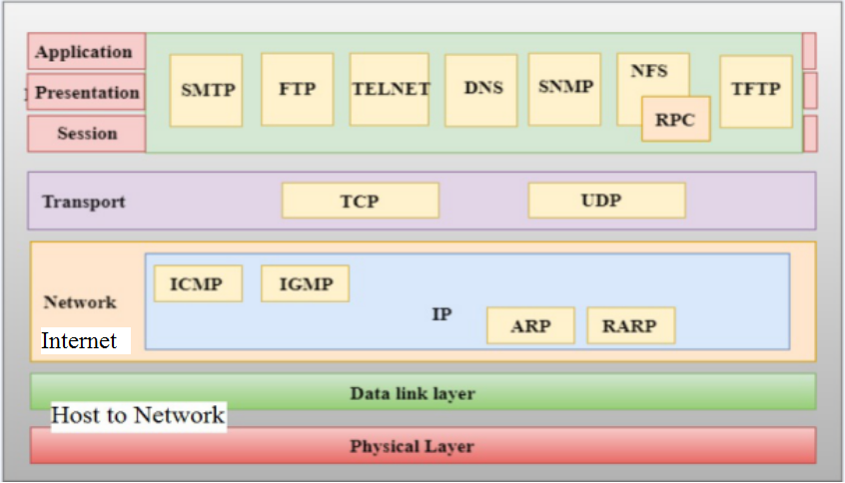
TCP/IP Model

Slide 38
TCP/IP Model
TCP/IP is a hierarchical protocol made up of interactive modules, each of which provides a specific functionality.
The term hierarchical means that each upper-level protocol is supported by one or more lower-level protocols.
At the transport layer, TCP/IP defines three protocols: Transmission Control Protocol (TCP), User Datagram Protocol (UDP), and Stream Control Transmission Protocol (SCTP).
At the network layer, the main protocol defined by TCP/IP is the Internetworking Protocol (IP); there are also some other protocols that support data movement in this layer.

Slide 39
Some Protocols
Protols:
SMTP:Simple mail transfer protocol
SNMP:Simple network management protocol
NFS:Network File system
RPC:remote procedure call
TFTP:Trivial File Transfer Protocol
TELNET:Terminal Network

Slide 40
Advatages/Disadntages of Internet
Advantages of the Internet
1.Communication:
The main advantage of the internet is the faster communication than any other device. It’s an instant process. Communication in the form of video calls, emails, etc. is possible using the internet. Thus, there is no specific region that can be accessed. It is accessible all over the world.
2.Information:
The internet is the source of knowledge. One can get information about almost everything. It is easily accessed with sources giving you the option of additional knowledge on the subject as well. Information like educational related, government laws, market sales, stocks and shares, new creations, etc. are gathered from a single place.

Slide 41
Advantages of the Internet
3.Learning:
The internet has now become a part of education. Education like homeschooling is easily carried out using the internet. Teachers can upload their teaching videos on the internet and are accessed by people across the world which is helpful for all students. The marks are also released on the internet since, releasing mark for the whole institution in notice boards will create chaos.
4.Entertainment:
The internet is now the most popular form of entertainment. Movies, songs, videos, games, etc. are available on many websites for free. Social networking is also possible using the internet. Hence, there are tons of entertainment that are available online with easy accessibility for everyone.

Slide 42
Advantages of the Internet
4.Social network:
Social networking is the sharing of information with people across the world. Apart from being an entertainment website, it has many uses. Any job vacancy, emergency news, ideas, etc. can be shared on the website and the information gets passed on quickly to a wide area. Also, social networking websites are used to easy communications. For example, Facebook, Twitter, and Instagram are some popular networking sites.
5.E-commerce:
All business deals started shifting towards working on the internet like transactions of money etc. And this is what evolved into E-commerce later. Online reservations, online ticket bookings for movies, etc. can be done easily. It saves us lots of time. Online shopping is now the latest trend in the internet world where products from dresses to household furniture are available at doorstep.

Slide 43
Disadvantages of Internet
1.Information loss:
The information crucial to us or any important files can be easily taken by the hackers. There is no exact proof for the security for the details we store like account numbers, passwords, etc. hence, sensitive information must be carefully stored by the people.
2.Spam:
The unnecessary emails, advertisements, etc. sometimes are said to be spam because they have the ability to slow down the system and make the users to face lots of problems. Spam emails create confusion as important emails are also stored along with them.

Slide 44
Disadvantages of Internet
3.Virus attacks:
The malware or virus threats are so deadly that affects the system to a greater extend. It immediately deletes all important files and finally, the system ends up crashing. The virus attack is possible in three ways. One it attacks selected files. Two, it harms the executable boot files and most dangerous of all is the macro virus which has the ability to replicate and expand to all parts of files.
4.Virtual world:
The people using the internet often will forget the difference between the virtual and real worlds. This causes people to get depressed quickly and it leads to social isolation and obesity problems. Obesity is due to the lack of any physical exercise. So it is better to play outdoor rather on the internet

Slide 45
HTTP
This protocol is known as HyperText Transfer Protocol because of its efficiency that allows us to use in a hypertext environment where there are rapid jumps from one document to another document.
It is a protocol used to access the data on the World Wide Web (www).
The HTTP protocol can be used to transfer the data in the form of plain text, hypertext, audio, video, and so on.
HTTP is similar to the FTP as it also transfers the files from one host to another host. But, HTTP is simpler than FTP as HTTP uses only one connection, i.e., no control connection to transfer the files.
HTTP is similar to SMTP as the data is transferred between client and server. The HTTP differs from the SMTP in the way the messages are sent from the client to the server and from server to the client. SMTP messages are stored and forwarded while HTTP messages are delivered immediately.

Slide 46
TELNET
Telnet is an abbreviation for Terminal Network.
Telnet is a protocol used to log in to remote computer on the internet. There are a number of Telnet clients having user friendly user interface.
A better solution to meet client-server program that lets the user access any application program on a remote computer. Therefore, a program that allows a user to log on to a remote computer. A popular client-server program Telnet is used to meet such demands. Telnet provides a connection to the remote computer in such a way that a local terminal appears to be at the remote side.

Slide 47
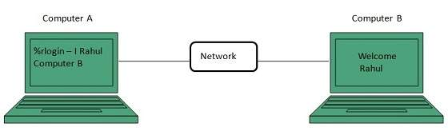
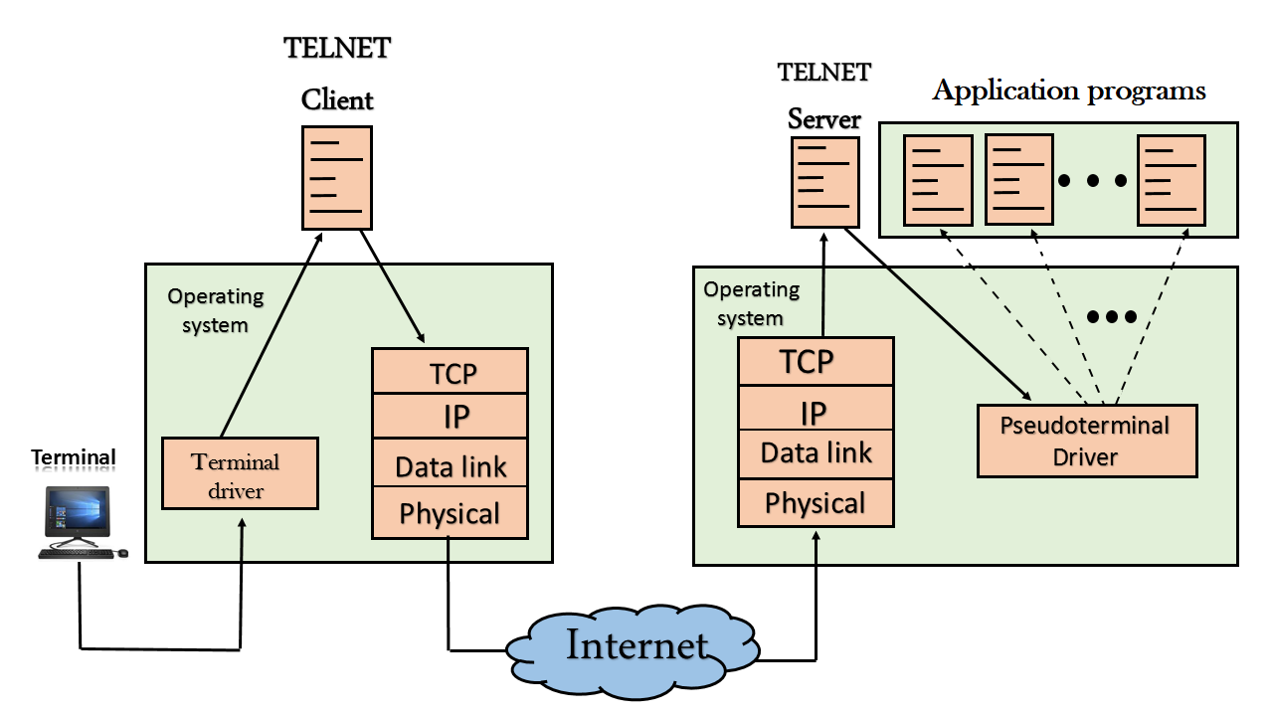
Telnet

Slide 48
FTP
FTP stands for File transfer protocol.
FTP is a standard internet protocol provided by TCP/IP used for transmitting the files from one host to another.
It is mainly used for transferring the web page files from their creator to the computer that acts as a server for other computers on the internet.
It is also used for downloading the files to computer from other servers.
Why FTP?
Although transferring files from one system to another is very simple and straightforward, but sometimes it can cause problems. For example, two systems may have different file conventions. Two systems may have different ways to represent text and data. Two systems may have different directory structures. FTP protocol overcomes these problems by establishing two connections between hosts. One connection is used for data transfer, and another connection is used for the control connection.

Slide 49
IP Protocol
Internet Protocol (IP)
Internet Protocol is connectionless and unreliable protocol. It ensures no guarantee of successfully transmission of data.
In order to make it reliable, it must be paired with reliable protocol such as TCP at the transport layer.

Slide 50
Transmission Control Protocol (TCP)
TCP is a connection oriented protocol and offers end-to-end packet delivery. It acts as back bone for connection.It exhibits the following key features:
Transmission Control Protocol (TCP) corresponds to the Transport Layer of OSI Model.
TCP is a reliable and connection oriented protocol.
TCP offers:
Stream Data Transfer.
Reliability.
Efficient Flow Control
Full-duplex operation.
Multiplexing.

Slide 51
Transmission Control Protocol (TCP)
TCP offers connection oriented end-to-end packet delivery.
TCP ensures reliability by sequencing bytes with a forwarding acknowledgement number that indicates to the destination the next byte the source expect to receive.
It retransmits the bytes not acknowledged with in specified time period.

