Slide 1

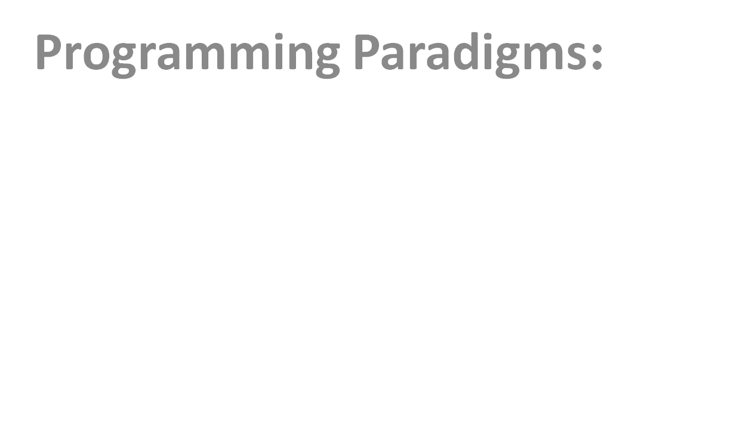

Slide 2
What is Program?
A program is a sequence of instructions written in Computer Programming Language to perform a specified task by the computer.
In other words program is a sequence of instructions that a computer can interpret and execute.
Program can be written for one instruction to millions of instruction.

Slide 3
Qualities of good Program
These are the following characteristics of a good computer program.
Portability
Maintainability
Efficient
Reliable
Machine Independence
Cost Effectiveness
Flexible

Slide 4
Portability
A program should be supported by many different computers. The program should compile and run smoothly on different platforms. So, portability is measured by how a software application can be transferred from one computer environment to another without failure. A program is said to be more portable, if it is easily adopted in different computer systems.

Slide 5
Maintainability
It is the process of fixing program errors and improving the program. If a program is easy to read and understand, then its maintenance will be easier. It should also prevent unwanted works, so that the maintenance cost in future will be low. It should also have quality to easily meet new requirements.

Slide 6
Efficient :
Program is said to be more efficient, if it takes less space and easily converted to machine language. The algorithm should be more effective. The program efficiency is also high if it has high speed during runtime execution of program.
Reliable:
The user's actual needs will change from time-to-time, so program is said to be reliable if it works smoothly in every version. It is measured as high reliable if it gives same performance in all simple to complex conditions.

Slide 7
Machine Independence
Program should be machine independent. Program written on one system should be able to execute on any other without any changes. It is not system specific and provide more flexibility.
Cost Effectiveness
Cost Effectiveness is the key to measure the program quality. Cost must be measured over the life of the program and must include both cost and human cost of producing these programs.
Flexible
Program should be written in such a manner that it allows to add new features without changing the existing module. It should be always ready to meet new requirements. A high flexible software is always ready for a new world of possibilities.

Slide 8
Software Development Life Cycle (SDLC)
Software Development Life Cycle (SDLC) is a process used by the software industry to design, develop and test high quality softwares. The SDLC aims to produce a high-quality software that meets or exceeds customer expectations, reaches completion within times and cost estimates.
It consists of a detailed plan describing how to develop, maintain, replace and alter or enhance specific software. The life cycle defines a methodology for improving the quality of software and the overall development process.

Slide 9
Phases of SDLC
SDLC methodology focuses on the following phases of software development:
Recognition of need
Feasibility study
Analysis
Design
Implementation
Post Implementation & Maintenance

Slide 10
Recognition of need
The requirement is the first stage in the SDLC process. It is conducted by the senior team members with inputs from all the stakeholders and domain experts in the industry. Planning for the quality assurance requirements and recognization of the risks involved is also done at this stage.

Slide 11
Feasibility study
Once the requirement analysis phase is completed the next SDLC.Next step is to define and document software needs. This process conducted with the help of 'Software Requirement Specification' document also known as 'SRS' document. It includes everything which should be designed and developed during the project life cycle.
There are mainly five types of feasibilities checks:
Economic: Can we complete the project within the budget or not?
Legal: Can we handle this project as cyber law and other regulatory framework/compliances.
Operation feasibility: Can we create operations which is expected by the client?
Technical: Need to check whether the current computer system can support the software
Schedule: Decide that the project can be completed within the given schedule or not.

Slide 12
SDLC
Analysis:It involves detailed evaluation of present system and data collecton.What must be done to solve a problem? What are the facts?Logical model of system is studied in this phase.
Design:
In this phase, the system and software design documents are prepared as per the requirement specification document. This helps define overall system architecture.
This design phase serves as input for the next phase of the model.
There are two kinds of design documents developed in this phase:
High-Level Design (HLD)
Low-Level Design(LLD)

Slide 13
Implementation: Once the system design phase is over, the next phase is implementation. In this phase, developers start build the entire system by writing code using the chosen programming language. In the coding phase, tasks are divided into units or modules and assigned to the various developers. It is the longest phase of the SDLC.
In this phase, Developer needs to follow certain predefined coding guidelines. They also need to use programming tools like compiler, interpreters, debugger to generate and implement the code.

Slide 14
Post Implementation & Maintenance
This phase involves testing, installation and maintenance. The testing team starts testing the functionality of the entire system. This is done to verify that the entire application works according to the customer requirement. Based on the feedback given by the project manager, the final software is released and checked for deployment issues if any. Once the system is deployed, and customers start using the developed system, following 3 activities occur.
Bug fixing - bugs are reported because of some scenarios which are not tested at all
Upgrade - Upgrading the application to the newer versions of the Software
Enhancement - Adding some new features into the existing software

Slide 15
Structured Programming
Structured programming is a programming paradigm aimed at improving the clarity, quality, and development time of a computer program by making extensive use of the structured control flow constructs of selection (if/then/else) and repetition (while and for), block structures, and subroutines in contrast to using simple tests and jumps such as the go to statement.
Structured Programming Approach, as the word suggests, can be defined as a programming approach in which the program is made as a single structure. It means that the code will execute the instruction by instruction one after the other. It doesn’t support the possibility of jumping from one instruction to some other with the help of any statement like GOTO, etc. Therefore, the instructions in this approach will be executed in a serial and structured manner.

Slide 16
Structured Programming
The structured program mainly consists of three types of elements:
Selection Statements
Sequence Statements
Iteration Statements
The structured program consists of well structured and separated modules. But the entry and exit in a Structured program is a single-time event. It means that the program uses single-entry and single-exit elements. Therefore a structured program is well maintained, neat and clean program. This is the reason why the Structured Programming Approach is well accepted in the programming world.

Slide 17
Structured Programming in Everyday Life
1. Sequence Execute a list of statements in order.
Example: Baking Bread
Add flour.
Add salt.
Add yeast.
Mix.
Add water.
Knead.
Let rise.
Bake.

Slide 18
Structured Programming in Everyday Life
2. Repetition Repeat a block of statements while a condition is true.
Example: Washing Dishes
Stack dishes by sink.
Fill sink with hot soapy water.
While more Dishes
Get dish from counter,
Wash dish,
Put dish in drain rack.
End While
Wipe off counter.
Rinse out sink.

Slide 19
Structured Programming in Everyday Life
3. Selection Choose at most one action from several alternative conditions.
Example: Sorting Mail
Get mail from mail box.
Put mail on table.
While more Mail To Sort
Get piece of mail from table.
If piece is Personal Then
Read it.
Else If piece is Magazine Then
Put in magazine rack.
Else If piece is Bill Then
Pay it,
Else If piece is Junk Mail Then
Throw in waste basket.
End If
End While

Slide 20
Program constructs
Programming constructs are basic building blocks that can be used to control computer programs. There are three main programming constructs.
Sequence statements
Selection statements
Iteration statements
These three constructs are extremely important. They can help to control the flow of program; allowing to specify how or when parts of programs are executed.

Slide 21
Sequence Statements
A sequence is one of the simplest programming constructs. With a sequence, you have a set of instructions that are executed one after another. For example,
msgbox "This is the first message, it will be displayed first"
msgbox "This is the second message, it will be displayed next "
msgbox "This is the third message, it will be displayed last"

Slide 22
Selection statements
Selection is the second programming construct. In programming, there are occasions when a decision needs to be made. Selection is the process of making a decision. The result of the decision decides which path the program will take next.
For example, a program could tell a user whether they are old enough to learn how to drive a car. If the user's age meets the required driving age, the program would follow one path and execute one set of instructions. Otherwise, it would follow a different path and execute a different set of instructions. Eg.
age = int(input("How old are you? ")
if age > 16 then
print("You are old enough to drive a car!")
else
print("Come back when you are older!")
endif

Slide 23
Iteration/ Repetition statements
A repetition construct causes a group of one or more program statements to be invoked repeatedly until some end condition is met.
Let's stick with the salary case, and try to give the salary for a whole month.
For simplicity sake, let's consider we have 20 working days in a month and we have to calculate the whole month's salary for the employee.
Since we already calculated the salary for 1(one) day based on employee's present or absent status, we repeat the same process for 20 days and Ta 'Da we have calculated the whole month's salary for the employee.

Slide 24
Concept of Modular Programming
Modular programming is a general programming concept. It involves separating a program’s functions into independent pieces or building blocks, each containing all the parts needed to execute a single aspect of the functionality. Together, the modules make up the executable application program.
Two approaches used in Modular Programming
The Top-Down Approach
The Bottom-Up Approach

Slide 25
The Top-Down Approach
In the top-down approach, a complex algorithm is broken down into smaller fragments, better known as ‘modules.’ These modules are then further broken down into more smaller fragments until they can no longer be fragmented. This process is called ‘modularization.’ However, during the modularization process, you must always maintain the integrity and originality of the algorithm.
By breaking a bigger problem into smaller fragments, the top-down approach minimizes the complications usually incurred while designing algorithms. Furthermore, in this approach, each function in a code is unique and works independently of other functions.
C programming language supports this approach for developing projects. It is always good idea that decomposing solution into modules in a hierarchal manner.

Slide 26
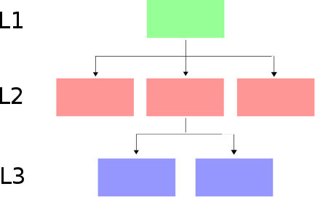
The Top-Down Approach

Slide 27
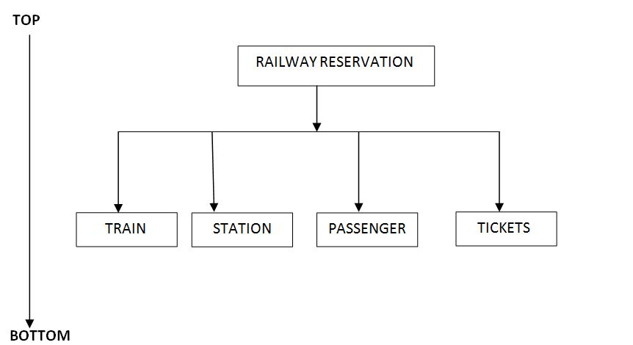
Example

Slide 28
The Bottom-Up Approach
Contrary to the top-down approach, the bottom-up approach focuses on designing an algorithm by beginning at the very basic level and building up as it goes.
In this approach individual parts of the system are specified in details.
The parts are linked together to form larger components, which are in turn linked until a complete system is formed.
Object oriented languages such as C++ and java use bottom up approach where each object is identified first.
Examples : Payroll problem (Book ),Stock market portfolio
Eg. let us assume we have stock portfolio consisting of just one stock (say in XYZ corp.) .Furthermore we will only compute how much this little portfolio is worth first. So we begin design process from this stock.
Thus this approach concentrates on designing the fundamental components of an algorithm and then moves up to a higher level to achieve a complete result.

Slide 29
