Slide 1
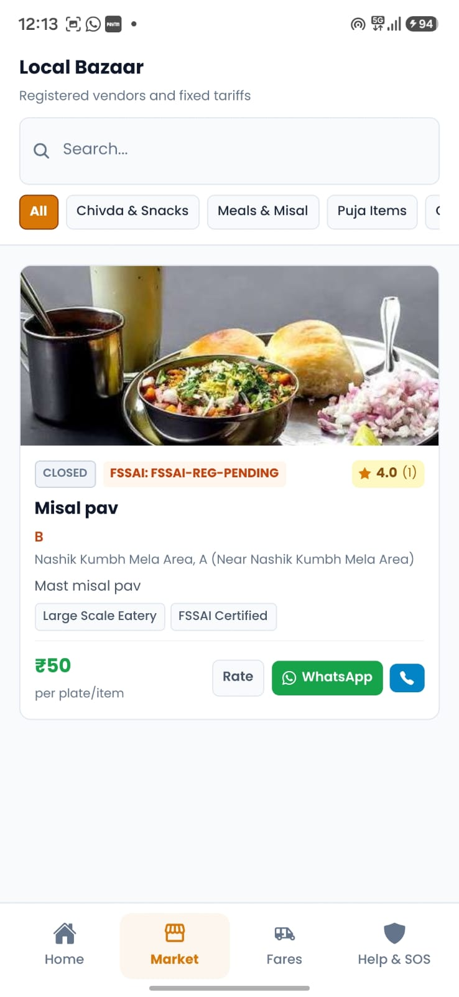
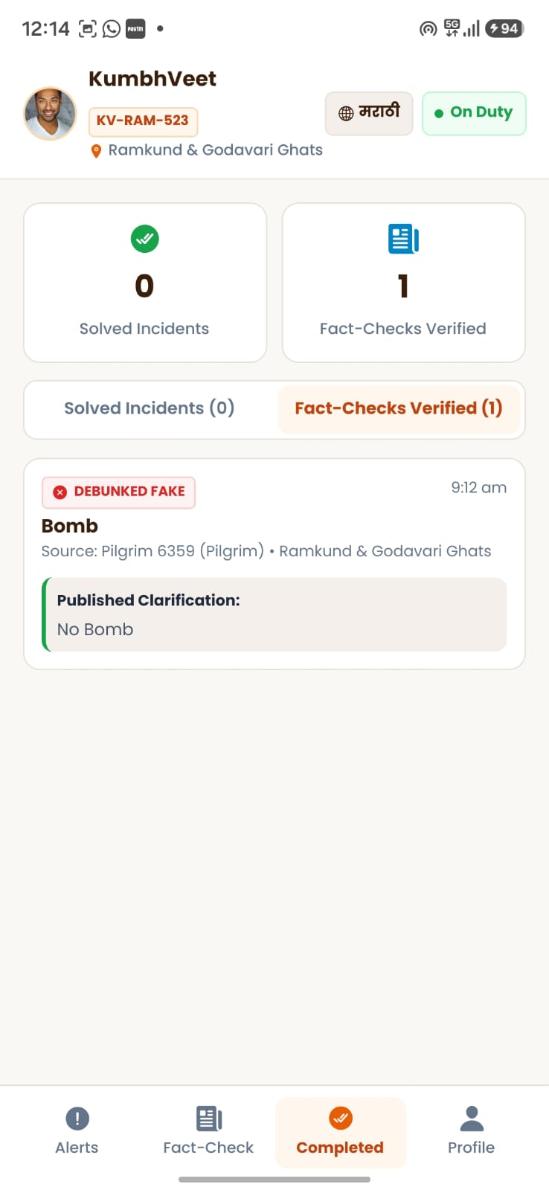
KUMBHSETU
Integrated Smart Governance, Pilgrim Safety & Anti-Extortion Ecosystem
Engineered for Nashik-Trimbakeshwar Simhastha Kumbh Mela 2027 (100M+ Projected Visitors)
Tri-App Command Network: Pilgrim Mobile App | KumbhVeer Volunteers | Police Rapid Radar

Slide 2
OPERATIONAL BOTTLENECKS
Executive Challenge Matrix: Managing 100M+ Pilgrims at Scale
PRICING
RESPONSE
Transit & Market Price Extortion
Unscrupulous auto, taxi, and stall operators charge 3x-5x standard rates, exploiting rural and elderly pilgrims with zero real-time tariff visibility.
High-Latency Ground Dispatch
Traditional emergency response takes 25-45 minutes to reach patrol squads, risking crowd bottlenecks and uncontrolled crowd surges.
PANIC
SILOS
Unchecked Rumor & Misinformation Cascades
Viral unverified claims regarding ghat closures or bridge damage create hazardous panic stampede risks before authorities can clarify.
Disconnected Stakeholder Operations
Pilgrims, on-ground volunteers (NCC/NSS), and Flying Police Squads operate on disconnected communication channels.

Slide 3
SYSTEM ARCHITECTURE
The Solution: A Synchronized Tri-Application Network
PILGRIM
VOLUNTEER
COMMAND
KumbhSetu-Expo
Pilgrim Super App
• 4 Languages (HI / MR / GU / EN)
• Fare Calculator & RTO Price Caps
• 1-Tap Photo + GPS Complaint Log
• Verified Bazaar & Snan Timers
• 24x7 Emergency SOS Speed-Dial
KumbhVeer
Volunteer Ground App
• Real-Time Sector Incident Alerts
• 3-Stage Severity Tagging (Low/Med/High)
• Field Triage & Merchant Spot-Check
• 1-Tap Google Maps GPS Route
• Direct Pilgrim Phone Connection
KumbhSetu-Admins
Police & Collector Center
• Dedicated Police Rapid Radar
• Instant Challan & Fine Enforcement
• Dynamic Route Tariff Management
• Official Rumor Buster Dispatcher
• Desktop (.exe) & Web Control

Slide 4
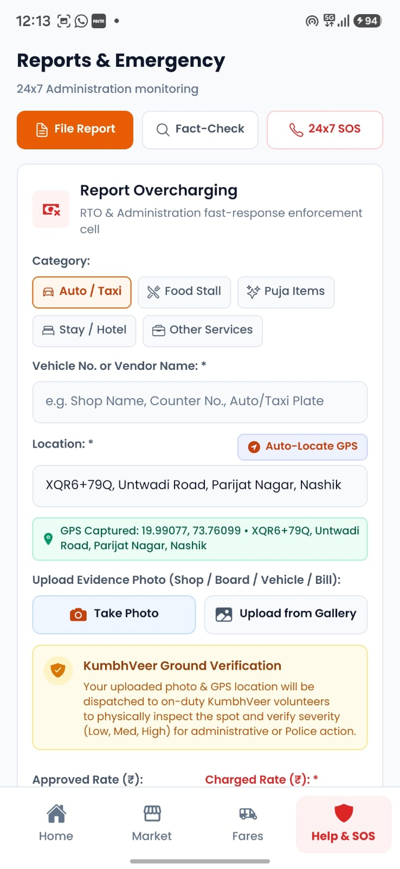
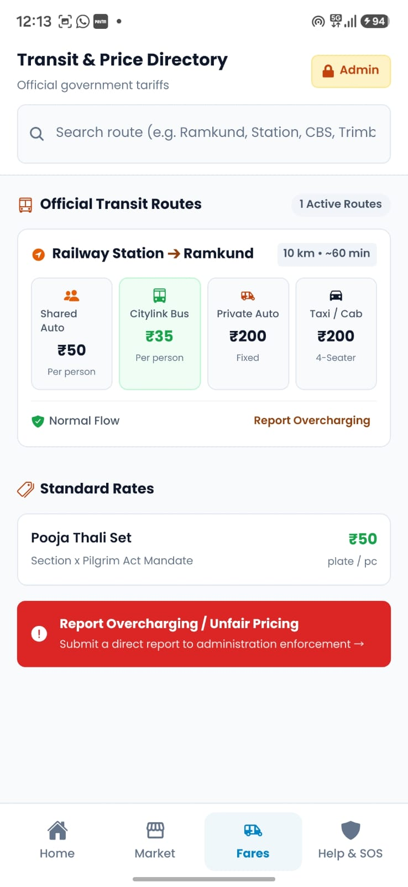
APPLICATION SHOWCASE 1 / 4
Pilgrim Super App: Anti-Extortion & Safety in 4 Languages
KumbhSetu-Expo (Pilgrim Mobile Application)
• 4-Language Cultural Localization
Instant switching across Hindi, Marathi, Gujarati, and English with culturally authentic terminology.
• Dynamic RTO Transit Fare Calculator
Pre-calculated maximum rates for 50+ routes across Nashik Road, CBS, Ramkund, and Trimbakeshwar.
• 1-Tap Photo & GPS Incident Logging
Pilgrims capture shop/vehicle photos and lock coordinates with instant Case Token IDs (KS-RTO-XXXXXX).
• Case Self-Management & Withdrawal
Pilgrims track ground volunteer verification live and can delete or withdraw resolved complaints.

Slide 5
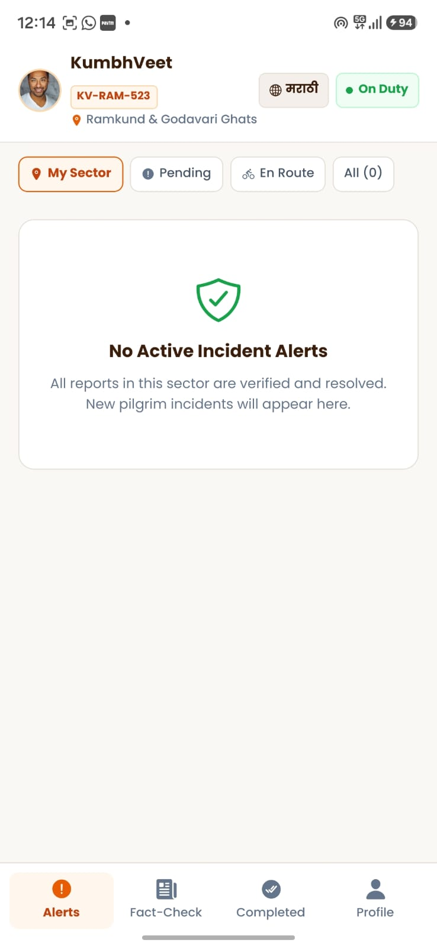
APPLICATION SHOWCASE 2 / 4
KumbhVeer: Decentralized Ground Triage & Verification
KumbhVeer (Volunteer Ground Application)
• Sub-Minute Sector Dispatch
On-duty volunteers stationed at Ramkund, Tapovan, and Kushavarta receive instant real-time vibration alerts for nearby incidents.
• 3-Tier Severity Calibration
Volunteers physically inspect the spot and calibrate ticket priority:
- Low: Informal spot resolve
- Medium: Price compliance check
- High: Direct Police Flying Squad escalation
• 1-Tap Google Maps GPS Route
Provides walking and transit navigation directly to the pilgrim's locked GPS pin.
• Direct Pilgrim Dialing
Instant one-touch phone verification to prevent false reporting and clarify landmark details.

Slide 6
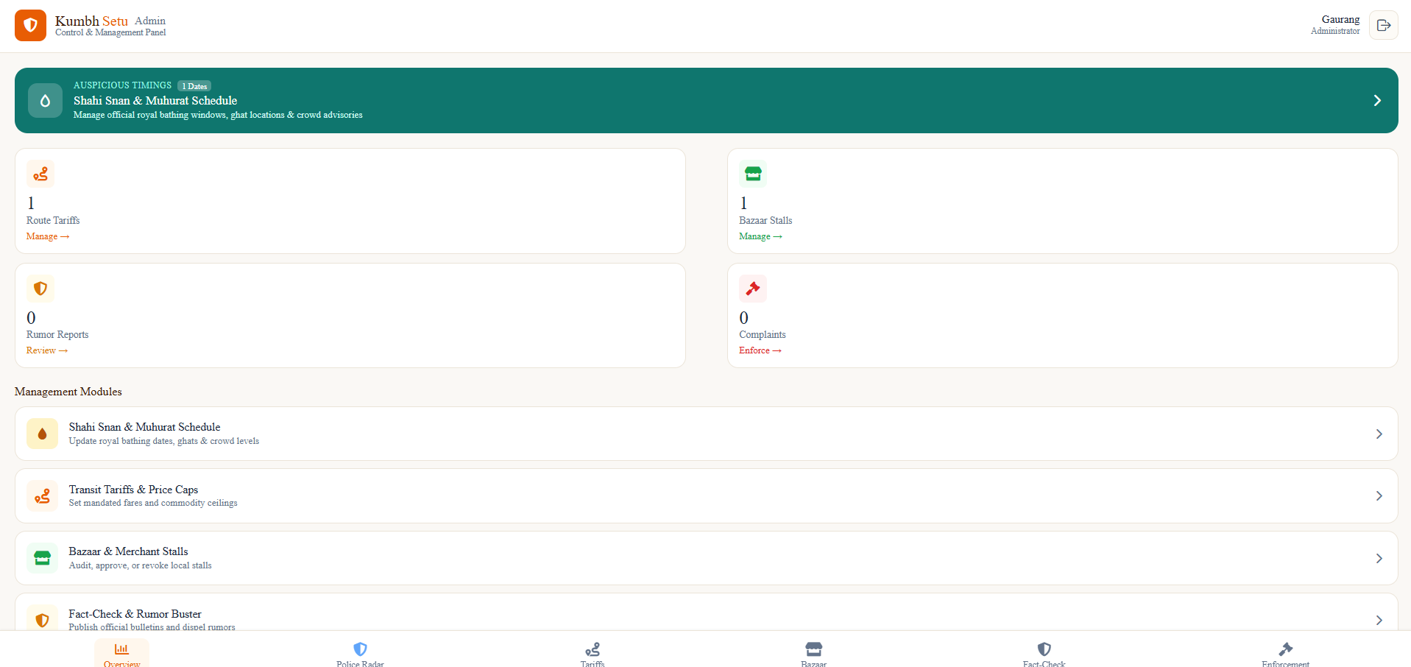
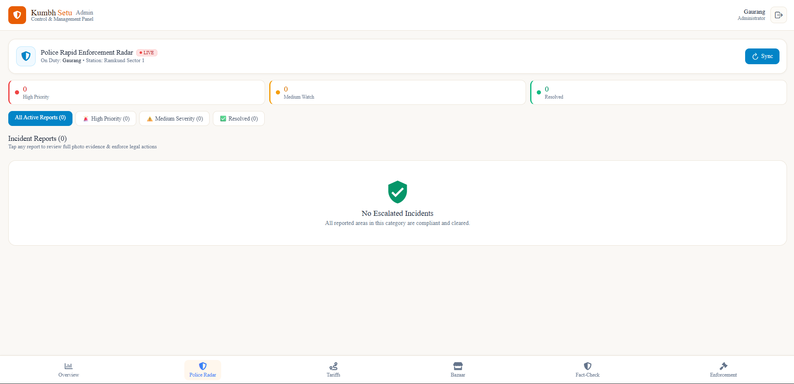
APPLICATION SHOWCASE 3 / 4
Police Command Center: Tactical Live Radar &
Enforcement
KumbhSetu-Admins (Police Tactical Center)
• Dedicated Police Rapid Radar Stream
Real-time triage stream prioritizing High Severity and Medium Watch extortion tickets across sectors.
• 150px Full-Resolution Photo Evidence
High-resolution photographic inspection modal allowing officers to verify signboards and vehicle plates.
• Instant Digital Challans & Penalties
Executes formal fines (INR 500 / 1,000 / 2,000 / 5,000), shop license suspensions, or FIR registrations.
• Cross-Platform Desktop (.exe) & Web
Zero-dependency standalone Windows software built for the Mela Control Room and field laptops.

Slide 7
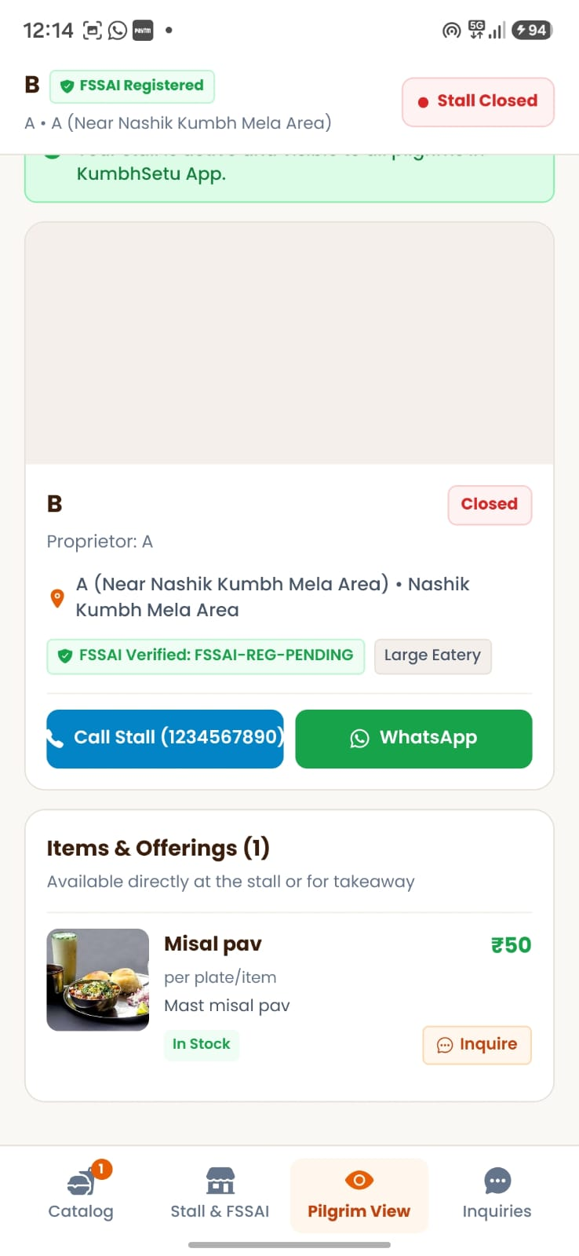
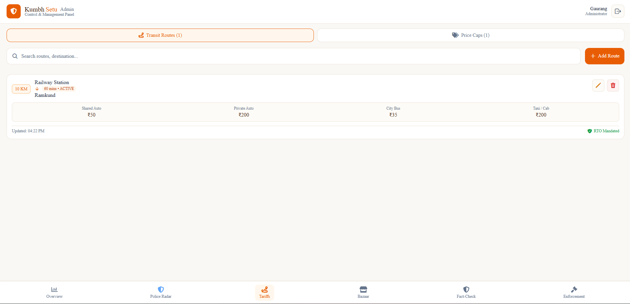
APPLICATION SHOWCASE 4 / 4
Verified Local Bazaar & Rumor Buster Dispatcher
Commerce Integrity & Public Safety
• Verified Kumbh Bazaar Directory
• Zero-Panic Rumor Buster
• Shahi Snan Live Muhurat Countdown
• Direct Merchant Calling & Inquiries
Pilgrims directly connect with verified stalls to pre-order food and puja essentials at capped rates.

Slide 8
TECHNICAL SPECIFICATIONS
Enterprise Technology Stack & Cloud Infrastructure
CLIENT
CLOUD
DESKTOP
Mobile & Web Tier
• React Native Expo SDK 57 (React 19)
• TypeScript with strict type-safety
• 4-Language i18n localization engine
• Asynchronous safe storage caching
• Responsive iOS, Android & Web
Real-Time Cloud Engine
• Supabase PostgreSQL Database
• Sub-second WebSocket Channels
• Dedicated 'kumbh-media' bucket
• Pure JS Base64 binary converter
• Row Level Security (RLS) enforcement
Command Center Software
• Electron 44 Standalone Windows App
• Automated .exe packaging pipeline
• Role-based DBA provisioning
• Custom HTTP static asset bridge
• Zero-dependency desktop bundle

Slide 9
PERFORMANCE METRICS
Projected Impact & Operational Benchmarks
TIME
PRICE
< 4 Min
Incident Response Time
Reduced from 35+ mins via volunteer ground triage
100%
Price Transparency
Across 50+ transit routes & commodity caps
SCALE
SAFETY
100M+
Pilgrim Reach
In Hindi, Marathi, Gujarati & English
0 Panic
Misinformation Containment
Sub-minute rumor clarification broadcast

Slide 10
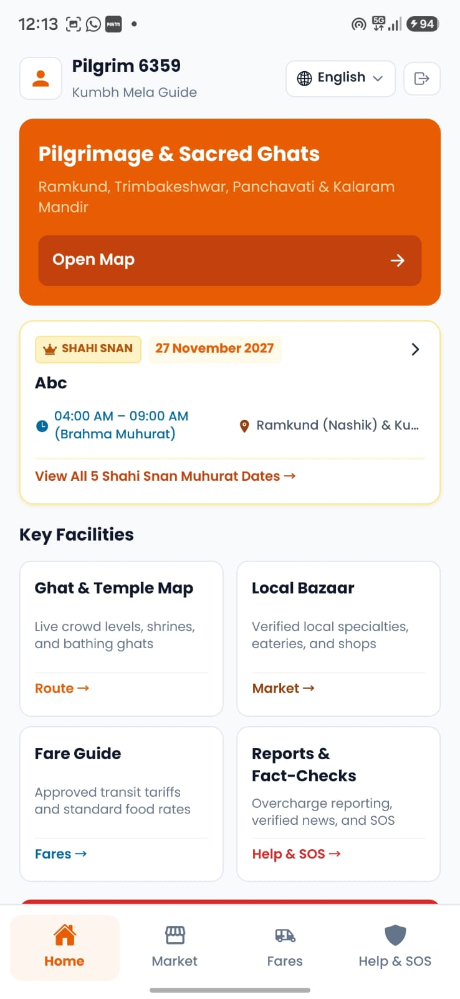
KumbhSetu: Ready for Simhastha Kumbh Mela 2027
Empowering Pilgrims • Equipping Volunteers • Enabling Authorities
• Cross-Platform Mobile Apps Ready (Android, iOS)
• Desktop Command Center Built (Windows .exe Standalone)
• Cloud Real-time Backend & Supabase Storage Operational
• 4-Language Cultural Localization & SOS Triage Validated

