Slide 1
getting started conference speaking: global diversity CFP day

Slide 2
Welcome 🎉

Slide 3
Your Team
Sarah - @geekygirlsarah Colin - @colindean Justin - @justinxreese

Slide 4
Todays Schedule
Introductions
What is a CFP?
Brainstorming speaking ideas
Writing a proposal
Creating a speaker bio
Submit a CFP
Lunch!
Making your talk
Slide design and caring for your audience
Presentation tips and practice
Close

Slide 5
Introductions

Slide 6
Name What you do currently Something awesome about you

Slide 7
What is a CFP?

Slide 8
CFP = Call for Proposals

Slide 9
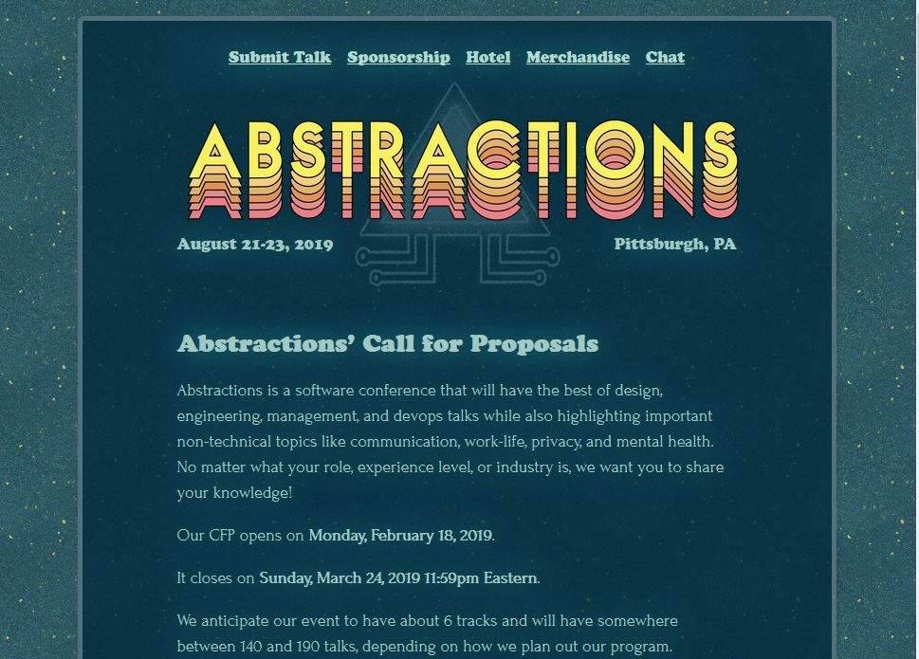

Slide 10
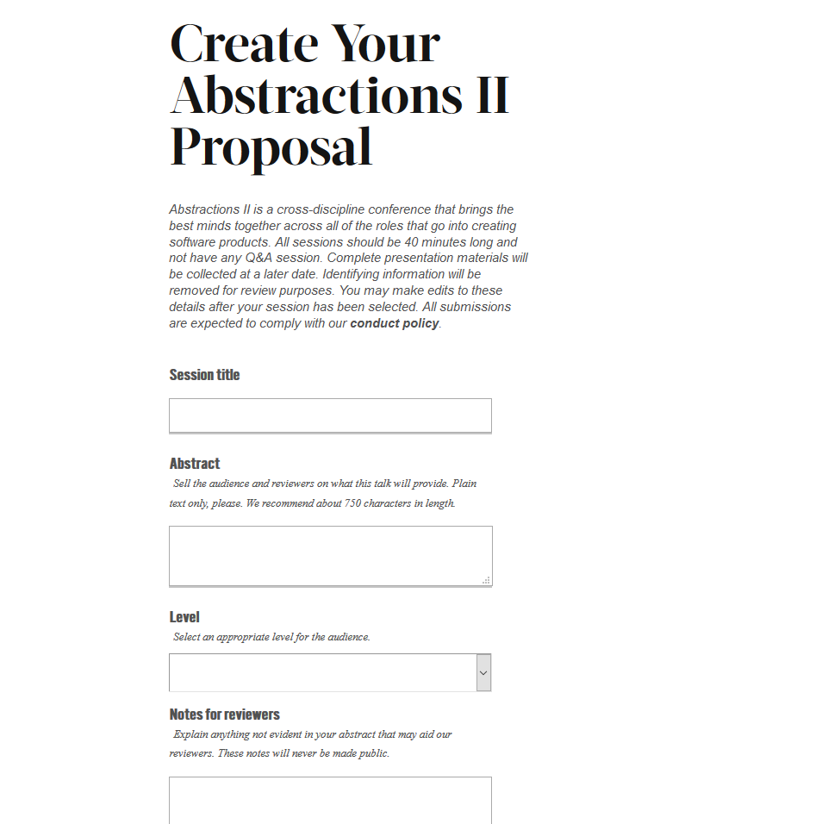

Slide 11
Brainstorming speaking ideas

Slide 12
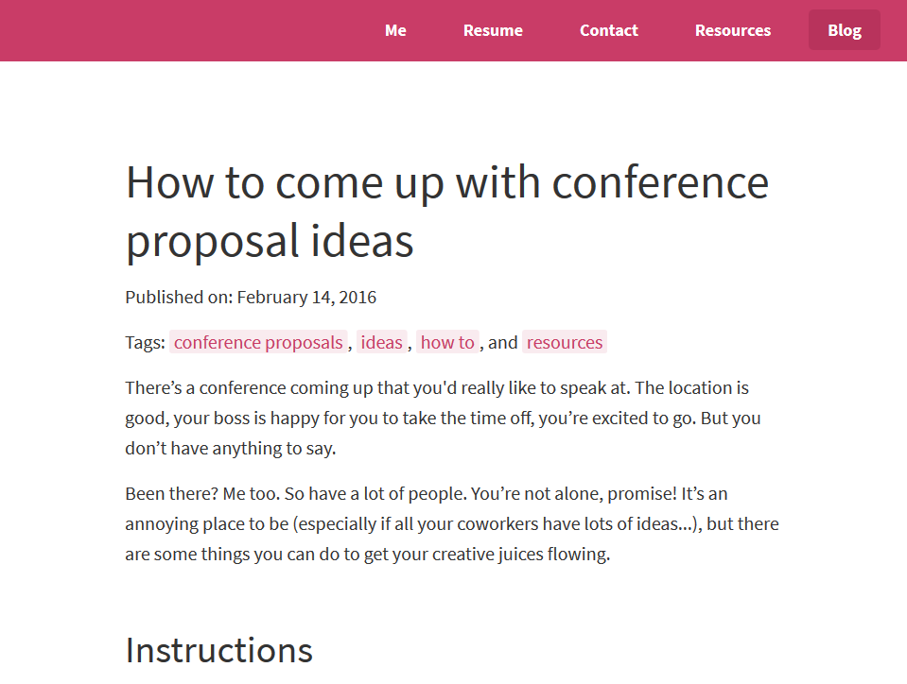
https://lucybain.com/blog/2016/conference-proposal-ideas/

Slide 13
Writing a proposal

Slide 14
Sarah’s Outline Tips
Start with intro
Choose 3-7 main bullet points
End with conclusion
Use this outline to write abstract

Slide 15
Example:
Intro
Job searches are terrible
Prepping for the job hunt
Prepare mentally
Tools for the hunt
What can companies do about it?
Conclusion

Slide 16
Sarah’s Abstract Tips
Start with a problem
Say what you’ll talk about
End with what the takeaway is

Slide 17
Example:
Searching for a new job. We all have to do it at some point. In the thick of the search, you’re likely to get a lot of terrible tech interviews as well as a bunch of rejections. How do you maintain your energy, your motivation, and perhaps more importantly, not feel like a failure after all that?
I will talk a bit about my most recent job search. You’ll see how I went into it with a different frame of mind than I had in the past, and how that helped me push through the interviews easier and take better care of myself in the process. You’ll also hear about some of the specific interviews and the problems I saw with them. I’ll show how, as companies and teams, we can improve the process for everyone. Finally, I’ll offer ways that both companies and employees can offer feedback to continue to improve interviews.

Slide 18
Sarah’s Outline Tips
Start with intro
Choose 3-7 main bullet points
End with conclusion
Use this outline to write abstract

Slide 19
Sarah’s Abstract Tips
Start with a problem
Say what you’ll talk about
End with what the takeaway is

Slide 20
Creating a speaker bio

Slide 21
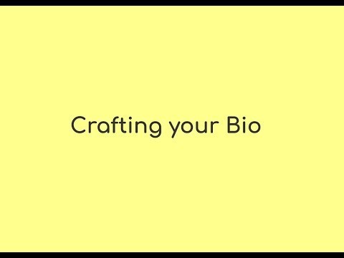

Slide 22
Crafting Your Bio
What lights you up?
What’s the coolest thing you’ve accomplished?
What are you a product of?
What are some of your talk ideas? Why? Why you?
What’s important about you that isn’t on your resume?

Slide 23
Crafting Your Bio
Currently ___________
Before that ___________
Also ___________

Slide 24
Submit a CFP
https://www.globaldiversitycfpday.com/cfps
https://abstractions.io/cfp

Slide 25
Lunch!

Slide 26
Making your talk

Slide 27

18:30
11:23 – 18:30

Slide 28
Making your talk

Slide 29
Slide design

Slide 30
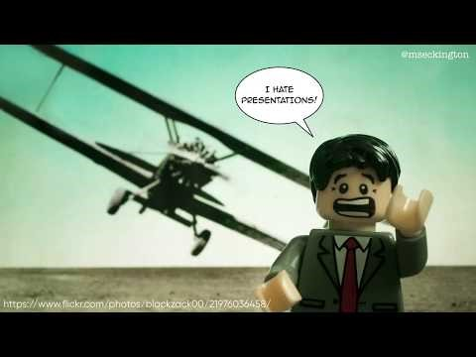

Slide 31
Maximize signal, minimize noise
Make important information stand out
Show and Tell
Be consistent
Notes:
Is it better to have more slides or fewer slides?
Did you learn anything new?
Anything seem different than what you expected?
Seen examples of good slides?
Seen examples of bad slides?
Slidescarnival.com

Slide 32
Presentation tips and practice

Slide 33
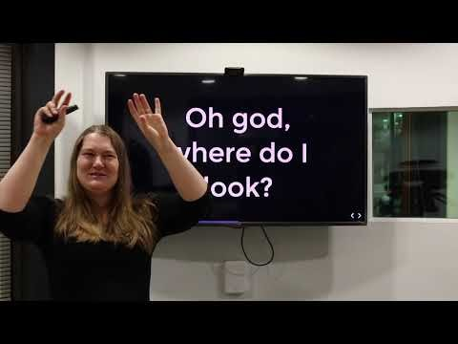

Slide 34
Close

Slide 35
Group picture

Slide 36
global diversity CFP day

