Slide 1
Nuclear Plasma Disruption Prediction using various Machine Learning Techniques

Slide 2
Manamrit Singh(2022B1A31013G)
At Bhabha Atomic Research Centre, Visakhapatnam
A Practice School-I Station of BITS PILANI
June 2024

Slide 3
Objective
The objective of this project was to implement machine learning techniques for predicting nuclear plasma disruptions in Tokamak fusion reactors.
By leveraging advanced algorithms, the project aims to enhance the reliability and efficiency of disruption prediction systems, thus improving reactor safety and operational stability which I try to do using data analysis techniques and model training.

Slide 4
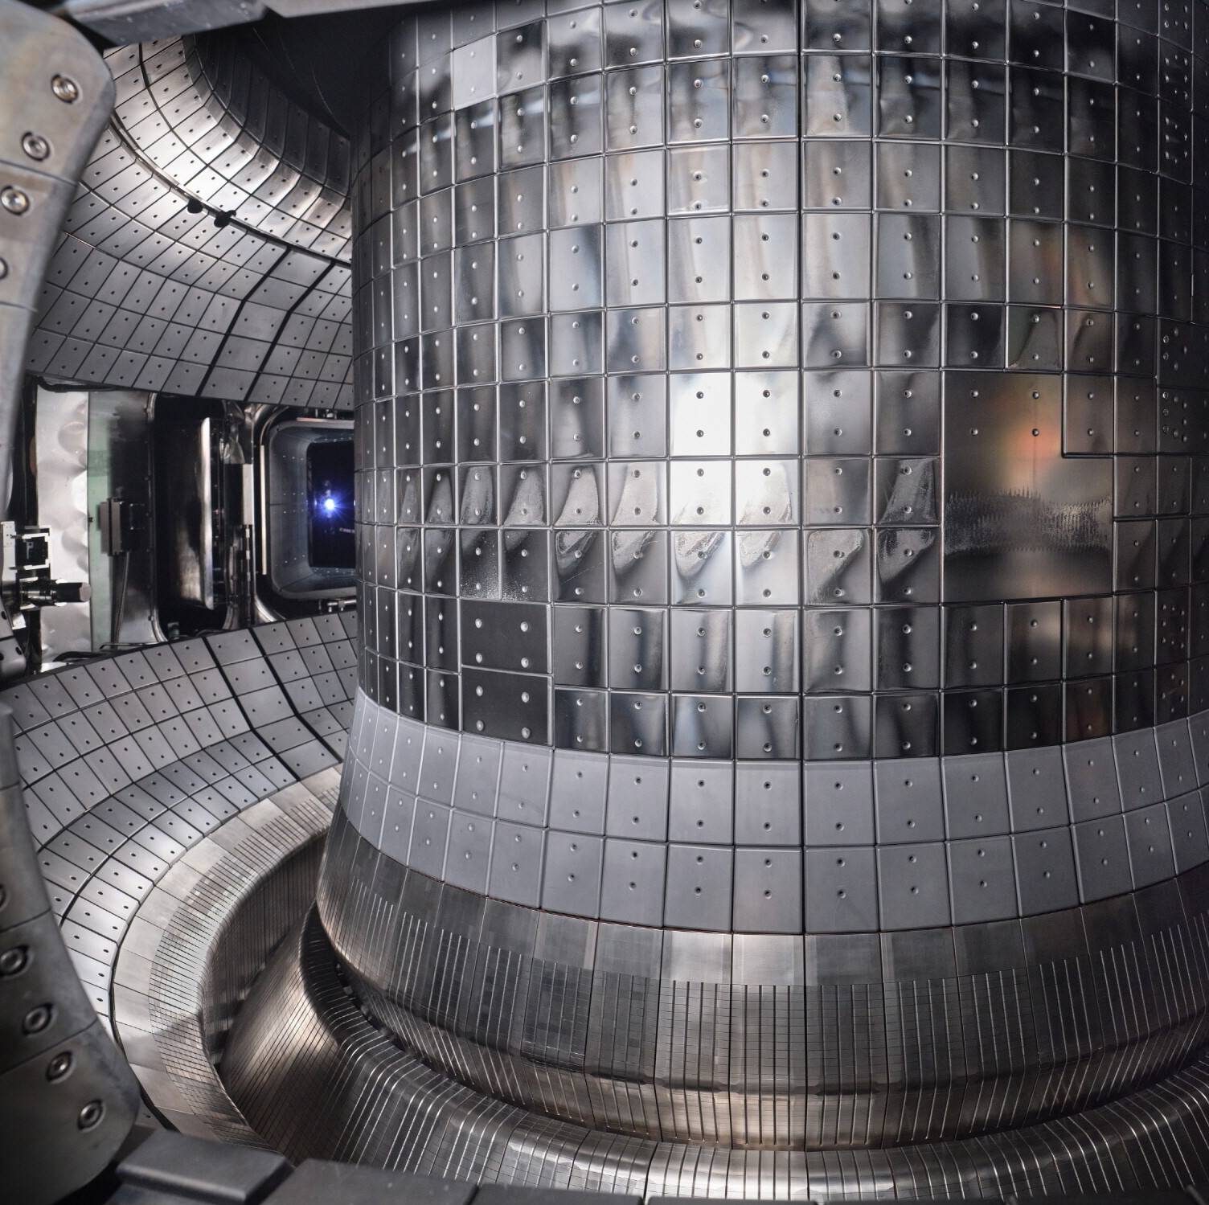
What are Tokamaks? Why need
early Predictions?
They confine Plasma in a toroidal chamber
End goal is to achieve controlled nuclear fusion.
Plasma is at extremely high temperatures (150 million degree Celsius) and a very strong magnetic field keeps it confined.
Disruptions are Sudden Catastrophic events when plasma loses its stability. These can cause severe damage to the Tokamak and the surrounding

Slide 5
Studying the parameters and
classifying their importance
Initially developed understanding of the physics inside Tokamaks and the variables (features) that will be used in the Machine Learning models via Research Papers.
This can be used to have a better understanding of which features to drop and which to give more importance or weightage in the final model.
https://docs.google.com/spreadsheets/d/1ZAg_LVyM-MQem7eGq4eDPyRTtiRHpg3OBH5EhbYWyd4/edit?gid=1044834239#gid=1044834239

Slide 6
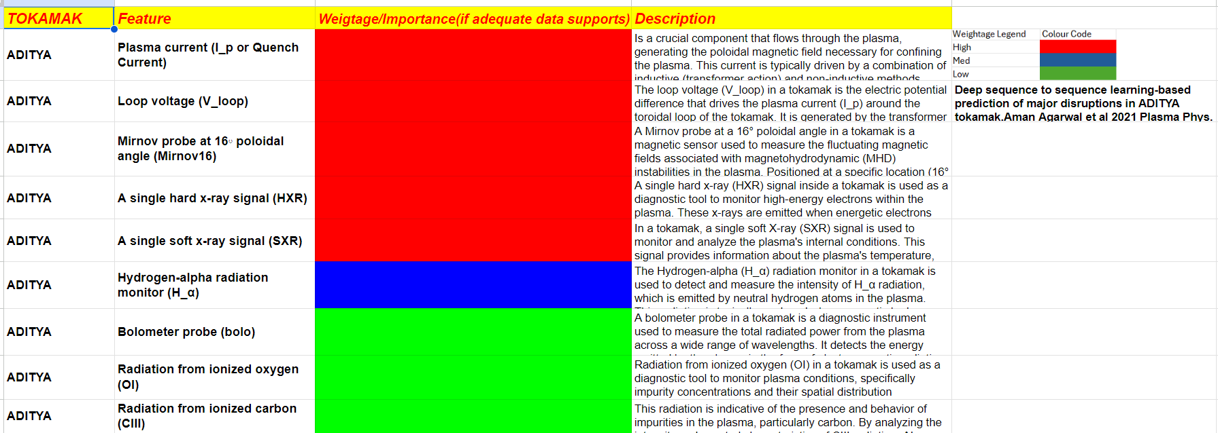
The Classification:-

Slide 7
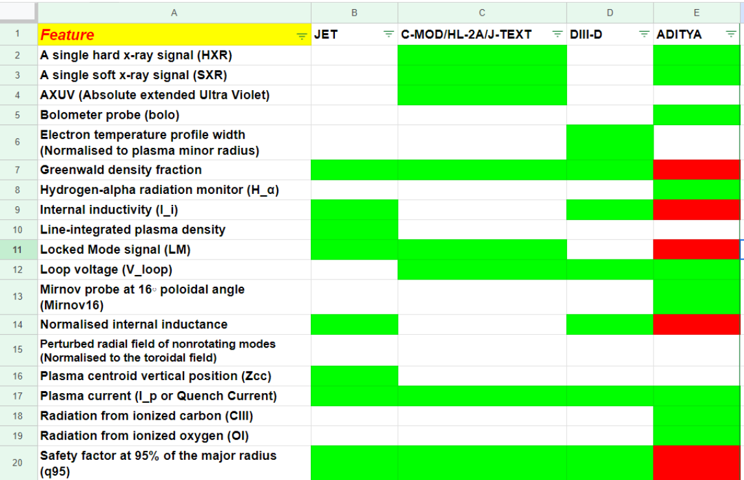
Other Tokamaks Compared

Slide 8
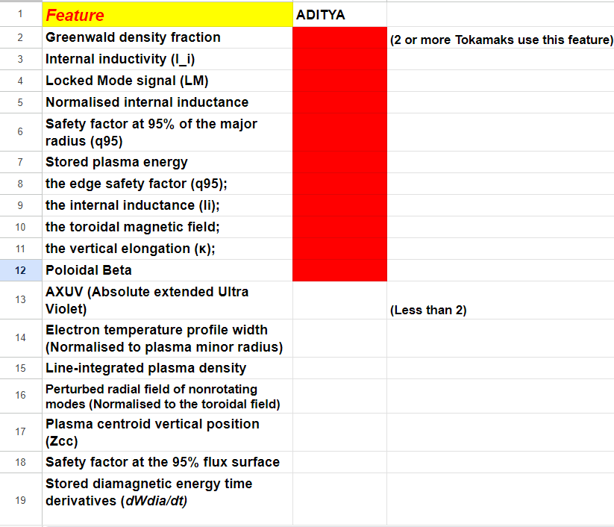
Missing Parameters

Slide 9
Data Analysis
I finally received Data to work on which was from the HL-2A Tokamak and I did some initial Data Analysis on it to develop a sense of which features matter more in our model.

Slide 10
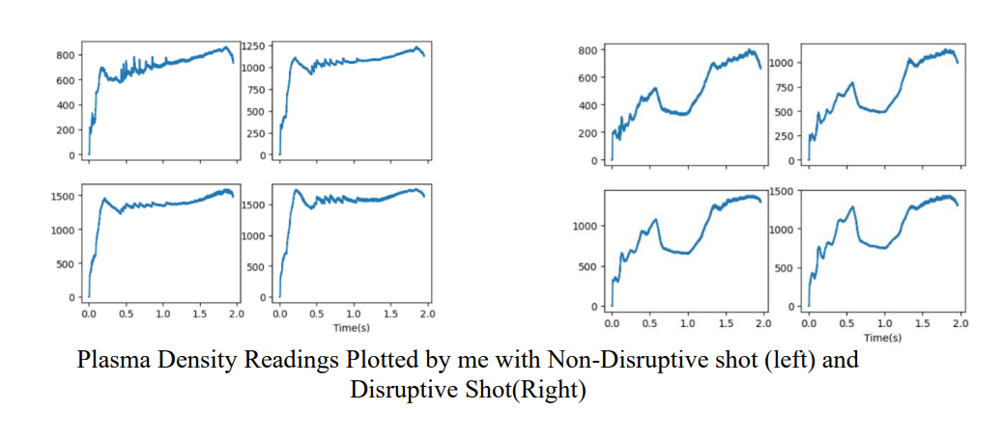
Data Analysis

Slide 11
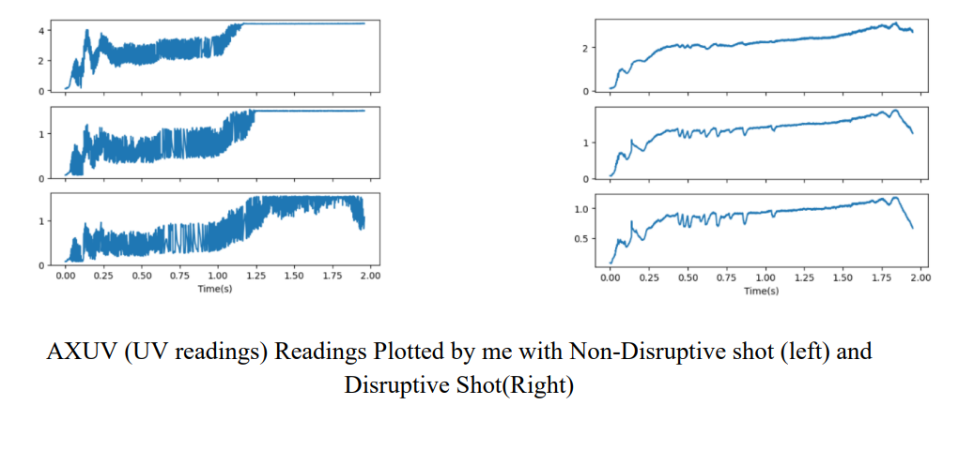
Data Analysis

Slide 12
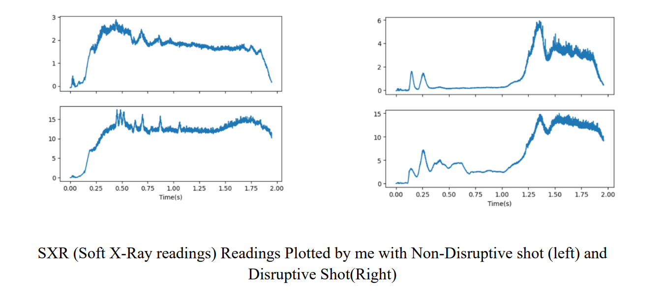
Data Analysis

Slide 13
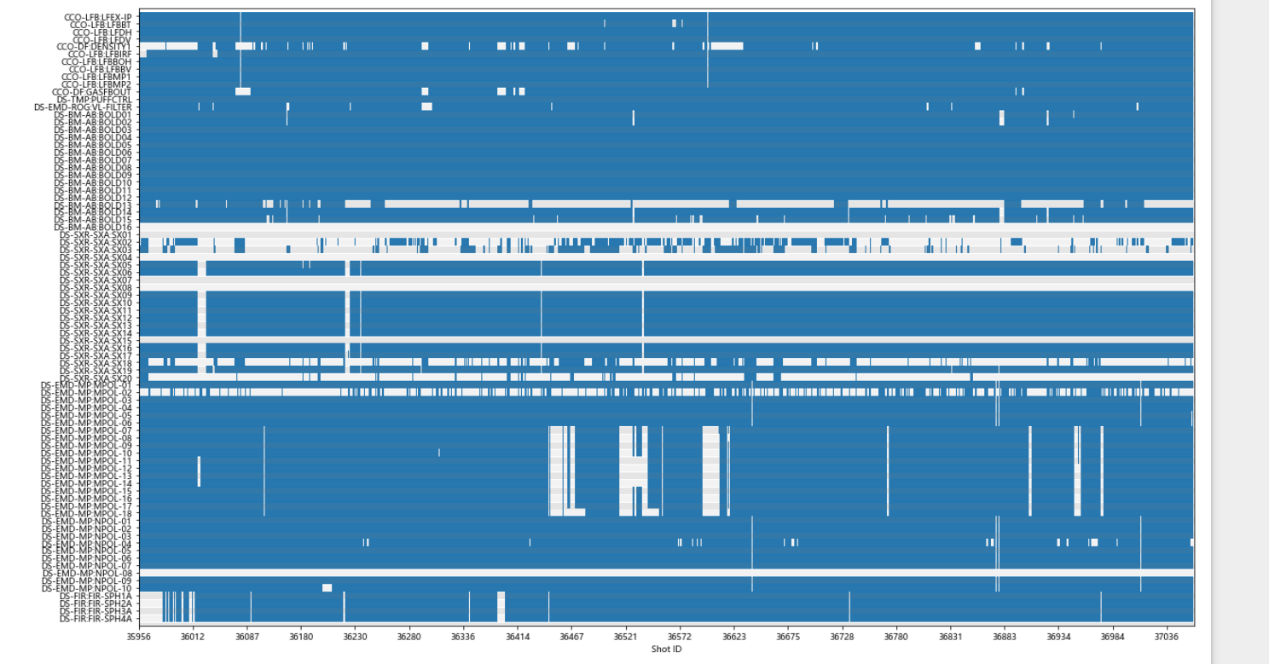
Data Cleaning
I finally received Data to work on which was from the HL-2A Tokamak and I did some initial Data Analysis on it to develop a sense of which features matter more in our model.

Slide 14
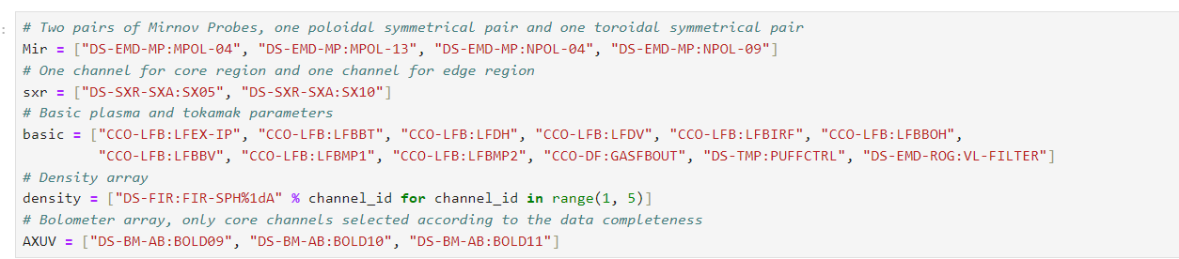
Data Cleaning
All the Features (parameters) chosen after data analysis and cleaning. Rest are dropped

Slide 15

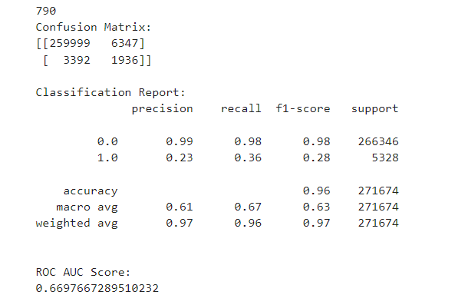
Running Models

Slide 16
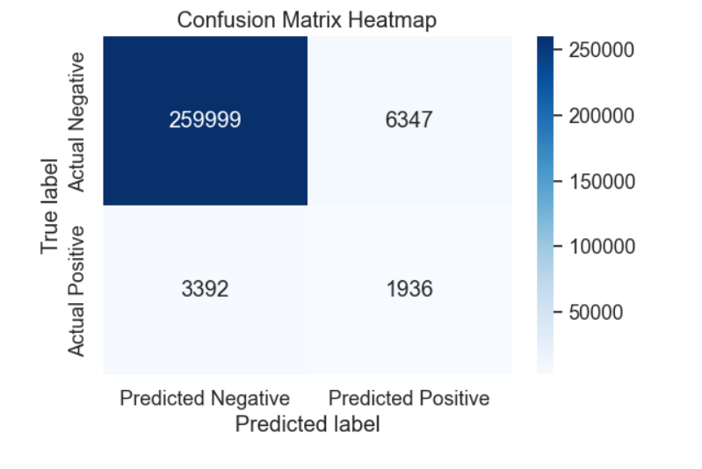
Running Models

Slide 17
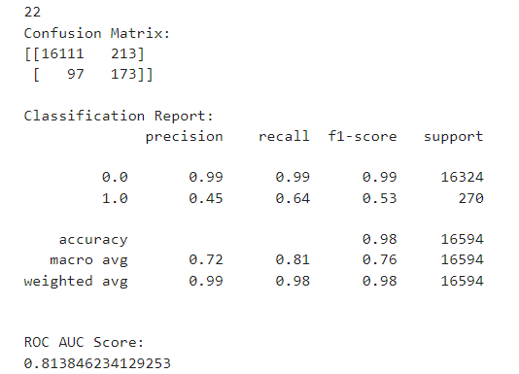
Running Models

Slide 18
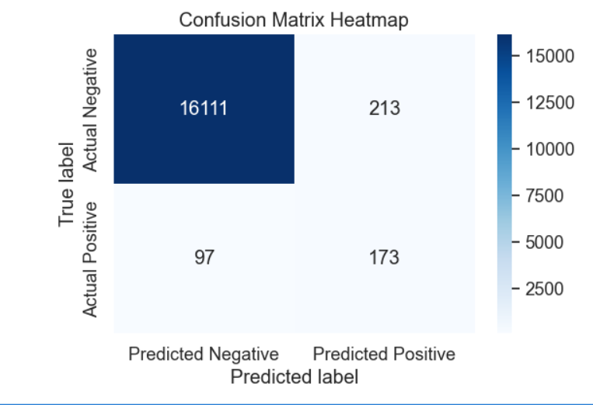
Running Models

Slide 19

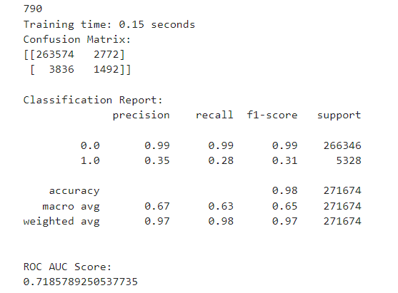
Running Models

Slide 20
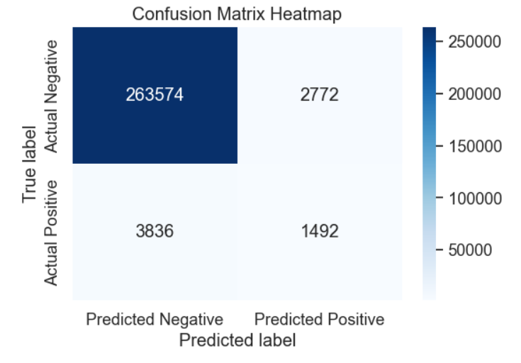
Running Models

Slide 21

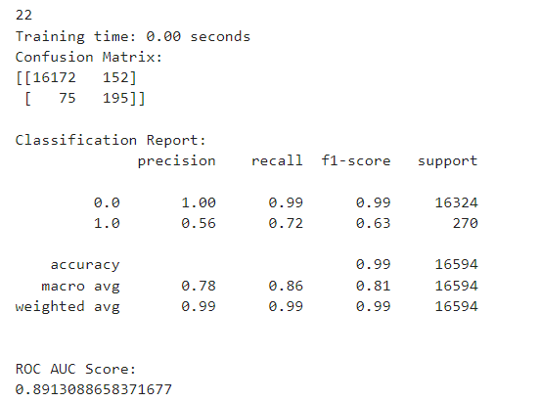
Running Models

Slide 22
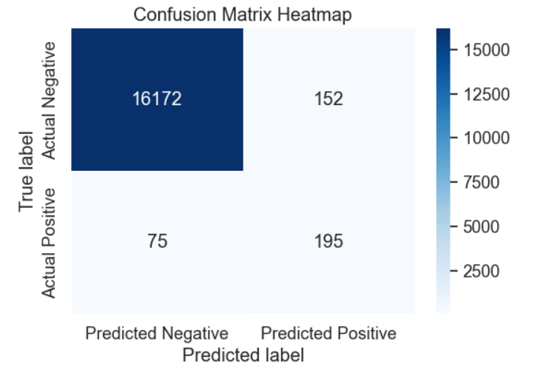
Running Models

Slide 23
Running Models

Slide 24

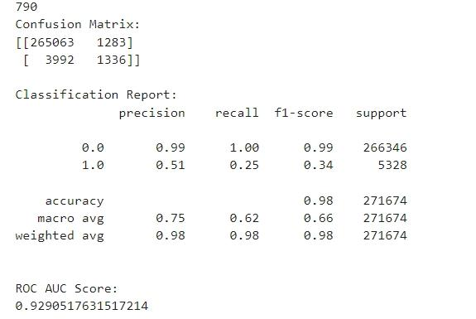
Running Models

Slide 25
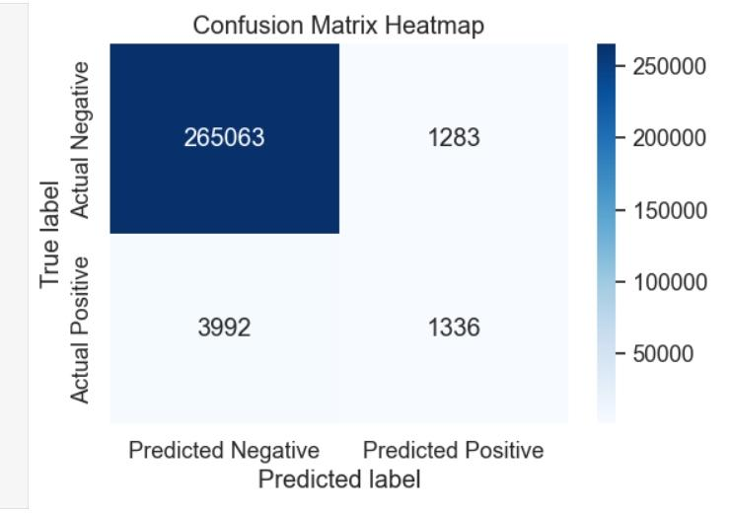
Running Models

Slide 26
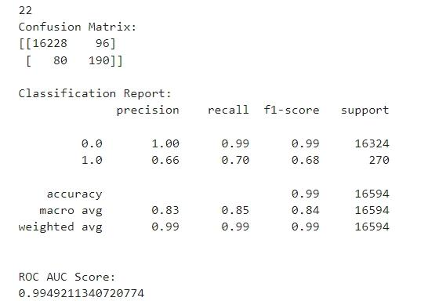
Running Models

Slide 27
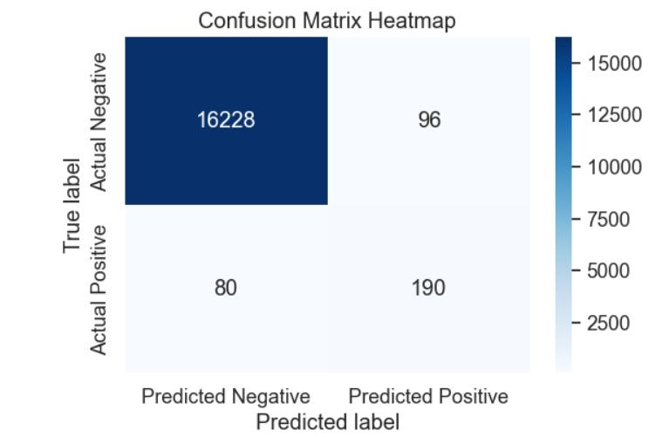
Running Models

Slide 28

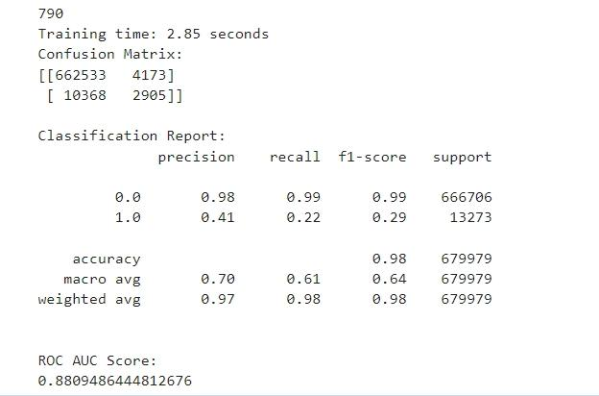
Running Models

Slide 29
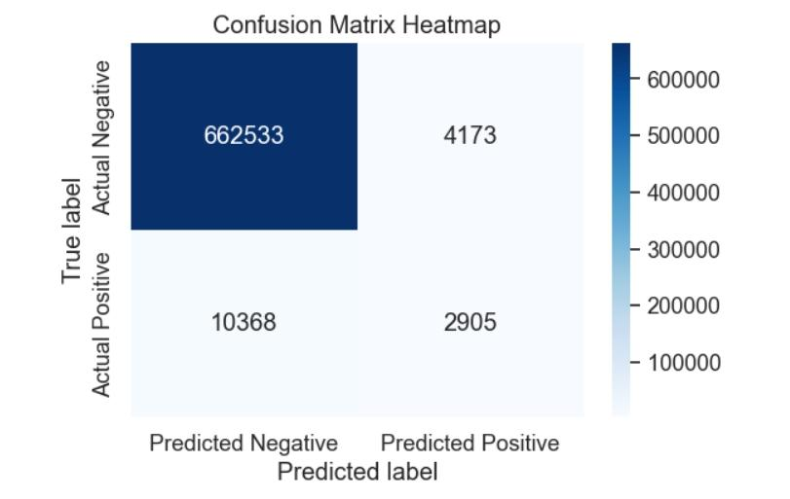
Running Models

Slide 30

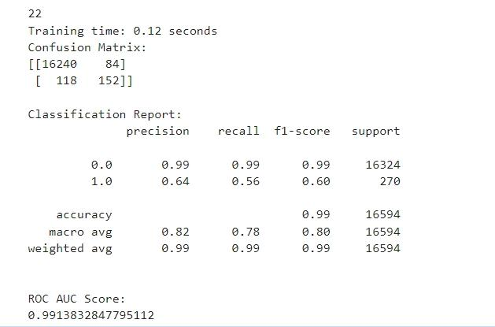
Running Models

Slide 31
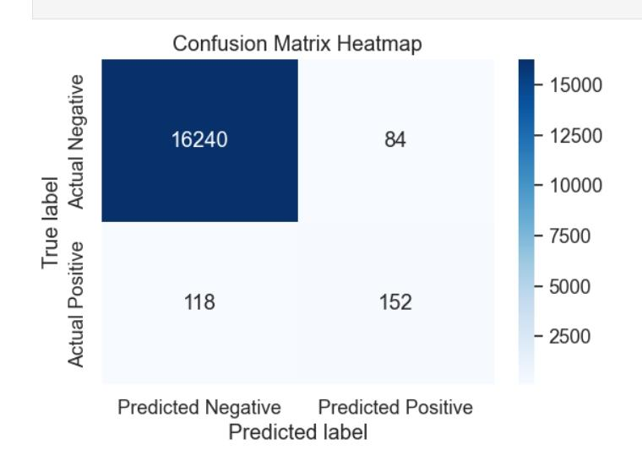
Running Models

Slide 32
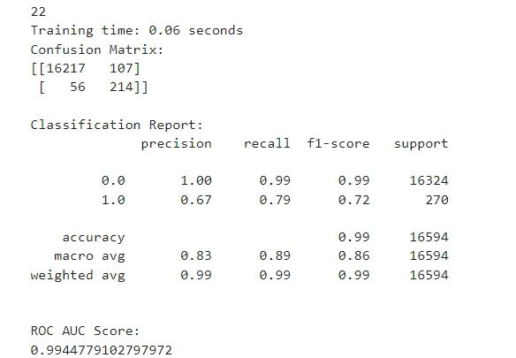
Running Models

Slide 33
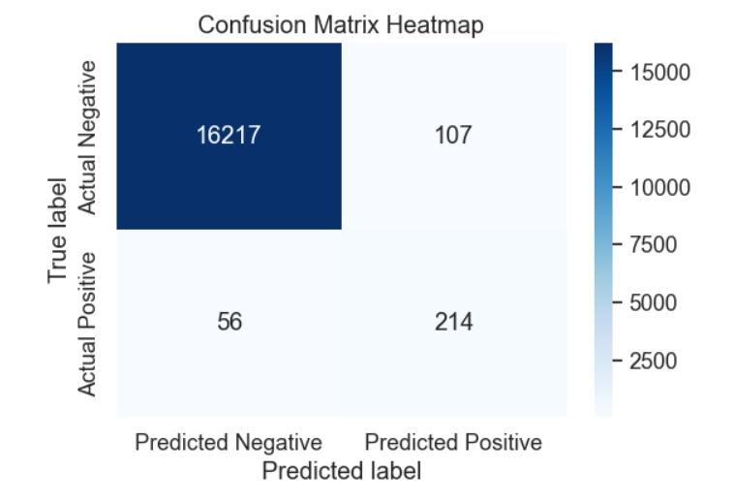
Running Models

Slide 34
Conclusion
We can therefore conclude from all the models we ran that pre-processing of data is highly important , in our case we had the issue of highly imbalanced data. This was resolved using modern sampling techniques mostly under sampling, oversampling and a combination of oversampling-undersampling.
This along with adjusting weights of the minority class almost doubled the F1 score and brought about a good increase in accuracy.

Slide 35
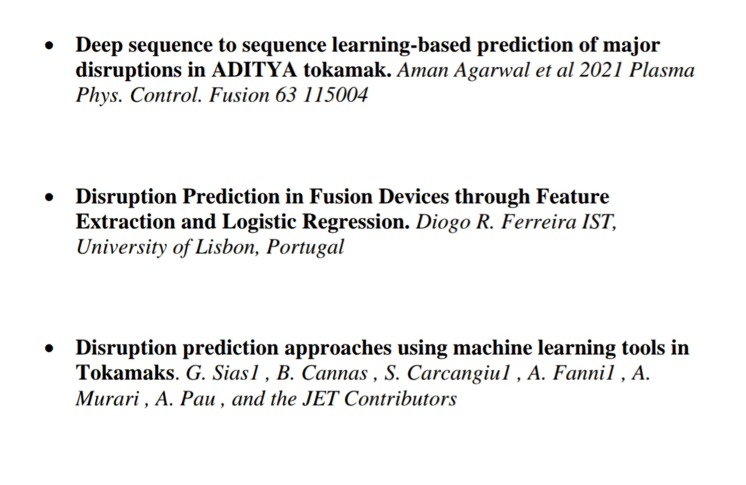
References

