Slide 1
Recitation for Homework 1: Numerical Search

Slide 2
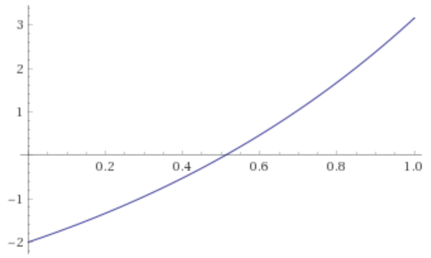
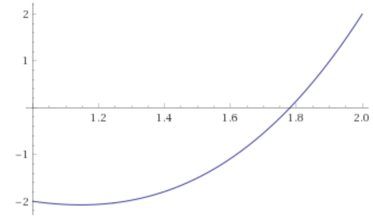
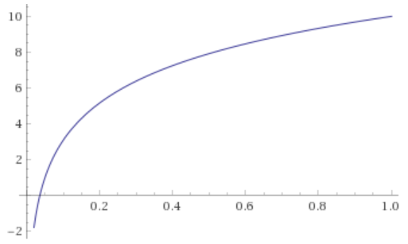
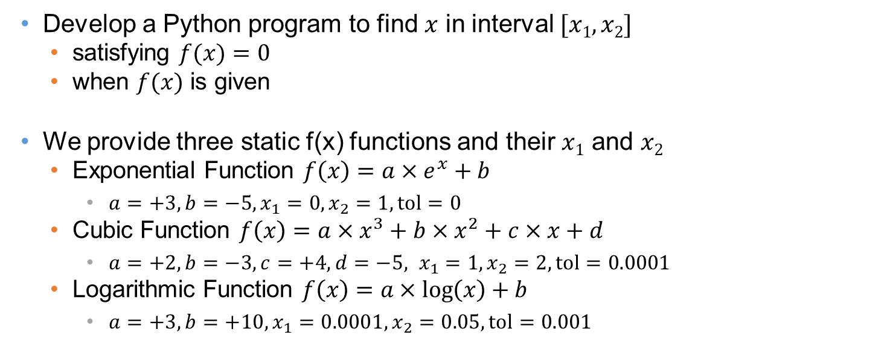
Homework Objectives
Develop a Python program to find $x$ in interval $[x1, x2]$
satisfying $f(x)=0$
when $f(x)$ is given
We provide three static f(x) functions and their $x1$ and $x2$
Exponential Function $f\left(x\right)=a×e^{x}+b$
$a=+3, b=−5, x_{1}=0,x_{2}=1, tol=0$
Cubic Function $f\left(x\right)=a×x^{3}+b×x^{2}+c×x+d$
$a=+2, b=−3,c=+4,d=−5, x_{1}=1,x_{2}=2, tol=0.0001$
Logarithmic Function $f\left(x\right)=a×\log\left(x\right)+b$
$a=+3, b=+10, x_{1}=0.0001,x_{2}=0.05, tol=0.001$
Exponential Function
Cubic Function
Logarithmic Function

Slide 3




Numerical Searching Algorithms (1)
How to solve the equations?
Use numerical searching algorithms
Binary search
(Optional) Newton search
(Optional) Secant search
Binary Search
Find $x[low, high]$such that $f(x) = 0$
Assumption : $f(low) f(high) < 0$
Iteration
Mid = (low + high) / 2;
While ( |f (mid)| > tol ) {
If (f(low)*f(mid) > 0)
low = mid
else
high = mid;
mid = (low + high) / 2;
}
$$f(low) ∗ f(mid) < 0$$
Then, variable high gets value mid
f(x)
low
$i^{th}$ iteration
mid
high
${(i+1)}^{th}$ iteration
low
mid
high

Slide 4

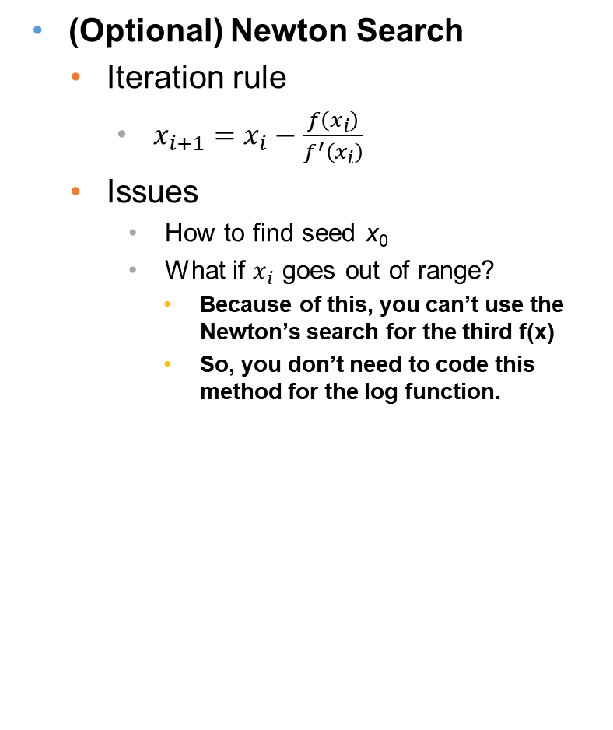
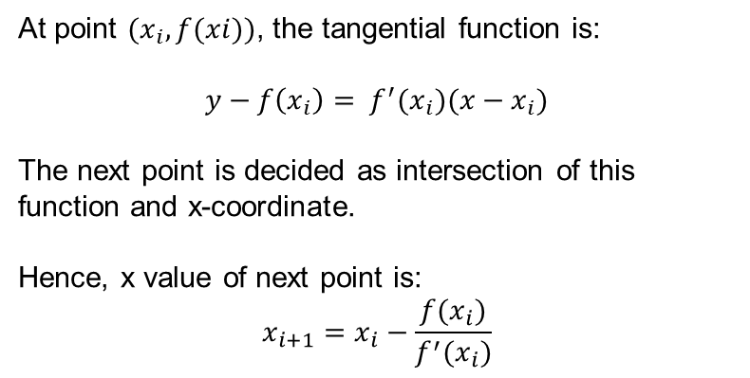


Numerical Searching Algorithms (2)
(Optional) Newton Search
Iteration rule
$x_{i+1}=x_{i}−\frac{f\left(x_{i}\right)}{f^{′}\left(x_{i}\right)}$
Issues
How to find seed x₀
What if $x_{i}$ goes out of range?
Because of this, you can’t use the Newton’s search for the third f(x)
So, you don’t need to code this method for the log function.
At point $(x_{i}, f(xi))$, the tangential function is:
$$y−f\left(x_{i}\right)= f^{′}(x_{i})(x−x_{i})$$
The next point is decided as intersection of this function and x-coordinate.
Hence, x value of next point is:
$$x_{i+1}=x_{i}−\frac{f(x_{i})}{f^{′}(x_{i})}$$
f(x)
$$x_{i+1}$$
$$x_{i+2}$$
$$x_{i}$$

Slide 5










Numerical Searching Algorithms (3)
(Optional) Secant Search
Iteration rule
$x_{i+2}=x_{i+1}−f\left(x_{i+1}\right)\frac{x_{i+1}−x_{i}}{f\left(x_{i+1}\right)−f\left(x_{i}\right)}$
Assuming $y=0$
➔
At points $(x_{i}, f(x_{i}))$ and $(x_{i+1}, f(x_{i+1}))$ , the function of line passing through two points is
$$y= \frac{f\left(x_{i+1}\right)−f\left(x_{i}\right)}{x_{i+1}−x_{i}}\left(x−x_{i+1}\right)+f(x_{i+1})$$
The next point is decided as intersection of this function and x-coordinate.
Hence, x value of next point is
$$x_{i+2}=x_{i+1}−f(x_{i+1})\frac{x_{i+1}−x_{i}}{f\left(x_{i+1}\right)−f(x_{i})}$$
f(x)
$$x_{i}$$
$$x_{i+2}$$
$$x_{i+1}$$
$$x_{i+3}$$

Slide 6
Suggested Architecture
ExpFunc
Main
a, b
funcExp: ExpFunc
funcCubic: CubicFunc
funcLog: LogFunc
eval (x)
deriv (x)
binarySearch(low, high, tol)
newtonSearch(x₀, tol)
secantSearch(x₀, x₁, tol)
printFunction ()
printResult ()
Main “use” (dependency) ExpFunc, CubicFunc and LogFunc
main ()
CubicFunc
a, b, c, d
ExpFunc f1 = new ExpFunc();
f1.printFunction();
f1.binarySearch (…);
f1.printResult (“Binary search”);
f1.newtonSearch ();
f1.printResult (“Newton search”);
f1.secantSearch ();
f1.printResult (“Newton search”);
// CubicFunc
//Log Func
eval (x)
deriv (x)
binarySearch(low, high, tol)
newtonSearch(x₀, tol)
secantSearch(x₀, x₁, tol)
printFunction ()
printResult ()
LogFunc
a, b
eval (x)
deriv (x)
binarySearch(low, high, tol)
newtonSearch(x₀, tol)
secantSearch(x₀, x₁, tol)
printFunction ()
printResult ()
Don’t need to follow suggested architecture!
Well-designed architecture may receive high score

Slide 7
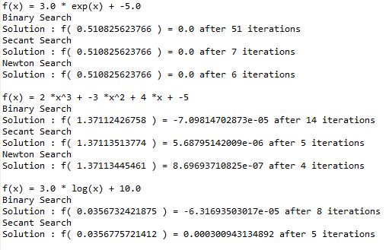
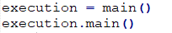
Homework Execution
TA will only execute the following codes
The execution result should be same as the sample output!
Execution Code
Sample Output

Slide 8
Grading Criteria
Criteria (Total 100)
Binary Search for exponential function (25)
Binary Search for cubic function (25)
Binary Search for logarithmic function (25)
Report – only word file (.docx)
1 page of your class diagram (20)
Well-designed class diagram will receive high score
Your code should be matched with your class diagram.
1 page of your output capture (5)

Slide 9
Homework Deliverables
By 23:59, March, 20
You should submit a zip file of
Python Program
PyCharm project folder
Reports
1 page of your class diagram
1 page of your output capture

