Slide 2
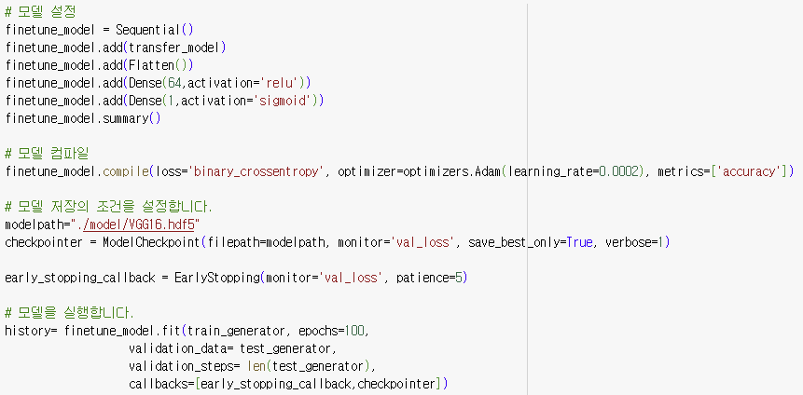
Result - VGG16 (64-hidden-node)

Slide 3
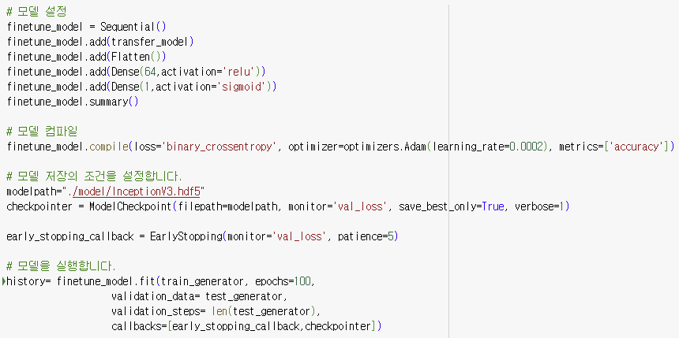
Model - InceptionV3 (64-hidden-node)

Slide 4
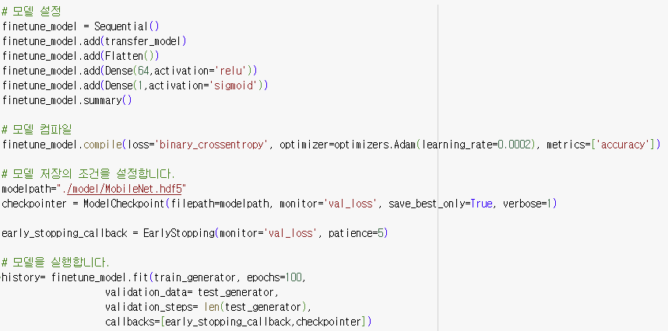
Model - MobileNet (64-hidden-node)

Slide 5

Model - VGG16 (128-hidden-node)

Slide 6
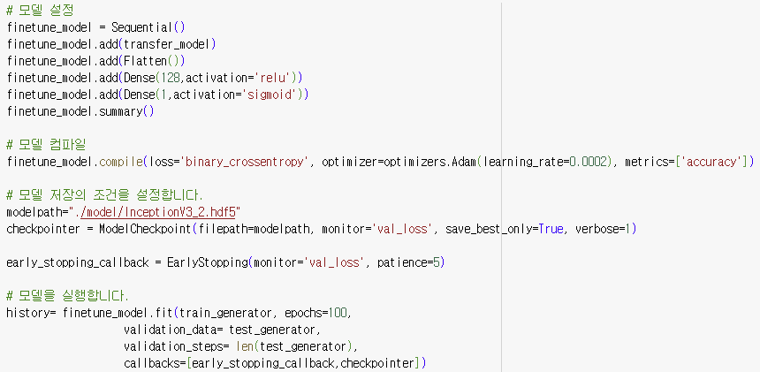
Model - InceptionV3 (128-hidden-node)

Slide 7
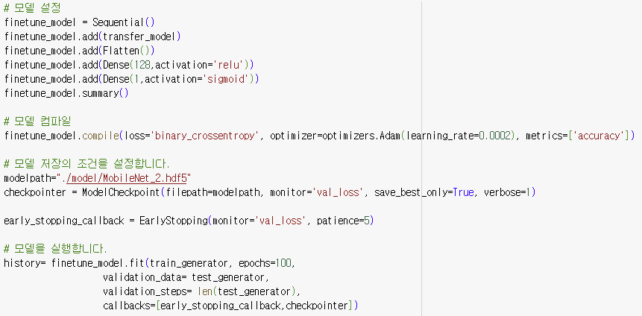
Model - MobileNet (128-hidden-node)

Slide 8
Model - Table
Dataset | 모델 | No_hiddenNode | h_flip | v_flip | image | epoch | Patience | Val_loss_best | Val_acc_best
Textile | VGG16 | 64 | Y | Y | 150*150 | 100 | 5 | 0.2256 | 0.9115
Textile | InceptionV3 | 64 | Y | Y | 150*150 | 100 | 5 | 0.1608 | 0.9310
Textile | MobileNet | 64 | Y | Y | 150*150 | 100 | 5 | 0.1685 | 0.9172
Textile | VGG16 | 128 | Y | Y | 150*150 | 100 | 5 | 0.2256 | 0.9115
Textile | InceptionV3 | 128 | Y | Y | 150*150 | 100 | 5 | 0.2122 | 0.9195
Textile | MobileNet | 128 | Y | Y | 150*150 | 100 | 5 | 0.1878 | 0.9207

Slide 9
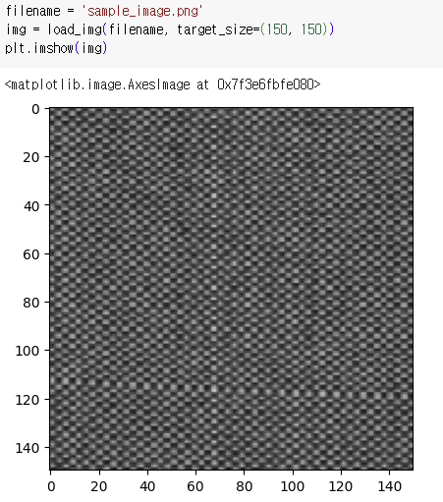
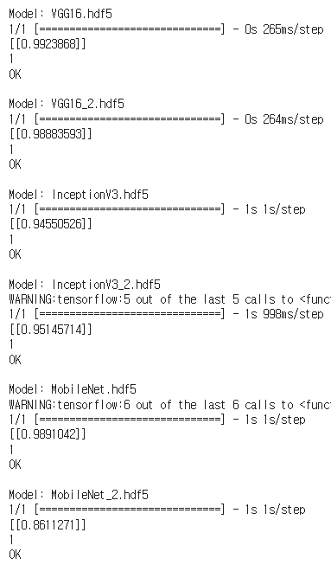
Result (OK)

Slide 10
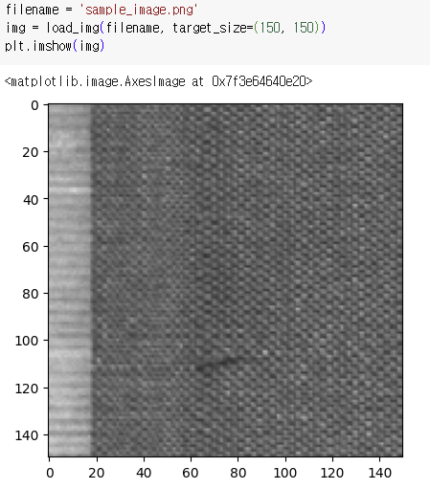
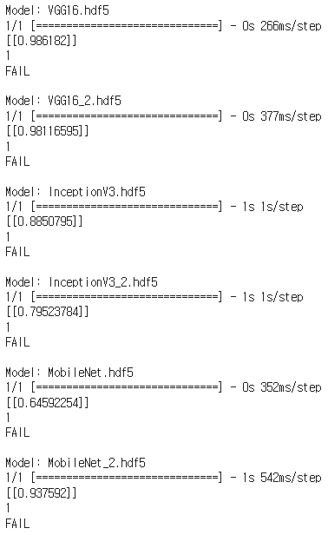
Result (FAIL)

