Slide 2
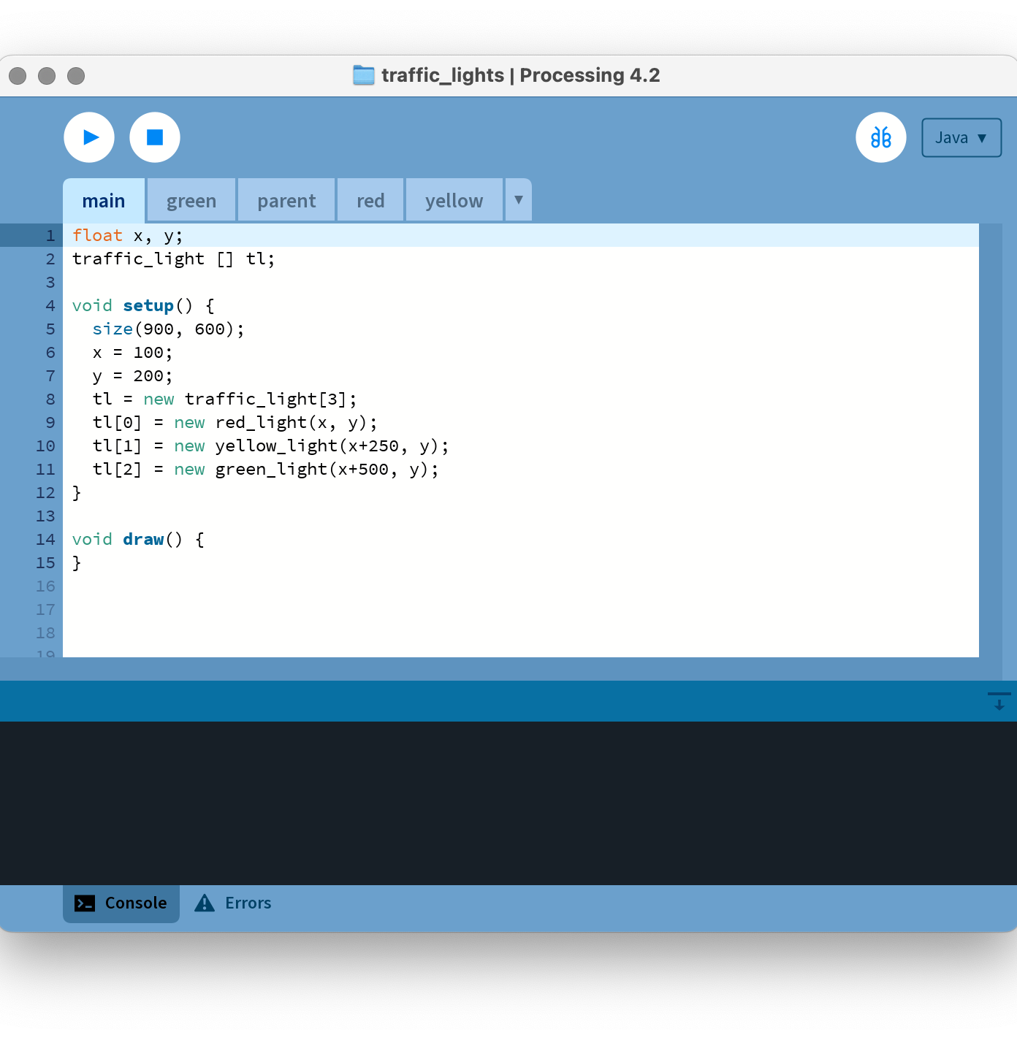
Main
float x, y;
traffic_light [] tl;
void setup() {
size(900, 600);
x = 100;
y = 200;
tl = new traffic_light[3];
tl[0] = new red_light(x, y);
tl[1] = new yellow_light(x+250, y);
tl[2] = new green_light(x+500, y);
}
void draw() {
}

Slide 3
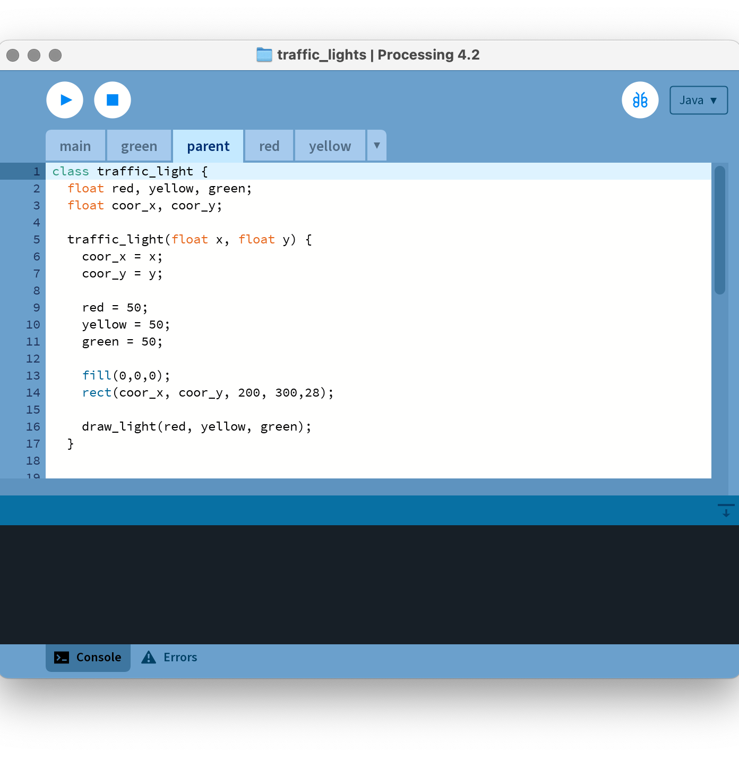
Parent
class traffic_light {
float red, yellow, green;
float coor_x, coor_y;
traffic_light(float x, float y) {
coor_x = x;
coor_y = y;
red = 50;
yellow = 50;
green = 50;
fill(0,0,0);
rect(coor_x, coor_y, 200, 300,28);
draw_light(red, yellow, green);
}
void on() {
this.red = 255;
this.yellow = 255;
this.green = 255;
}
void off() {
this.red = 50;
this.yellow = 50;
this.green = 50;
}
void draw_light(float r, float y, float g) {
fill(r,0,0);
circle(coor_x+100,coor_y+50,80);
fill(y,y,0);
circle(coor_x+100,coor_y+150,80);
fill(0,g,0);
circle(coor_x+100,coor_y+250,80);
}
}

Slide 4
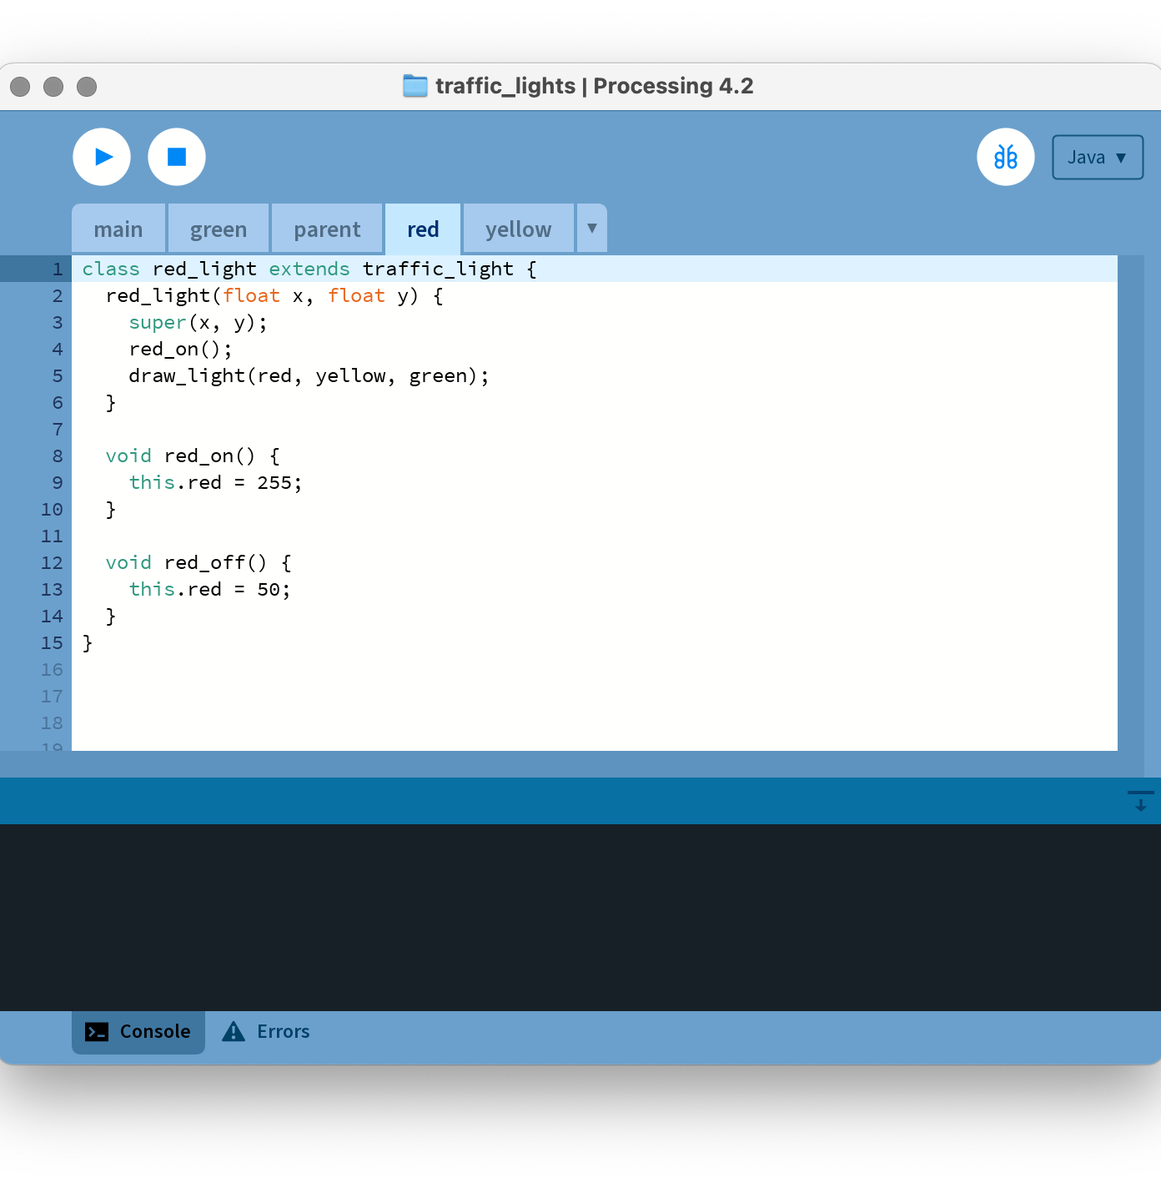
Red
class red_light extends traffic_light {
red_light(float x, float y) {
super(x, y);
red_on();
draw_light(red, yellow, green);
}
void red_on() {
this.red = 255;
}
void red_off() {
this.red = 50;
}
}

Slide 5
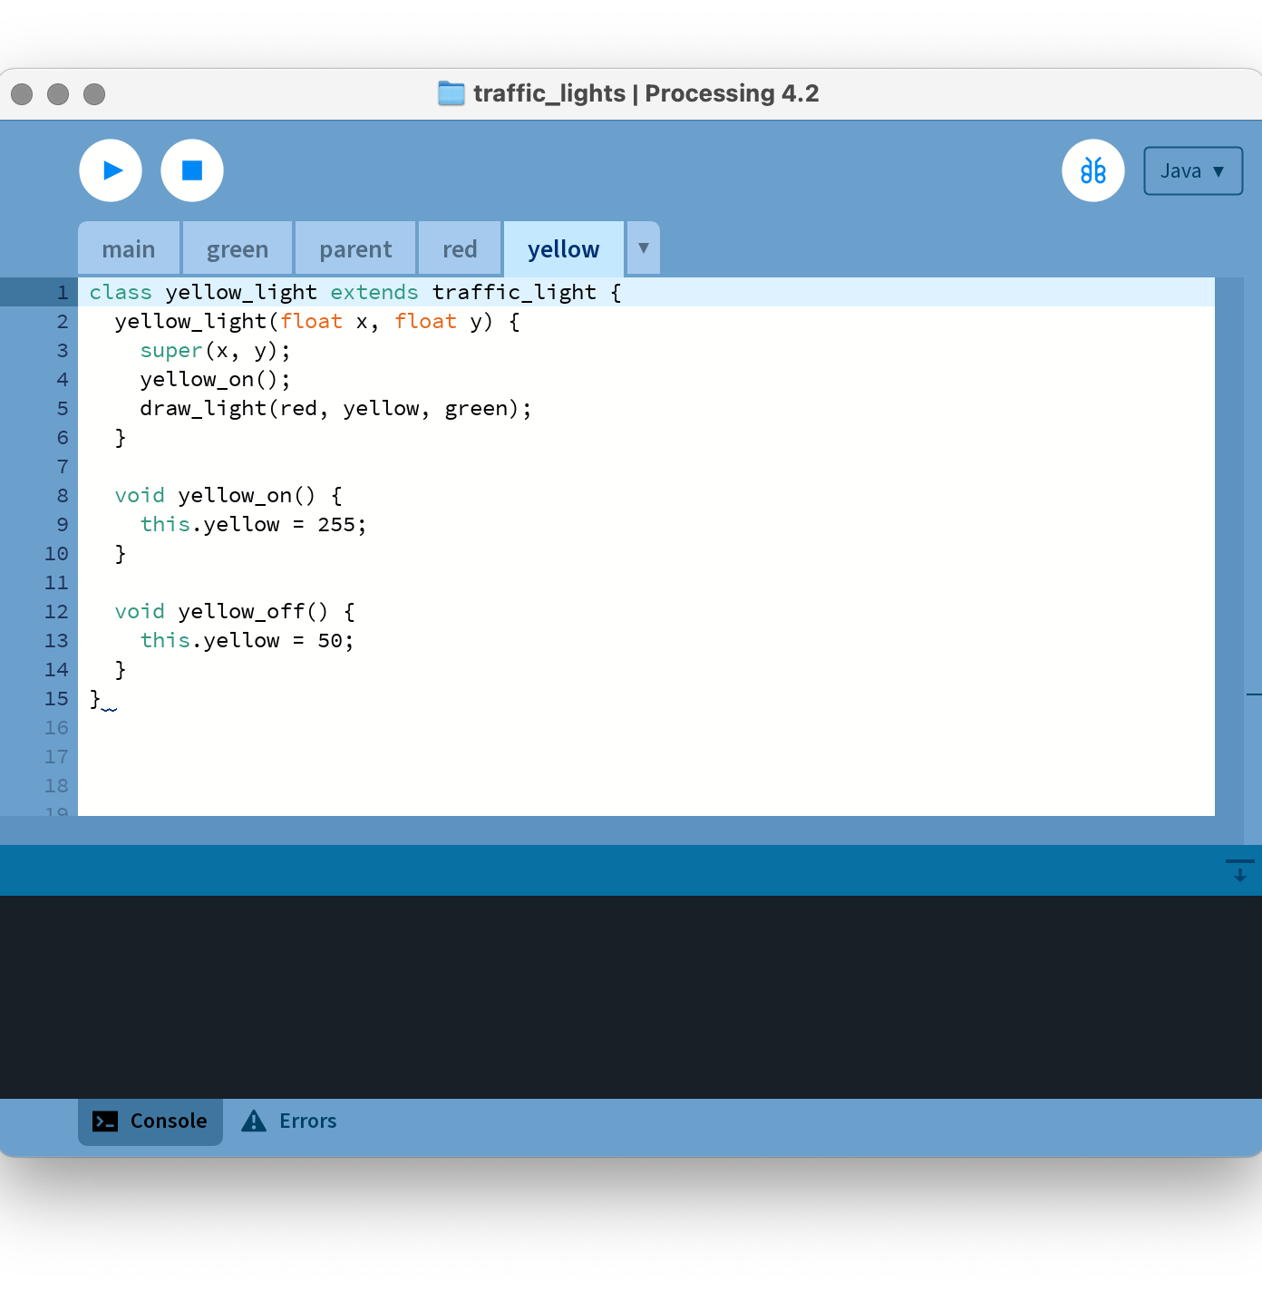
Yellow
class yellow_light extends traffic_light {
yellow_light(float x, float y) {
super(x, y);
yellow_on();
draw_light(red, yellow, green);
}
void yellow_on() {
this.yellow = 255;
}
void yellow_off() {
this.yellow = 50;
}
}

Slide 6

Green
class green_light extends traffic_light {
green_light(float x, float y) {
super(x, y);
green_on();
draw_light(red, yellow, green);
}
void green_on() {
this.green = 255;
}
void green_off() {
this.green = 50;
}
}

Slide 7
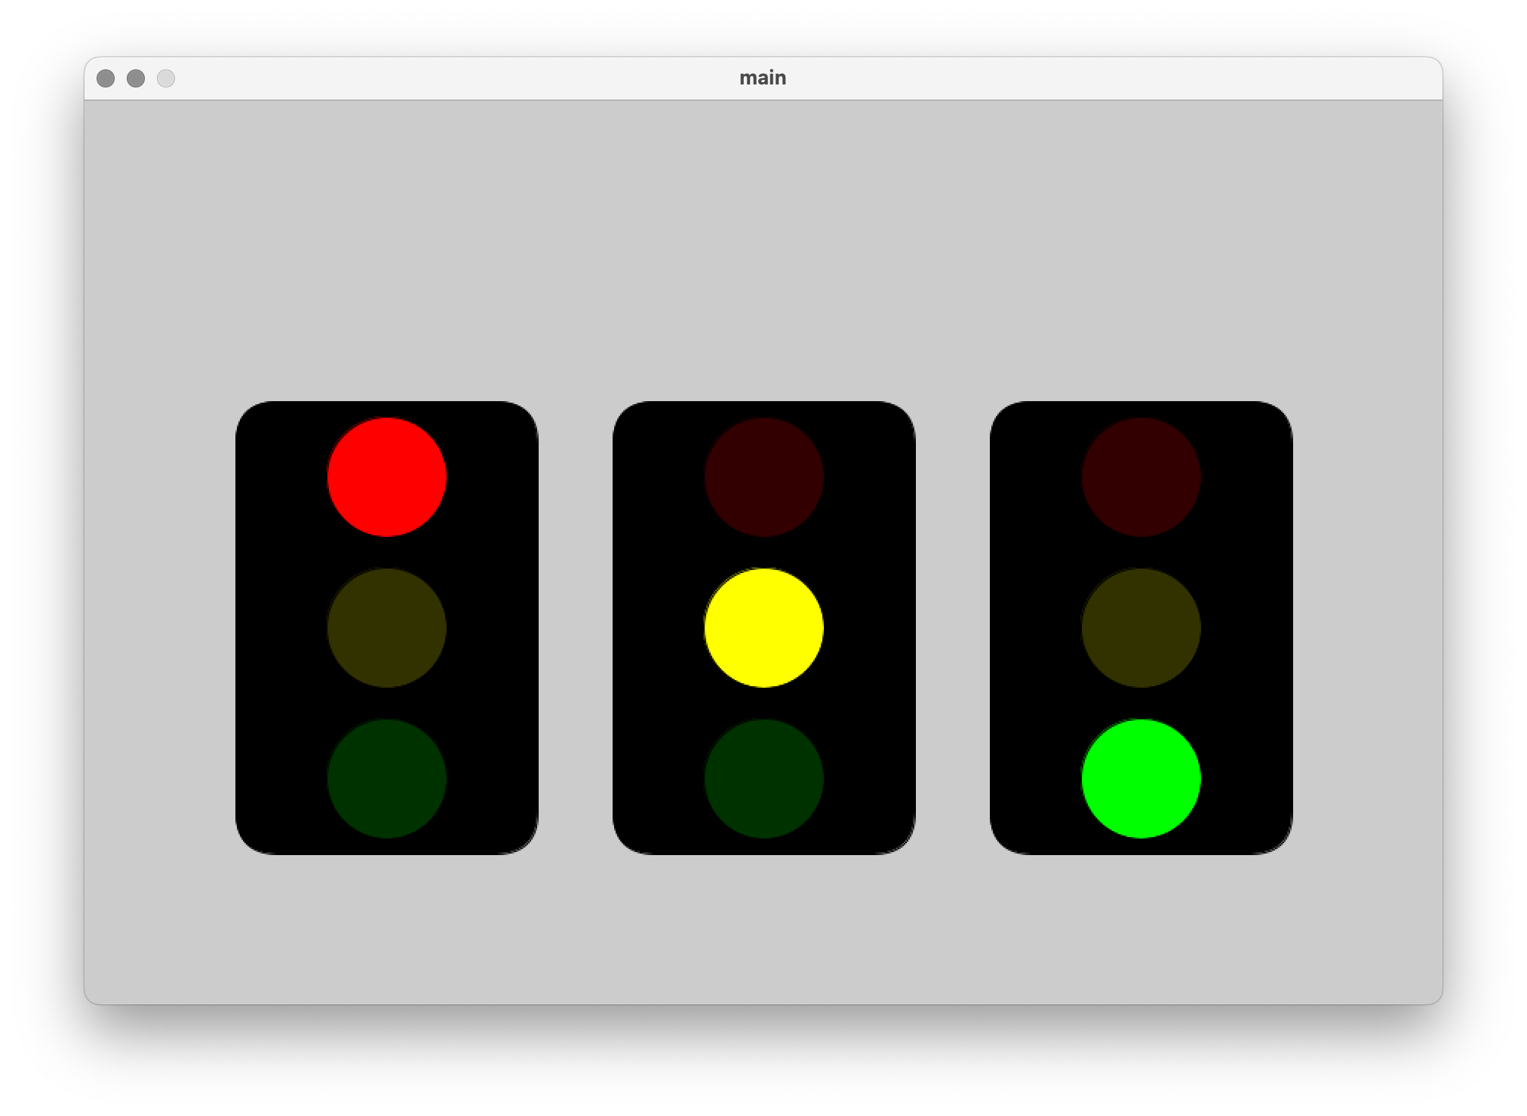
Result

