Slide 1
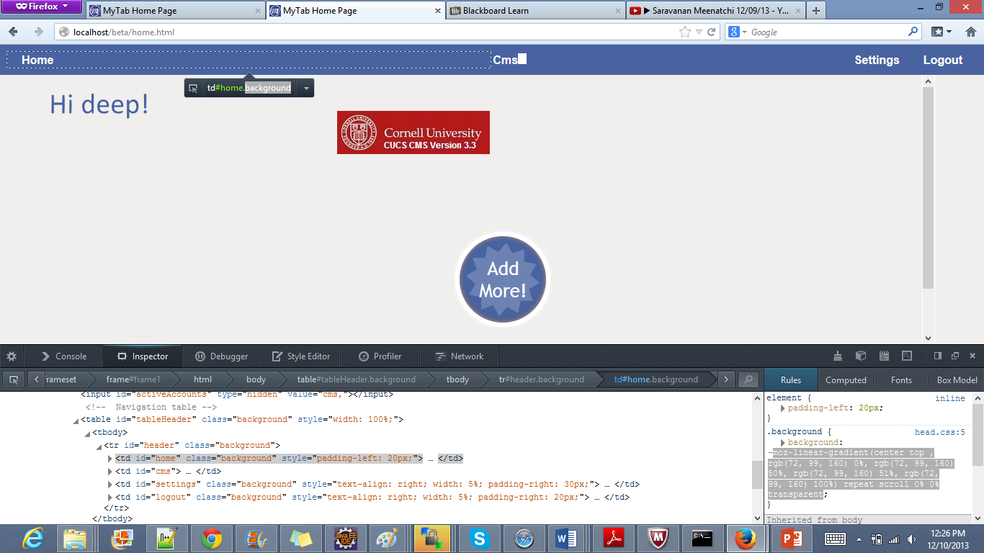
onclick='logoutFromAllAccounts()'

