Slide 1
Financial fraud detection
MAMATA SHEE (@geekytaurus115)
NITISH KUMAR (@nitishmca03)
Copyright 2014-2015 AICPA Unauthorized copying prohibited

Slide 2
CONTENTS
Introduction
What is Financial Fraud
Types of Financial Fraud
Fraud detection Techniques
Our detection
Dataset
Results
Delimitations
Guidelines

Slide 3
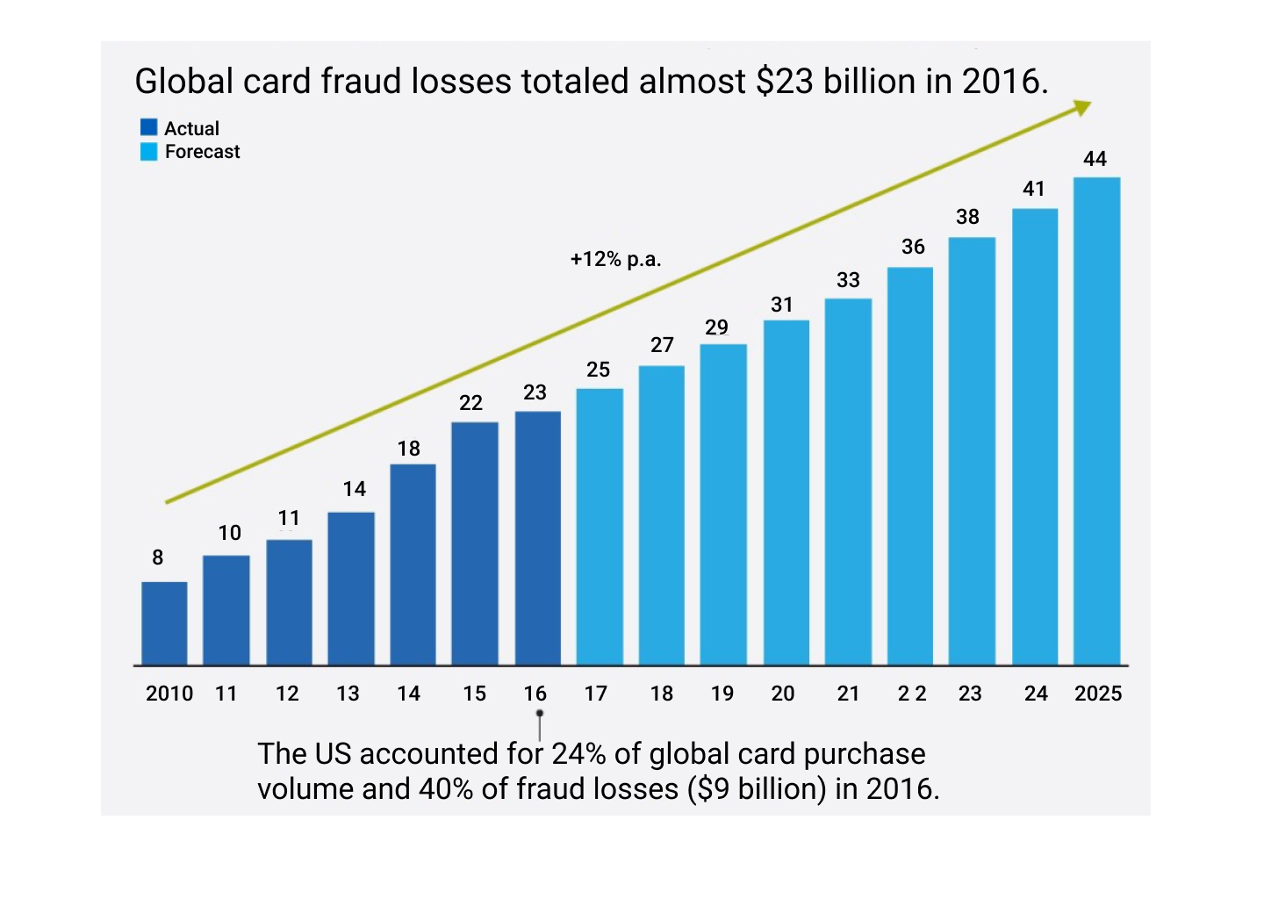
Introduction:
Modern financial institutions face the growing threat of fraud in its different and ever-changing ways. For example, fraudulent transactions with cards could amount up to $44 billion by 2025 as shown in Figure:

Slide 4
What is Financial Fraud:
Financial fraud happens when someone deprives you of your money or otherwise harms your financial health through misleading, deceptive, or other illegal practices.
This can be done through a variety of methods such as identity theft or investment fraud.

Slide 5
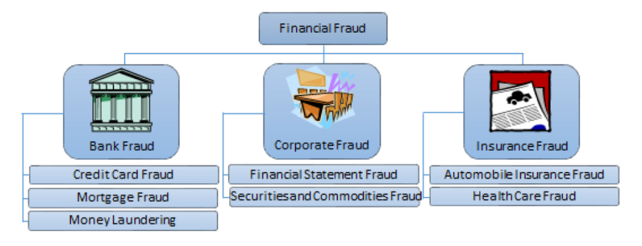
Types of Financial Fraud:

Slide 6
Bank Fraud:
Credit card fraud refers to the unauthorized use of a personal credit card to perform fraudulent transactions without this personal knowledge. The transactions can be performed using the physical card, where the card was either lost or stolen, as well as remotely. The cardholder information may be acquired through several methods.
Mortgage fraud is a specific form of financial fraud that refers to the manipulation of a property or mortgage documents. It is rather often committed to misrepresenting the value of a property for the purpose of influencing a lender to fund a loan for it.
Money laundering Money laundering is a method used by criminals to insert proceeds obtained from illicit ventures into valid businesses. This conceals the origin of the money, giving them the appearance of legitimate income and making it difficult to track their crimes. Money laundering is extremely undesirable since it enables criminals to have vast economic influence.

Slide 7
Corporate Fraud:
Financial statement fraud include improving stock performance, reducing tax obligations, or exaggerating business performance due to managerial pressure. Financial statement fraud can be difficult to disclose due to a general lack of understanding in the field, infrequency of its occurrence, and the fact that it is often committed by experienced people in the industry who can disguise their deceit.
Securities and commodities fraud refers to a variety of methods through which a person is deceived into investing in a company based on false information. It includes pyramid schemes, Ponzi schemes, hedge fund fraud, foreign exchange fraud, and embezzlement.

Slide 8
Insurance Fraud:
Insurance fraud is a fraud that can be committed at any point during the insurance process, and by any person(s) in the chain. Insurance claim fraud occurs when a customer submits a fraudulent insurance claim as a result of an exaggerated injury or loss of assets, or a completely fraudulent event.
A common form of claim fraud is automobile insurance fraud, which is often committed by faking or intentionally committing accidents that result in excessive repair and injury costs.
Larger-scale claim fraud also occurs as, for example, crop insurance fraud, where an insurance purchaser overstates the losses due to declining agricultural prices or the effects of natural disasters. Insurance fraud can additionally include excessive billing, duplicate claims, kickbacks to brokers, as well as «upcoding» of items.

Slide 9
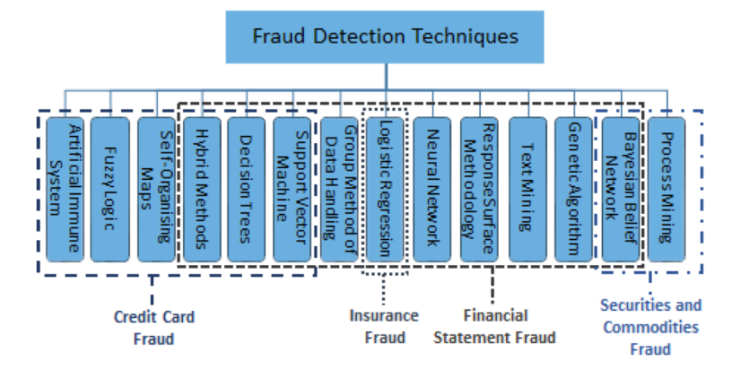
Fraud detection techniques:

Slide 10
Our Detection:
We are detecting Credit Card Fraud Detection related to Bank Fraud under Financial Fraud.
Visa Platinum
VISA
Platinum
5203 7612 1092 6322
12/30
RETURN ZERO

Slide 11
Dataset:
It is important that credit card companies are able to recognize fraudulent credit card transactions so that customers are not charged for items that they did not purchase.
The data sets contains transactions made by credit cards by cardholders. This dataset we have found 492 frauds out of 284,807 transactions.

Slide 12
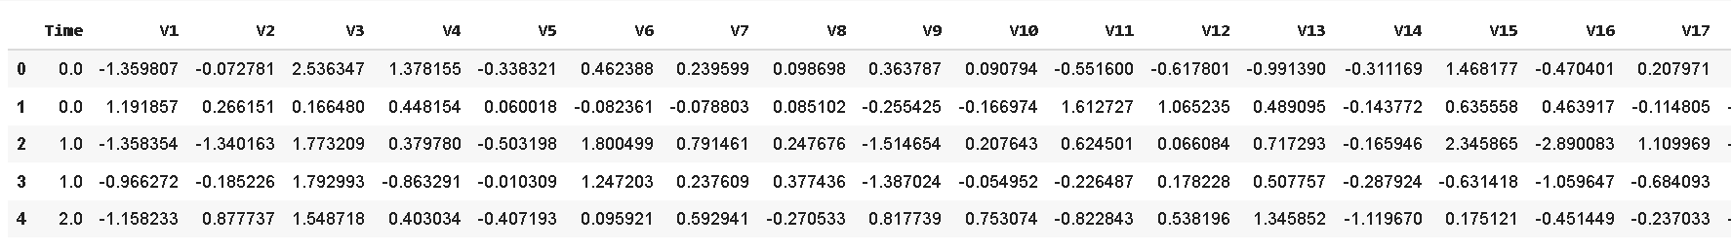
Contd..
It contains only numeric input variables which are the result of a PCA transformation. Features V1, V2, … V28 are the principal components obtained with PCA, the only features which have not been transformed with PCA is Time and Amount.
Feature Time contains the seconds between each transaction and the first transaction in the dataset. The feature Amount is the transaction Amount, this feature can be used for example-dependant cost-sensitive learning.
Feature Class is the response variable and it takes value 1 in case of fraud and 0 otherwise.

Slide 13
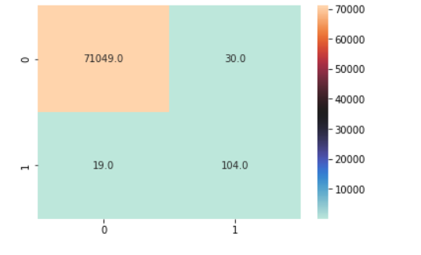
Results:
We use confusion matrix to calculate the accuracy value.

Slide 14
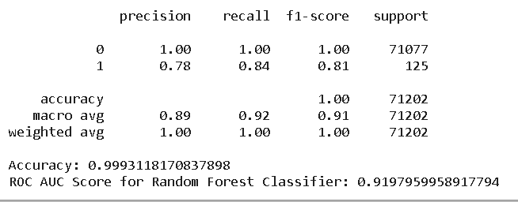
We use classification report to represent our analysis.
We get the accuracy 0.99931181

Slide 15
Delimitations:
Our system does not guarantee 100% accuracy
The system is unable to test data that is unrelated to the training database.

Slide 16
Thank You

