Slide 1
Churn Analysis and Prediction
Training Module L2 : A3
Presented By Sandipan Ghorai

Slide 2
Problem Statement
Churn Analysis and Prediction (Survival Modelling)
What is Customer Churning ?
Customer churn analysis is a way to understand the number or percentage of customers
who don't purchase additional products or services
A churned customer provides less revenue or zero revenue and increases
competitor market share

Slide 3
Business value
Customer churn analysis helps businesses understand why customers don’t return for repeat business.
Churn rate tells what portion of your customers leave over a period of time.
t’s often useful to look at churn by product, region or other granular factors.
Identify patterns in customer behavior of potential churners and initiate pro active
measures to reduce churn

Slide 4
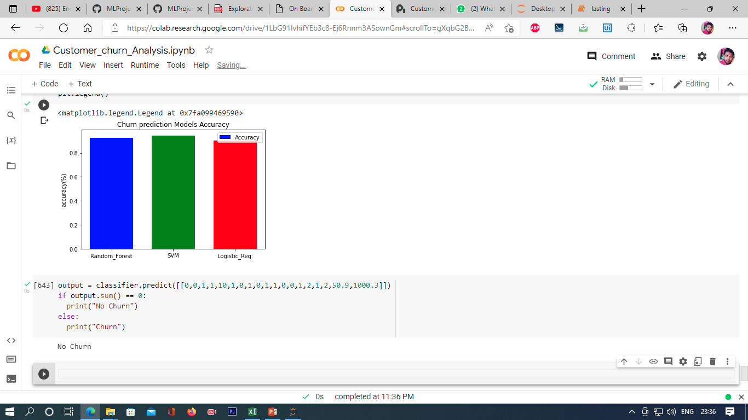
Visual representation of the overall solution

Slide 5
Scenario or Use cases used to provide a solution
Our target predicted column (Churn) have 73% ‘No’ values and 26% ‘YES’ values.
so we need to Sampling (Random oversampling, Under Sampling) this column for
create a Good ML model.
Handle missing values In our dataset. But our dataset have min missing values or NaN values (< 0.5%). So drop those rows from our dataset.
There are many fetchers values not co-relate or our output values not depended of these types of values. So we just ignore these columns.
Before Creating ML Model, all data preprocess using Encoding techniques , Feature Scaling and then splitting data set by training and testing data.

Slide 6
KPIs w.r.t scenarios [Descriptive, diagnostic and predictive]
Descriptive Analysis:
After Reading data, first knows the data shape of our dataset.
Show and understand all columns and features values
Checking the data types of the columns
Then describe the data using Count, Mean, Median, standard Deviation and find mini, max etc.
Understand what are the Feathers values ? and what is my outcomes or dependent value ?

Slide 7
Diagnostic Analysis:
Here the dataset explores by the Chart, graph and various plot
After explore the data the outcomes are –
Electronic check medium are the highest churners
Contract Type - Monthly customers are more likely to churn because of no
contract terms, as they are free to go customers.
No Online security, No Tech Support category are high churners
Non senior Citizens are high churners

Slide 8
Predictive Analysis
In predictive Analysis we create mainly three Machine Learning Models –
- Random Forest Classifier
- Logistic Regression
- Support Vector Machine (SVM)
From Our data Set we predict the outcome either Any customer Churn or Not.
Our Model Accuracy is nearly 92% and the SMV give the best accuracy by training our dataset.
Our Predictive analysis, we give any new data to our created ML Model as a Input. Then our model will give the output. After prediction then we can go to the prescriptive analysis based on our prediction.

Slide 9
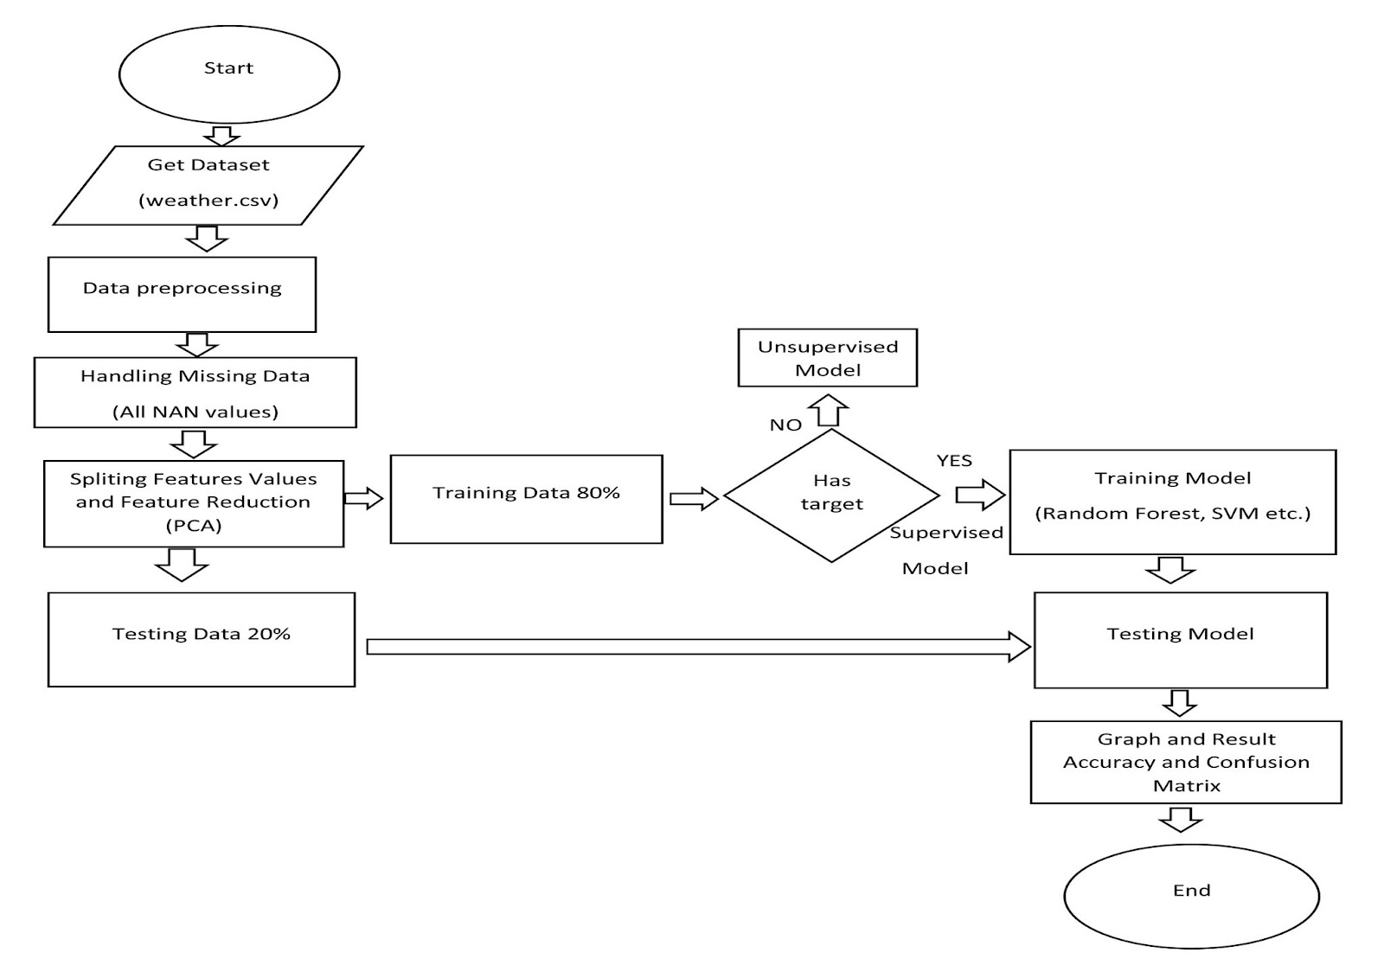
Dashboard Use Python [data preprocessing/visual creation] Maintain a document Prepare a presentation Note: Use simple ML model wherever required
My Data Set Link -
https://drive.google.com/file/d/1eSQyuDVxsmdF56Kn9zU_Vun9ZFJlFiAk/view?usp=sharing
Machine Learning Project Link -
https://colab.research.google.com/drive/1LbG91IvhifYEb3c8-Ej6Rnnm3ASownGm?usp=sharing

Slide 10
Thank You

