Slide 1



Sound
Data Representaion
Notes:
IGCSE Computer Science: Data Representation - Representing Sound

Slide 2

What is Sound?
Sound is energy that travels in waves through air, water, or other substances, and can be heard. (Collins English Dictionary, 2020)
Notes:
What is sound?
According to the Collins English Dictionary Sound is energy that travels in waves through air, water, or other substances, and can be heard.

Slide 3

What is Sound?
Sound can be represented as a waveform showing the vibrations of the air (or other substance).
These vibrations can produce an infinitely variable range of values.
Sound/Audio vibrations are analogue to capture this data on a computer we need to make this digital

Slide 4
Capturing Sound
To capture the sound we need…
  Microphone
  Analogue to digital convertor
  And the computer to store the data
Notes:
For us to capture or record sounds we need a microphone, and analogue to digital convertor and a device to process and store the data.

Slide 5
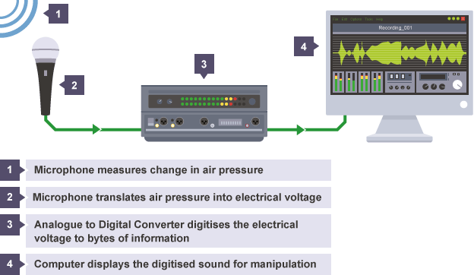
https://bam.files.bbci.co.uk/bam/live/content/zpwsr82/large
Notes:
This image, from the BBC, shows the simplified process of capturing sound.
1 - the sound waves cause changes in the air pressure that are measured by the microphone.
2 - the microphone translates these changes in pressure into an electrical voltage
3 - the analogue to digital convertor, or ADC, digitises the voltage into bytes of information
4 - the computer captures, process and displays the digitised sound for manipulation.

Slide 6
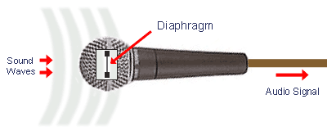
The Microphone
Converts acoustic energy (sound waves) into electrical energy (audio signal) (mediacollege.com, n.d.)
(mediacollege.com, n.d.)
Notes:
The microphone:
This is a device used to capture the sound waves. It converts acoustic energy in the electrical energy. It does this with the use of a diaphragm. The sound waves cause the diaphragm to move which in turn causes a copper coil to move backwards and forwards. This motion causes the coil to cut through a magnetic field around from a magnet, inducing an electric current.

Slide 7
Analogue to Digital Convertor
Converts the electrical signal into digital data
Sound is broken down into thousands of samples per second
Each sound sample is stored as binary data
Notes:
The Analogue to Digital Convertor or ADC converts the electrical signal into digital data. It breaks down the audio signal into thousands of individual samples. These samples are taken at regular intervals

Slide 8

Capturing the Sound
Going from analogue to digital we need
Sample rate
Bit depth (or sampling resolution)
Bit rate
Notes:
When we convert from analogue to digital we have to handle the sample rate, the bit depth (or sampling resolution) and the bit rate.

Slide 9
Sampling
A measurement of the amplitude at a specific point in time.
Samples per second is known as the sample rate.
The rate is measure in Hertz (Hz)
  1Hz = 1 sample per second
The higher the sample rate the more detail therefore better, higher quality data is captured
Notes:
Sampling is when we take a measurement of the audio waves amplitude at a specific point in time.
Many samples are taken over the duration of the sound and the number of samples per second is known as the sample rate. We measure the sample rate in Hertz and 1 herts is 1 sample per second.
The higher the sample rate the more detail about the audio is captures and so higher quality data can be captured.

Slide 10
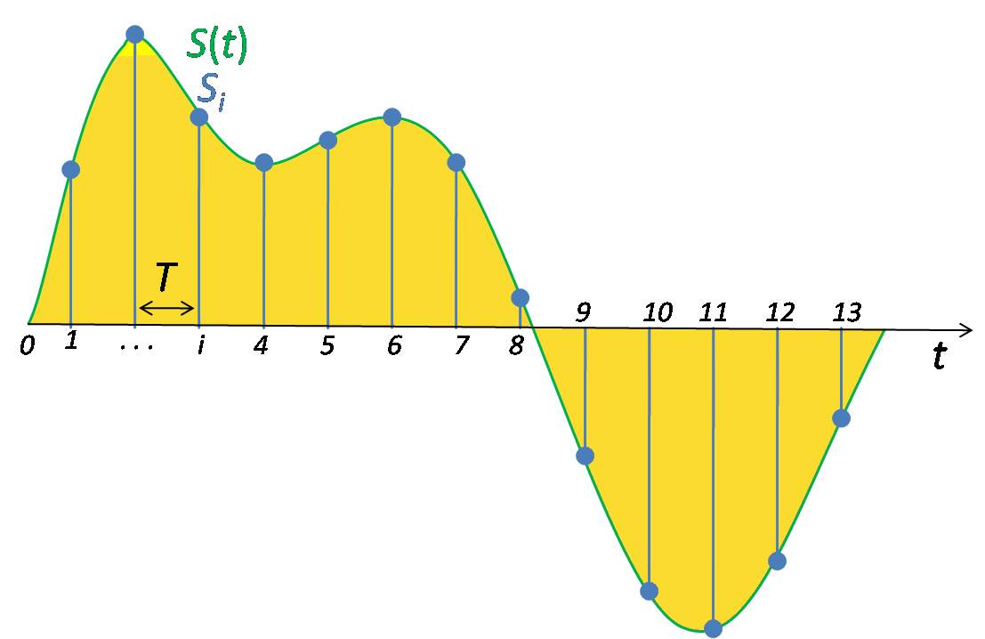
Sampling
By Email4mobile (talk) - http://en.wikipedia.org/wiki/File:Signal_Sampling.png, Public Domain, https://commons.wikimedia.org/w/index.php?curid=8693098
Notes:
Signal sampling representation. The continuous signal is represented with a green coloured line while the discrete samples are indicated by the blue vertical lines.

Slide 11
Sampling:
The line is no longer smooth but you can still just about see the curve that we had before.
If we want a ‘digitised’ version of the waveform we may need to consider adding in more sampling points so that the steps are smaller
Notes:
The image shows the new, digitised audio wave. With a low sampling rate you can clearly see it is no longer the same smooth wave but can just make out the original shape.

Slide 12
Sampling:
The line is no longer smooth but you can still just about see the curve that we had before.
If we want a ‘digitised’ version of the waveform we may need to consider adding in more sampling points so that the steps are smaller
Notes:
Here the image shows the same wave but with an increased sample rate and the original wave form is more visible now. Thein crease in the sample rate, taking more samples per second, allows us to better recreate the original wave form.

Slide 13
Bit Depth
The number of bits available for each clip
A higher bit depth means higher quality, or a better resolution
For example, a typical bit depth for CD Audio is 16 bits, DVD audio is 24 bits.
So…
A bit depth of 16 has a resolution of 65,536 possible values (0 to 65,535)
And a bit depth of 24 has a resolution of over 16 million (0 to 16,777, 216).
Notes:
Bit Depth:
Also knows as sampling resolution.
This is the number of bits available for each clip, A higher bit depth means higher quality, or a better resolution. The more bits we have available for each sample the more data can be captured. This allows us to capture the sound waves amplitude in greater depth.
We often use the term resolution when talking about images.
In audio it is the number of values that can be represented over the range of the analogue values.

Slide 14

Bit Depth
Just like in images a higher bit depth means more colours (or shades of colours)
The more colours the more realistic the image.
In audio it means more notes which makes the sound a higher quality.
It will sound more realistic and closer to real life.

Slide 15
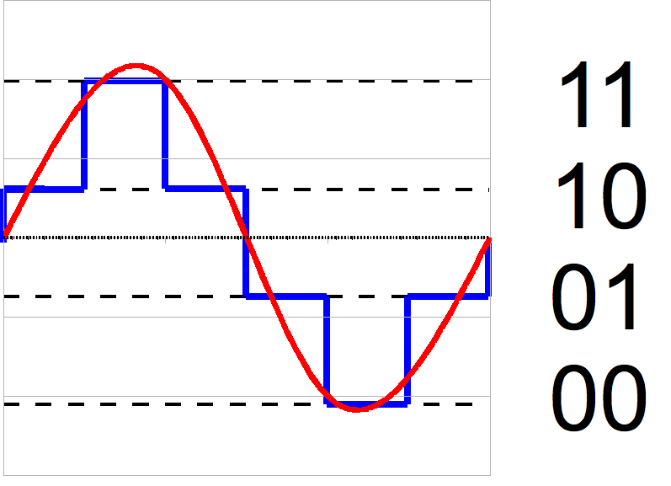
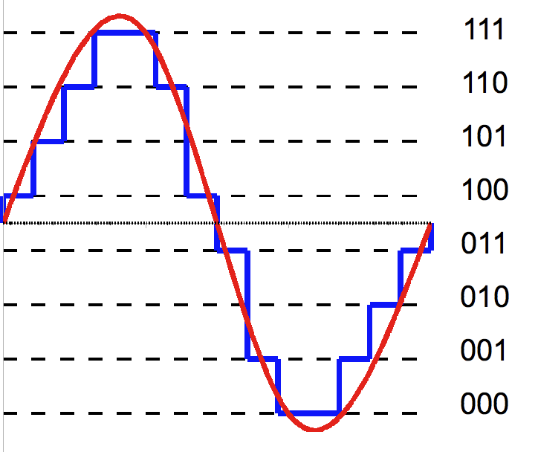
By Hyacinth - Own work, CC BY-SA 3.0, https://commons.wikimedia.org/w/index.php?curid=23867344
By Hyacinth - Own work, CC BY-SA 3.0, https://commons.wikimedia.org/w/index.php?curid=30716342
A 2-bit and

Slide 16
Bit Rate
How many bits of data are processed every second.
Usually measured in kilobits per second (kbps).
Calculated using:
Frequency × bit depth × channels = bit rate
Notes:
The bit rate of a file tells us how many bits of data are processed every second. Bit rates are usually measured in kilobits per second (kbps).

Slide 17
File Size Calculation
A mono audio file size is calculated as:
Sample Rate (Hz)
×
Sample Resolution (bits)
×
sample length (seconds)
The result is the size in bits.
REMEMBER: This is for a MONO (single channel) audio track.
If we record in stereo we need to multiply the answer by 2
Notes:
A mono, or single channel, audio file size is calculated as:
Sample Rate (Hz)
×
Sample Resolution (bits)
×
sample length (seconds)
The result is the size in bits.
If we are recording a stereo audio file this has 2 channels and so the result needs to be multiplied by 2.

Slide 18
EXAMPLE:
A typical, uncompressed high-quality audio file of four minutes long:
- sample rate of 44,100 samples per second
- a bit depth of 16 bits per sample
- and 2 channels of stereo audio.
44,100 samples per second × 16 bits per sample × 240 x 2 =
338,688,000 bits (or 40.37 MiB)
BBC Bitesize, 2020
Notes:
EXAMPLE:
If we have a typical, uncompressed high-quality audio file this would have
a sample rate of 44,100 samples per second,
a bit depth of 16 bits per sample
and 2 channels of stereo audio.
If our track is four minutes long (or 240 seconds)
A four-minute (240 second) song at this bit rate would create a file size of:
14,411,200 × 240 = 338,688,000 bits (or 40.37 Mebibytes)

Slide 19
Recap: Digital audio quality
Factors that affect the quality of digital audio include:
sample rate - the number of audio samples captured every second
bit depth - the number of bits available for each clip
bit rate - the number of bits used per second of audio

