Slide 1
Graph Traversal
SRIN Tech Dojo on Algorithm
Risman Adnan
Notes:
CODE SAMPLES AND DEMOS.
KEY TAKEAWAYS

Slide 2
Agenda
Types and Properties of Graph
Construct Graph’s Structures
Perform Graph’s Traversals (BFS, DFS)
Applications of BFS
Applications of DFS
Q&A

Slide 3
Why We Learn Graph?
Definition:
G = (V, E) set of Vertices and Edges
Graph represents any items and relationships.
Very important concept in computer science.
Solved many major computation problems for century (maps, road, hypertexts, circuits, schedules, transactions, matching, networks, connectivity, graphics, etc…).
Design a truly novel graph algorithm is HARD. Becoming familiar with many different graph concepts and problems is more important than memorizing the details of particular graph algorithms.

Slide 4
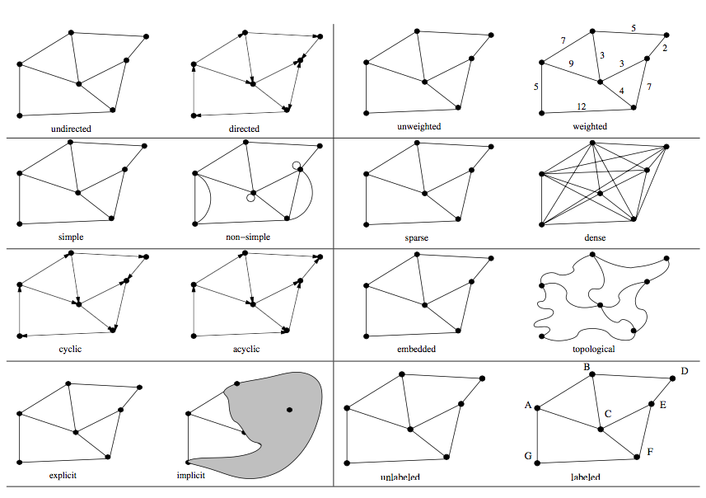
Types / Flavors of Graphs
Notes:
Undirected vs. Directed – A graph G = (V, E) is undirected if edge (x, y) ∈ E implies that (y, x) is also in E. If not, we say that the graph is directed. Road networks between cities are typically undirected, since any large road has lanes going in both directions. Street networks within cities are almost always directed, because there are at least a few one-way streets lurking somewhere. Program-flow graphs are typically directed, because the execution flows from one line into the next and changes direction only at branches. Most graphs of graph-theoretic interest are undirected.
Weighted vs. Unweighted – Each edge (or vertex) in a weighted graph G is as- signed a numerical value, or weight. The edges of a road network graph might be weighted with their length, drive-time, or speed limit, depending upon the application. In unweighted graphs, there is no cost distinction between various edges and vertices. The difference between weighted and unweighted graphs becomes particularly apparent in finding the shortest path between two vertices. For unweighted graphs, the shortest path must have the fewest number of edges, and can be found using a breadth-first search.
Simple vs. Non-simple – Certain types of edges complicate the task of working with graphs. A self-loop is an edge (x, x) involving only one vertex. An edge (x, y) is a multiedge if it occurs more than once in the graph. Both of these structures require special care in implementing graph algo- rithms. Hence any graph that avoids them is called simple.
Sparse vs. Dense: Graphs are sparse when only a small fraction of the possible vertex pairs (􏰂n2􏰃 for a simple, undirected graph on n vertices) actually have edges defined between them. Graphs where a large fraction of the vertex pairs define edges are called dense. There is no official boundary between what is called sparse and what is called dense, but typically dense graphs have a quadratic number of edges, while sparse graphs are linear in size.
Cyclic vs. Acyclic – An acyclic graph does not contain any cycles. Trees are connected, acyclic undirected graphs. Trees are the simplest interest- ing graphs, and are inherently recursive structures because cutting any edge leaves two smaller trees. Directed acyclic graphs are called DAGs. They arise naturally in scheduling problems, where a directed edge (x,y) indicates that activity x must occur before y. An operation called topological sorting orders the vertices of a DAG to respect these precedence constraints. Topological sorting is typically the first step of any algorithm on a DAG.
Embedded vs. Topological – A graph is embedded if the vertices and edges are assigned geometric positions. Thus, any drawing of a graph is an embedding, which may or may not have algorithmic significance. Occasionally, the structure of a graph is completely defined by the geometry of its embedding. For example, if we are given a collection of points in the plane, and seek the minimum cost tour visiting all of them (i.e., the traveling salesman problem), the underlying topology is the complete graph connecting each pair of vertices. The weights are typically defined by the Euclidean distance between each pair of points. Grids of points are another example of topology from geometry. Many problems on an n × m grid involve walking between neighboring points, so the edges are implicitly defined from the geometry.
Implicit vs. Explicit – Certain graphs are not explicitly constructed and then traversed, but built as we use them. A good example is in backtrack search. The vertices of this implicit search graph are the states of the search vector, while edges link pairs of states that can be directly generated from each other. Because you do not have to store the entire graph, it is often easier to work with an implicit graph than explicitly construct it prior to analysis.
Labeled vs. Unlabeled – Each vertex is assigned a unique name or identifier in a labeled graph to distinguish it from all other vertices. In unlabeled graphs, no such distinctions have been made. Graphs arising in applications are often naturally and meaningfully labeled, such as city names in a transportation network. A common problem is that of isomorphism testing—determining whether the topological structure of two graphs are identical if we ignore any labels. Such problems are typically solved using backtracking, by trying to assign each vertex in each graph a label such that the structures are identical.

Slide 5
Properties of Graph
A graph is defined by V and E, not by its draw. A graph with V vertices has at most V(V-1)/2 edges.
A path in a graph is a sequence of vertices in which each successive vertex (after the first) is adjacent to its predecessor in the path. In a simple path, the vertices and edges are distinct. A cycle is a path that is simple except that the first and final vertices are the same.
A graph is a connected graph if there is a path from every vertex to every other vertex in the graph. A graph that is not connected consists of a set of connected components , which are maximal connected subgraphs.

Slide 6
Properties of Graph
An acyclic connected graph is called a tree. A set of trees is called a forest . A spanning tree of a connected graph is a subgraph that contains all of that graph’s vertices and is a single tree. A spanning forest of a graph is a subgraph that contains all of that graph’s vertices and is a forest.
Graphs with all edges present are called complete graphs. The union of two graphs is the graph induced by the union of their sets of edges. The union of a graph and its complement is a complete graph. All graphs that have V vertices are subgraphs of the complete graph that has V vertices. A complete subgraph is called a clique.

Slide 7
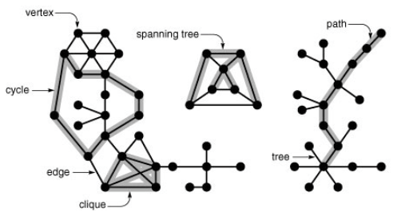
Pictures Can Tell You More….

Slide 8
Properties of Graph
A dense graph is a graph whose average vertex degree is proportional to V; a sparse graph is a graph whose complement is dense. In other words, we consider a graph to be dense if E is proportional to V² and sparse otherwise.
A bipartite graph is a graph whose vertices we can divide into two sets such that all edges connect a vertex in one set with a vertex in the other set. Any subgraph of a bipartite graph is bipartite.
Two graphs are isomorphic if we can change the vertex labels on one to make its set of edges identical to the other.
Note: Focus on undirected graph in this lecture.

Slide 9
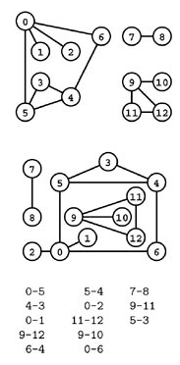
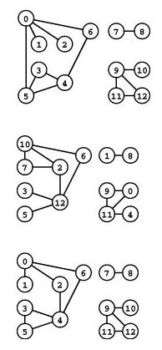
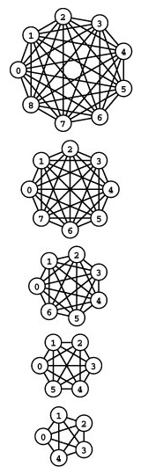
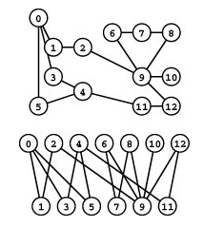
Pictures Can Tell You More….
Bipartite Graph
Graph Dataset
Complete Graphs
Isomorphic Graphs

Slide 10
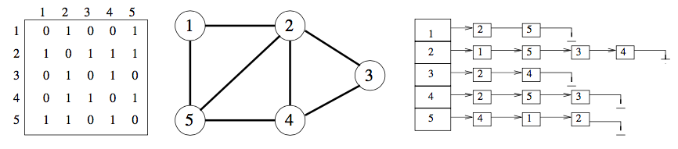
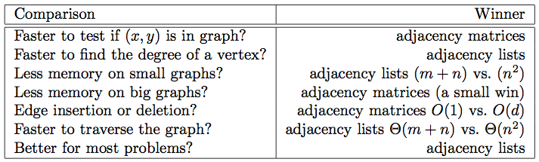
Graph Data Structures
Picking right structure can impact performance. Two options:
Adjacency Matrix
Adjacency Lists
Notes:
Adjacency Matrix: We can represent G using an n × n matrix M, where element M[i,j] = 1 if (i,j) is an edge of G, and 0 if it isn’t. This allows fast answers to the question “is (i, j) in G?”, and rapid updates for edge insertion and deletion. It may use excessive space for graphs with many vertices and relatively few edges, however.
Adjacency Lists: We can more efficiently represent sparse graphs by using linked lists to store the neighbors adjacent to each vertex. Adjacency lists require pointers but are not frightening once you have experience with linked structures. Adjacency lists make it harder to verify whether a given edge (i,j) is in G, since we must search through the appropriate list to find the edge. However, it is surprisingly easy to design graph algorithms that avoid any need for such queries. Typically, we sweep through all the edges of the graph in one pass via a breadth-first or depth-first traversal, and update the implications of the current edge as we visit it.

Slide 11
Adjacency Lists
#define MAXV 100
typedef struct{
int y;
int weight;
edgenode *next;
}edgenode;
typedef struct {
edgenode *edges[MAXV+1];
int degree[MAXV+1];
int nvertices;
int nedges;
int directed;
}graph;
Basic Operations:
Initialize Graph
Set Parameters
Insert Edge
Read Graph (File)
Delete Edge
Print Graph
Driver Program:
Create Graph g;
Initialize Graph
Set Vertices
Input Edges

Slide 12
Traversing in Graph
Traverse: Visit every vertex and edge in systematic way.
Idea: Mark each visited vertex and keep track other vertices.
Many graph algorithms are based on traversal methods.
Each vertex will exist in one of three states:
Undiscovered – vertex is in its initial, virgin state.
Discovered – vertex has been found, but edges not yet checked.
Processed – vertex after we have visited all its incident edges.
We must also maintain a structure containing the vertices that we have discovered but not yet completely processed. Initially, only the single start vertex is considered to be discovered.
Notes:
To completely explore a vertex v, we must evaluate each edge leaving v. If an edge goes to an undiscovered vertex x, we mark x discovered and add it to the list of work to do. We ignore an edge that goes to a processed vertex, because further contemplation will tell us nothing new about the graph. We can also ignore any edge going to a discovered but not processed vertex, because the destination already resides on the list of vertices to process.
Each undirected edge will be considered exactly twice, once when each of its endpoints is explored. Directed edges will be considered only once, when exploring the source vertex. Every edge and vertex in the connected component must eventually be visited. Why? Suppose that there exists a vertex u that remains unvisited, whose neighbor v was visited. This neighbor v will eventually be explored, after which we will certainly visit u. Thus, we must find everything that is there to be found.

Slide 13
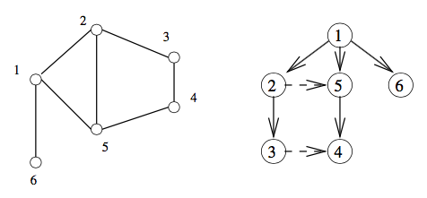
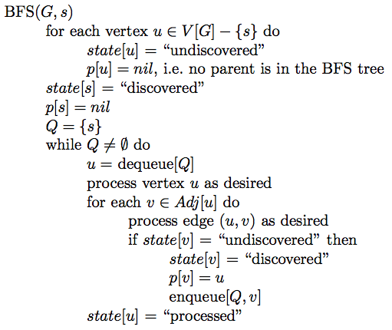
Breadth-First Search
State Implementation:
bool processed[MAXV+1]
bool discovered[MAXV+1]
int parent[MAXV+1]
Key BFS Functions:
initialize_search(graph *g)
bfs(graph *g, int start)
process_vertex_early(int v)
process_vertex_late(int v)
process_edge(int x, int y)
process_vertex(int v)
BFS Characteristics:
Uses Queue
Maintains two state arrays
Maintains parent array
Customized process functions
Has find path function
Notes:
The basic breadth-first search algorithm is given here. At some point during the course of a traversal, every node in the graph changes state from undiscovered to discovered. In a breadth-first search of an undirected graph, we assign a direction to each edge, from the discoverer u to the discovered v. We thus denote u to be the parent of v. Since each node has exactly one parent, except for the root, this defines a tree on the vertices of the graph. This tree defines a shortest path from the root to every other node in the tree. This property makes breadth-first search very useful in shortest path problems.
The graph edges that do not appear in the breadth-first search tree also have special properties. For undirected graphs, non-tree edges can point only to vertices on the same level as the parent vertex, or to vertices on the level directly below the parent. These properties follow easily from the fact that each path in the tree must be the shortest path in the graph. For a directed graph, a back-pointing edge (u, v) can exist whenever v lies closer to the root than u does.
Our breadth-first search implementation bfs uses two Boolean arrays to maintain our knowledge about each vertex in the graph. A vertex is discovered the first time we visit it. A vertex is considered processed after we have traversed all outgoing edges from it. Thus, each vertex passes from undiscovered to discovered to processed over the course of the search. This information could have been maintained using one enumerated type variable, but we used two Boolean variables instead. Once a vertex is discovered, it is placed on a queue. Since we process these vertices in first-in, first-out order, the oldest vertices are expanded first, which are exactly those closest to the root.
The exact behavior of bfs depends upon the functions process vertex early(), process vertex late(), and process edge(). Through these functions, we can customize what the traversal does as it makes its official visit to each edge and each vertex. Initially, we will do all of vertex processing on entry, so process vertex late() returns without action:
we get an accurate count of the number of edges. Different algorithms perform different actions on vertices or edges as they are encountered. These functions give us the freedom to easily customize our response.

Slide 14
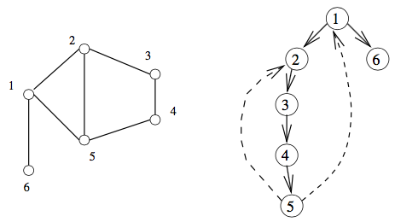
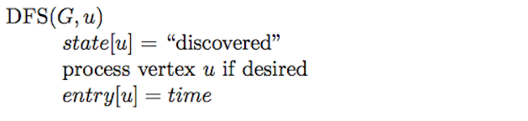
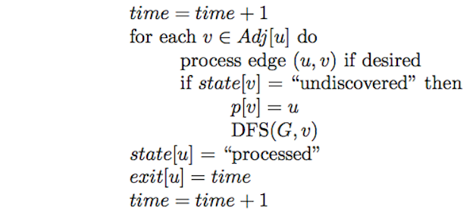
Depth-First Search
State Implementation:
bool processed[MAXV+1]
bool discovered[MAXV+1]
int parent[MAXV+1]
int entry_time[MAXV+1]
Int time_exit[MAXV+1]
Key DFS Functions:
initialize_search(graph *g)
dfs(graph *g, int start)
process_vertex_early(int v)
process_vertex_late(int v)
process_edge(int x, int y)
process_vertex(int v)
DFS Characteristics:
Uses Stack / Timer
Maintains two state arrays
Maintains parent array
Customized process functions
Has find path function
Notes:
There are two primary graph traversal algorithms: breadth-first search (BFS) and depth-first search (DFS). For certain problems, it makes absolutely no difference which you use, but in others the distinction is crucial. The difference between BFS and DFS results is in the order in which they explore vertices. This order depends completely upon the container data structure used to store the discovered but not processed vertices.
Queue – By storing the vertices in a first-in, first-out (FIFO) queue, we explore the oldest unexplored vertices first. Thus our explorations radiate out slowly from the starting vertex, defining a breadth-first search.
Stack – By storing the vertices in a last-in, first-out (LIFO) stack, we explore the vertices by lurching along a path, visiting a new neighbor if one is available, and backing up only when we are surrounded by previously discovered vertices. Thus, our explorations quickly wander away from our starting point, defining a depth-first search.
Our implementation of dfs maintains a notion of traversal time for each vertex. Our time clock ticks each time we enter or exit any vertex. We keep track of the entry and exit times for each vertex. Depth-first search has a neat recursive implementation, which eliminates the need to explicitly use a stack.
The time intervals have interesting and useful properties with respect to depth- first search:
Who is an ancestor? – Suppose that x is an ancestor of y in the DFS tree. This implies that we must enter x before y, since there is no way we can be born before our own father or grandfather! We also must exit y before we exit x, because the mechanics of DFS ensure we cannot exit x until after we have backed up from the search of all its descendants. Thus the time interval of y must be properly nested within ancestor x.
How many descendants? – The difference between the exit and entry times for v tells us how many descendents v has in the DFS tree. The clock gets incremented on each vertex entry and vertex exit, so half the time difference denotes the number of descendents of v.
We will use these entry and exit times in several applications of depth-first search, particularly topological sorting and biconnected/strongly-connected com- ponents. We need to be able to take separate actions on each entry and exit, thus motivating distinct process vertex early and process vertex late rou- tines called from dfs. The other important property of a depth-first search is that it partitions the edges of an undirected graph into exactly two classes: tree edges and back edges. The tree edges discover new vertices, and are those encoded in the parent relation. Back edges are those whose other endpoint is an ancestor of the vertex being expanded, so they point back into the tree. An amazing property of depth-first search is that all edges fall into these two classes. Why can’t an edge go to a brother or cousin node instead of an ancestor? All nodes reachable from a given vertex v are expanded before we finish with the traversal from v, so such topologies are impossible for undirected graphs. This edge classification proves fundamental to the correctness of DFS-based algorithms.

Slide 15
Traversal Common Problems
Find Path in Graph for both BFS and DFS
BFS on Undirected Graph
Connected Component
Two Coloring Graph
DFS on Undirected Graph
Finding Cycles
Articulation Vertices
DFS on Directed Graph
Topological Sorting
Strongly Connected Component

Slide 16
Lets See The Codes…..
SRIN Code Catalog
Codes implemented only with primitive types (C/C++, Java)
Simple one file code template
Sample dataset for typical Graph
Embedded basic structures (Linked List, Stack, Queue)
Comment based documentation
Complete problem-solution from GeeksForGeeks
Sample solution from Hackerrank
Compatible to common algorithm books
Will be shared on SRIN Github…(in progress)

Slide 17
C/C++ Demos
Construct Directed and Undirected Graphs
Perform BFS and DFS on Graphs
Find Path in Graphs (DFS & BFS)
Connected Components (BFS)
Two Coloring Bipartite Graph (BFS)
Finding Cycles (DFS)
Articulation Points (DFS)
Topological Sorting (DFS)
Strongly Connected Components (DFS)

Slide 18
Call to Action
Familiarize with Graph Concepts
Practicing Graph Construction
Practicing Graph Traversal BFS and DFS
Get Sixth Sense on Graph Traversal Problems
Understanding + Practices != Memorizing

Slide 19
Further Readings
[ADM] Algorithm Design Manual - Skiena
[CLRS] Introduction to Algorithm – Cormen
[ALP] Algorithms - Sedgewick

