Slide 1
Bayesian statistics, structure elucidation and the DP4 probability
Vinícius Capriles Port
18th of april, 2022
Supervisor: Prof. Giovanni F. Caramori
Molecular electronic structure group

Slide 2
Summary
Bayesian statistics
Frequentists vs Bayesians
Let’s look at an example: the classic coin toss
Structure elucidation
The problem
Experimental techniques
Why NMR?
Computational chemistry enters the game
The DP4 probability
CP(1,2,3) parameters
DP4 parameter
Beyond DP4

Slide 3
1.
Bayesian Statistics

Slide 4
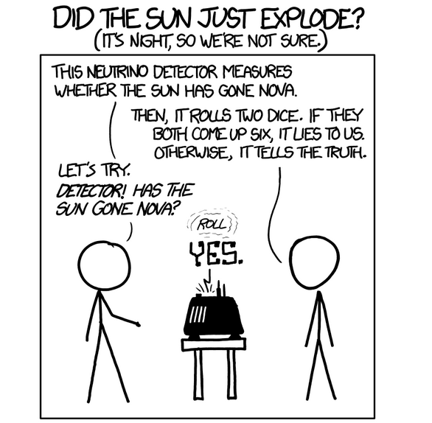

Slide 5
https://towardsdatascience.com/frequentist-vs-bayesian-statistics-54a197db21

Slide 6
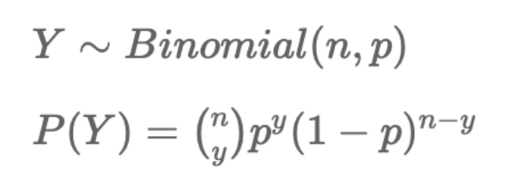
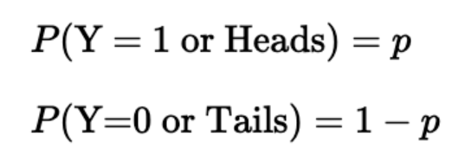
Let’s look at an example: the classic coin toss

Slide 7
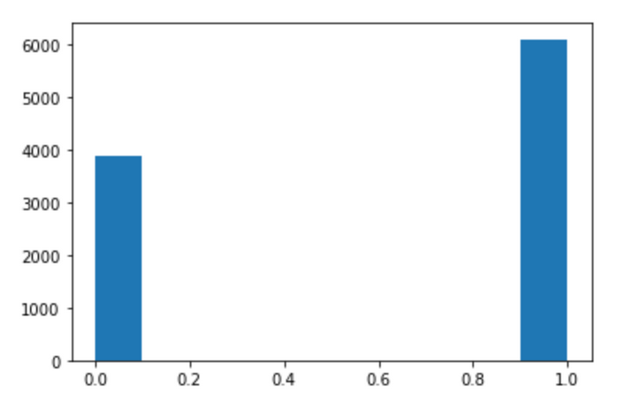
Let’s look at an example: the classic coin toss

Slide 8
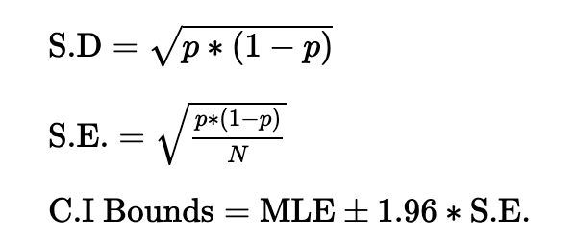
The classic coin toss: frequentist
Maximum Likelihood Estimation (MLE).

Slide 9
The classic coin toss: frequentist

Slide 10
The classic coin toss: bayesian
Likelihood function
posterior
prior
Marginal distribution

Slide 11
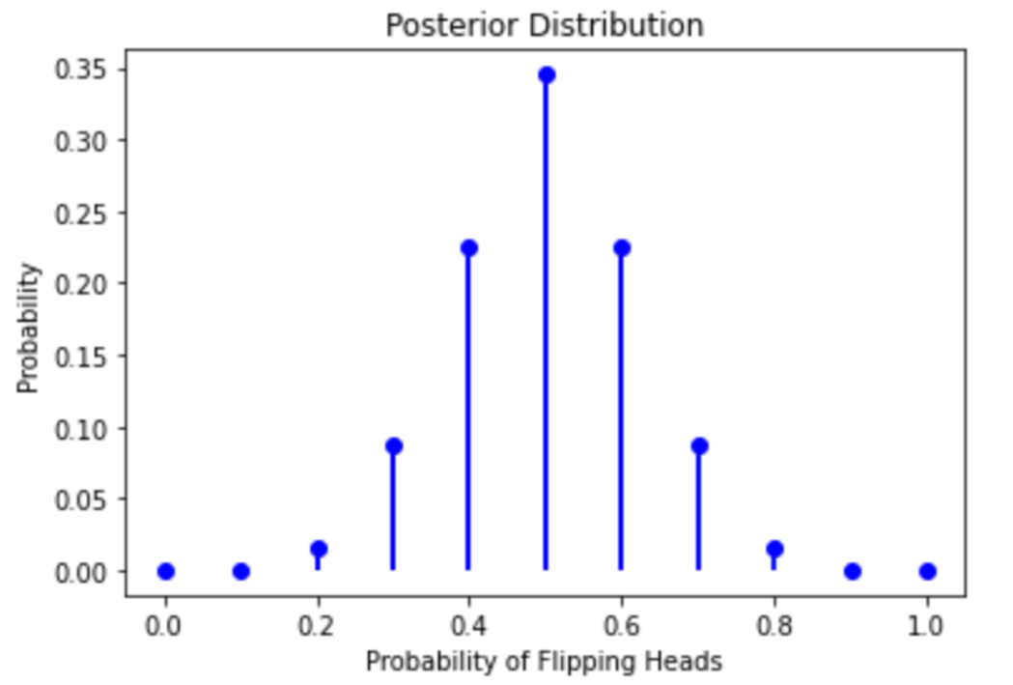
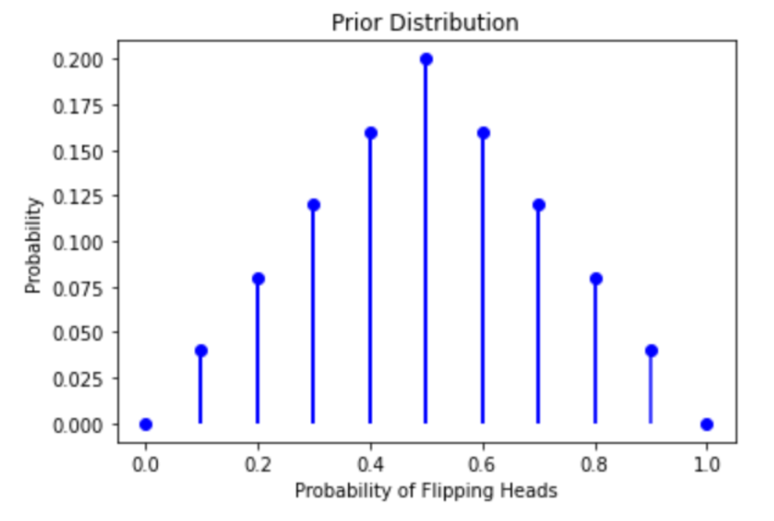
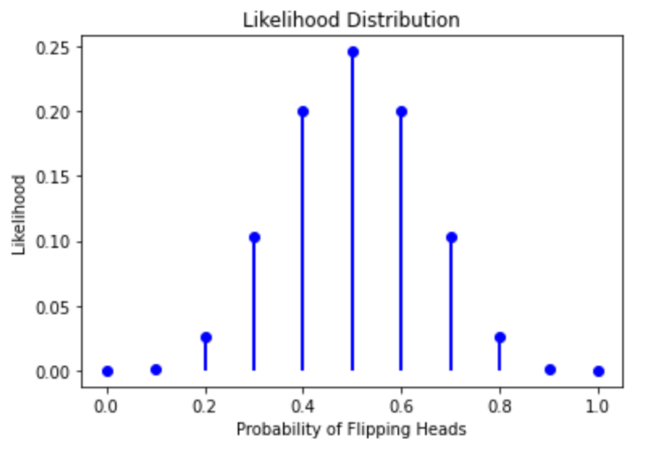
The classic coin toss: bayesian

Slide 12
The classic coin toss: bayesian

Slide 13
The classic coin toss: conclusion
- The Frequentist approach estimates the unknown parameter using the Maximum Likelihood Estimate (MLE): the point estimate which is the most likely true value of the parameter, given the data that we’ve observed.
- The Frequentist answer is completely formed from the observed data and is delivered in the form of a single point estimate. This puts us at the mercy of the data’s accuracy and quality.
- The Bayesian approach combines a prior probability distribution with observed data (in the form of a likelihood distribution) to obtain a posterior probability distribution.
- While the Bayesian approach also relies on data, its estimate incorporates our prior *knowledge* about the parameter of interest, its answer is delivered in the form of the parameter of interest’s probability distribution. We can offset our reliance on the data by setting stronger priors.
- Both the Frequentist and Bayesian estimates begin to equal each other as our sample size grows and the statistical inference becomes objective.

Slide 14
2.
Structural elucidation

Slide 15
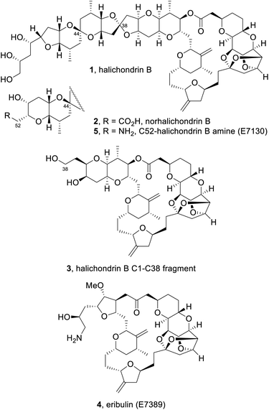
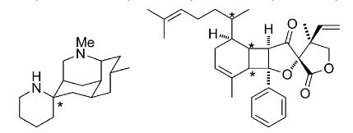
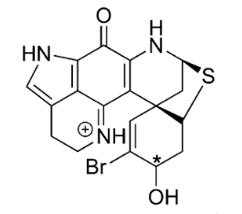
Structural elucidation - the problem
Batista, A.; Angrisani, B.; Lima, M. E.; da Silva, S.; Schettini, V.; Chagas, H.; dos Santos Jr., F.; Batista Jr., J.; Valverde, A. Absolute Configuration Reassignment of Natural Products: An Overview of the Last Decade. J. Braz. Chem. Soc. 2021. https://doi.org/10.21577/0103-5053.20210079.
Wu, Z.-C.; Boger, D. L. The Quest for Supernatural Products: The Impact of Total Synthesis in Complex Natural Products Medicinal Chemistry. Nat. Prod. Rep. 2020, 37 (11), 1511–1531. https://doi.org/10.1039/D0NP00060D.

Slide 16
Experimental techniques employed
X-ray crystallography
Provides resolution at atomic level
Requires a single well-defined crystal
Chiroptical spectroscopy
Naturally sensitive to chirality
Flexible molecules can be a pain
Proper chromophores are required
Stereocontrolled organic synthesis
Most robust method
Depends on the correct AC of the starting materials
Expensive
Time consuming
Nuclear Magnetic Resonance (NMR)
Insensitive to chirality in isotropic medium
May require chiral auxiliaries (solvents, semi-synthesis)
Batista, A.; Angrisani, B.; Lima, M. E.; da Silva, S.; Schettini, V.; Chagas, H.; dos Santos Jr., F.; Batista Jr., J.; Valverde, A. Absolute Configuration Reassignment of Natural Products: An Overview of the Last Decade. J. Braz. Chem. Soc. 2021. https://doi.org/10.21577/0103-5053.20210079.

Slide 17
Why NMR?
Chemical shifts can provide information about the chemical environment
Multiplicity of the peaks (Spin Spin Coupling Constant) provides information about the connectivity in the system
Powerful 2D spectra
Batista, A.; Angrisani, B.; Lima, M. E.; da Silva, S.; Schettini, V.; Chagas, H.; dos Santos Jr., F.; Batista Jr., J.; Valverde, A. Absolute Configuration Reassignment of Natural Products: An Overview of the Last Decade. J. Braz. Chem. Soc. 2021. https://doi.org/10.21577/0103-5053.20210079.

Slide 18
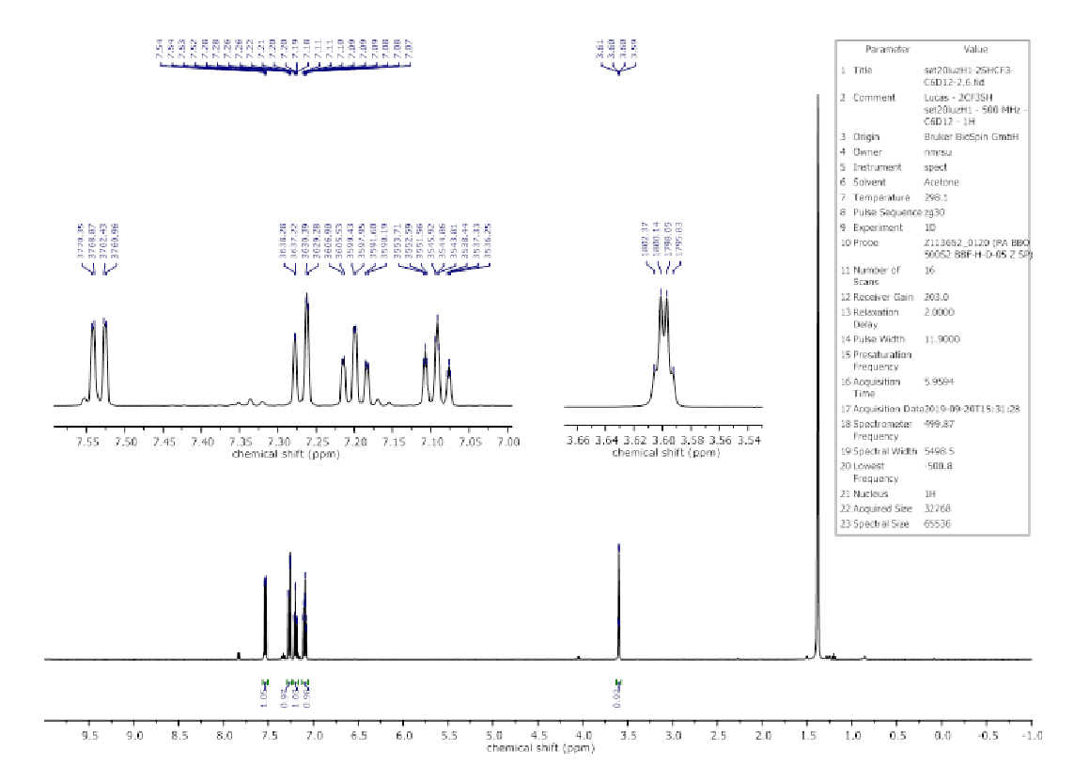
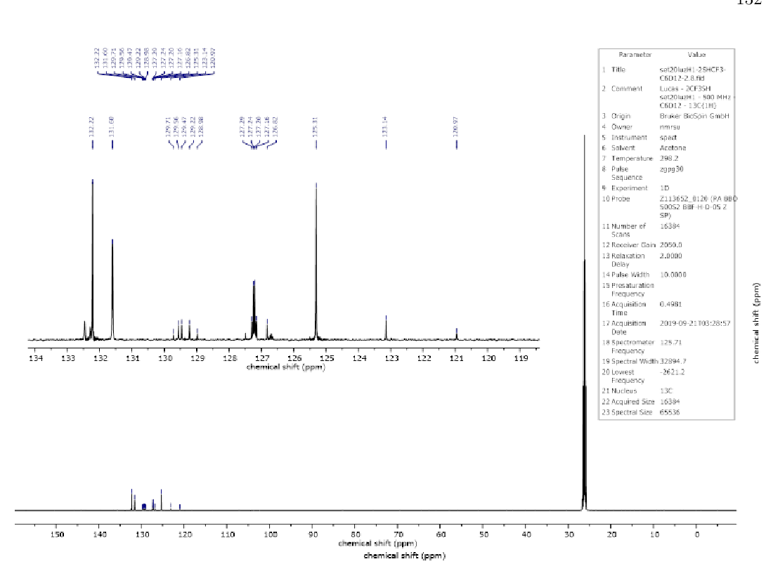
Why NMR?

Slide 19
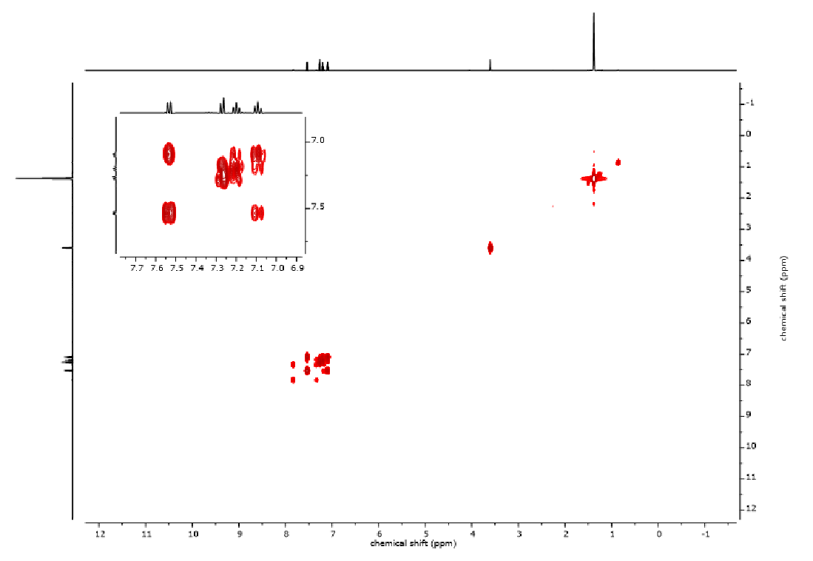
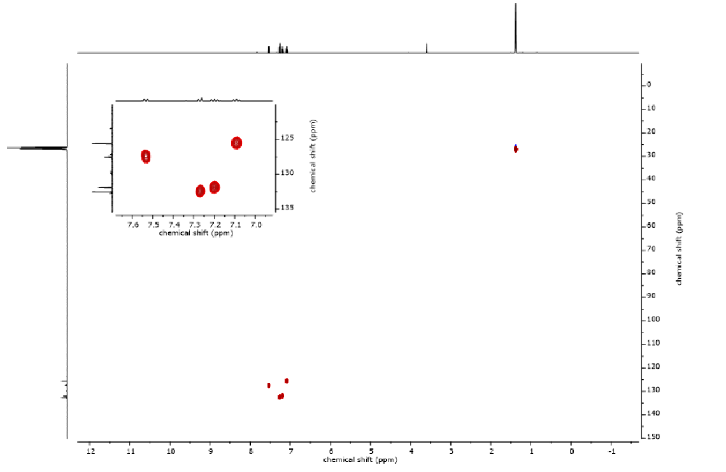
Why NMR?

Slide 20
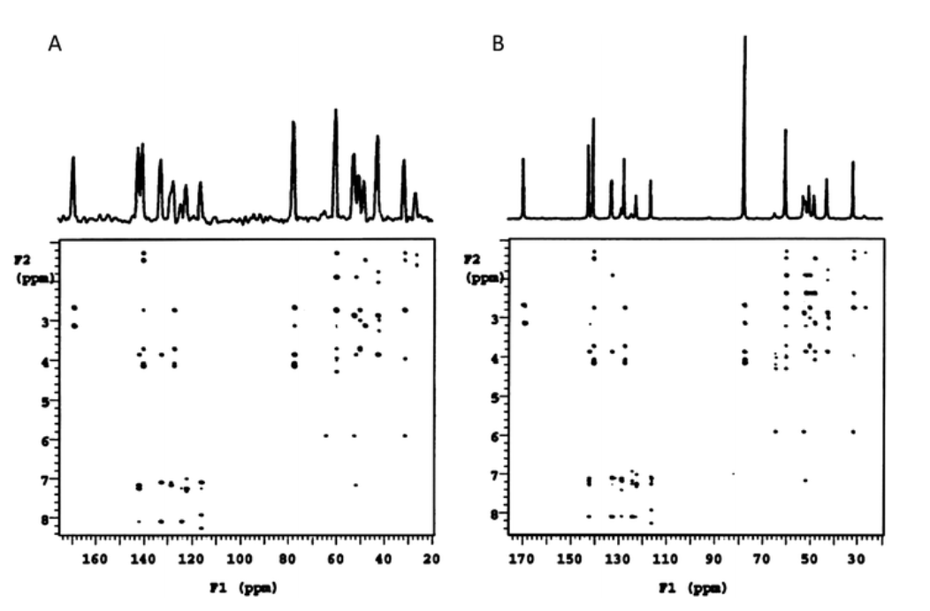
Why NMR?

Slide 21
Why NMR?
Chemical shifts can provide information about the chemical environment
Multiplicity of the peaks (Spin Spin Coupling Constant) provides information about the connectivity in the system
Powerful 2D spectra
Possibility of pairing experimental data with ab-initio calculations

Slide 22
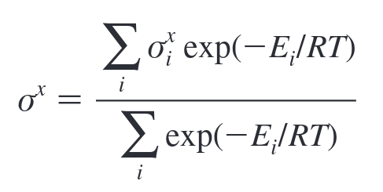
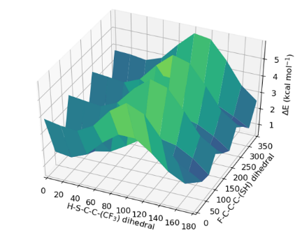
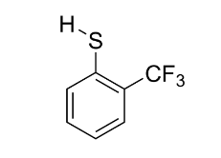
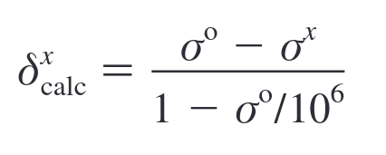
Computational Chemistry enters the game

Slide 23
3.
The DP4 probability

Slide 24
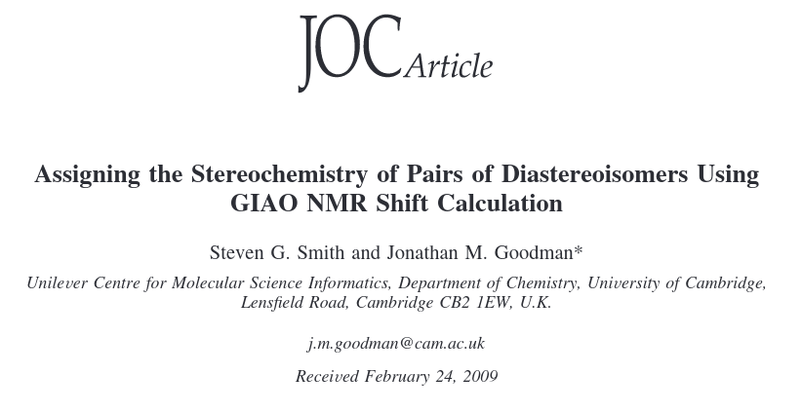
Computational Chemistry enters the game
Smith, S. G.; Goodman, J. M. Assigning the Stereochemistry of Pairs of Diastereoisomers Using GIAO NMR Shift Calculation. J. Org. Chem. 2009, 74 (12), 4597–4607. https://doi.org/10.1021/jo900408d.

Slide 25
CP1,2,3 parameter - comparing two different spectra
a,b = theoretical data
A,B = experimental data

Slide 26
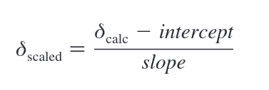
CP1,2,3 parameter - comparing two different spectra
Correlation coefficient
Mean absolute error
Corrected mean absolute error

Slide 27
CP1,2,3 parameter - comparing two different spectra

Slide 28
CP1,2,3 parameter - comparing two different spectra

Slide 29
CP1,2,3 parameter - comparing two different spectra

Slide 30
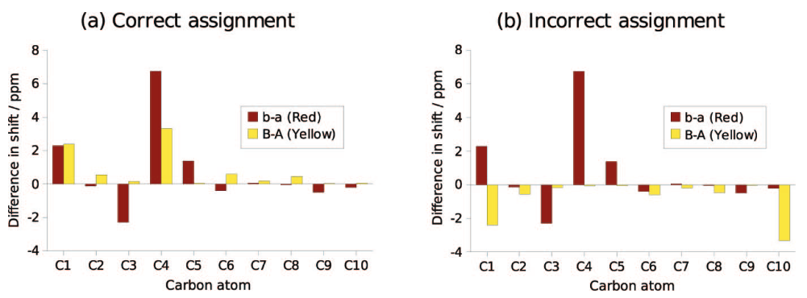
CP1,2,3 parameter - comparing two different spectra

Slide 31
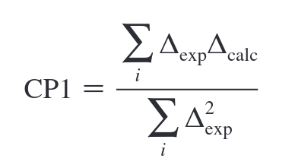
CP1,2,3 parameter - comparing two different spectra

Slide 32
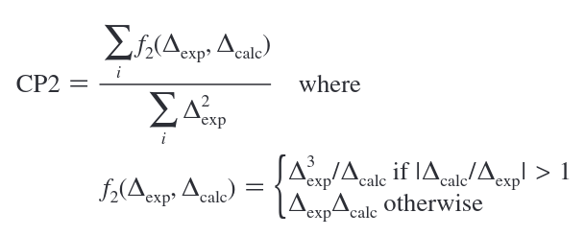
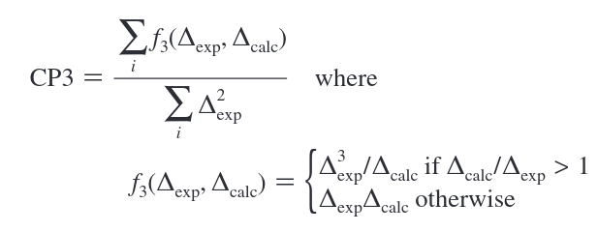
CP1,2,3 parameter - comparing two different spectra

Slide 33
CP1,2,3 parameter - comparing two different spectra

Slide 34
CP1,2,3 parameter - comparing two different spectra

Slide 35
CP1,2,3 parameter - comparing two different spectra

Slide 36
CP1,2,3 parameter - comparing two different spectra
How confident we are that our answer is correct based on theses parameters?

Slide 37
CP1,2,3 parameter - comparing two different spectra

Slide 38
CP1,2,3 parameter - comparing two different spectra
0.909
95%
0.0483
0.5

Slide 39
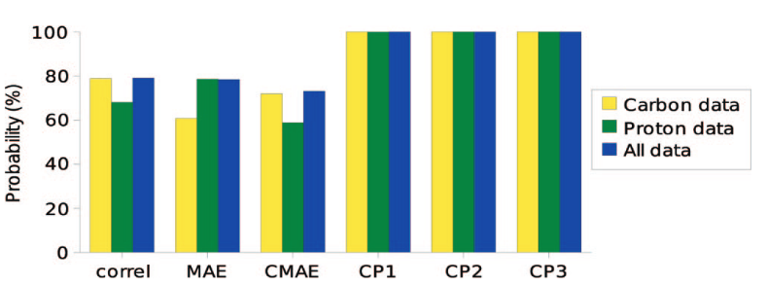
CP1,2,3 parameter - comparing two different spectra

Slide 40
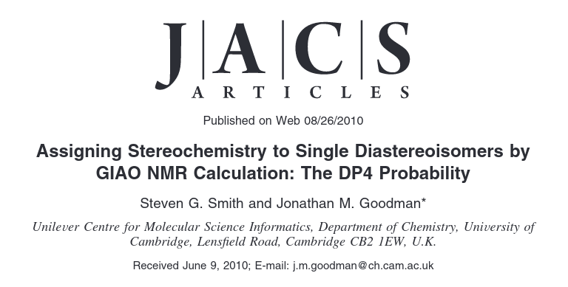
DP4 - only one spectra required
Smith, S. G.; Goodman, J. M. Assigning Stereochemistry to Single Diastereoisomers by GIAO NMR Calculation: The DP4 Probability. J. Am. Chem. Soc. 2010, 132 (37), 12946–12959. https://doi.org/10.1021/ja105035r.

Slide 41
DP4 - only one spectra required
Calculate the empirically scaled shifts (CMAE way)
Assume that the error for an atom obeys a t distribution with mean μ, standard deviation σ and degrees of freedom ν.
Assume that the error for each atom is independent of one another
Smith, S. G.; Goodman, J. M. Assigning Stereochemistry to Single Diastereoisomers by GIAO NMR Calculation: The DP4 Probability. J. Am. Chem. Soc. 2010, 132 (37), 12946–12959. https://doi.org/10.1021/ja105035r.

Slide 42
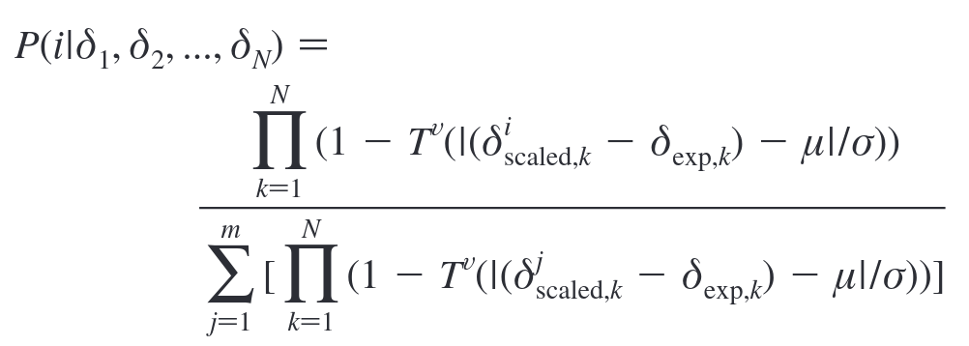
DP4 - only one set of spectra required
Smith, S. G.; Goodman, J. M. Assigning Stereochemistry to Single Diastereoisomers by GIAO NMR Calculation: The DP4 Probability. J. Am. Chem. Soc. 2010, 132 (37), 12946–12959. https://doi.org/10.1021/ja105035r.

Slide 43
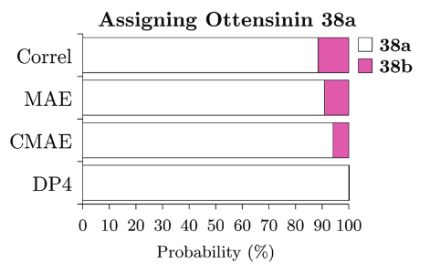
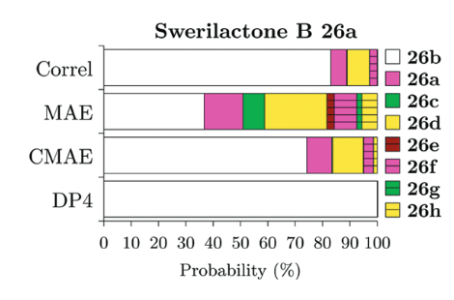
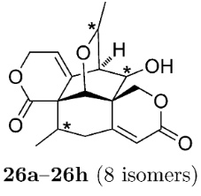
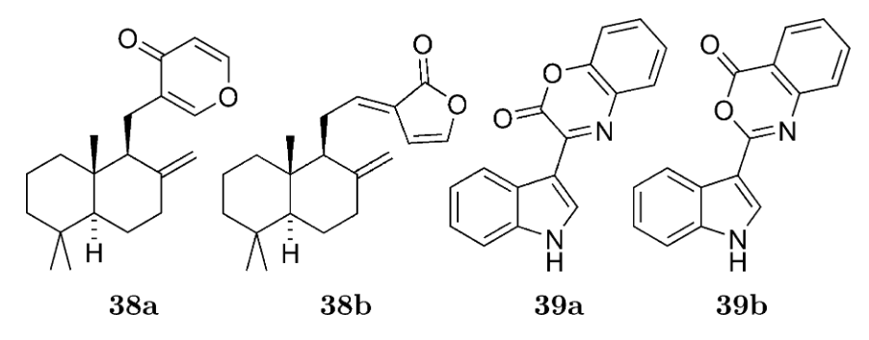
DP4 - only one set of spectra required
Smith, S. G.; Goodman, J. M. Assigning Stereochemistry to Single Diastereoisomers by GIAO NMR Calculation: The DP4 Probability. J. Am. Chem. Soc. 2010, 132 (37), 12946–12959. https://doi.org/10.1021/ja105035r.

Slide 44
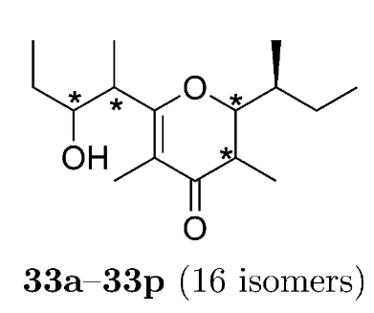
DP4 - only one set of spectra required
Smith, S. G.; Goodman, J. M. Assigning Stereochemistry to Single Diastereoisomers by GIAO NMR Calculation: The DP4 Probability. J. Am. Chem. Soc. 2010, 132 (37), 12946–12959. https://doi.org/10.1021/ja105035r.

Slide 45
Beyond DP4 - DP5, DP4/AI, DP4+

Slide 46
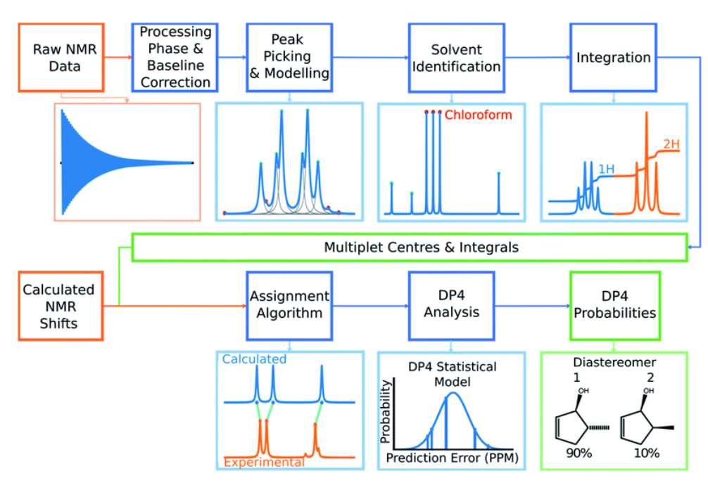
Beyond DP4 - DP5, DP4/AI, DP4+

Slide 47
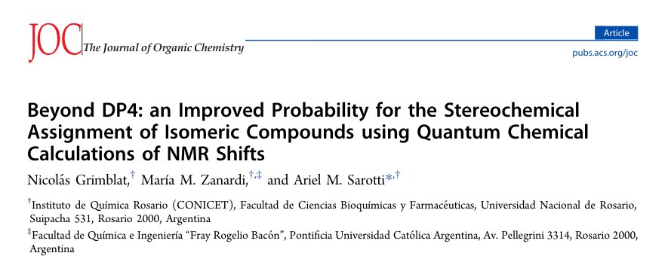
Beyond DP4 - DP5, DP4/AI, DP4+

Slide 48
Thanks for your attention!

