Slide 1
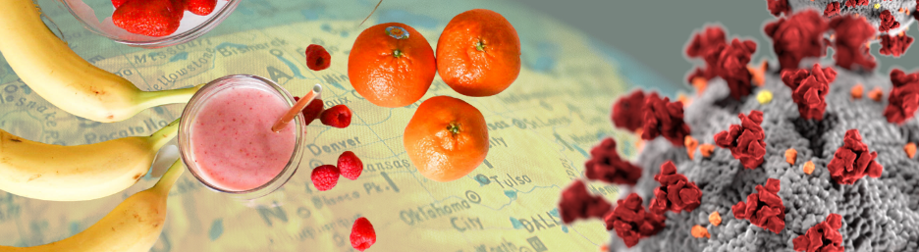

COVID-19 & Diet
DATA 622 FINAL PROJECT
Abdellah Ait Elmouden | Gabriel Abreu | Jered Ataky

Slide 2

The Dataset
The dataset combined data of :
Different types of food,
World population obesity and
undernourished rate, and
Global COVID-19 cases count from around the world

Slide 3

Methodology
Exploratory Data Anaysis (EDA)
Machine Learning :
PCA analysis
K-mean Clusting
Random forest,
Gradient Boosting and
Cubist
Support Vector Regression

Slide 4
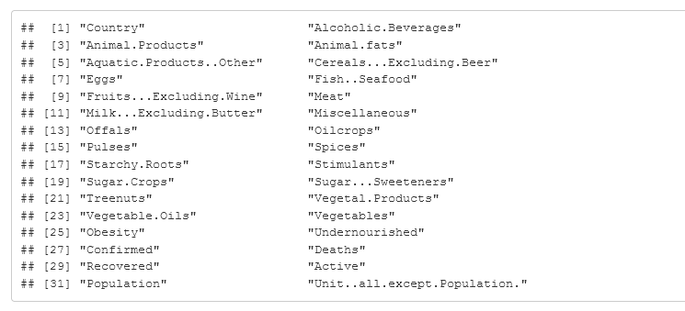
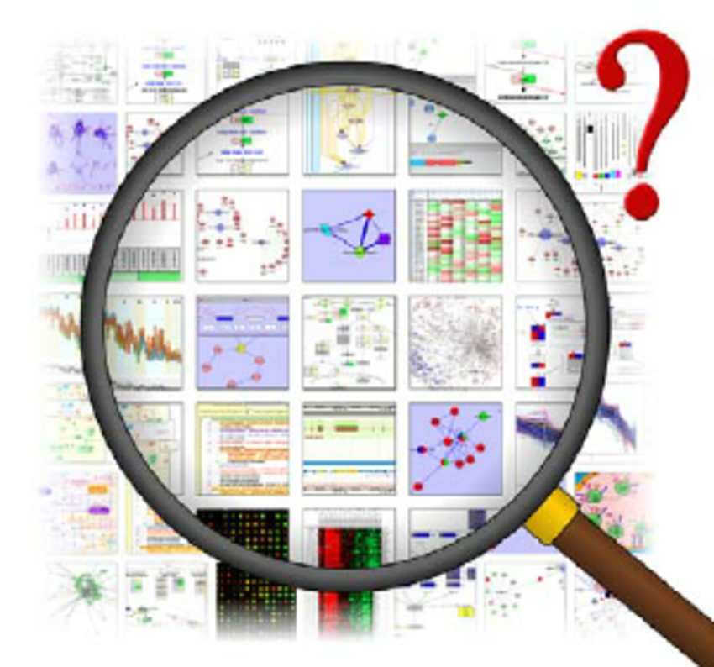
Data Exploration and Processing

Slide 5
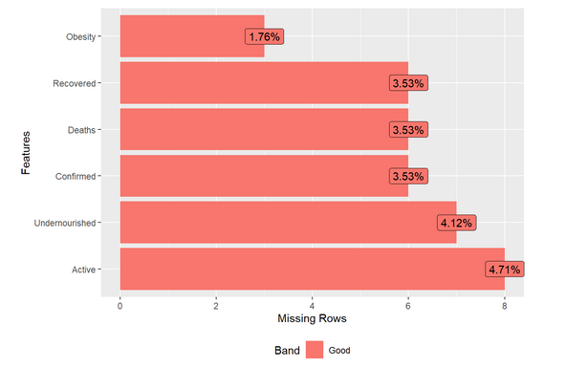
Missing Data

Slide 6
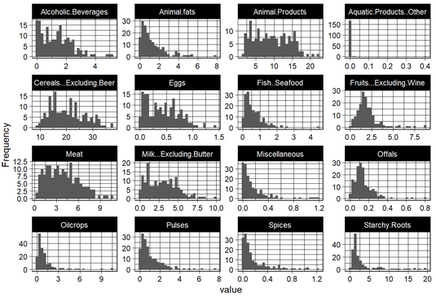
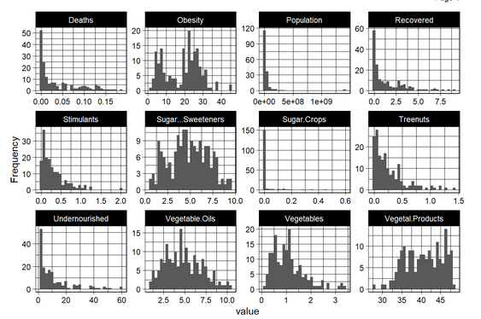
Statistical Analyses

Slide 7
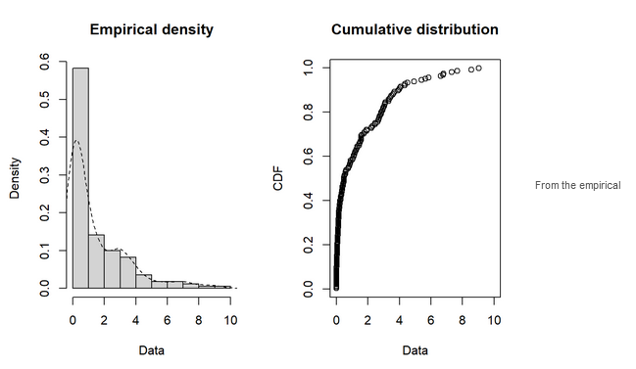
Statistical Analyses

Slide 8
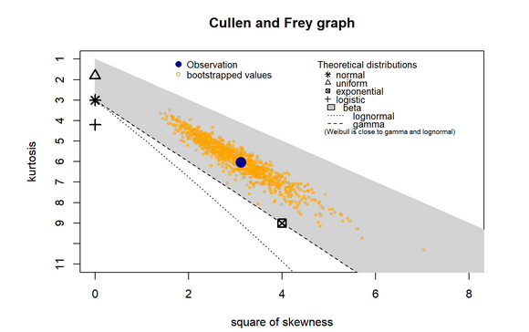
Statistical Analyses

Slide 9
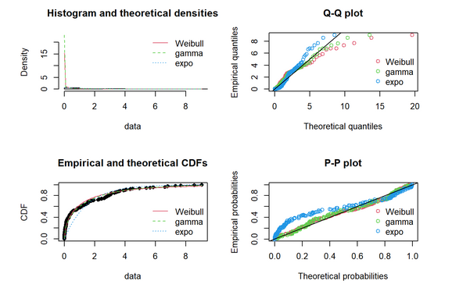
Statistical Analyses

Slide 10
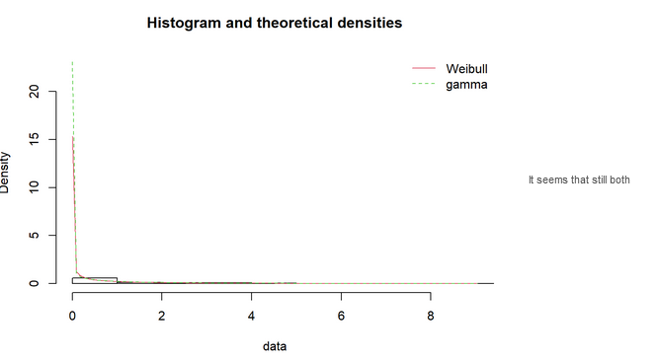
Statistical Analyses

Slide 11
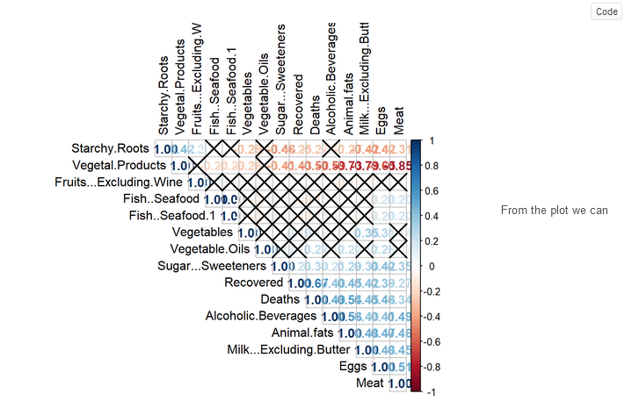
PCA

Slide 12
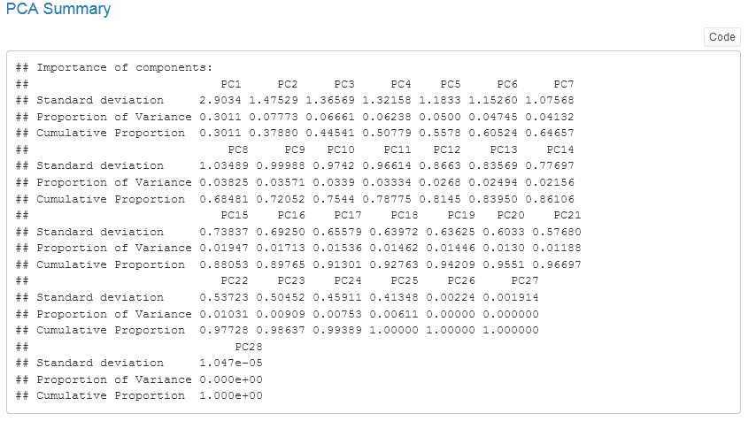
PCA

Slide 13
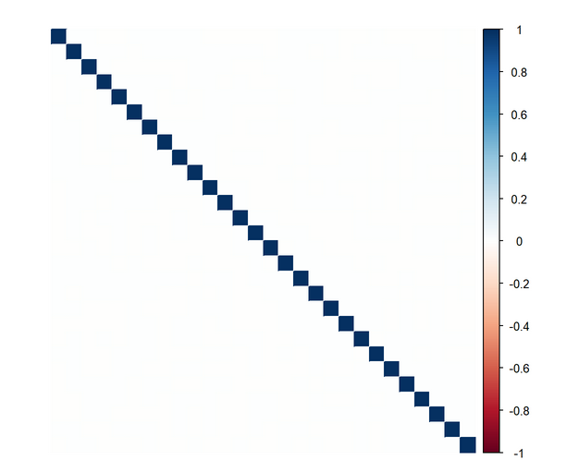
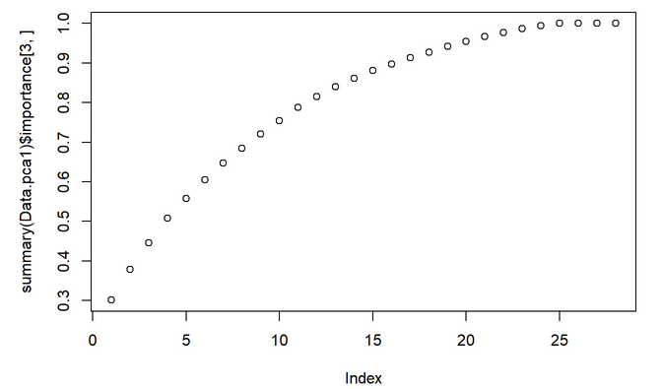
PCA

Slide 14
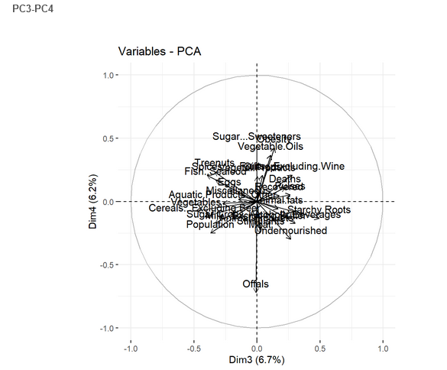
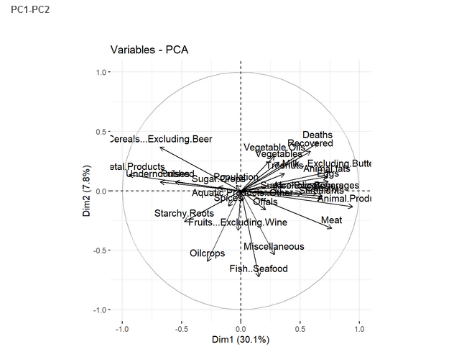
PCA

Slide 15
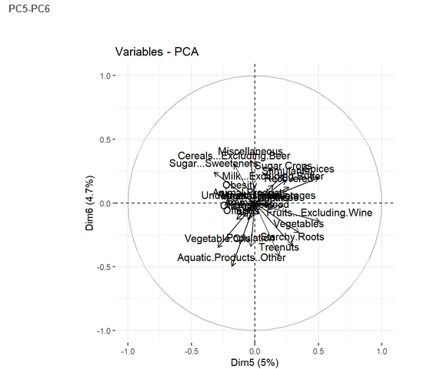
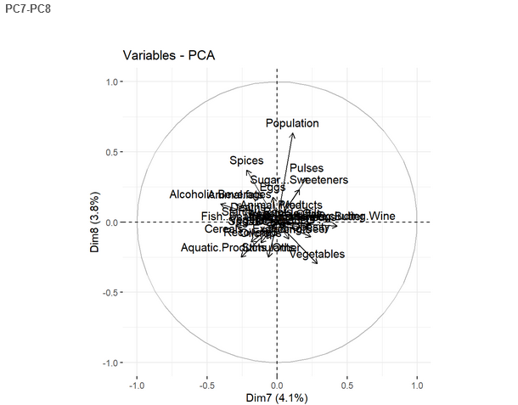
PCA

Slide 16
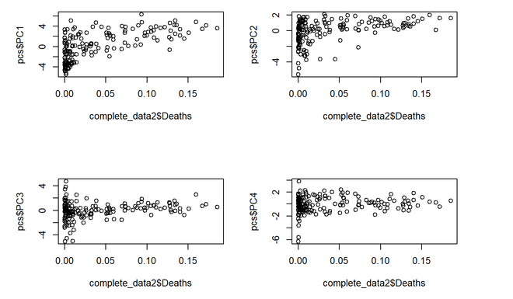
Linear regression with principal components

Slide 17
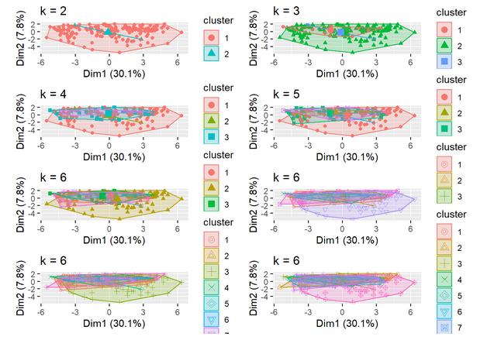
K-mean

Slide 18
Thank you!

