Slide 1
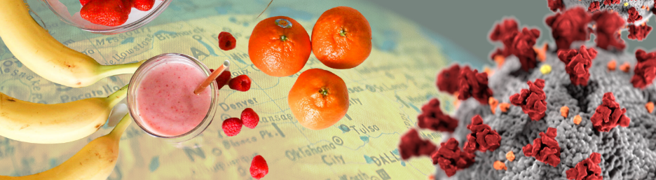

COVID-19 & Diet
DATA 622 FINAL PROJECT
Abdellah Ait Elmouden | Gabriel Abreu | Jered Ataky

Slide 2

The Dataset
The dataset combined data of :
Different types of food,
World population obesity and
undernourished rate, and
Global COVID-19 cases count from around the world

Slide 3

Methodology
Exploratory Data Analysis (EDA)
Machine Learning :
PCA analysis
K-mean Clustering
Random forest,
Gradient Boosting
Cubist
Support Vector Regression

Slide 4
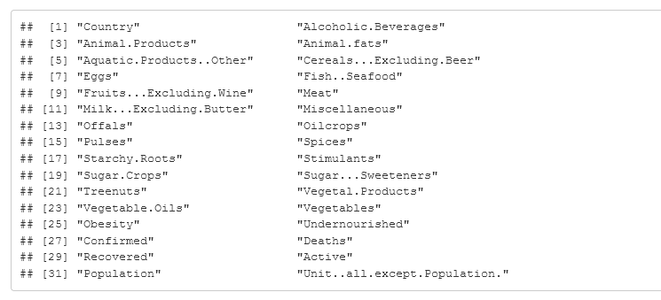
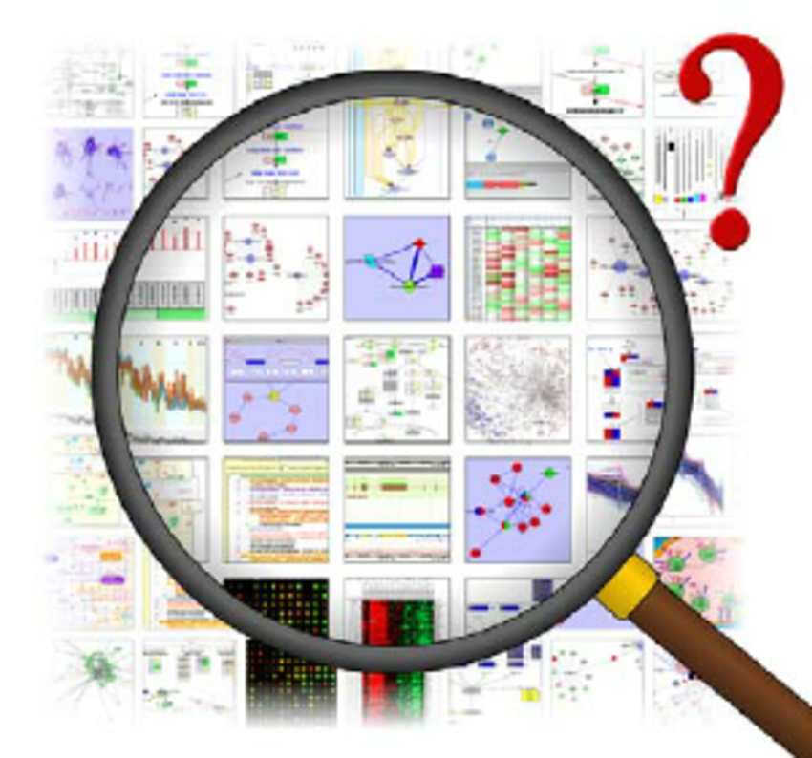
Data Exploration and Processing

Slide 5
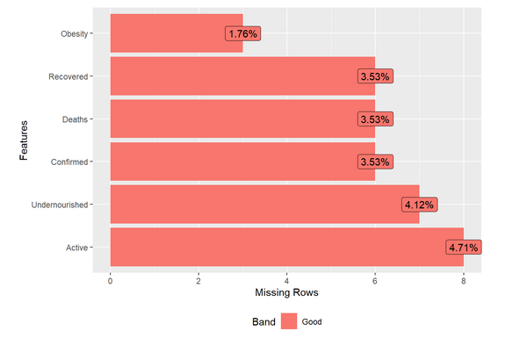
Missing Data

Slide 6
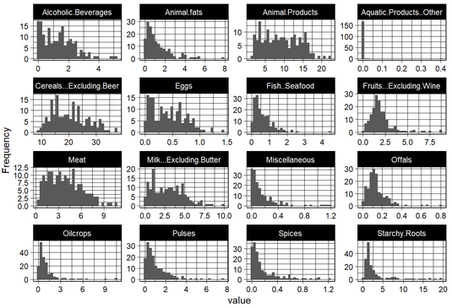
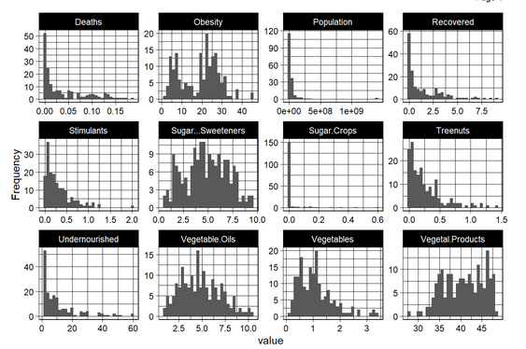
Statistical Analyses

Slide 7
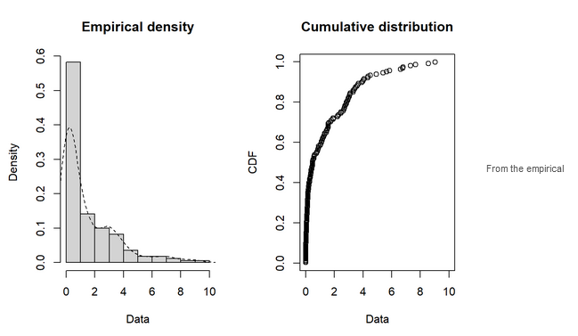
Statistical Analyses

Slide 8
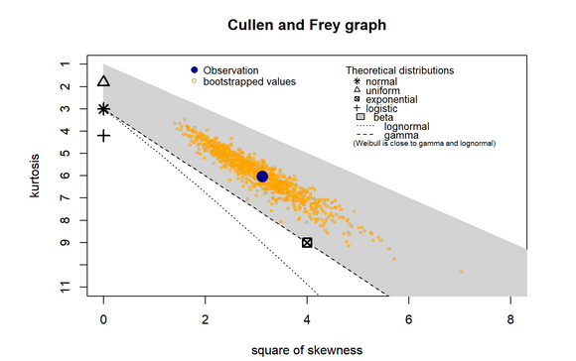
Statistical Analyses

Slide 9
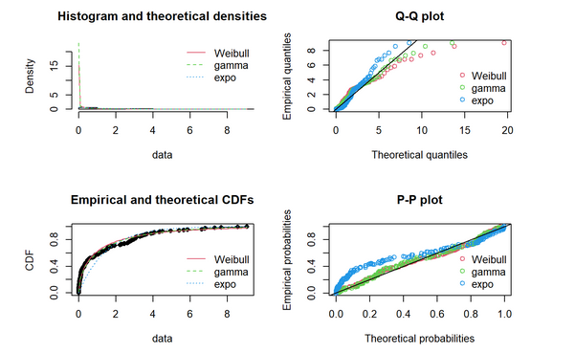
Statistical Analyses

Slide 10
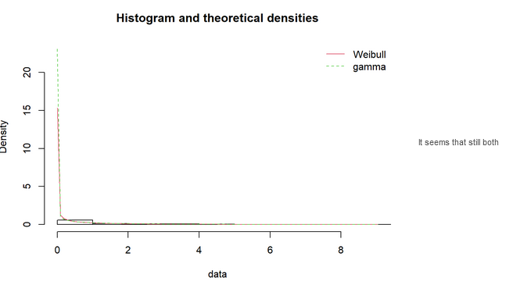
Statistical Analyses

Slide 11
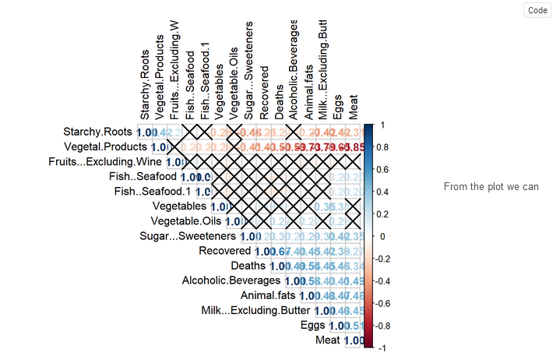
PCA

Slide 12
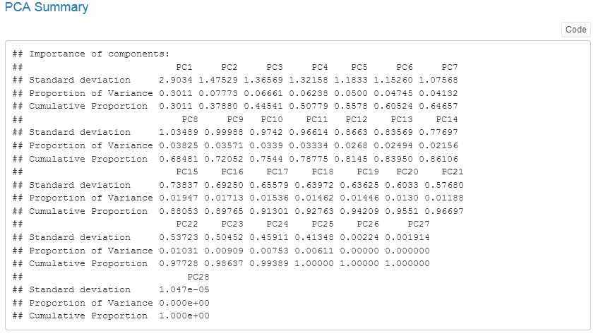
PCA

Slide 13
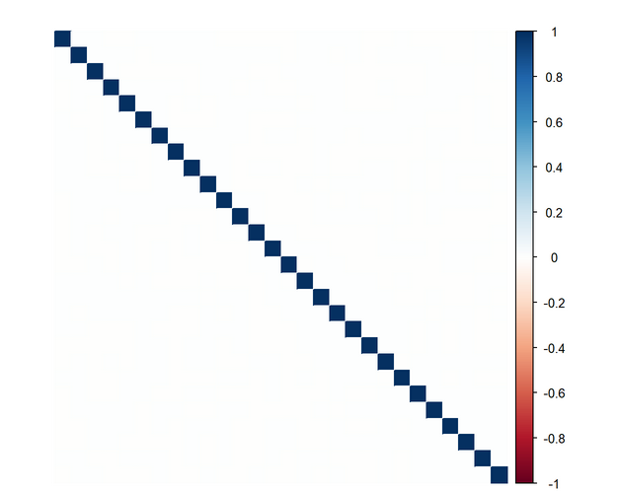
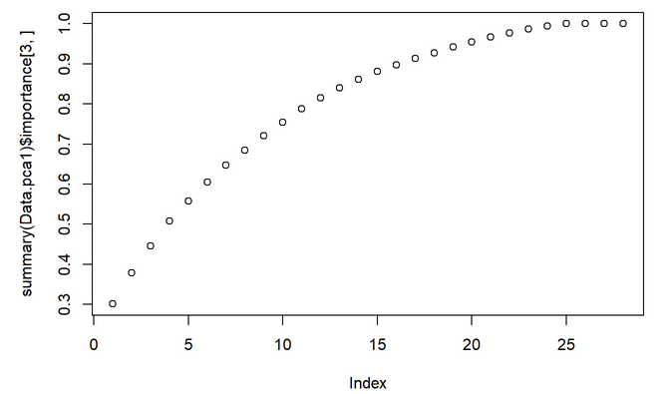
PCA

Slide 14
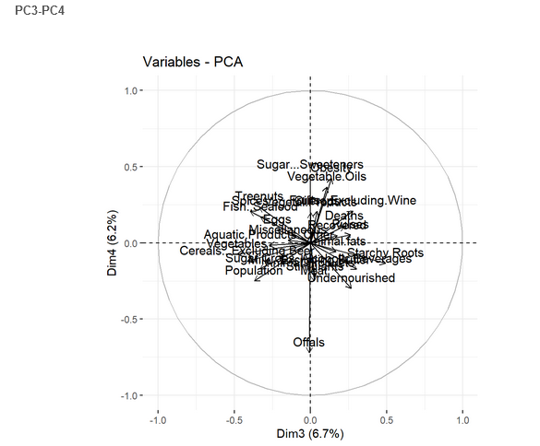
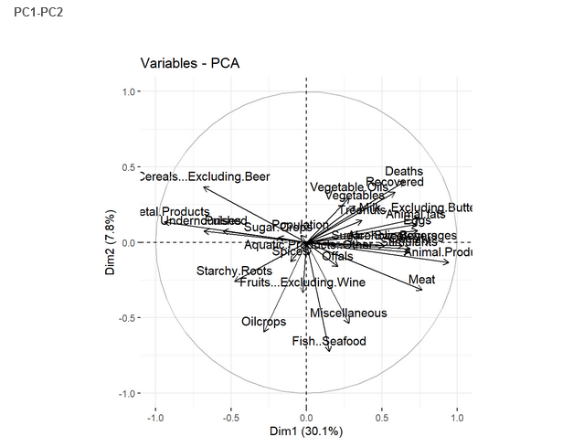
PCA

Slide 15
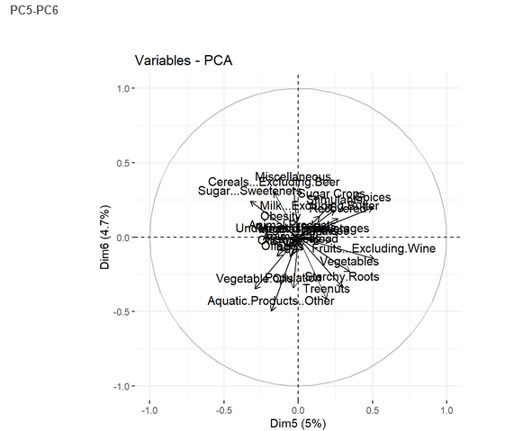
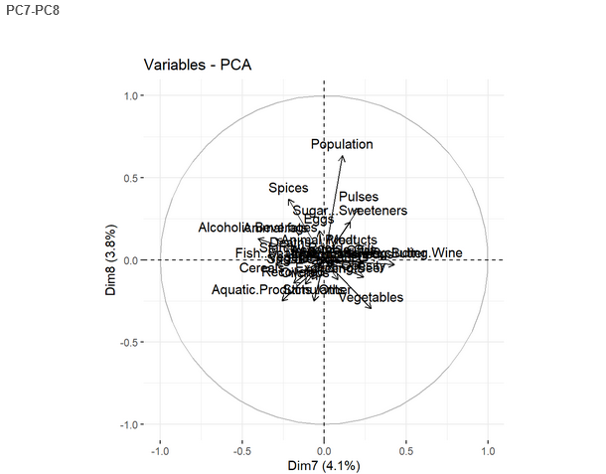
PCA

Slide 16
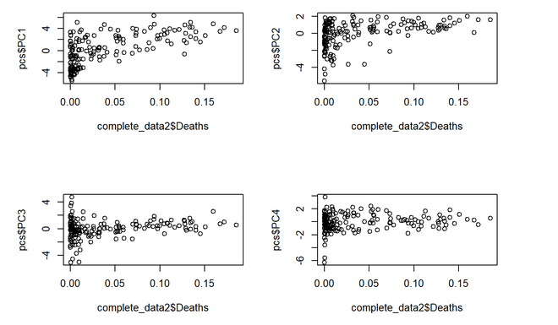
Linear regression with principal components

Slide 17
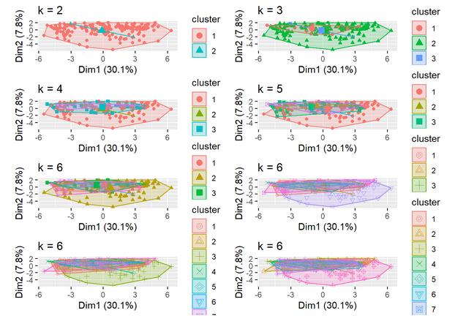
K-mean

Slide 18
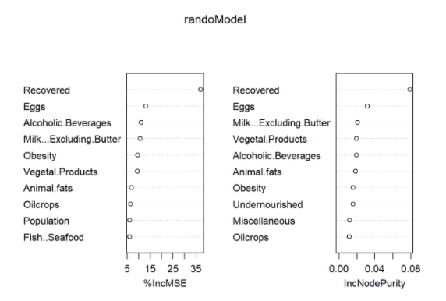
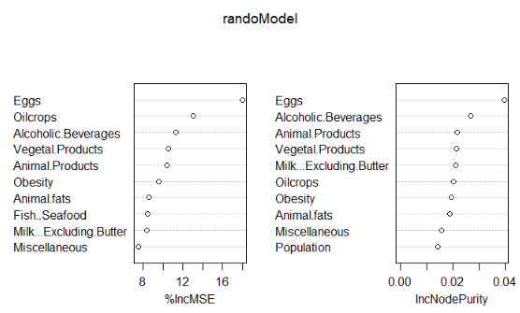
Trees – Random Forest, Cubist, Gradient Boost
Random Forest
Random Forest: Food Only

Slide 19
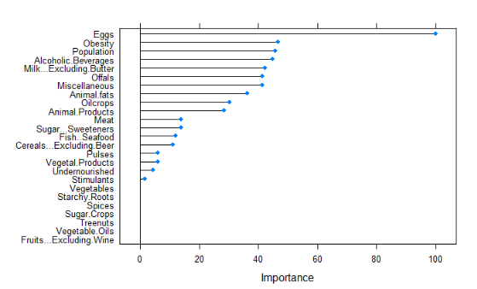
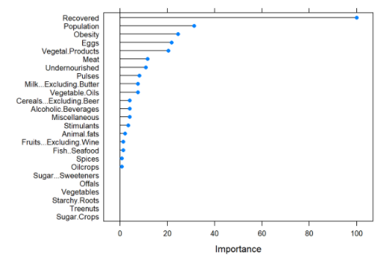
Cubist

Slide 20
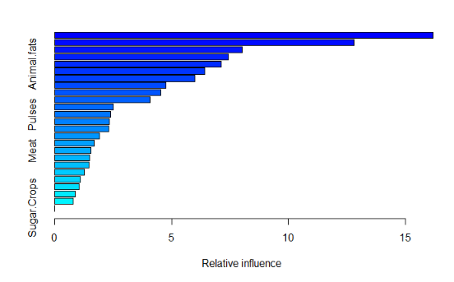
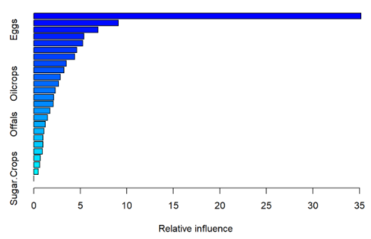
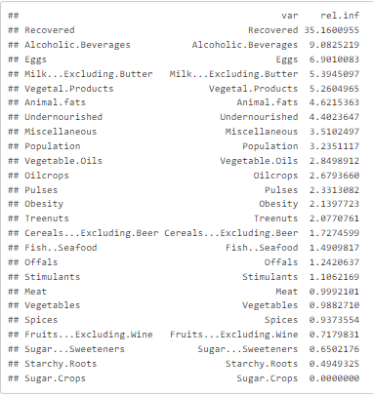
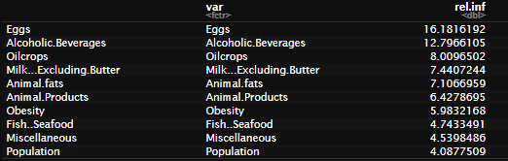
Gradient Boost

Slide 21
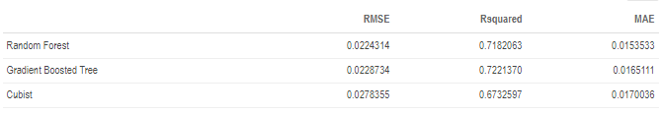
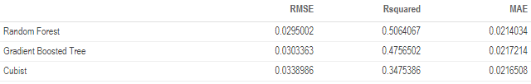
Tree Prediction Results

Slide 22
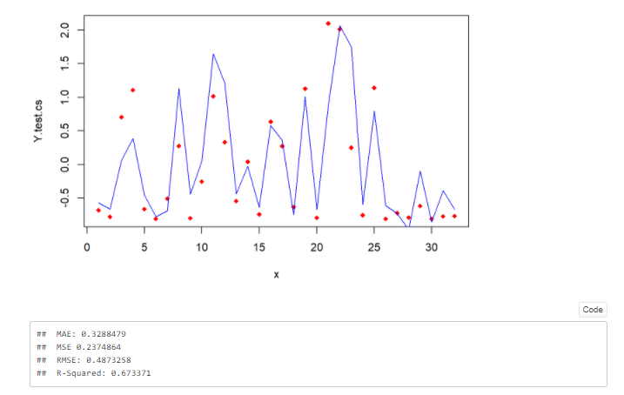
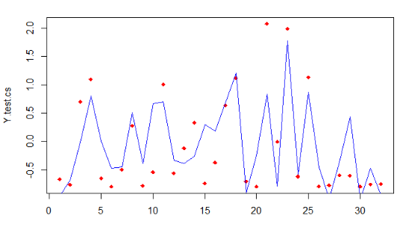

Support Vector Regression Plots

Slide 23
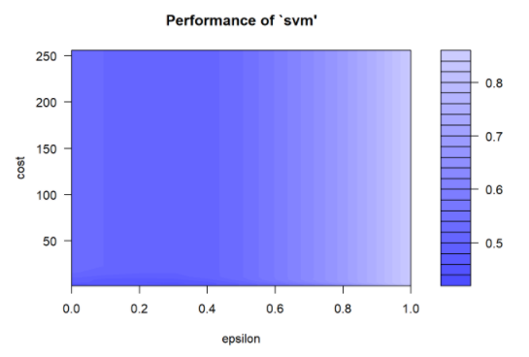
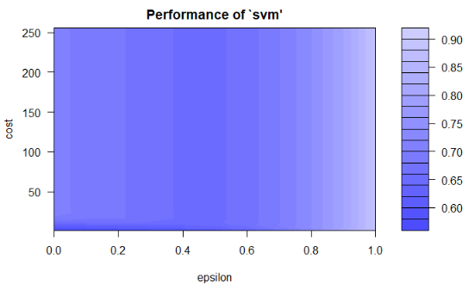
Tuned Grid Plots

Slide 24
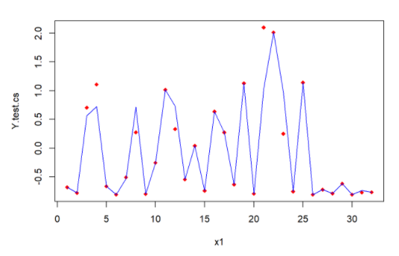

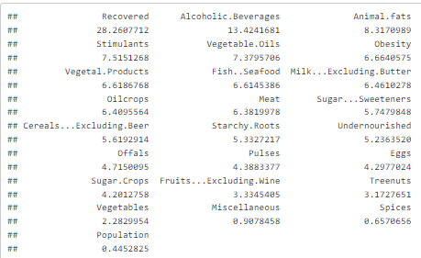
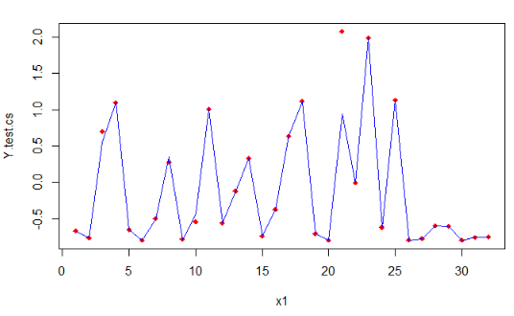

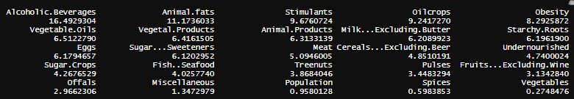
Tuned SVR Plots and Results

Slide 25
Conclusion & Findings
We used several models to study the correlation between countries’ diet and COVID-19 mortality rate
We found out that food cultures is very important key as in predicting the mortality rate of COVID-19
The models show foods associated with overall poor health increases the mortality rate of COVID-19 in each country
A population which has a healthy diet (food based on vegetal products, cereals,..) has a lower death rate in comparison with a population which has a higher obesity rate and consumes more animal products

Slide 26
Thank you!

