Slide 1
KEDA on OpenShift - Autoscaling with Custom Metrics
Overview & Objectives

Slide 2
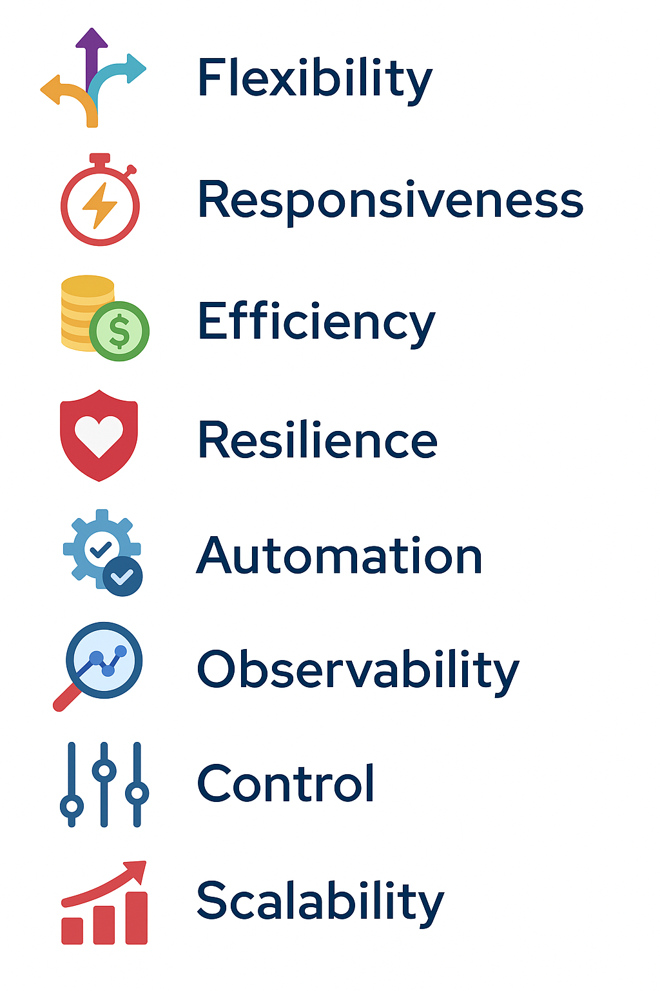
Key Objectives of Using KEDA in OpenShift

Slide 3
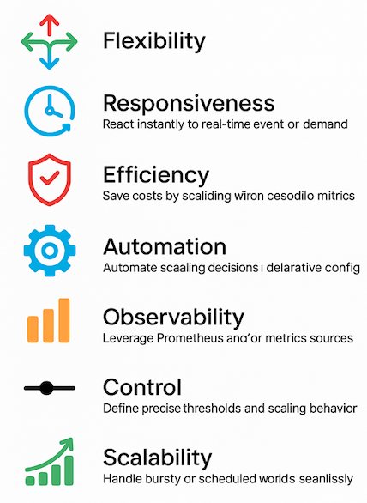

Slide 4
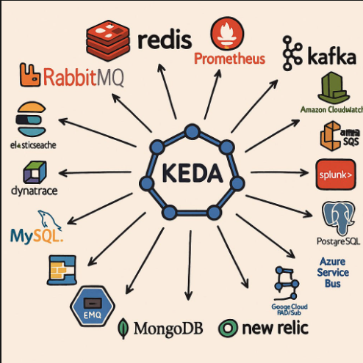

Slide 5
