Slide 1
Shareplex POC
Geert Jan Frese
Solutions Architect
Notes:
How to can change, move, replace or delete icons is outlined on slide 22 of the Quest PPT User Guide: With curser, select any icon and you can delete, move, replace or resize icons.
To Replace icon: Delete the icon and then find the icon you’d like to use in the icon library is on pages 69-79 of this template.
To Resize icon: Select the icon and click on one of the corner points. HOLD down the shift key and drag the icon box to the size you want.

Slide 2


Shareplex POC in VirtualBox with Vagrant
Create an automatic POC for the clients
Tools
Virtualbox: VirtualBox is a general-purpose full virtualizer for x86 hardware, targeted at server, desktop and embedded use.
Vagrant: Vagrant is a tool for building and managing virtual machine environments in a single workflow. With an easy-to-use workflow and focus on automation, Vagrant lowers development environment setup time, increases production parity, and makes the "works on my machine" excuse a relic of the past.
DB’s
Oracle
PostgreSQL
POC

Slide 3
Which environments are created?
Node 1
Oracle Linux 7.9
ssh port: 2201
Oracle 19c (cdb1 and pdb1 databases)
Oracle DB port: 1522
Shareplex 10.2
Node 2
Oracle Linux 7.9
ssh port: 2202
Oracle Oracle 19c (cdb1 and pdb1 databases)
Oracle DB port: 1523
Shareplex 10.2

Slide 4
How to connect
To connect to oracle environment
sudo su – oracle
sqlplus / as sysdba
To shareplex console
sudo su – oracle
sp_cop &
sp_ctrl

Slide 5
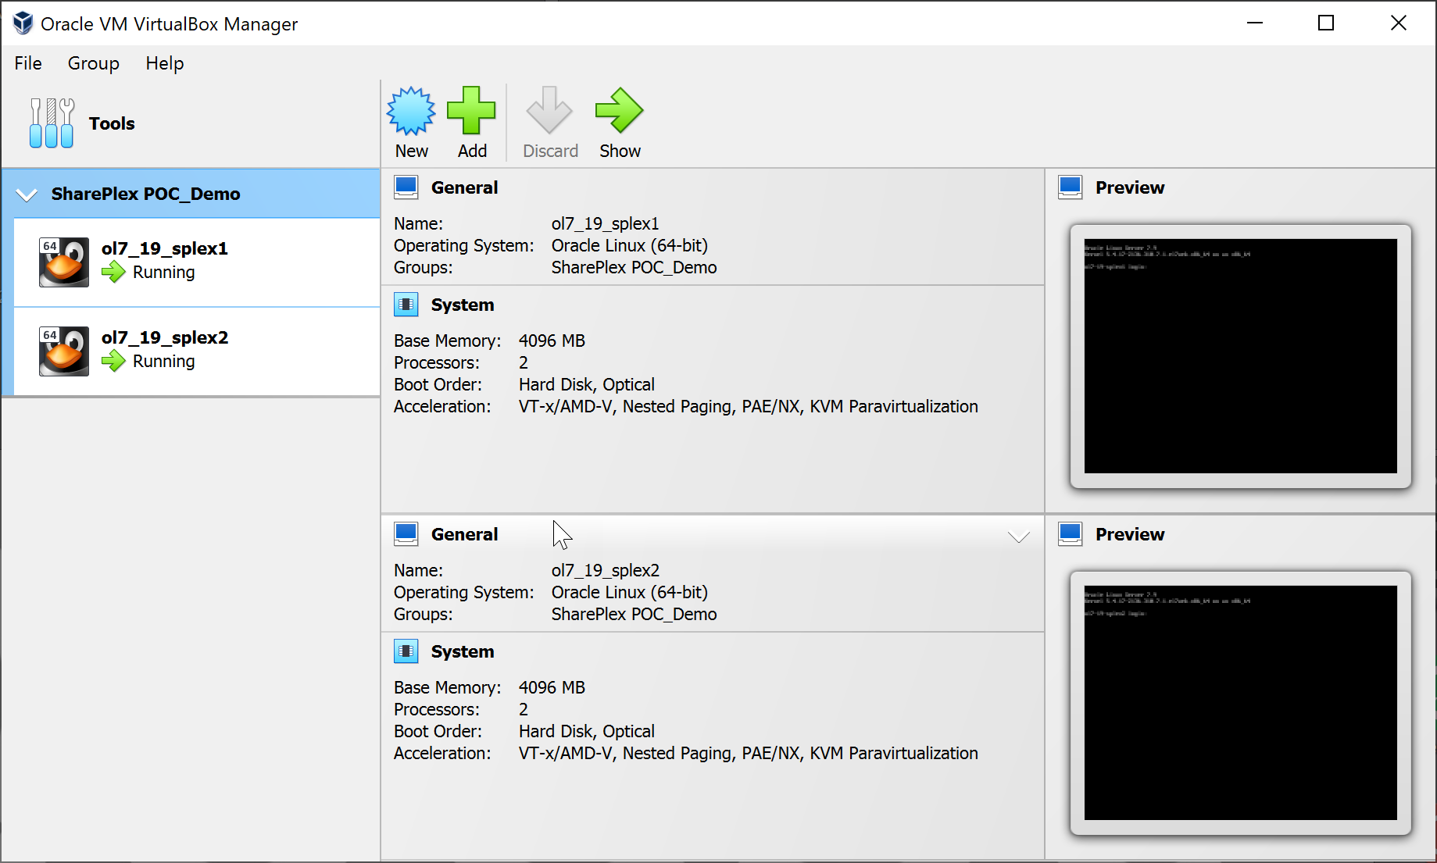
VirtualBox VM’s
All VirtualBox VM’s are managed with Vagrant
3 commands to start/stop and destroy VM’s
vagrant up
vagrant halt
vagrant destroy -f

Slide 6

Github project
https://github.com/geertjanf/shareplex_vagrant

Slide 7
Execute ‘vagrant up’ command in Node 1 and 2
C:\Users\gfrese\Shareplex_Vagrant\node1>vagrant up
Bringing machine 'default' up with 'virtualbox' provider...
==> default: Importing base box oraclebase/oracle-7'...
==> default: Matching MAC address for NAT networking...
==> default: Checking if box oraclebase/oracle-7' is up to date...
==> default: Setting the name of the VM: ol7_19_splex1
==> default: Clearing any previously set network interfaces...
==> default: Preparing network interfaces based on configuration...
default: Adapter 1: nat
default: Adapter 2: intnet
default: Adapter 3: bridged
==> default: Forwarding ports...
default: 22 (guest) => 2201 (host) (adapter 1)
default: 1521 (guest) => 1522 (host) (adapter 1)
default: 5500 (guest) => 5502 (host) (adapter 1)
default: 2100 (guest) => 2102 (host) (adapter 1)
==> default: Running 'pre-boot' VM customizations...
==> default: Booting VM...
==> default: Waiting for machine to boot. This may take a few minutes...
default: SSH address: 127.0.0.1:2201
default: SSH username: vagrant
default: SSH auth method: private key
default: Warning: Remote connection disconnect. Retrying...
default:
default: Vagrant insecure key detected. Vagrant will automatically replace
default: this with a newly generated keypair for better security.
default:
default: Inserting generated public key within guest...
default: Removing insecure key from the guest if it's present...
default: Key inserted! Disconnecting and reconnecting using new SSH key...
==> default: Machine booted and ready!
==> default: Checking for guest additions in VM...

Slide 8
Connect to oracle DB Node 1 and check DB
[vagrant@ol7-19-splex1 ~]$ sudo su - oracle
Last login: Fri Nov 11 10:36:22 UTC 2022
[oracle@ol7-19-splex1:~ ] $ s
SQL*Plus: Release 19.0.0.0.0 - Production on Fri Nov 11 11:03:23 2022
Version 19.17.0.0.0
Copyright (c) 1982, 2022, Oracle. All rights reserved.
Last Successful login time: Mon Nov 07 2022 10:10:28 +01:00
Connected to:
Oracle Database 19c Enterprise Edition Release 19.0.0.0.0 - Production
Version 19.17.0.0.0
SQL> create table test (id number);
Table created.
SQL> insert into test values (1);
1 row created.
SQL> commit;
Commit complete.

Slide 9
Check shareplex replication in Node 1
sp_ctrl (ol7-19-splex1.localdomain:2100)> list config
File Name State Datasource
-------------------------------------------------- ---------- ---------------
my_config_oracle.cfg Active o.pdb1
Last Modified At: 11-Feb-22 10:40 Size: 140 Internal Name: .conf.3
sp_ctrl (ol7-121-splex1.localdomain:2100)> show
Process Source Target State PID
---------- ------------------------------------ ---------------------- -------------------- ------
Capture o.pdb1 Running 24790
Read o.pdb1 Running 24820
Export ol7-19-splex1 ol7-19-splex2 Running 24884
[oracle@ol7-19-splex1:~ ] $ sqlplus test/test@pdb1
SQL*Plus: Release 19.0.0.0.0 - Production on Fri Nov 11 11:03:23 2022
Version 19.17.0.0.0
Copyright (c) 1982, 2022, Oracle. All rights reserved.
Last Successful login time: Mon Nov 07 2022 10:10:28 +01:00
Connected to:
Oracle Database 19c Enterprise Edition Release 19.0.0.0.0 - Production
Version 19.17.0.0.0
SQL> select * from test;
ID
----------
1

Slide 10
Check shareplex replication in Node 2
sp_ctrl (ol7-19-splex1.localdomain:2100)> show
Process Source Target State PID
---------- ------------------------------------ ---------------------- -------------------- ------
Capture o.pdb1 Running 24790
Read o.pdb1 Running 24820
Export ol7-19-splex1 ol7-19-splex2 Running 24884
[oracle@ol7-121-splex2:~ ] $ sqlplus test/test@pdb1
SQL*Plus: Release 19.0.0.0.0 - Production on Fri Nov 11 11:03:23 2022
Version 19.17.0.0.0
Copyright (c) 1982, 2022, Oracle. All rights reserved.
Last Successful login time: Mon Nov 07 2022 10:10:28 +01:00
Connected to:
Oracle Database 19c Enterprise Edition Release 19.0.0.0.0 - Production
Version 19.17.0.0.0
SQL> select * from test;
ID
----------
1

