Slide 1


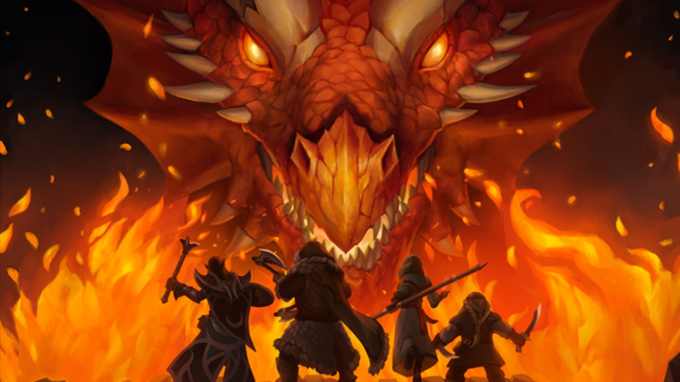
Dungeons and dragons: Character Multiclassing
Louisa Reilly

Slide 2
Character Creation
Race
Class
Skills
Spells
Stats
Notes:
Race e.g. dwarf, elf, gnome
Roll for stats: constitution, strength, dexterity, wisdom, charisma, and intelligence
Skills e.g. athletics, deception, sleight of hand, medicine

Slide 3
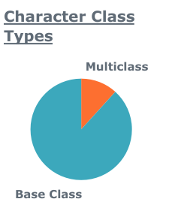
Multiclassing in Dnd
When leveling up, can choose to “take a level” in a different class to gain different abilities.
Method of character optimization
Not always better
Complicated
Novel story ideas

Slide 4
Dnd character sheet dataset and tools
From B. Ogan Mancarci’s printSheetApp and interactive Sheet (Online character sheet tools)
Features include HP, AC, level, skills, weapons, race, spells, casting, background, casting, class
Homebrew (non-standard data)
Free text fields:
Spells, Weapons, Alignment
Logistic Regression focus
Tools:
Tableau, Matplotlib, Seaborn
Pandas, NumPy
Scikit-learn
Notes:
Talk about model,

Slide 5
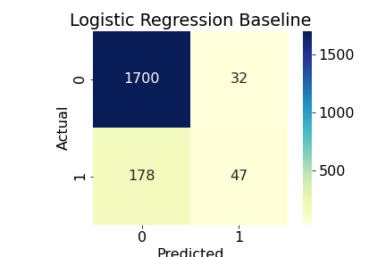
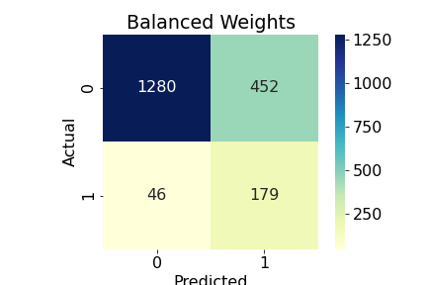
Confusion Matrices
Severe class imbalance so accuracy is deceiving
Baseline: 0.893
Balanced Weights: 0.746
Increase correct + class guess
Increase in false positives
Decrease in false negatives
Notes:
First ran logistic regression got vey high accuracy. Suspicious.
Checked confusion matrix and saw that it was mostly predicting 0 (base class), but we want 1 multiclass.
Adjusted model so weights were biased towards

Slide 6
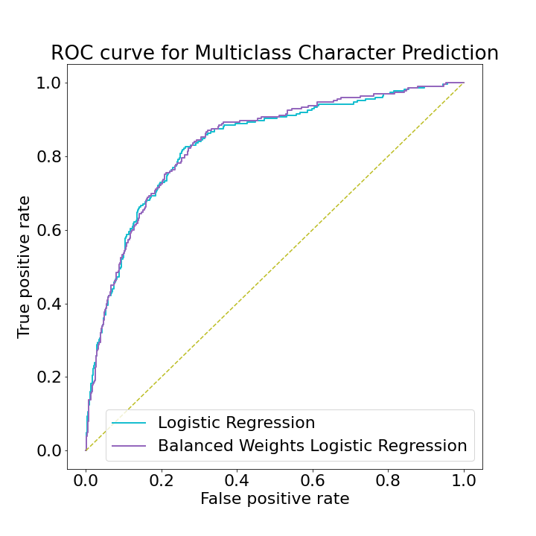
Logistic Regression Stats
F-1 Score
0.309
0.418
Model | Precision | Recall | F-1 Score | ROC AUC
Baseline | 0.595 | 0.209 | 0.309 | 0.595
Balanced Weights | 0.284 | 0.796 | 0.418 | 0.767
Notes:
ROC curves used to show the connection between the sensitivity and specificity (TPR and FPR).
Still better than guessing, and slight improvement with balanced weights.

Slide 7
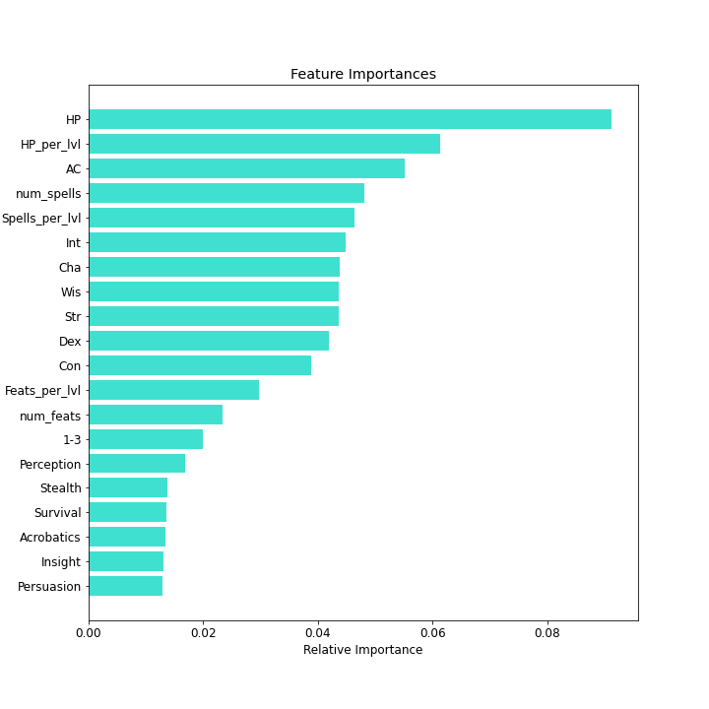
Feature Importance
Engineered features
Character stats had a large impact
Skills, levels
More engineered features could improve performance.

Slide 8
Sources/ Acknowledgements
Gary Gygax and Dave Arneson for creating DnD.
Wizards of the Coast(subsidary of Hasbro) which publishes DnD guides.
B. Ogan Mancarci for his data collection.
https://github.com/oganm/dnddata
Dan Quach for his 2020 blogpost about creating a classifier using Oganm's dataset.
https://towardsdatascience.com/classifying-character-classes-in-dungeons-dragons-with-machine-learning-86751240594d

Slide 9
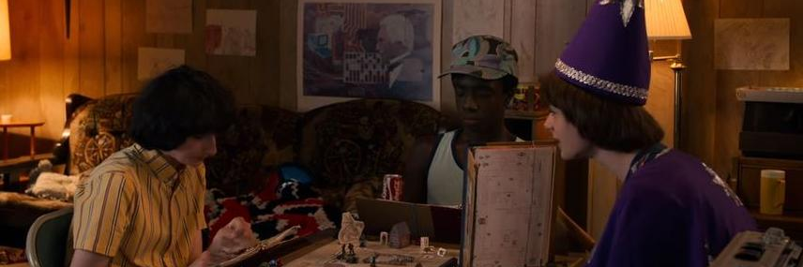
Any questions?

Slide 10
Character Class
Half-Caster
Paladin
(Holy Warrior)
Ranger
(Scout, Hunter, Tracking, Survival)
Martial
Fighter
(All-around combat expert)
Barbarian
(Primal, Rage, No combat training)
Rogue
(Stealthy, Assassin, Thief)
Monk
(Martial Artist)
Caster
Wizard
(Scholarly, Caster)
Warlock
(Given power via a pact)
Sorcerer
(Born with power)
Druid
(Nature-based magic
Cleric
(Healer, gains magic via deity)
Bard
(Minstrel, casts spells with music)

Slide 11
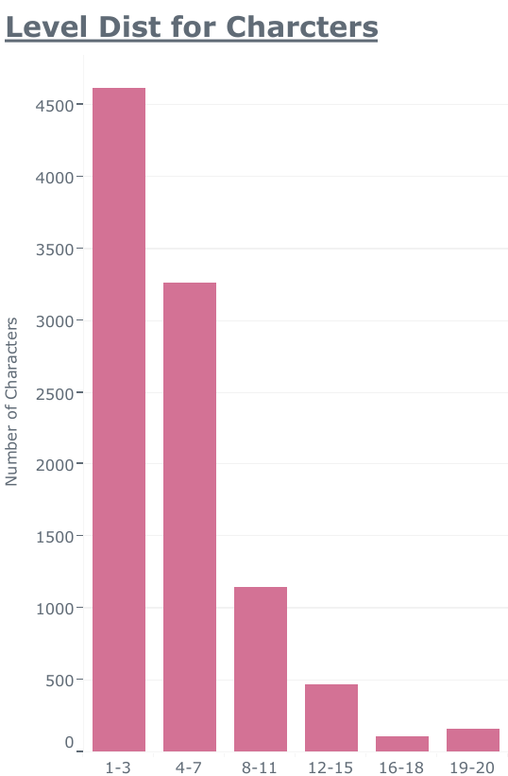
Feature Engineering
Normalize to level since data skewed to lower-level characters.
HP/level
Spells/level
Feats/level
Weapon categories: martial, simple, ranged.
One-hot encoding skills, race/ other race group, casting stat, level groups

Slide 12
Dungeons and dragons (DND) Explained
Dungeon Master
Campaign
Game Rules
Character 2
Party
Character 1
Monsters
Non-Playable Characters
Adventures/ Storyline
Character 3

Slide 13
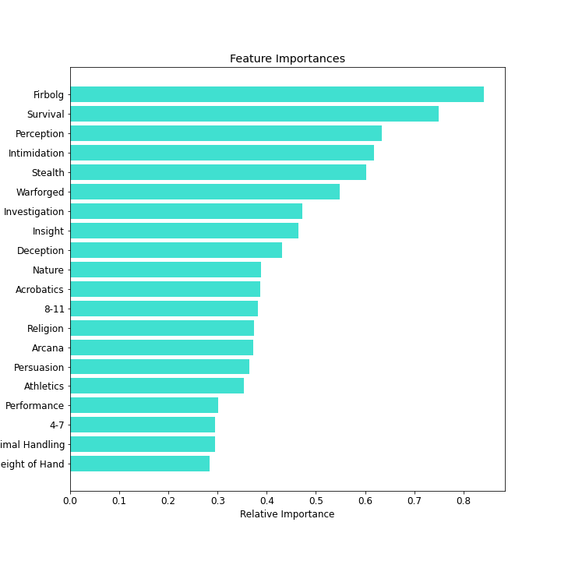
Feature importance
Skills, levels
More engineered features could improve performance.

Slide 14
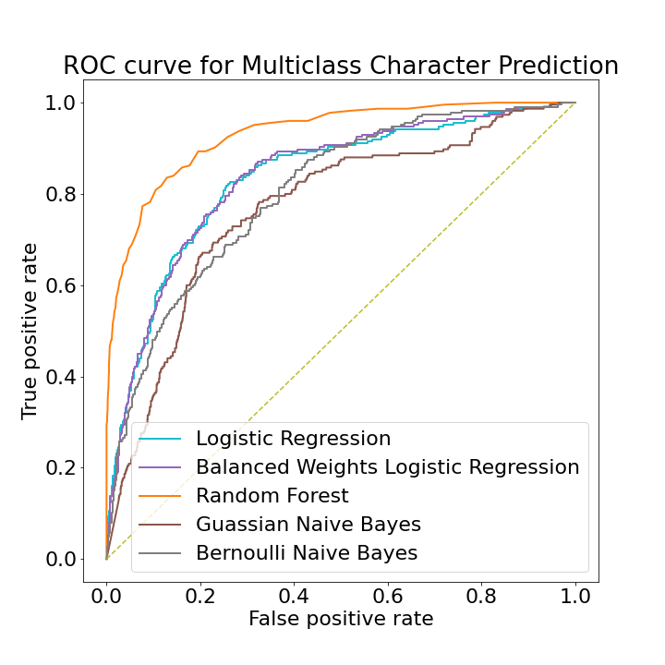
ROC Curve for all models

