Slide 1
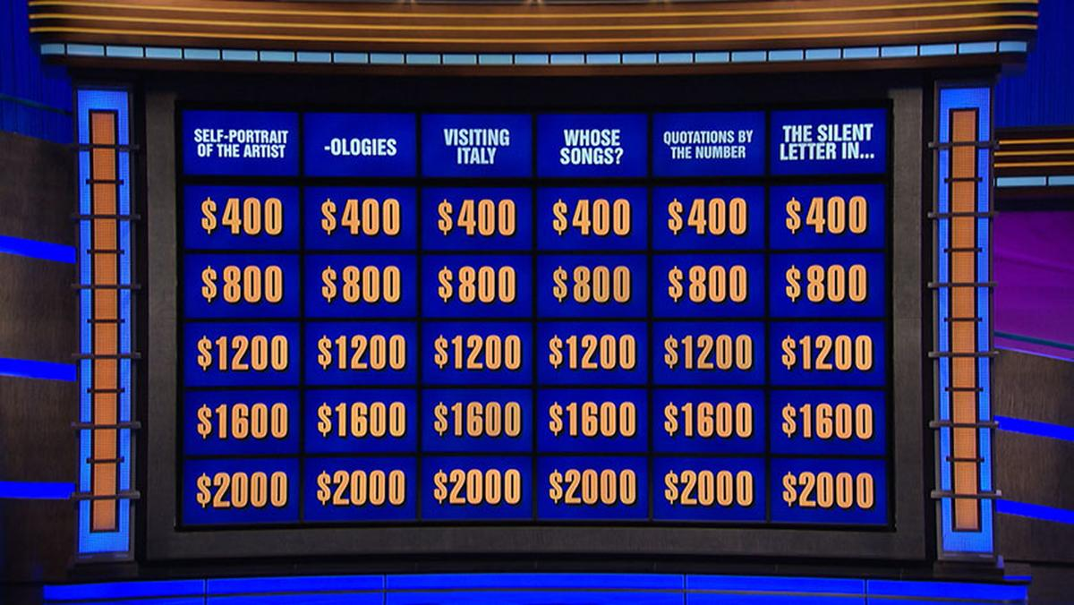
Jeopardy Questions: Can They be Generalized?
Louisa Reilly

Slide 2
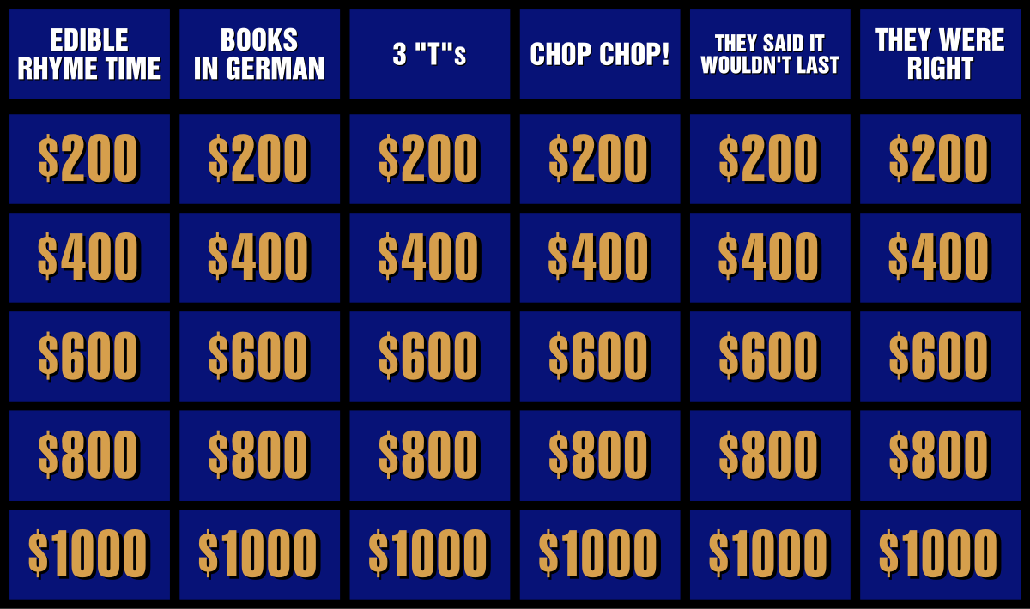
In case you have not seen the show…
Answer → Question
Contestants are given quiz clues in the form of answers
They must respond in the form of a question.
Audition:
Exam, IRL group audition, mock game, interviews
No previous contestants
Have not auditioned for at least the past 18 months

Slide 3

Outline
Dataset
216k Jeopardy questions and answers
Spans from 1984 to 2012
Scrapped from J-archive by a Reddit User
EDA
Tableau
Topic Modeling
NLP tools: NLTK, sklearn
Processing tools: pandas, regex
Algo: NMF
Vectorizer: TFIDF
This Photo by Unknown Author is licensed under CC BY

Slide 4

Exploratory Data Analysis

Slide 5

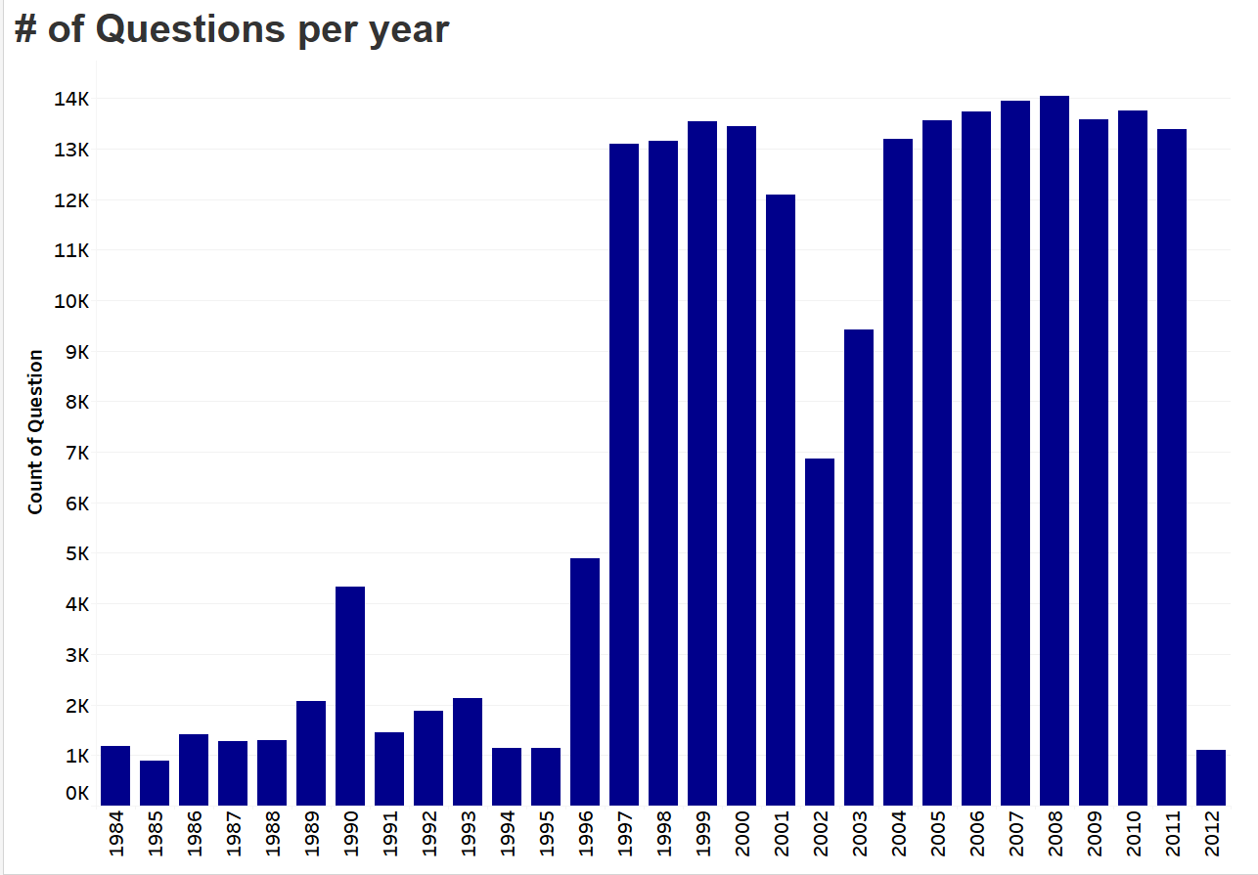
Majority of Q’s in the 2000’s decade

Slide 6
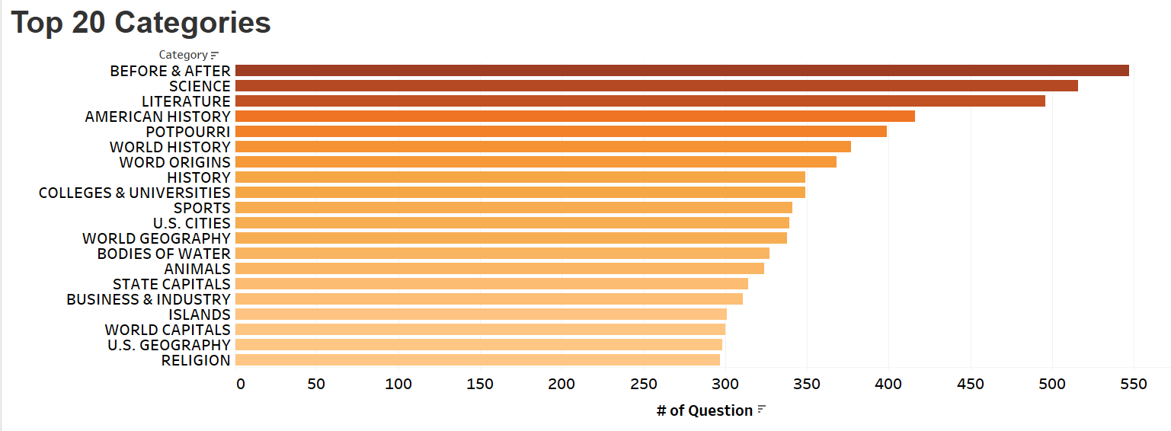
Top 20 Categories
Emphasis on Geography and History
Before & After = combo of 2 things to form an answer
Potpourri = random unrelated questions

Slide 7

Topic Modeling

Slide 8
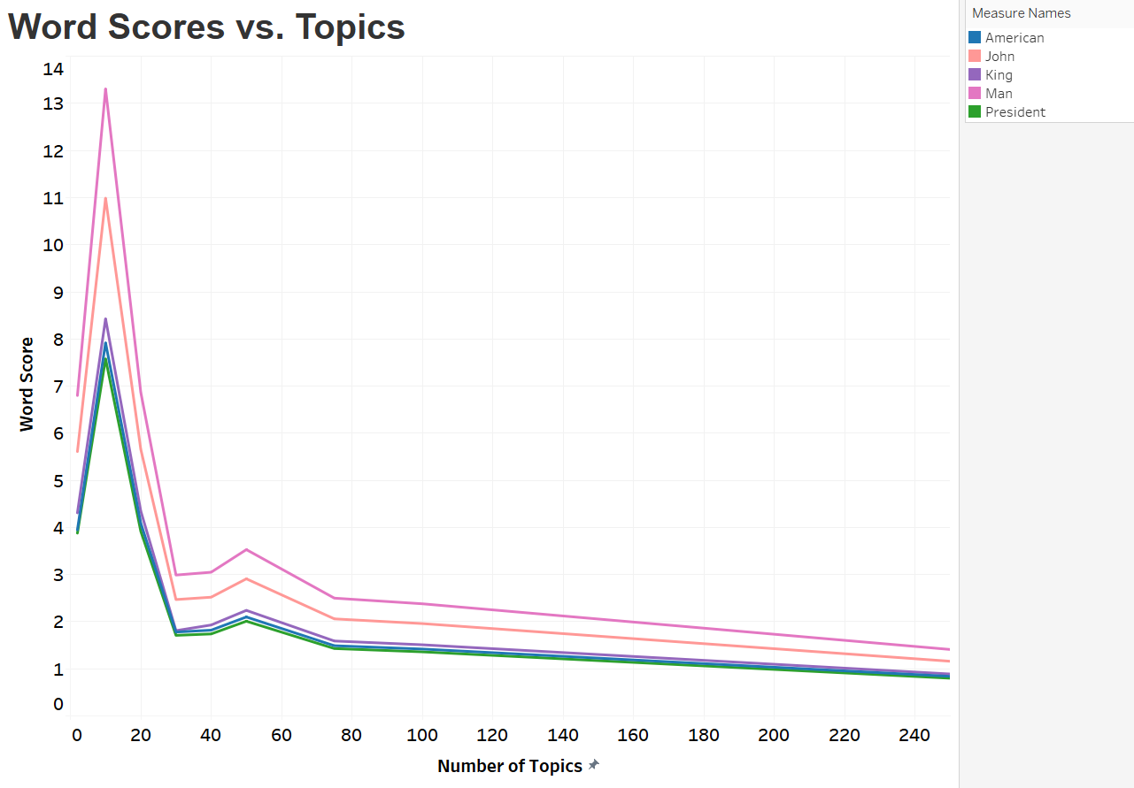
Increasing the number of topics

Slide 9
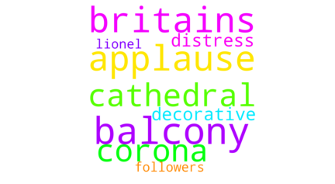
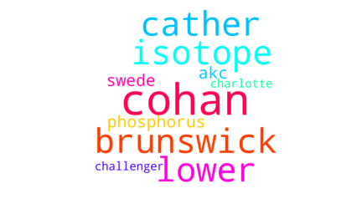
The topics: examples
Science-ish
General arts

Slide 10
Conclusions
Diverse dataset
Topic modeling needs more fine tuning
Filter for just nouns and adjectives

Slide 11
History
1964
Created by Merv Griffin
1964 - 1975
Aired on NBC
2020 - Present
Since Trebek’s Death, different hosts but still going strong
Answer → Question
1984 - 2020
Revived by Sony and hosted by Alex Trebek

Slide 12
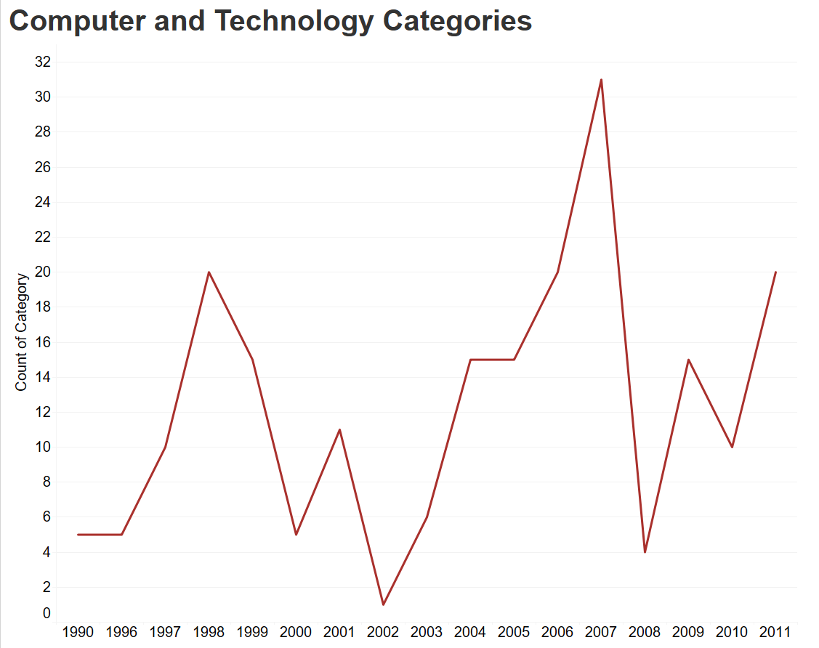
Tech Categories
Did not start appearing until the 90s
Increase overtime with a few dips
Corresponding to economic dips?

Slide 13
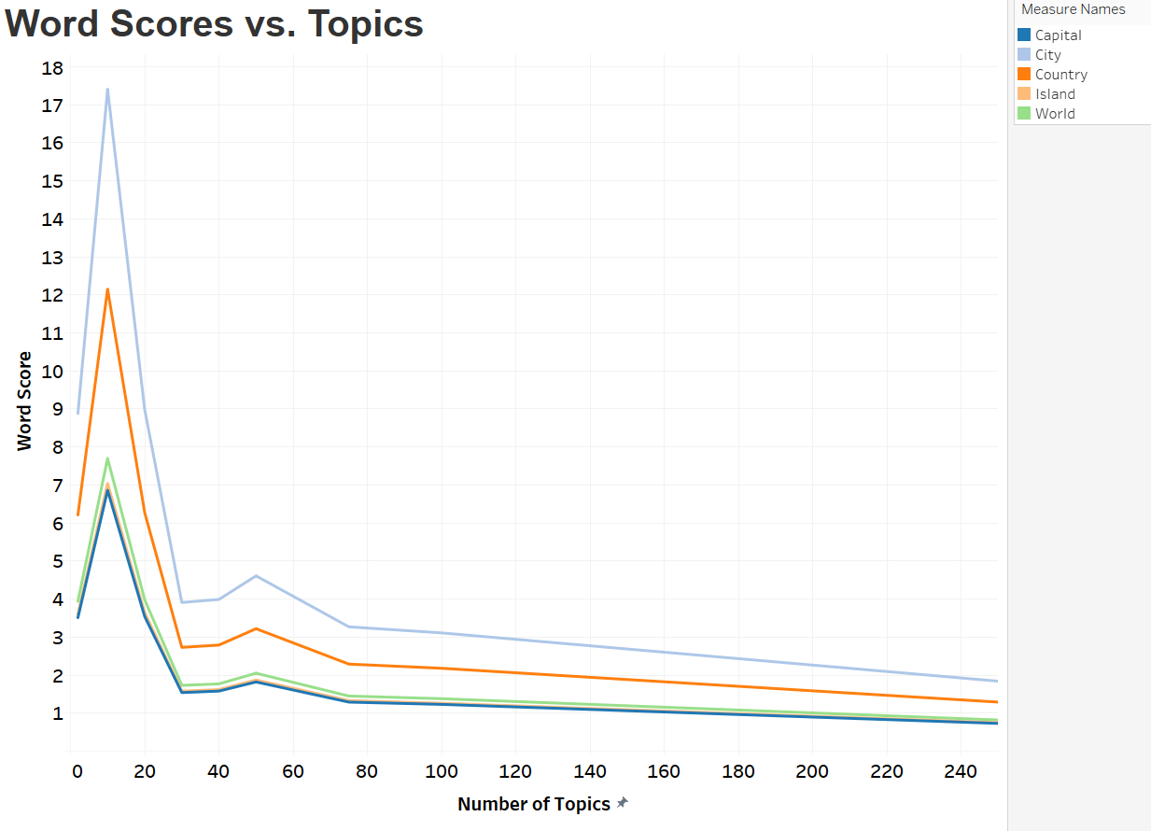
Increasing the number of topics
Geography!

