Slide 1
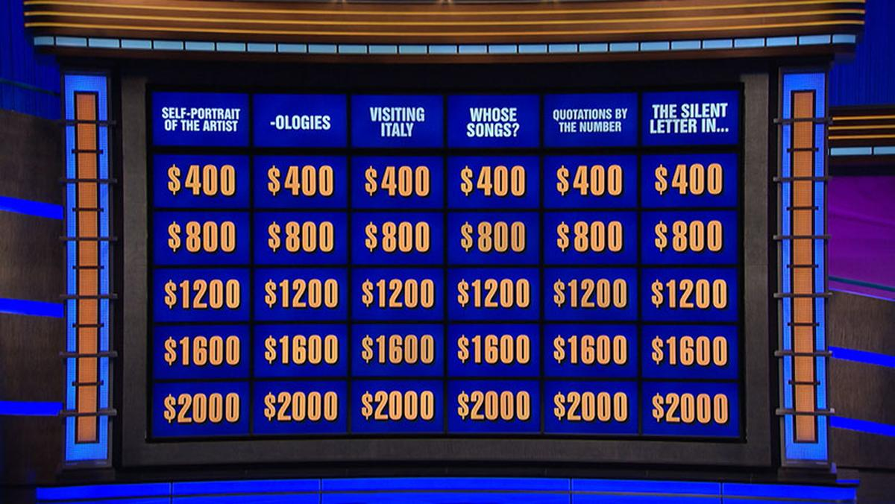
Jeopardy Questions: Can They be Generalized?
Louisa Reilly

Slide 2
History
1964
Created by Merv Griffin
1964 - 1975
Aired on NBC
2020 - Present
Since Trebek’s Death, different hosts but still going strong
Answer → Question
1984 - 2020
Revived by Sony and hosted by Alex Trebek

Slide 3
In case you have not seen the show…
Answer → Question
Contestants are given quiz clues in the form of answers
They must respond in the form of a question.
Audition:
Exam, IRL group audition, mock game, interviews
No previous contestants
Have not auditioned for at least the past 18 months

Slide 5
Topic Modeling

