Slide 1

FlyClient
and
MerkleMountainRanges

Slide 2
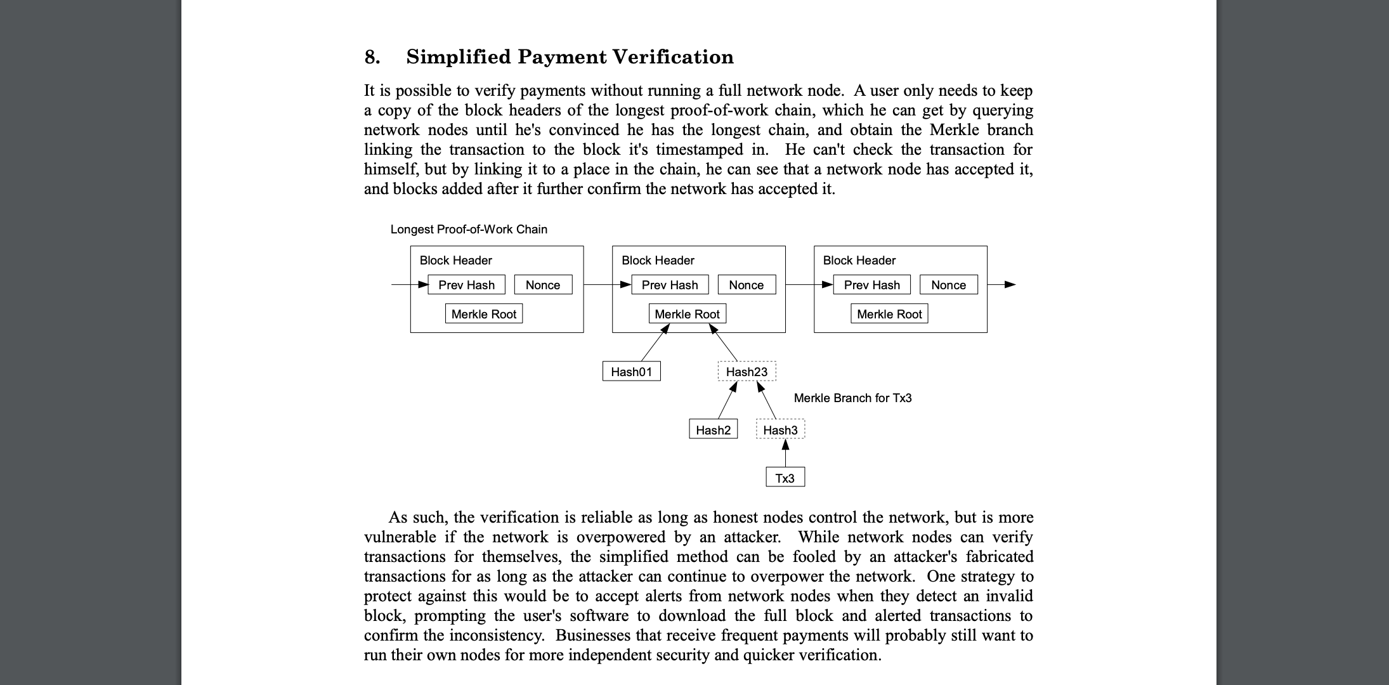
From The Bitcoin White Paper
Notes:
Opening
When satoshi made the bitcoin whitepaper he included the tx merkle tree as a way for some users to interact with the system without storing the entire blockchain.
Opening Question
These methods haven't really taken off. I’m going explain why that is. And I’m going to propose FlyClient as the solution to the current problems

Slide 3
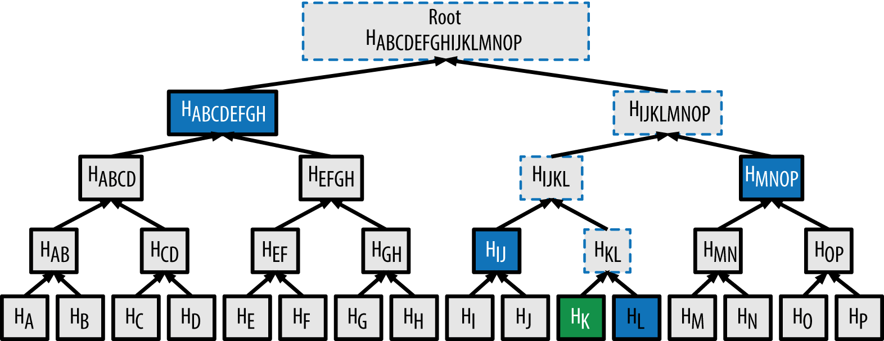
Binary Merkle Trees (review)
Notes:
short description how it works
emphasis that you only can prove AGAINST a root. People forget to solve HOW to trust the root.
How is that done?

Slide 4
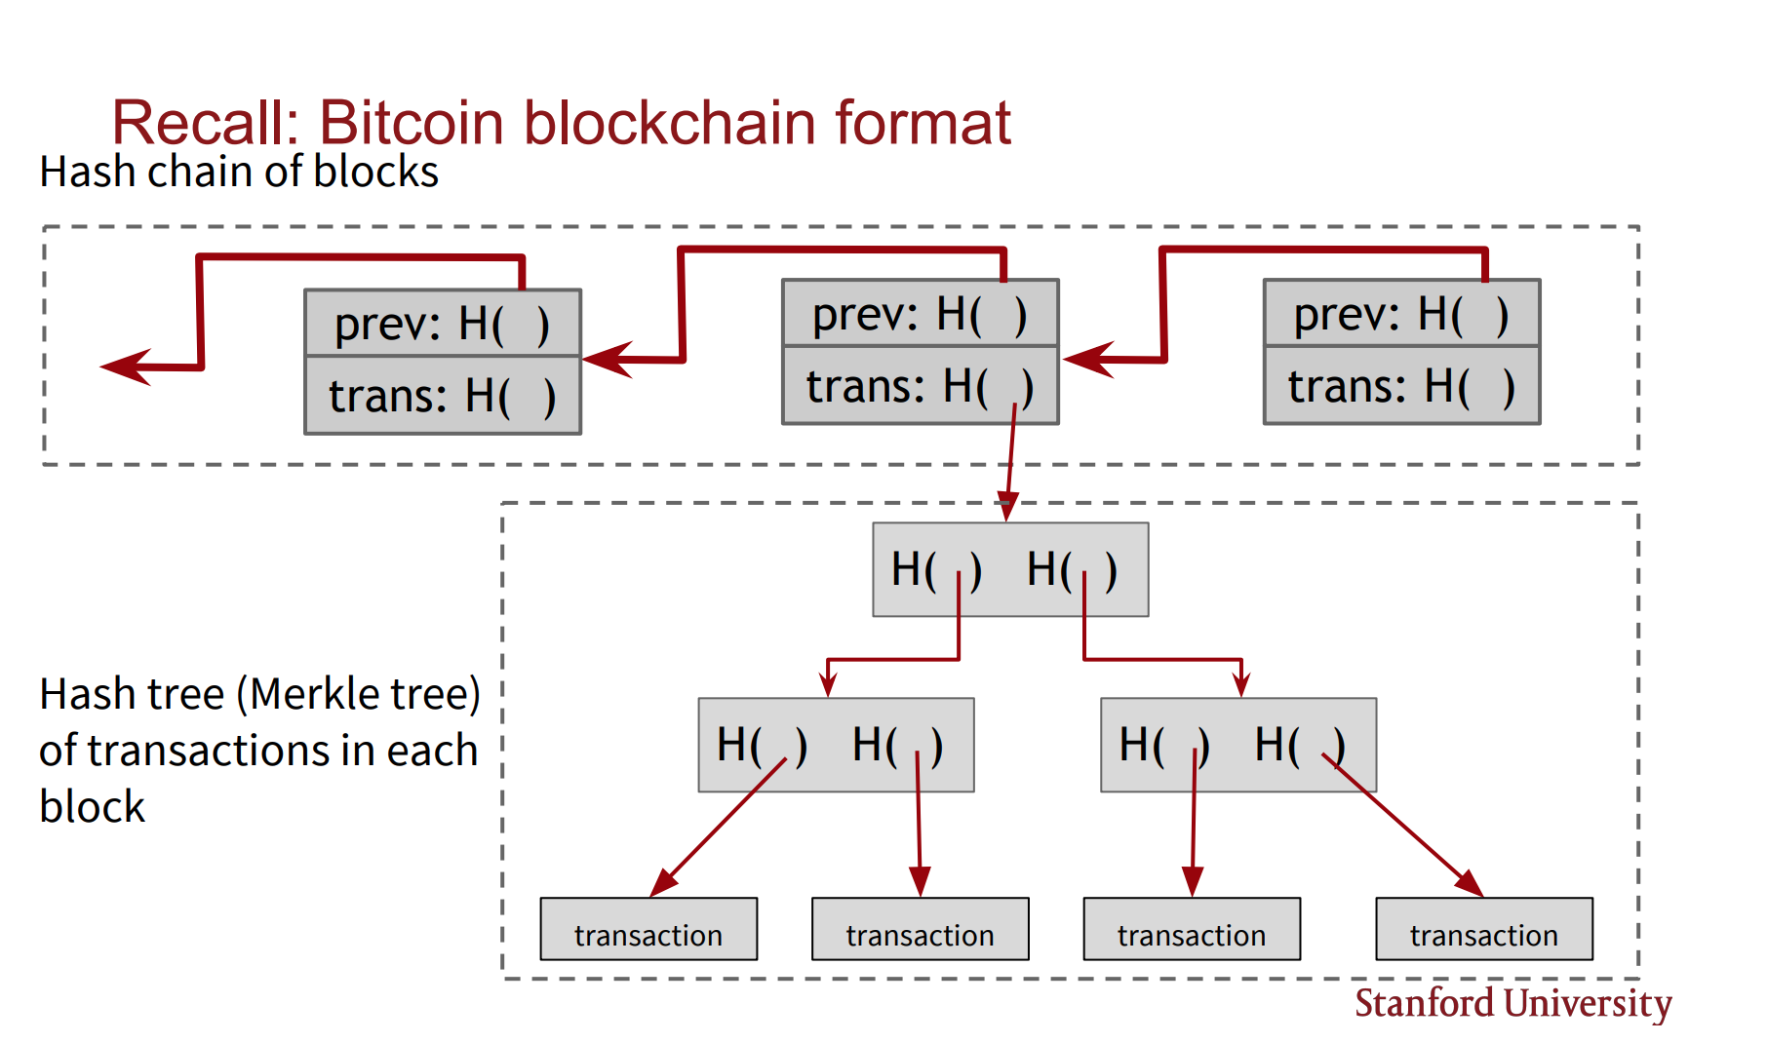
Notes:
In pretty much all of blockchains (before flyclient) this is how you come to trust a blockhash: You embed a root in each blockheader, and the headers are verified in a totally different way with a totally different level of security.

Slide 5
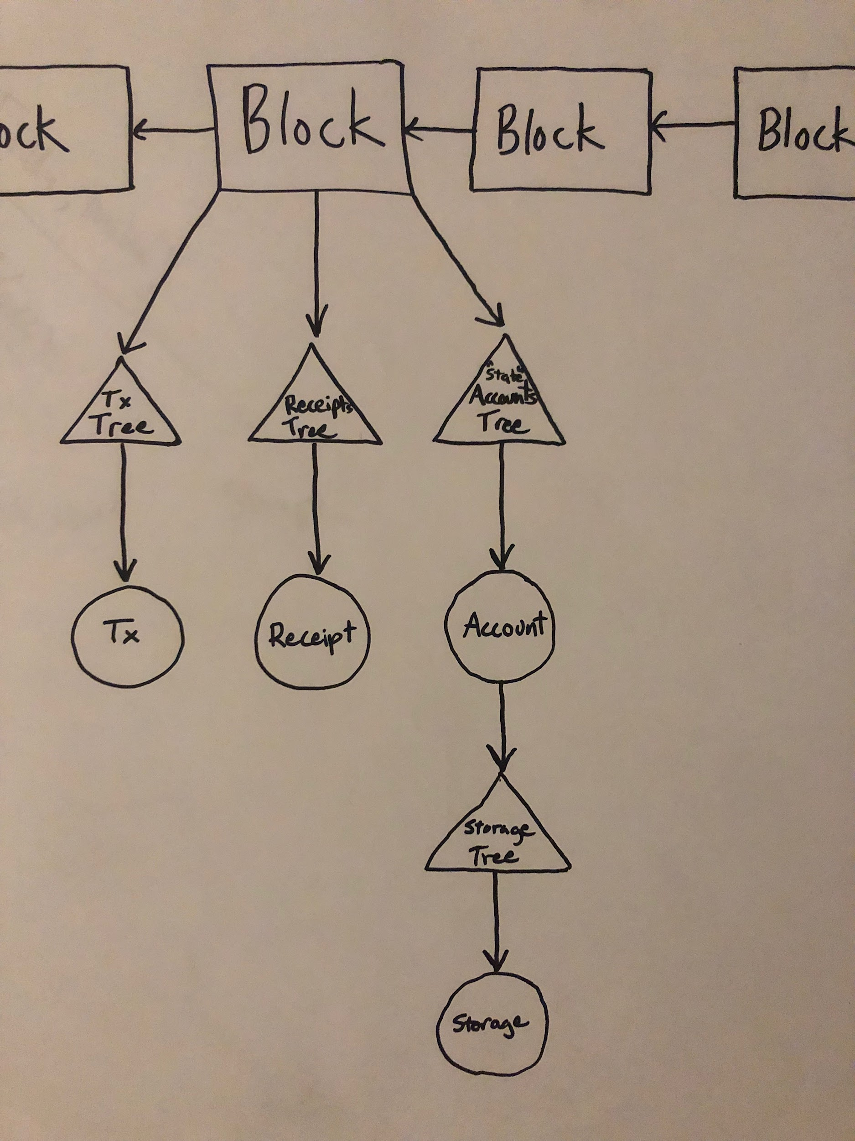
- Validate all block headers
- this is the problematic bit
- headers ~ 50Mb <- even this
- headers ~ 3Gb <- problem here
---------------------------------------------------
- Fly headers ~ < 500kb
--------------------------------------------------------
- Fly headers ~ < 500kb
What are the numbers?
- Validate data against a header
- simple and straigtforward
- BTC
- tx proof ~ 400bytes
-ETC/ETH
- storage proof ~ 800bytes
Notes:
On Ethereum its a little more complicated, because there are a few trees. But it works the same way. A storage variable is inside of tree a tree and the root of that tree is embedded in another tree, and that’s embedded in a blockheader.
But you chain the proofs all together with the same result - and the same exact issue: The final root is in a blockheader and we need to download ALL those headers to validate the proof of work.
The headers on ETH/ETC are particulalry bad, because we have so many blocks. More than Bitcoin. How bad? Here are the numbers:
The header is more than 6 orders of magnitude larger than the storage proof
This limits the way we have to design surrounding software:

Slide 6
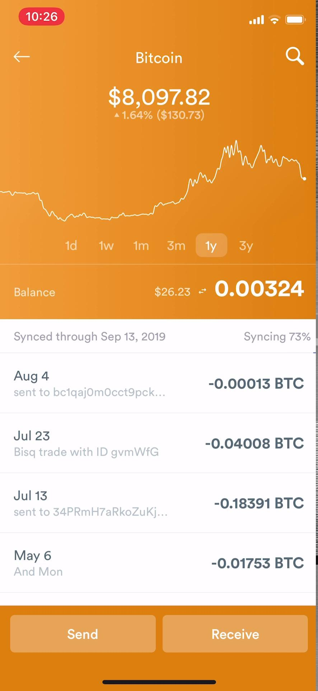

Typical UX now
~15 minutes on first install
~45 seconds every time I open it
Notes:
so What can the current architecture achieve? This is bread wallet. See how its loading (loading)? You have to give them credit: They’re actually downloading all the headers here and doing the SPV proofs. but...
This is why no one is using merkle proofs and no one is validating data.
FlyClient can enable a replacement for this process - with the same security, in 2 seconds
Instead? The Super vigalant will run a full Bitcoin Ethereum node? almost no one runs full or archive ethereum nodes. What do they do? They use Infura
// come back to the question at the end to answer it
Leading Q: A while back I started thinking about how you could prove the work without needing all the headers.

Slide 7
Why not sample just a few random ones?
Since we cannot verify that they point to each other, an attacker can produce just the samples without the ones in-between.
They can produce them after the fact
Notes:
We cant prove if they point to eachother. (that they commit to all previous ones).
-next
That means the person giving the proof can just make the ones requested for After they’re requested.
So they only need to do the sum of the work of the individual requested blocks.

Slide 8
Solution: Each block should point to every previous block.
DO this by using a merkle-tree instead of a hash-linked-list
Tree requirements
Can efficiently append new blochashes
Can efficiently prove a specific blockhash is contained at a specific index
Can efficiently prove a earlier value using a later value
Notes:
It seems obvious that you would want to put them in some sort of merkle tree, but that’s not so trivial so we can have small proofs from each block to any block before it.
But you would need to verify it recursively

Slide 9
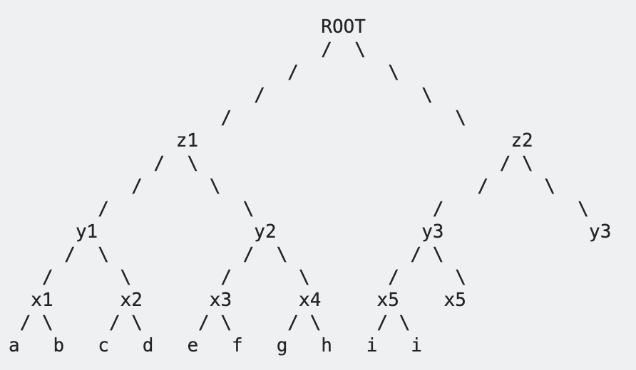
Regular binary merkle tree
Problem:
When h is added, the proof for f changes (namely y2, z1, and ROOT)
Notes:
So the problem with this regular merkle tree is that there is too much updating of nodes

Slide 10
Merkle Mountain Ranges
H(H(H(0,1),H(2,3)),H(H(4,5),H(6,7)))
H(H(0,1),H(2,3))
H(H(4,5),H(6,7))
H(0,1)
H(2,3)
H(4,5)
H(6,7)
H(8,9)
bh0
bh1
bh2
bh3
bh4
bh5
bh6
bh7
bh8
bh9
bh10
Array Representation:
bh0
bh1
H
bh2
bh3
H
H
bh4
bh5
H
bh6
bh7
H
H
H
bh8
bh9
H
bh10
Notes:
so what does it look like
It is the blockhash that we arrange into this tree
...
And notice as new leaves are added, none of the previous nodes ever change - which means none of the proofs will have to change, that’s a very useful property for us.

Slide 11
14
Tree Representation:
6
13
21
2
5
9
12
17
20
24
0
1
3
4
7
8
10
11
15
16
18
19
22
23
25
Leaf index:
0
1
2
3
4
5
6
7
8
9
10
11
12
13
14
Array Implementation:
L0
L1
H
L2
L3
H
H
L4
L5
H
L6
L7
H
H
H
L8
L9
H
L
10
L
11
H
H
L
12
L
13
H
L
14
0
1
2
3
4
5
6
7
8
9
10
11
12
13
14
15
16
17
18
19
20
21
22
23
24
25
Proof:
H
L8
L9
H
H
H
L
12
L
13
H
L
14
14
15
16
17
20
21
22
23
24
25
Optimized Proof:
H
L8
L9
H
L
12
L
13
L
14
14
15
16
20
22
23
25
Notes:
Just a little about how this is written in code. (The tree nodes have indices and if I want to find leaf ...8 I can apply a simple algorithm to 7 to get its position in the tree which is 15 .
what the proofs look like. A proof is just a collection of tree nodes along with their index numbers
and some optimizations…(skip)
I have written Golang and Javascript implementation of this. Looking for someone to do a rust implimentation so we can drop this into Parity

Slide 12
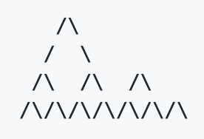
“Bagging the Peaks”:
Creates a single merkle root by hashing all of the peaks
Each later-proof is a superset of its earlier proof. Verifying 1 implicitly verifies the other
This:
Is sufficient to prove this:
Notes:
Again we are trying to prove that everything was committed to exactly in place. And because of that property that nodes are never updated only added, these 3 proofs (up here) actually contain all of the nodes needed for the 3 more recursive ones (down here)
So what do we change with Ethereum Classic?

Slide 13
Current Blockheader
After FlyClient
parentHash: '0x',
sha3Uncles: '0x',
miner: '0x',
stateRoot: '0x',
transactionsRoot: '0x',
receiptRoot: '0x',
logsBloom: '0x',
difficulty: '0x',
number: '0x',
gasLimit: '0x',
gasUsed: '0x',
timestamp: '0x',
extraData: '0x',
mixHash: '0x',
nonce: '0x'
parentHash: '0x',
sha3Uncles: '0x',
miner: '0x',
stateRoot: '0x',
transactionsRoot: '0x',
receiptRoot: '0x',
logsBloom: '0x',
difficulty: '0x',
number: '0x',
gasLimit: '0x',
gasUsed: '0x',
timestamp: '0x',
extraData: '0x',
mixHash: '0x',
nonce: '0x',
mmrRoot: ‘0x’
Notes:
Now we still havent talked about the actual protocol yet - how these structures get used

Slide 14
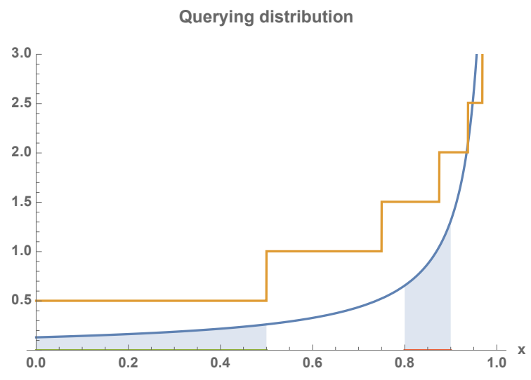
Fly Proofs
Requests ~600 headers w/ connection-proofs
Queries more toward the tip of the chain
Uses latest blockhash for randomness (Fiat-Shamir Heuristic)
Result is a non-interactive proof of total work
Notes:
Benedict did a 30 minutes talk on just this part. I have about 10 minutes left. I really suggest you watch that if you want the exact details, it’s great. I link to it in the last slide. I’m going to give the general idea.
First we pseudo randomly request a sample of just a few headers and proofs of their exact placement.
If we request enough of these headers (about 600) we can know with a cryptographic level of certainty, how much work has gone into this chian.
Now, Instead of requesting random block number, we can use the latest blockhash for randomness. This makes the proof non-interactive. The proof is thus self-contained. Can be sent to anyone, they don’t have to “trust” the randomness picked by anyone else.
Normally using the blockhash as randomness is insecure. - but this is a really cool part - The blockhash can be manipulated, but only by doing extra work. And here our only goal is to determine how much work was done. So the problem actually cancels itself out.
In the end we have a single proof about 500kb that proves the total work of the chain, and it can be reused indefinitely to prove any other data in the blockchain (even including historic data).

Slide 15
Main Benefit
All data can be passed with proofs without any noticeable difference to UX
All Peer data can be verified
Even Infura data can be verified
Other Potential Benefits
Full node-syncing will no-longer require ugly checkpoints
Peers can develop trust from initial contact
Trustless ETC <> ETH Bridge
No need to relay headers
Improvements to the EVM
All historic data available within smart contracts
Notes:
This means that even in the lazy case you still want to use infura, you can verify that data.
And, this is something happen in the background.
Users don’t need to know this is even happening.
Even bitcoin has these checkpoints. I can’t stress enough that when you are able to prove work succinctly in 1 step, you remove all these spam issues where other nodes can use up your resources before you know if they are being legit.
The proofs are finally small enough to run a bridge.
We no longer need to relay headers! (users relay only the header they need)
like awareness of historic blockhashes/state-data

Slide 16
Outstanding Issues
Do we even want to continue supporting EthHash
Alternatives
Ethash is incredibly expensive (times 600!)
100s of millions of gas in a smart contract
> 20 seconds on a phone
> 10 seconds on a laptop
Has already failed at its intended purpose
Gets exponentially harder to verify (without bound)
Is obscure and proprietary
Prevents FlyClient
Keccak256
Well documented global standard
Being worked on by Alex Tsankov

Slide 17
Merkle Mountain Ranges:
Reference 1: https://github.com/opentimestamps/opentimestamps-server/blob/master/doc/merkle-mountain-range.md
Reference 2: https://github.com/proofchains/python-proofmarshal/blob/master/proofmarshal/mmr.py
Reference 3: https://github.com/mimblewimble/grin/blob/master/doc/mmr.md
Fly Client:
Slides: https://scalingbitcoin.org/stanford2017/Day1/flyclientscalingbitcoin.pptx.pdf
Lecture: https://www.youtube.com/watch?v=BPNs9EVxWrA&t=8375
WhitePaper: https://eprint.iacr.org/2019/226.pdf
ECIP: https://github.com/etclabscore/ECIPs/pull/11
Contact Me:
Zac mitton - zacmitton23@gmail.com
These Slides: https://docs.google.com/presentation/d/1EQJQH_2enQhOT19viLqS9Vswbl0KNRtUuZTGYIPLRzY/edit#slide=id.g620366209e_0_21

