Slide 1
Project
SCSJ2154

Slide 2
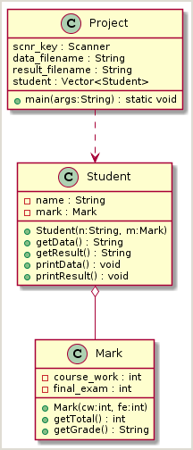
Class Diagram

Slide 3
Screen Input/output
PS F:\temp\SCSJ2154\Project> java Project
1. Set data file -
2. List data
3. List Result
4. Save Result -
5. Quit
Choose operation: 1
Enter file name: SCA3803-05062.txt
1. Set data file - SCA3803-05062.txt
2. List data
3. List Result
4. Save Result -
5. Quit
Choose operation:

Slide 4
Screen Input/output
1. Set data file - SCA3803-05062.txt
2. List data
3. List Result
4. Save Result -
5. Quit
Choose operation: 2
CHUAH TEONG LIM 65 29
FAWAZ NEJDI BIN NASSERI 32 21
KOAY HEAN HWA 68 26
KRISHNAVENI A/P SELVARAJ 46 11
NORHAFIZA BINTI HAMZAH 47 26
SITI MUNIRAH BT. MOHD HAZAM 47 27
SITI NURUL JANNAH BINTI MOHAMMAD NOR 35 3
SITI SAFINAS BINTI SAAD 47 15
TEH KOK CHONG 64 25
Press ENTER to continue...

Slide 5
Screen Input/output
1. Set data file - SCA3803-05062.txt
2. List data
3. List Result
4. Save Result -
5. Quit
Choose operation: 3
CHUAH TEONG LIM 94 A+
FAWAZ NEJDI BIN NASSERI 53 C
KOAY HEAN HWA 94 A+
KRISHNAVENI A/P SELVARAJ 57 C+
NORHAFIZA BINTI HAMZAH 73 B+
SITI MUNIRAH BT. MOHD HAZAM 74 B+
SITI NURUL JANNAH BINTI MOHAMMAD NOR 38 D
SITI SAFINAS BINTI SAAD 62 B-
TEH KOK CHONG 89 A
Press ENTER to continue...

Slide 6
Screen Input/output
1. Set data file - SCA3803-05062.txt
2. List data
3. List Result
4. Save Result -
5. Quit
Choose operation: 4
1. Set data file - SCA3803-05062.txt
2. List data
3. List Result
4. Save Result - SCA3803-05062-result.txt
5. Quit
Choose operation: 5
PS F:\temp\SCSJ2154\Project>

Slide 7
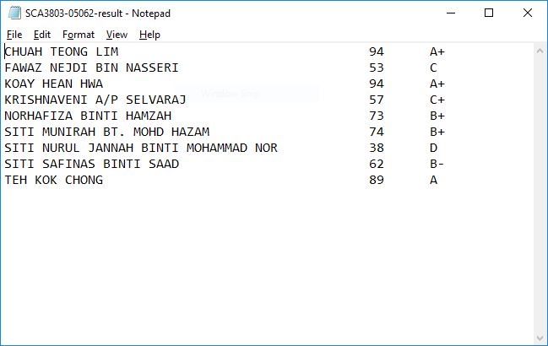
File Output

