Slide 1

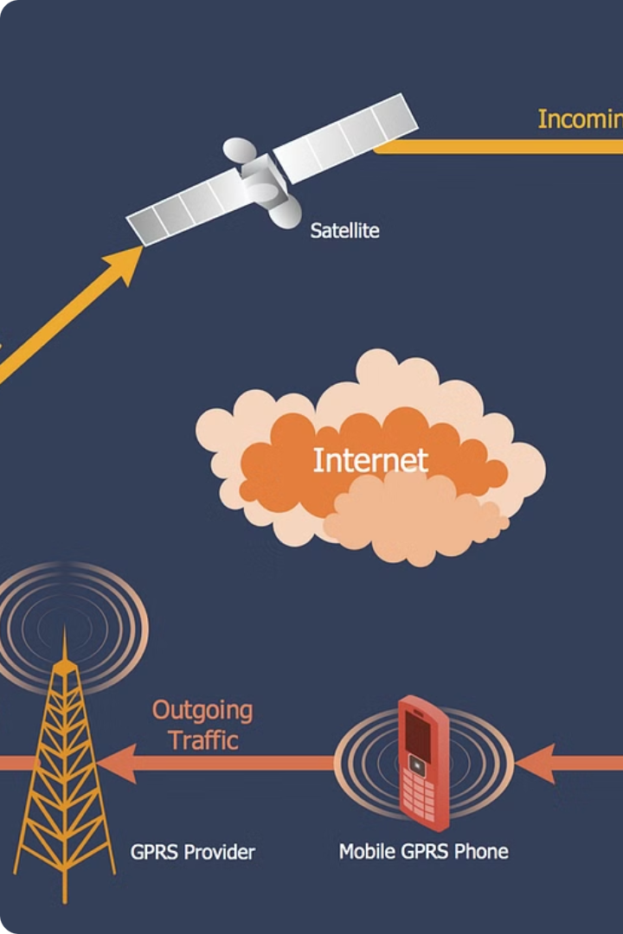
Telecom User Analysis: A Comprehensive Report
This presentation provides a comprehensive analysis of telecom user data, encompassing customer overview, user engagement, experience, and satisfaction. The analysis aims to provide valuable insights into user behavior, engagement patterns, and overall satisfaction levels. This information can be leveraged to optimize network resources, enhance user experience, and drive business growth.
by Geet Govind

Slide 2
User Overview Analysis
1
Understanding the Customer
2
Identifying Key Trends
The analysis begins with a comprehensive overview of user data, focusing on handset usage and application preferences.
The analysis aims to identify the top handsets, manufacturers, and applications used by customers, providing valuable insights into user preferences.
3
Data Exploration
4
Data Interpretation
Exploratory data analysis techniques are employed to identify missing values, outliers, and patterns in the data, ensuring data quality and accuracy.
The analysis provides a clear interpretation of the findings, highlighting key trends and patterns observed in the data.

Slide 3
Handset Usage Analysis
Top 10 Handsets
Top 3 Handset Manufacturers
Top 5 Handsets per Manufacturer
The analysis identifies the top 10 handsets used by customers, providing insights into popular device choices.
The analysis identifies the top 3 handset manufacturers, highlighting the dominant players in the market.
The analysis identifies the top 5 handsets for each of the top 3 manufacturers, providing a detailed understanding of popular models.

Slide 4

Customer Overview: Application Usage
1
Number of xDR Sessions
2
Session Duration
This metric represents the frequency of data sessions initiated by users, providing insights into overall data usage patterns.
The average duration of data sessions reveals user engagement levels and preferences for specific applications.
3
Total Download (DL) and Upload (UL) Data
4
Total Data Volume (Bytes)
This metric represents the overall data volume consumed during each session, providing a comprehensive view of user data usage.
Analyzing the total data volume downloaded and uploaded provides insights into user data consumption patterns and potential network resource requirements.

Slide 5
Univariate Analysis: Exploring Individual Variables
1
Variable Description
2
Basic Metrics
The analysis describes each variable and its associated data type, providing a clear understanding of the data structure.
The analysis calculates basic metrics such as mean, median, and standard deviation for each variable, providing insights into data distribution.
3
Dispersion Parameters
4
Graphical Analysis
The analysis computes dispersion parameters for each quantitative variable, providing insights into data variability and spread.
The analysis utilizes appropriate plotting options for each variable, visualizing data distribution and identifying potential outliers.

Slide 6
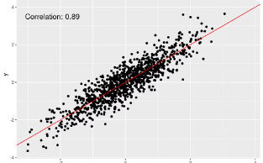
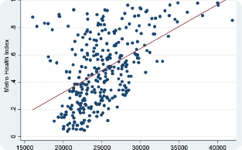
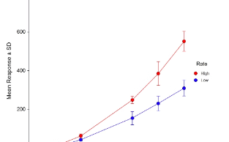
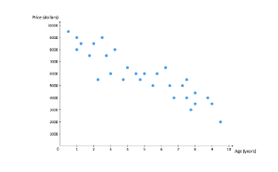
Bivariate Analysis: Exploring Relationships
Social Media vs. Total Data
Google vs. Total Data
Email vs. Total Data
YouTube vs. Total Data
The analysis explores the relationship between social media usage and total data consumption, identifying any potential correlations.
The analysis explores the relationship between Google usage and total data consumption, identifying any potential correlations.
The analysis explores the relationship between email usage and total data consumption, identifying any potential correlations.
The analysis explores the relationship between YouTube usage and total data consumption, identifying any potential correlations.

Slide 7
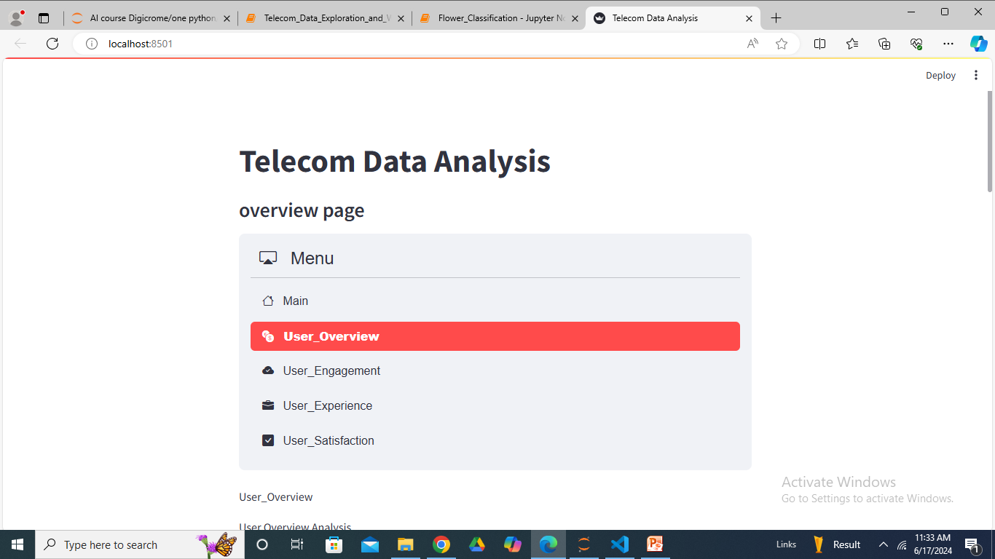
The screenshot of model deployment at Streamlit

Slide 8
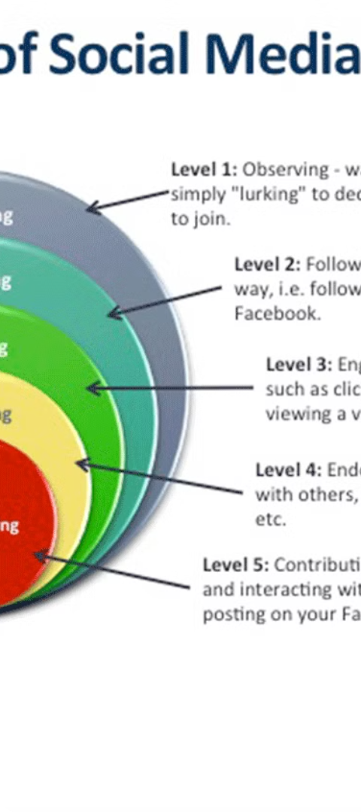
User Engagement Analysis
1
Session Frequency
The analysis tracks the frequency of user sessions, providing insights into user activity levels.
2
Session Duration
The analysis tracks the duration of user sessions, providing insights into user engagement levels.
3
Session Traffic
The analysis tracks the total data volume (download and upload) during user sessions, providing insights into data consumption patterns.

Slide 9



Customer Segmentation: Identifying Engagement Clusters
High Engagement
Medium Engagement
Low Engagement
Customers in this cluster exhibit high session frequency, long session durations, and significant data consumption.
Customers in this cluster exhibit moderate session frequency, moderate session durations, and moderate data consumption.
Customers in this cluster exhibit low session frequency, short session durations, and minimal data consumption.

Slide 10
Top Engaged Users: Identifying Key Contributors
1
Top 10 Engaged Users
2
Top Engaged Users per Application
The analysis identifies the top 10 users based on engagement metrics, highlighting the most active customers.
The analysis identifies the top 10 engaged users for each application, providing insights into application-specific engagement patterns.
3
Visualizing Engagement
The analysis utilizes appropriate charts to visualize engagement trends and patterns, providing a clear understanding of user behavior.

Slide 11

Understanding User Experience
User experience in the telecommunication industry is often tied to network performance and device characteristics. This analysis focuses on key network parameters like TCP retransmission, Round Trip Time (RTT), and throughput, along with handset type, to gain a comprehensive understanding of user experience.
TCP Retransmission
Round Trip Time (RTT)
Throughput
TCP retransmission occurs when data packets are lost or corrupted during transmission, requiring re-sending. High retransmission rates can indicate network congestion or instability, leading to poor user experience.
RTT measures the time it takes for a data packet to travel from the user's device to the server and back. A high RTT can result in delays and latency, impacting user interactions and application performance.
Throughput refers to the amount of data transferred per unit of time. Low throughput can lead to slow loading times and sluggish application performance, negatively impacting user satisfaction.

Slide 12
Analyzing User Experience Metrics
The analysis aims to understand the distribution and relationships between user experience metrics and handset types. This information can help identify potential areas for improvement and optimize network performance for different user segments.
1
Average TCP Retransmission
2
Average RTT
The average TCP retransmission rate per customer is calculated, providing insights into network stability and potential issues across different user groups.
The average RTT per customer is determined, highlighting potential latency issues and their impact on user experience across various handset types.
3
Average Throughput
4
Handset Type
The average throughput per customer is analyzed, revealing potential bottlenecks and variations in data transfer speeds across different user segments.
The handset type is considered as a key factor influencing user experience, allowing for targeted analysis and optimization strategies.

Slide 13
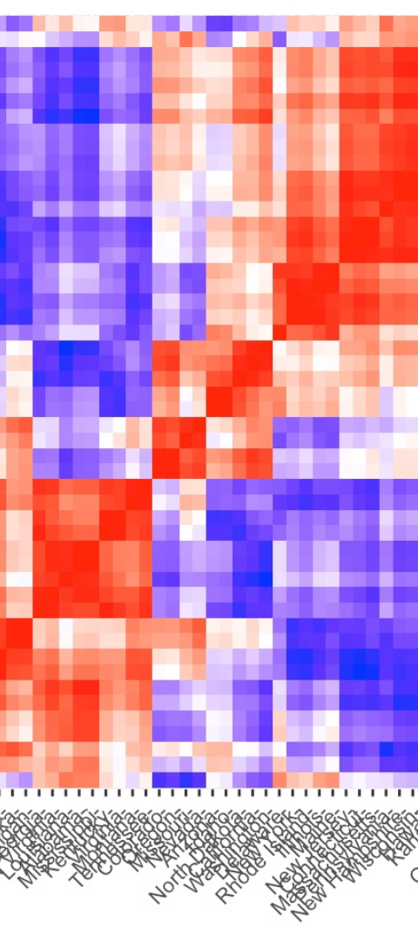
User Segmentation Based on Experience
To gain deeper insights into user experience, a k-means clustering algorithm is applied to segment users into distinct groups based on their experience metrics. This segmentation allows for targeted interventions and personalized service offerings.
Cluster 1
Cluster 2
This cluster represents users with generally positive experiences, characterized by low TCP retransmission rates, low RTT, and high throughput. These users are likely to have a smooth and efficient network experience.
This cluster encompasses users with moderate experiences, exhibiting average values for TCP retransmission, RTT, and throughput. These users may experience occasional network fluctuations or delays.
Cluster 3
This cluster comprises users with less favorable experiences, characterized by higher TCP retransmission rates, higher RTT, and lower throughput. These users are likely to encounter frequent network issues and slow performance.

Slide 14
User Engagement Analysis
User engagement is a crucial aspect of customer satisfaction, reflecting the level of interaction and activity users have with telecommunication services. This analysis explores user engagement patterns and their relationship with user experience.
1
Data Collection
User engagement data is collected from various sources, including call logs, data usage records, and app usage patterns.
2
Engagement Metrics
Key engagement metrics are defined, such as call duration, data consumption, app usage frequency, and social media activity.
3
Clustering Analysis
A k-means clustering algorithm is applied to segment users into groups based on their engagement levels, identifying distinct user engagement profiles.

Slide 15
Customer Satisfaction Analysis
Customer satisfaction is a key indicator of business success, reflecting the overall level of happiness and loyalty among users. This analysis explores the relationship between user engagement, user experience, and customer satisfaction.
Engagement Score
Experience Score
Satisfaction Score
Euclidean distance from the less engaged cluster
Euclidean distance from the worst experience cluster
Average of engagement and experience scores

Slide 16




Predicting Customer Satisfaction
A regression model is developed to predict customer satisfaction based on user engagement and experience metrics. This model can be used to identify potential satisfaction issues and proactively address them.
Model Selection
Model Training
Model Evaluation
A suitable regression model is chosen based on the characteristics of the data and the desired prediction accuracy.
The selected model is trained on historical data, allowing it to learn the relationships between user engagement, experience, and satisfaction.
The trained model is evaluated on unseen data to assess its performance and ensure its ability to accurately predict customer satisfaction.

Slide 17



Customer Segmentation Based on Satisfaction
A k-means clustering algorithm is applied to segment customers into groups based on their satisfaction scores. This segmentation allows for targeted marketing campaigns and personalized service offerings.
High Satisfaction
Moderate Satisfaction
Low Satisfaction
This cluster represents customers with high satisfaction scores, indicating a positive overall experience with the telecommunication services.
This cluster encompasses customers with moderate satisfaction scores, suggesting a mixed experience with some areas for improvement.
This cluster comprises customers with low satisfaction scores, highlighting potential issues and areas requiring immediate attention.

Slide 18
Recommendations for Growth
Based on the analysis, several recommendations can be made to enhance customer experience and drive growth. These recommendations focus on addressing key areas identified through the analysis.
1
Network Optimization
2
Targeted Marketing
Prioritize network optimization efforts to improve TCP retransmission rates, reduce RTT, and enhance throughput, particularly for users experiencing network issues.
Develop targeted marketing campaigns based on customer segmentation, tailoring messages and offers to specific user groups with different needs and preferences.
3
Customer Support Enhancement
4
Product Innovation
Enhance customer support channels and processes to address customer concerns promptly and effectively, improving overall satisfaction and loyalty.
Invest in product innovation to develop new services and features that meet evolving user needs and preferences, staying ahead of the competition.

Slide 19
Limitations and Future Directions
This analysis provides valuable insights into user experience and satisfaction, but it's important to acknowledge its limitations. Future research can explore additional factors influencing customer satisfaction and refine the analysis for greater accuracy and comprehensiveness.
Data Availability
Model Complexity
The analysis is based on available data, which may not capture all relevant factors influencing customer satisfaction. Expanding the data sources can enhance the analysis.
The regression model used in this analysis is a simplified representation of the complex relationships between user engagement, experience, and satisfaction. More sophisticated models can be explored.
External Factors
The analysis does not account for external factors that can influence customer satisfaction, such as economic conditions, competitive landscape, and regulatory changes.

Slide 20
Recommendations and Conclusion
Based on the analysis, the company has a strong foundation for growth. The data suggests that customers are highly engaged with various applications, indicating a potential for further expansion and revenue generation. The company should focus on enhancing customer experience, optimizing network resources, and developing targeted marketing campaigns to capitalize on the identified trends.

