Slide 1
Worldwide Alcohol Consumption
Presented by Aditya Kuckian, Geeta Dandamudi, Nancy Maksoud-Wallace, and Premashree Jadhav

Slide 2
Description of the data
Data used from sqlbelle.com: data was compiled by the WHO from 193 countries in 2010
Three main alcoholic beverages trends: wine, beer, spirits
The serving sizes were standardized to report how many glasses of wine, cans of beer (12 oz) and shots of spirits (1.5 oz)were consumed by each person in each country
Data doesn’t include abstainers.
* Spirits (or liquor) are unsweetened alcoholic drinks produced by distilling ethanol produced by means of fermenting grain, fruit, or vegetables. The alcohol content should be at least 20% ABV. Examples are Vodka and Tequila
* The term “spirits” do not include liquors such as Amaretto or Peach Schnapps as their alcohol content is less than 20% ABV

Slide 3
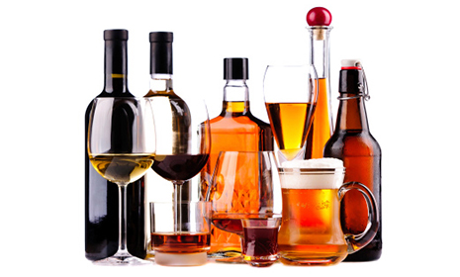
Who drinks the most what?
Beer: Namibia is the biggest beer consumer at 376 serving compared to Germany (who ranked fourth) at 346
Spirits: Grenada is the biggest consumer of spirits at 438. Belarus and Russia rank second and fourth respectively
Wine: France is the biggest consumer of wine at 370 per serving. The first eight biggest wine consumers are Europeans countries
Zero consumption: 11 countries reported null consumption of alcohol

Slide 4
Insights
Data conformed to some stereotypes:
France is the biggest wine consumer
Spirits is the most consumed alcoholic drink in Eastern Europe: Belarus, Russia, Bulgaria and Slovakia (other than Czech Republic who had the second highest beer consumption) ranked among the first ten consumers of spirits
Beer is the most consumed alcohol in the USA
8 of the 11 countries who reported non alcoholic consumption have an Islamic conservative regime
But had some unexpected results:
- Kingdom of Monaco has very low consumption of alcohol.

Slide 5
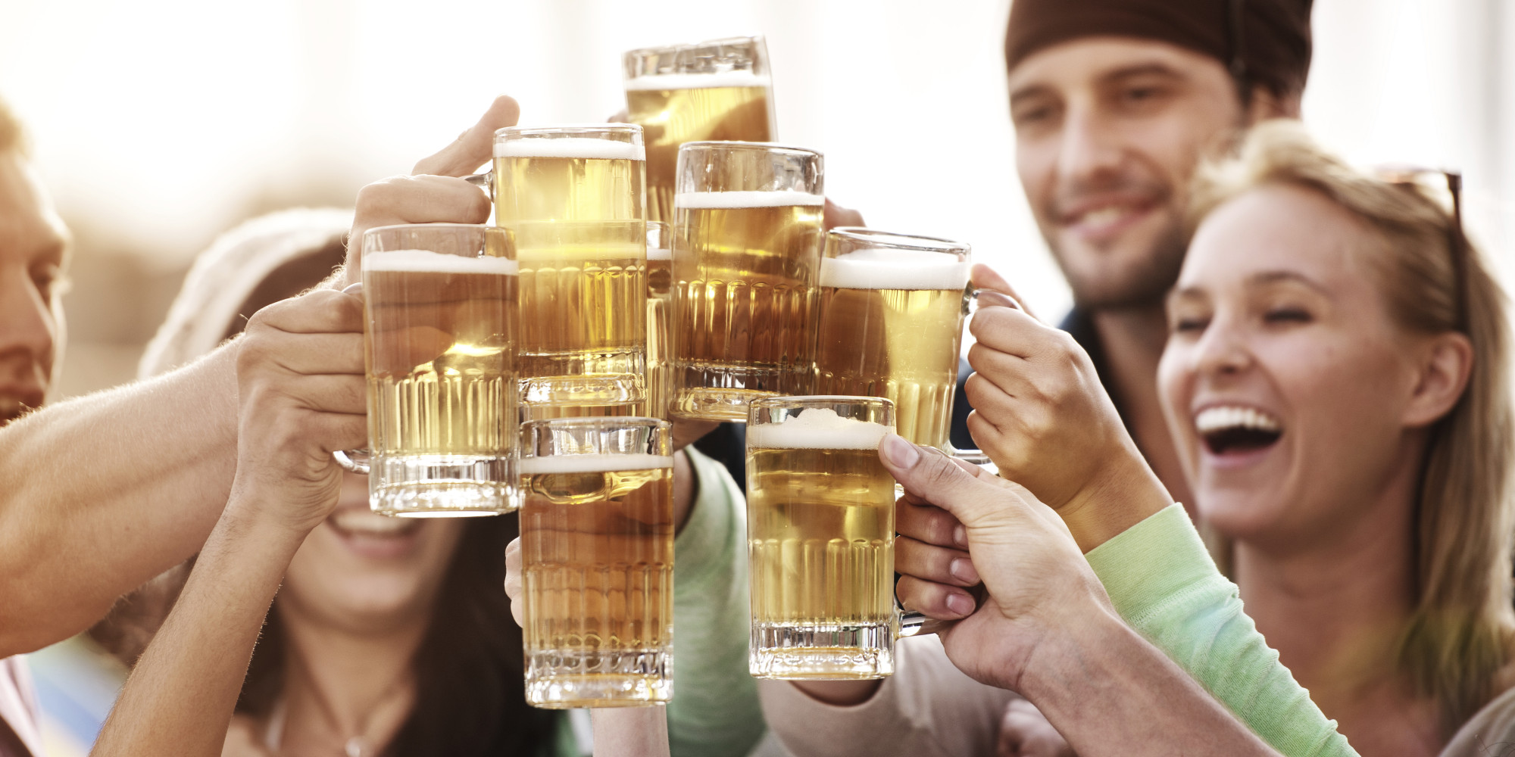
Conclusion
BEER is the most consumed alcoholic beverage in the world
Geography, history and culture play a role in what we drink
Tastes change overtime

