Slide 1
Customer Segmentation using K-means Clustering
~geeta dangal
Internship Project

Slide 2
Problem Statement and Dataset Overview.
Problem statement: Customers have different spending habits, and it is difficult to understand preferences when all customers are analyzed together. The objective of this project is to use machine learning, specifically K-means clustering, to divide customers into different groups based on age, annual income, and spending score.
Dataset source: Kaggle, Mall Customer Dataset. Features: customer ID (unique), age, annual income, spending score.

Slide 3
Data Understanding and Preprocessing.
Dataset inspection: Inspected the dataset to understand its structure and features. Checked for missing values and duplicate records. Identified potential outliers and checked for incorrect values.
Data preprocessing: Reviewed the dataset to ensure data quality. Selected relevant features for customer segmentation and prepared the data for K-means clustering.
Conclusion: The dataset was suitable for further analysis and machine learning implementation.

Slide 4
K-means Clustering Algorithm.
Content:
Applied the K-means clustering algorithm to the Mall Customer Dataset.
Selected relevant features such as Age, Annual Income, and Spending Score.
Grouped customers based on similarities in their characteristics and spending behaviour.
Assigned cluster labels to identify different customer groups.
Used the Elbow Method to help determine the optimal number of clusters.
Conclusion:
K-means clustering helped identify different customer segments based on their characteristics and spending patterns.

Slide 5
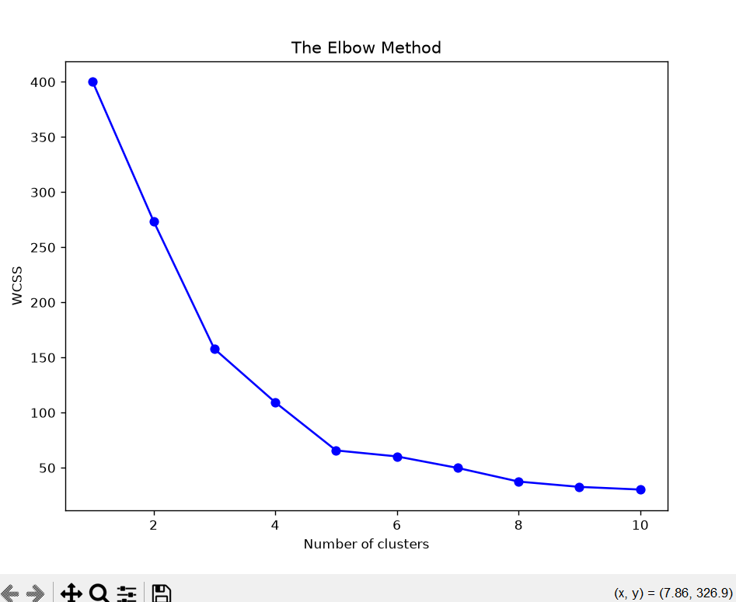
Customer Clusters Visualization
X-axis: Number of Clusters (K)
Y-axis: WCSS
Show K values from 1 to 10.
K = 5

Slide 6
Optimal Number of Clusters – Elbow Method
Applied the Elbow Method to determine the optimal number of clusters (K).
Tested different K values ranging from 1 to 10.
Calculated the Within-Cluster Sum of Squares (WCSS) for each K value.
Plotted the results using an Elbow Graph.
Selected the optimal K value by identifying the elbow point, where the reduction in WCSS starts slowing down.
Purpose: The Elbow Method helps determine the suitable number of clusters for effective customer segmentation.

Slide 7
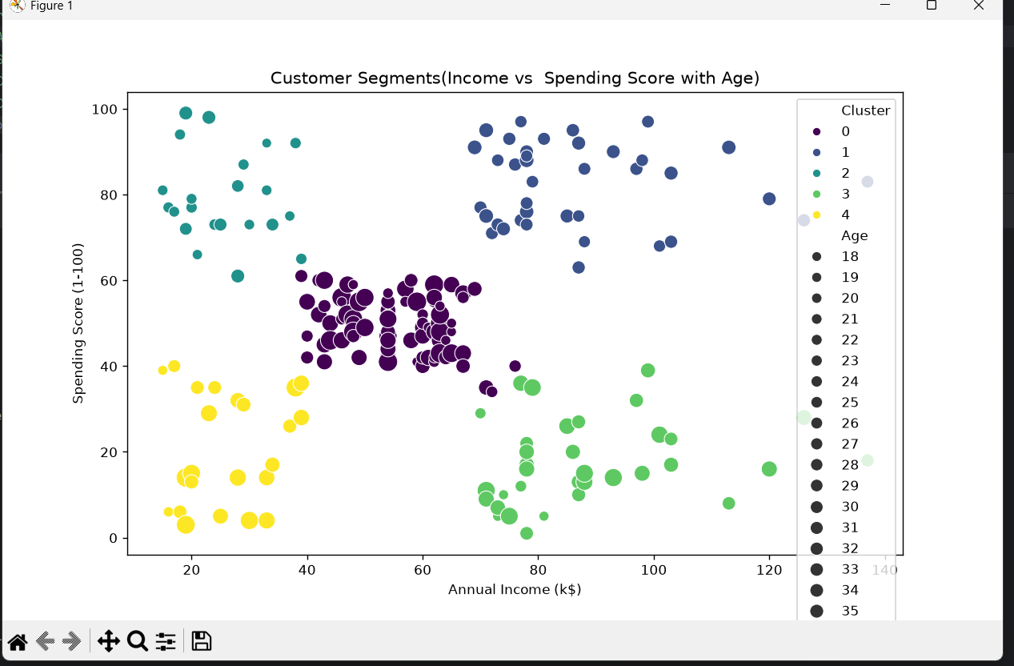
Customer Segmentation Results
Cluster | Customer segment
0 – Purple | Average Spenders
1 – Blue | High-Income High Spenders
2 – Teal | Low-Income High Spenders
3 – Green | High-Income Low Spenders
4 – Yellow | Low-Income Low Spenders

Slide 8
Customer Segmentation Results
The K-means clustering algorithm identified five different customer segments based on Annual Income, Spending Score, and Age.
Identified Customer Segments:
Cluster 0 – Average Spenders: Customers with moderate income and moderate spending scores.
Cluster 1 – High-Income High Spenders: Customers with high income and high spending scores.
Cluster 2 – Low-Income High Spenders: Customers with lower income but high spending scores.
Cluster 3 – High-Income Low Spenders: Customers with high income but relatively low spending scores.
Cluster 4 – Low-Income Low Spenders: Customers with lower income and low spending scores.
Key Finding:
The five clusters reveal different customer spending behaviours and income patterns.

Slide 9
Business Insights
Average Spenders: Offer loyalty rewards and personalized promotions to maintain customer engagement.
High-Income High Spenders: Introduce premium products and exclusive offers.
Low-Income High Spenders: Provide attractive discounts and value-for-money offers.
High-Income Low Spenders: Focus on understanding customer preferences and promoting products that match their interests.
Low-Income Low Spenders: Offer budget-friendly products and affordable deals.
Business Value:
Customer segmentation helps businesses understand customer behaviour, create targeted marketing strategies, improve customer engagement, and make better business decisions.

Slide 10
Conclusion
This project successfully applied K-means clustering to the Mall Customer Dataset to identify five different customer segments.
The Elbow Method was used to help determine the appropriate number of clusters.
The analysis revealed different customer patterns based on annual income, spending score, and age.
These insights can help businesses understand their customers, develop targeted marketing strategies, and improve customer satisfaction.
Overall, this project demonstrates how unsupervised machine learning can turn raw customer data into meaningful business insights.
~THANK YOU

