Slide 1
Gun Zombie
Project by
Geetanjali Agarwal(01)
Akansha Bathija (05)
Ashish Balani (04)

Slide 2
Networks
Collection of autonomous computers interconnected by a single technology is called a computer network
Two computers are said to be interconnected if they are able to exchange information
Connection can be through a copper wire, fiber optics, microwaves or satellite
An example is a local area network (LAN)

Slide 3
Local Area Network
A Local Area Network (LAN) is a collection of networking equipment located geographically close together.
Data transferred in high speed which ranges from 100 Mbps to gigabit for system development and have a low implementation cost.
Designed to share resources between PCs and workstation such as hardware or data
Usage: A work to internet connections would most likely require broadcast network (LAN) with a connection to the internet (Packet Switched Network)

Slide 4
Merits:
Cost reduction through sharing of information and databases , resources and network services
Increased information exchange between different departments in an organization or between individuals
The trend to automate communication and manufacturing process
Demerits:
Special security measures are needed to stop users from using programs and data that they should not have access to
Difficult to setup and need to be maintained by skilled technicians
If the file server develops a serious fault, all the users are affected

Slide 5
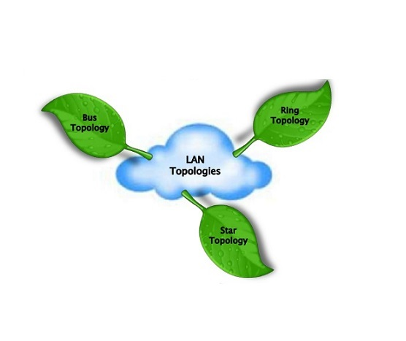
Lan Topologies

Slide 6
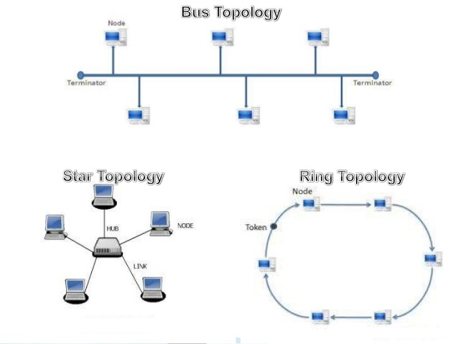

Slide 7
Bus Topology
In local area networks where bus topology is used, each node is connected to a single cable.
A signal from the source travels in both directions to all machines connected on the bus cable until it finds the intended recipient.
If the machine address does not match the intended address for the data, the machine ignores the data. Alternatively, if the data matches the machine address, the data is accepted.
Because the bus topology consists of only one wire, it is rather inexpensive to implement when compared to other topologies.
However, the low cost of implementing the technology is offset by the high cost of managing the network. Additionally, because only one cable is utilized, it can be the single point of failure.

Slide 8
Star Topology
Each network host is connected to a central hub with a point-to-point connection.
In Star topology every node (computer workstation or any other peripheral) is connected to a central node called hub or switch.
The star topology is considered the easiest topology to design and implement.
An advantage of the star topology is the simplicity of adding additional nodes.
The primary disadvantage of the star topology is that the hub represents a single point of failure.

Slide 9
Ring Topology
In a ring network, every device has exactly two neighbors for communication purposes.
All messages travel through a ring in the same direction (either "clockwise" or "counterclockwise").
A failure in any cable or device breaks the loop and can take down the entire network.
To implement a ring network, one typically uses FDDI, SONET, or Token Ring technology. Ring topologies are found in some office buildings or school campuses.

Slide 10
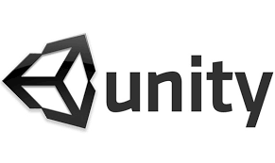

Slide 11
Introduction
Unity is a multi-platform, integrated IDE for scripting games and working with 3D virtual worlds including:
Game Engine- 3D objects/lighting/physics/animation/scripting
GUI system
3D object animation manager
The extension of a unity file is .unity. We can make games on unity for different platforms that include Android and OS

Slide 12
Unity Basics
1. Scene:
Scene is same as Hierarchy= same, just different views
Editable 3D game objects in current scene
2. Hierarchy:
Text list of game objects and sub-objects in the current scene
3. Inspector:
Properties for currently selected
4. Game:
Preview of how game will look when executing

Slide 13
Scripting
Unity implements a MONO compiler
Scripts can be written in:
JAVA script
Most introductory tutorials are written in Java script
C#
Very similar to Java, Unity can be integrated with the Microsoft Visual Studio Editor, get full benefits of code completion, source version control, etc

Slide 14
Networking In Unity
Networking is a very large detailed topic, bt in Unity it is extremely simple to create network functionality.
Unity makes extensive use of Network View components to share data over the network. One of the functions provided by it is Remote Procedure Calls or RPC
Maintenance:
1.State Synchronization is a method of regularly updating specific set of data across two or more game instances running across the network
2.Network instantiation can be used to handle this task
3.A master server can be used as a place to advertise a game system and allow people to join.

Slide 15
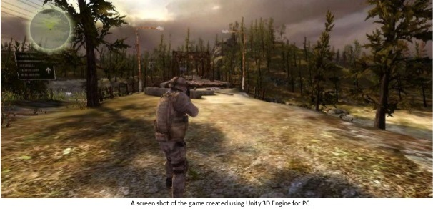
Graphics In Unity
As we can see in the above picture, the graphics are realistic. The shadow of tree is according to the sun and the rest of graphics is also giving a realistic view. Most of the games today are developed using Unity Engine.

Slide 16
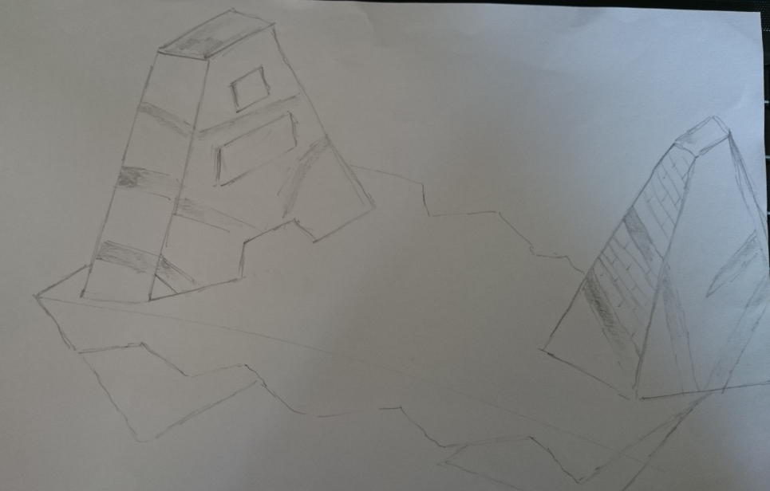
Designed Map

Slide 17
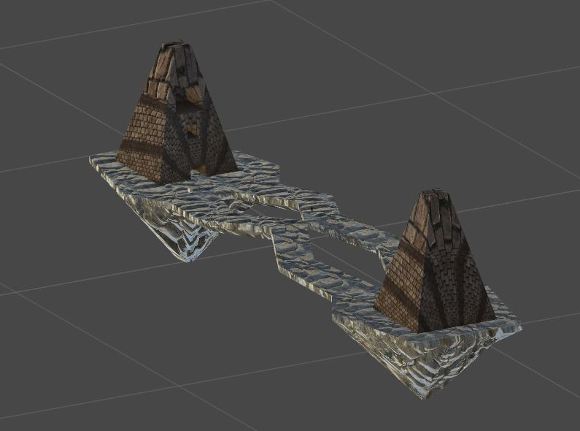
Screenshots
Map

Slide 18
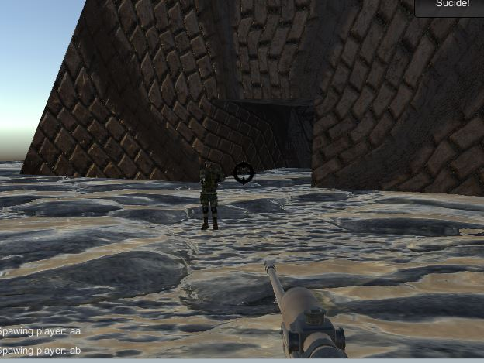
Gameplay

