Slide 1


Data visualization on web series using social media
TEAM MEMBERS
AVINASH GANGURI
AKHIL KANUGOLU
GEETANJALI MAKINENI
BHASHITHA SIDDAREDDY

Slide 2
MOTIVATION
The motivation behind doing this analysis is we are living in a world where data handling and data using plays one most important role in making the decisions for most of the industries like Banking, Financial, Telecom and Health and IT sector serving ones. The main factors would be for getting the insights would be like managing its sheer volumes of data and its insights. Using the Apache Spark is one of the best amazing kind frameworks which will be handling big data and its real time performance of these analysis.

Slide 3

Idea
Instead of collecting from different data sources, we chose a single social media platform – Twitter where we feel users reviews are authentic than predictable. So we can analyse the list of trending web series where people desired to watch.

Slide 4
WHO?
Helps the advertiser’s for pushing the advertisement and series makers for making quick analysis. Also helps binge watchers.

Slide 5
WHAT ?
To understand the trending and most popular series right now which have buzz on social media which helps to understand according to the perception of the people.

Slide 6
WHEN?
Due to Quarantine and Isolation most of the people are looking for entertainment back in their homes.

Slide 7
WHERE?
All over the world without any borders. (in the present 2020 situation)

Slide 8
WHY?
Because of mixed reviews of critics and reviewers as a third party, the review system is being compromised as a result we consider people thoughts as a prime factor.

Slide 9
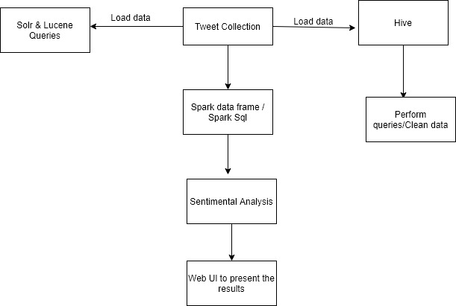
SIMPLE PROJECT FLOW

Slide 10
TOOLS & TECNOLOGIES
PYTHON
HIVE / SPARK
HADOOP
SQOOP
TEXTBLOB
FLASK & AWS

Slide 11
OBJECTIVE
The main objective of our project is doing the ETL process using the Spark’s Batch Processing and then Spark Integration using Web UI. The main source of our data is twitter and then collecting the data with Spark Batch Process. We can perform our transactions on the set of RDD’s and later we load our data in our Hive which is similarly equal to the ETL basic process.

Slide 12
SIGNIFICANCE
Due to Quarantine and Isolation most of the people are looking for entertainment back in their homes by watching series, and to suggest trending based on the peoples genuine interest.

Slide 13
FEATURES
The main feature of the project is to collect the tweets from the twitter steaming API, also by performing the ETL which means we preprocess the data and extract the necessary data and then we load this data in our HIVE. Next, we use TextBlob for predicting the sentiment for each of the mentioned tweet. Later, we feed the data into our HDFS and then we implement SQL and Hive queries. Sqoop is used for transferring data between SQL and HDFS.

Slide 14
APPLICATIONS
To draw out the collective results.
Understand most trending web series on social media.
Analyse positive and negative opinion of people on web series.

Slide 15
PHASE 1
Downloading data batch from twitter (Avinash, Geetanjali)
Implementation and Data preprocessing (Akhil, Bhashitha)

Slide 16
PHASE 2
HDFS, Hive imports with HUE visualizations.
Hive Queries
Spark Sql Queries, Data Frames, and visualizations.

Slide 17
PHASE 3
Sentimental Analyzation (TextBlob)
Solr Queries and Graph frames on the twitter data.
Hosting on a Web Application.

Slide 18
THANK YOU

