Slide 1
OpenJaw
Coding Challenge

Slide 2
Feature Engineering
METAR Data
Splitting Description Column.
Fetching Date and hour from UTC Date Time Column.
Arrivals and Departures
Same data present in departure data for arrival rows.
Creating target column for predicting cancel, delay and neither cancel nor delay flights.
Fetching Date and hour from departure and arrival scheduled time.

Slide 3
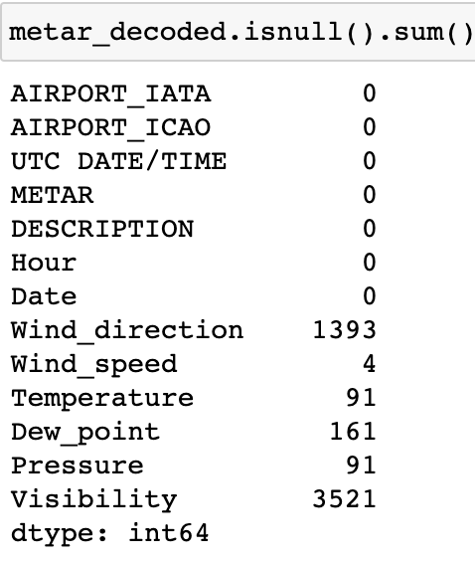
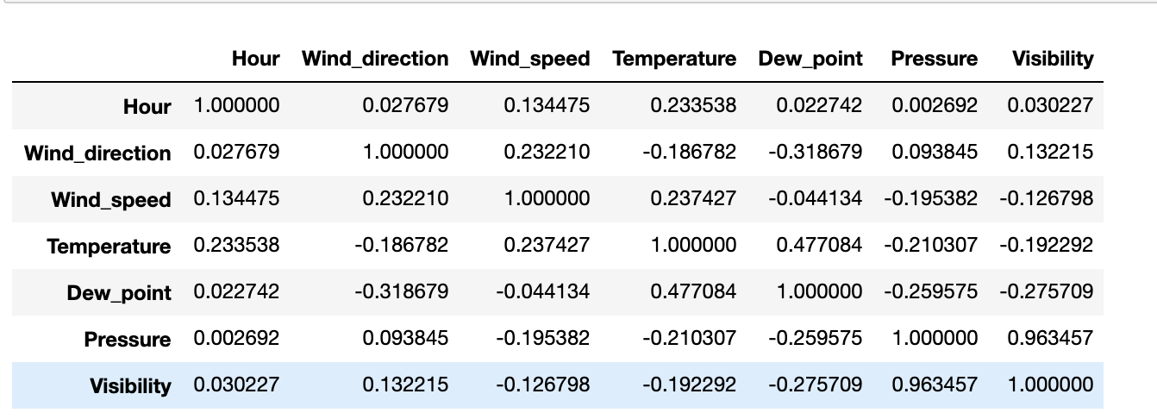
Exploratory Data Analysis - METAR
Pressure and Visibility are highly correlated. Also, Visibility column has high number of missing values. Therefore, dropping this column for further analysis.

Slide 4
Exploratory Data Analysis - METAR
Imputation of all missing columns.
1. Random Imputation
It will serve as parameters in regression models to estimate other variable values.
2. Stochastic Regression Imputation
Adding some normally distributed noise with a mean of zero and the variance equal to the standard error of regression estimates .

Slide 5
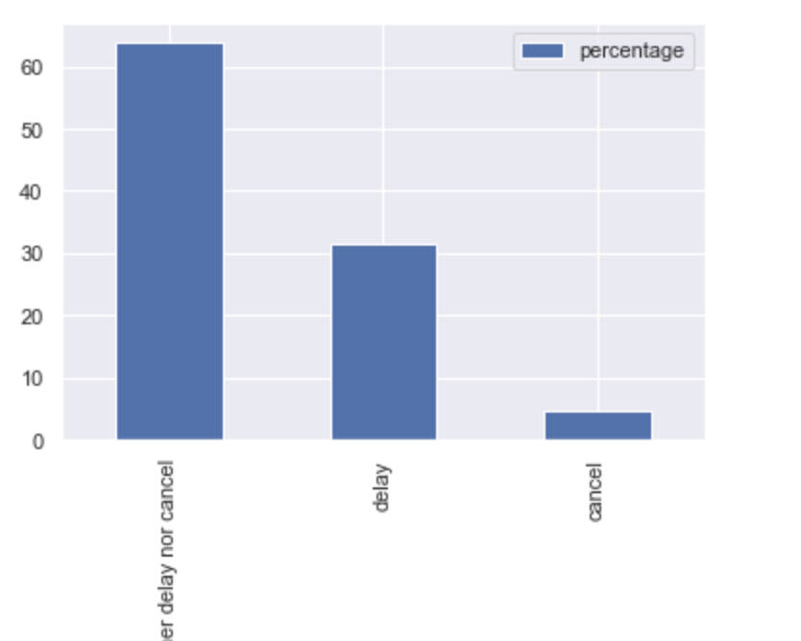
Flight Arrival Analysis
Delayed flights have an edge over canceled flights.

Slide 6
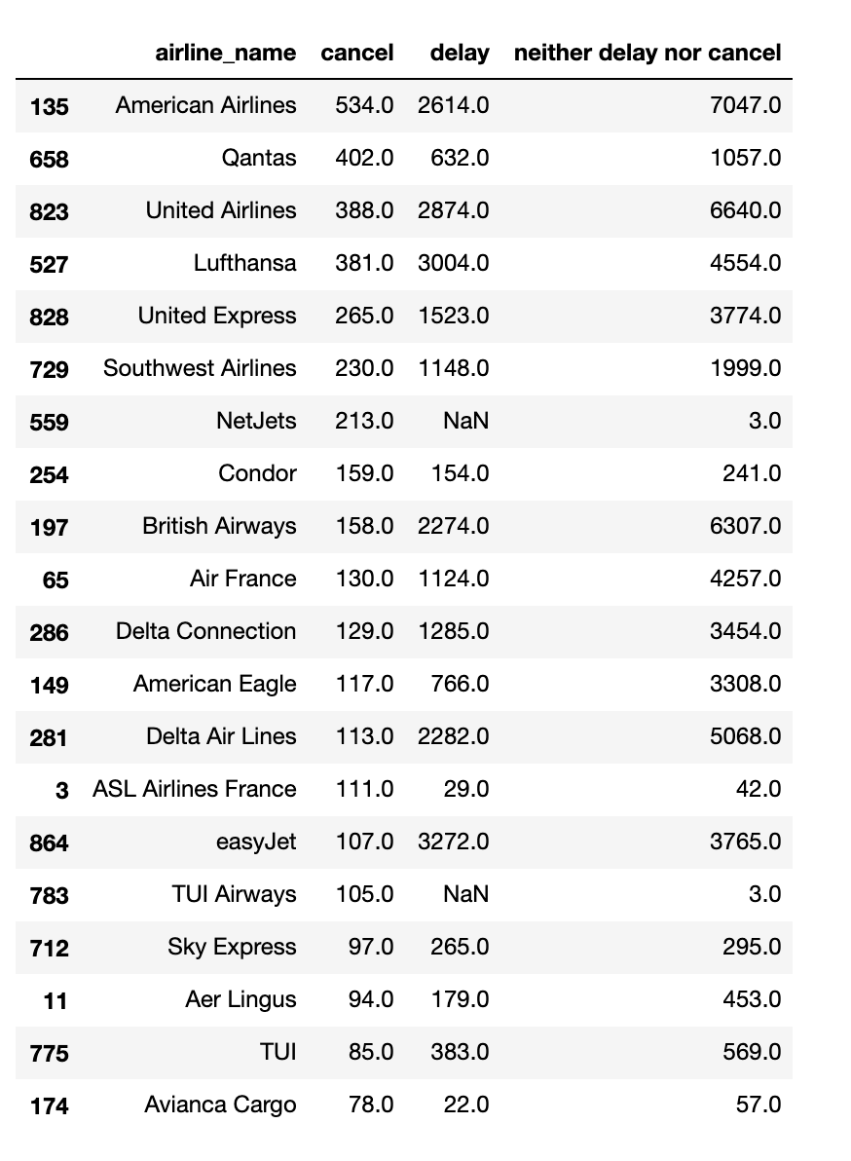
Flight Arrival Analysis
Top 20 airlines for canceled flights

Slide 7
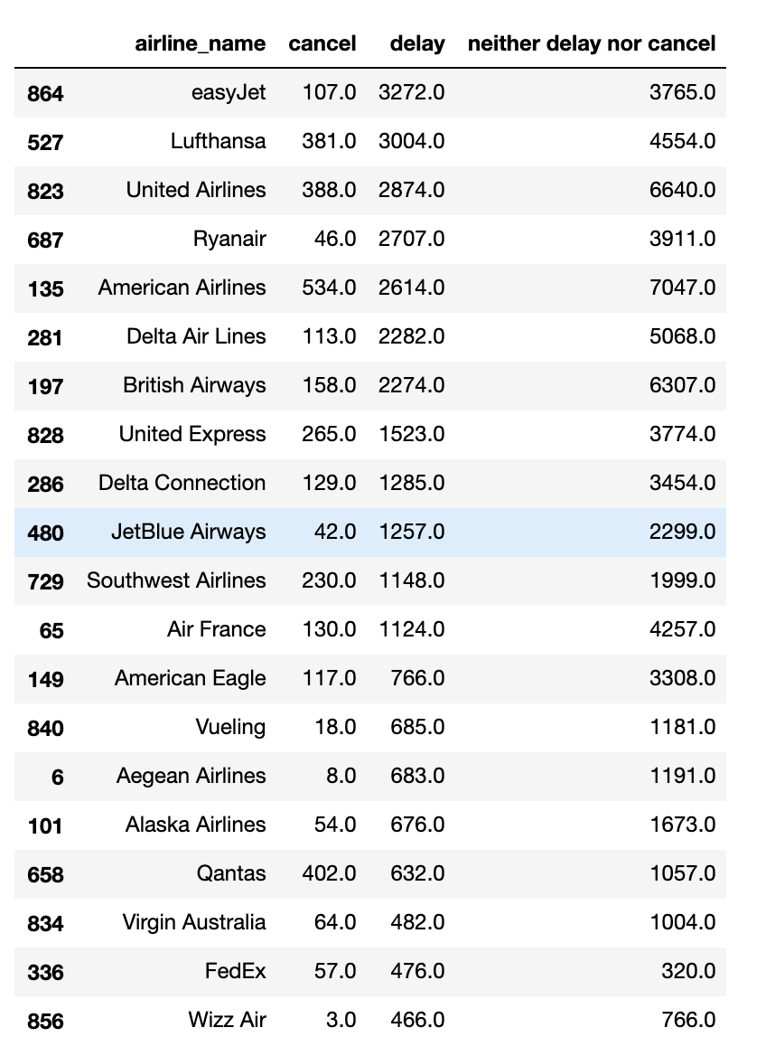
Flight Arrival Analysis
Top 20 airlines for delayed flights

Slide 8
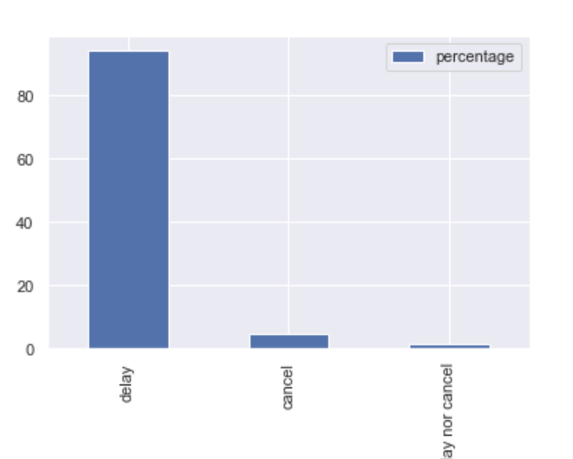
Flight Departure Analysis
Delayed flights have an edge over canceled flights.

Slide 9
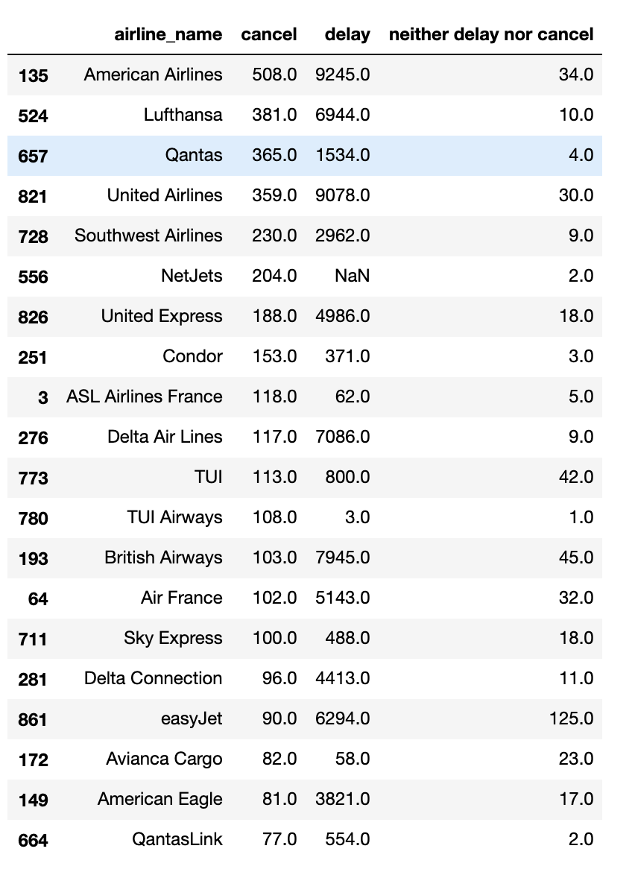
Flight Departure Analysis
Top 20 airlines for canceled flights

Slide 10
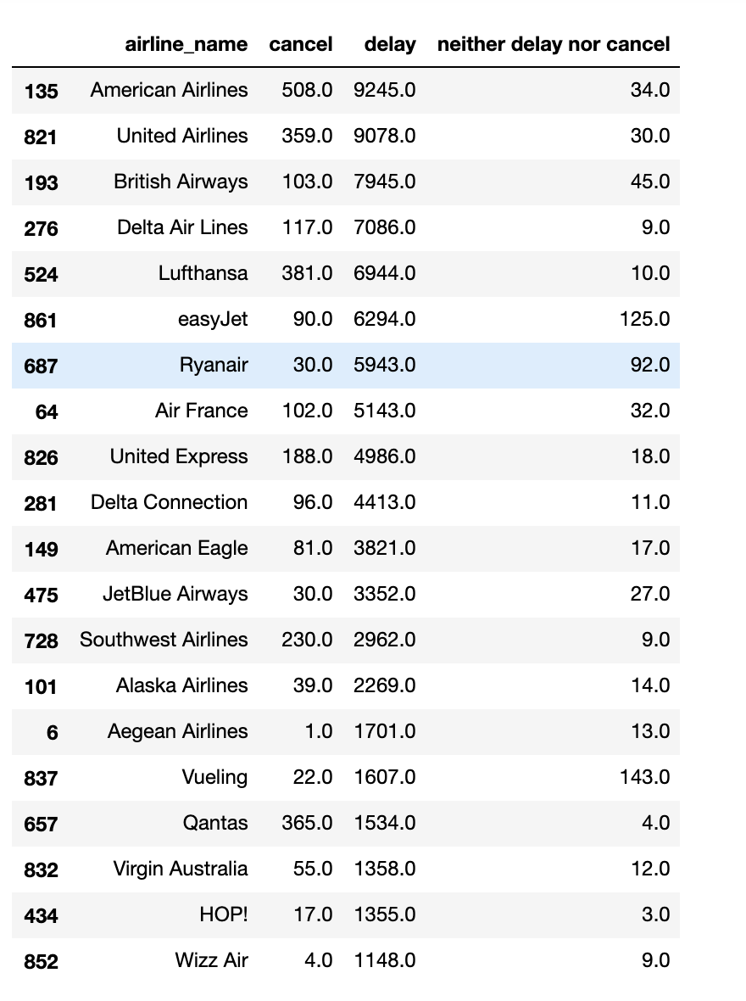
Flight Departure Analysis
Top 20 airlines for delayed flights

Slide 11

Data Modelling
Merging METAR and arrival/departure data.
Label encoding of categorical columns.
Multilabel Classification using Random Forest. Data has combination of numerical and categorical columns
Feature Scaling.
Hyper parameter optimization using Random Search CV.
For evaluation, accuracy and F1 score both are used. F1 score is useful as classes are imbalanced. For averaging purpose, I am using 'weighted' which compute a weighted macro-average, in which each class contribution to the average is weighted by the relative number of examples available for it.

Slide 12
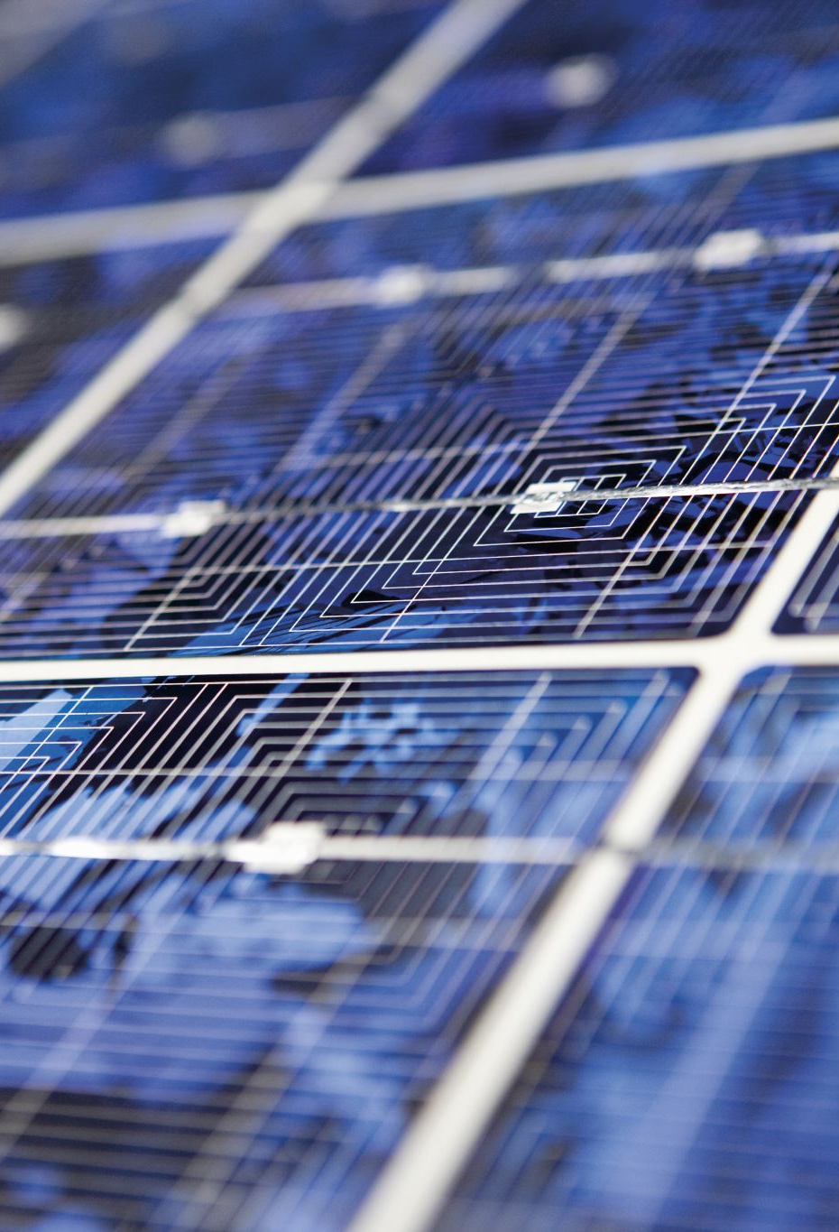
Further Improvements
Data balancing.
More Feature Analysis.
Using other ML algorithms like XGBoost.
Improving Accuracy.
Predicting time for delays.
Analysis of individual airports.
Finding patterns between arrivals and departures.

Slide 13

Questions

