Slide 1
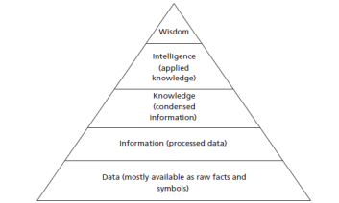
The Knowledge Pyramid

Slide 2
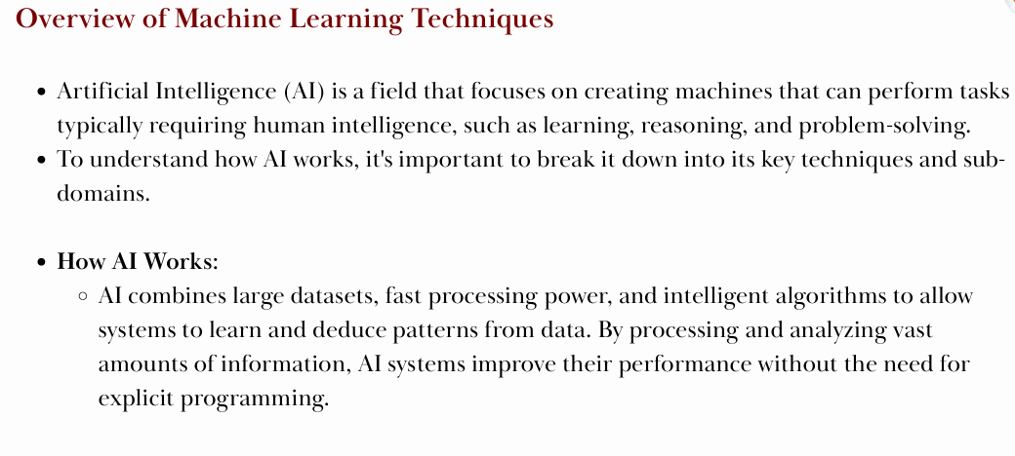

Slide 3
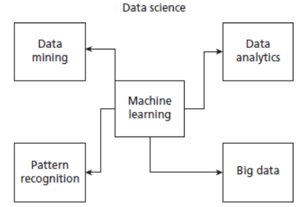
Relationship of Machine Learning with Other Major Fields

Slide 4
Machine learning:
How It’s Different from Human Instructions:
Human Instructions:
Humans write specific rules to perform tasks (e.g., write code for a program).
Machine Learning:
Machines learn by themselves from data, without explicit rules. They improve as they process more data.
Example in Action:
Problem: Classifying emails as "spam" or "not spam."
Without ML: Humans write specific rules (e.g., "If email contains 'buy now', mark as spam").
With ML: The machine analyzes data of past emails and learns to identify patterns like words, subject lines, or email addresses that are likely to be spam. It improves over time as it processes more emails.

Slide 5
Machine learning:
How Machine Learning Works:
  Learning from Data:
ML algorithms analyze large sets of data to find patterns.
For example, an ML algorithm might look at thousands of images of cats and dogs, and learn to recognize the differences between them.
  No Human Instructions Needed:
Instead of writing step-by-step rules for the machine, ML learns automatically from the data.
Example: If you want the machine to recognize a cat, you don’t need to tell it exactly what a cat looks like. Instead, you feed it data of cats and dogs, and the machine learns from the examples.
  Improvement Over Time:
The machine improves by analyzing its errors and correcting them automatically.
Example: If it wrongly identifies a dog as a cat, it adjusts and tries again, getting better each time.
  Making Better Decisions:
ML saves time and effort because it automates decision-making. It can analyze data and make decisions more accurately than humans.
Example: In healthcare, ML can analyze medical data and predict diseases faster than doctors.

Slide 6
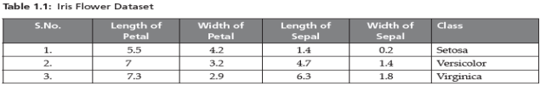
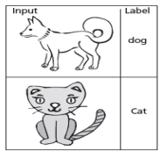

Labelled Data
Labelled Data
Unlabeled Data

Slide 7
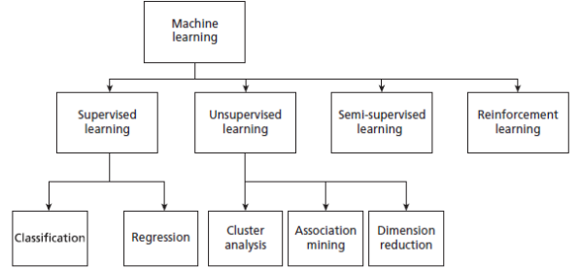
Type of Machine Learning

Slide 8
Machine Learning Model - Supervised Machine Learning Algorithms
Supervised Machine Learning is a type of learning where the machine learns from labeled data.
Think of it like a student learning from a teacher who provides both the questions (inputs) and the correct answers (outputs).
How It Works:
Learning from Past Data:
The algorithm is trained on labeled examples, where both the input and output are provided.
The machine learns the relationship between the inputs (X) and the outputs (Y).
Example: If we have a basket of fruits with labels (apple, banana, orange), the machine learns to associate features (like color, shape, size) of fruits with their labels.
Mapping Function (Y = f(X)):
The relationship between input (X) and output (Y) can be expressed as a function, like Y = f(X), where the machine learns to map inputs to outputs.
After learning from the data, it can predict the output for new, unseen data.
Example: If the input is a fruit with color = red, shape = round, the model predicts that it’s an apple.

Slide 9
Machine Learning Model - Supervised Machine Learning Algorithms
Supervised Learning Example:
Imagine you have a basket filled with apples, bananas, and oranges. You want to teach a machine to identify them based on certain features like color, size, and shape.
Step 1: Train the model using labeled data.
Input: Fruit features (e.g., color, shape, size). Output: Correct labels (apple, banana,orange).
Step 2: The machine learns to map the input features to the correct fruit labels
(mapping function: Y =f(X)).
Step 3: Now, if you give the machine a fruit with unknown features (e.g., color =yellow, shape = elongated), it will predict that it’s a banana.

Slide 10
Machine Learning Model - Supervised Machine Learning Algorithms
Categories of Supervised Learning:
Supervised learning can be classified into two main types: 1. Classification:
When the output is a category or label.
Example: Identifying whether an email is spam or not spam.
2. Regression:
When the output is a continuous value.
Example: Predicting the price of a house based on its size, location, and features.

Slide 11
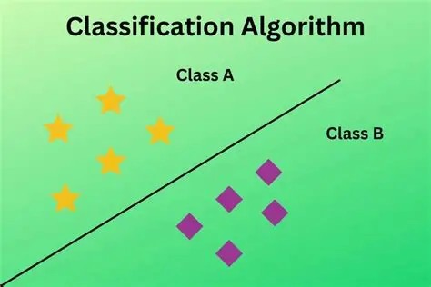
Machine Learning Model - Supervised Machine Learning Algorithms
1. Classification Algorithm
Its a type of machine learning algorithm that classifies or categorizes data into specific groups or categories. It helps the machine predict which category a new piece of data belongs to based on patterns learned during training.
How Classification Works:
Training Phase:
  During the training phase, the model is given labeled data, meaning each piece of data already has a known category (label).
  Example: If you have a dataset of fruits with labels like apple and banana, the algorithm learns the features (color, size, shape) of each fruit and associates them with the correct label.
Prediction:
After learning from the data, the model can predict the category (class) for new, unseen data based on the patterns it has learned.
Example: When given a new fruit (e.g., color = red, shape = round), the model predicts that it’s an apple.

Slide 12
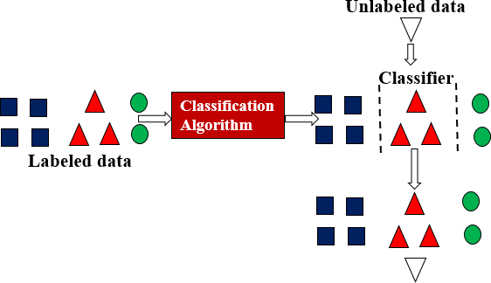
Module 3: Types of Machine Learning
Machine Learning Model - Supervised Machine Learning Algorithms
1. Classification Algorithm

Slide 13
Machine Learning Model - Supervised Machine Learning Algorithms
Classification Techniques
Classification Models can be categorized based on implementation technology like decision trees, probabilistic methods, distance measures and soft computing methods.
Some Key algorithms of Classification are
Decision Tree : Splits data based on feature values
Random Forest : Ensemble of decision trees
K-Nearest Neighbors (KNN): Classifies based on nearest neighbors
Support Vector Machines(SVM): Finds a hyperplane to separate classes
Naïve Bayes:Uses probabilities for classification
Logistic Regression: Used for binary classification

Slide 14
Machine Learning Model - Supervised Machine Learning Algorithms
Classification Algorithm
Applications of Classification Algorithms:
  Medical Imaging:
Example: Predicting whether an X-ray image shows a benign or cancerous tumor.
  Speech Recognition:
Example: Classifying spoken words into specific commands like "turn on" or "turn off".
  Handwriting Recognition:
Example: Identifying handwritten characters and classifying them as A, B, or C.
  Credit Scoring:
Example: Classifying loan applicants into groups like high risk or low risk based on their financial data.
  Email Classification:
Example: Predicting whether an incoming email is spam or not spam based on previous examples.

Slide 15
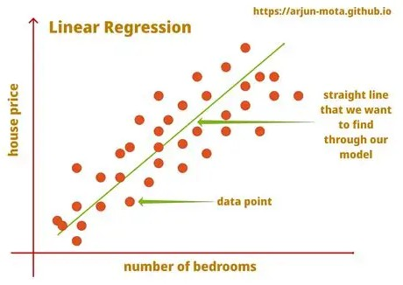
Machine Learning Model - Supervised Machine Learning Algorithms
2. Regression Algorithm
A Regression Algorithm is used in machine learning to predict a real value (a continuous number) based on the data it has learned from.
Unlike classification algorithms, which predict discrete categories, regression algorithms predict continuous values.
How Regression Works:
Training Phase:
  During training, the algorithm is provided with labeled data that includes input variables (features) and their corresponding real values (output).
Example: You have data on house features (size, location, number of rooms) and their prices.
The model learns the relationship between these features and the price.
Prediction:
  After learning, the model can predict the real value (continuous output) for new, unseen data.
Example: Given the size, location, and number of rooms of a new house, the model can predict its price.

Slide 16
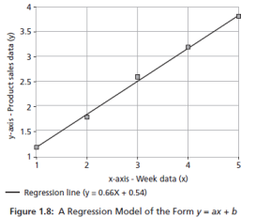
Machine Learning Model - Supervised Machine Learning Algorithms
2. Regression Algorithm
Regression Models takes input x and generates a model in form of fitted line of the form y=f(x)
x is independent variable that may be one or more attributes
y is the dependent variable.
Example: Regression Line : Product sales=0.66 X Week + 0.54
Here 0.66 and 0.54 are regression coefficients that are learnt f rom the data
Advantage of this model is that prediction of product sales(y) can be made for unknown week data(x).
Ex: Product sales(y) can be predicted for the unknow week 8, substituting x as 8 in regression formula to get y.

Slide 17
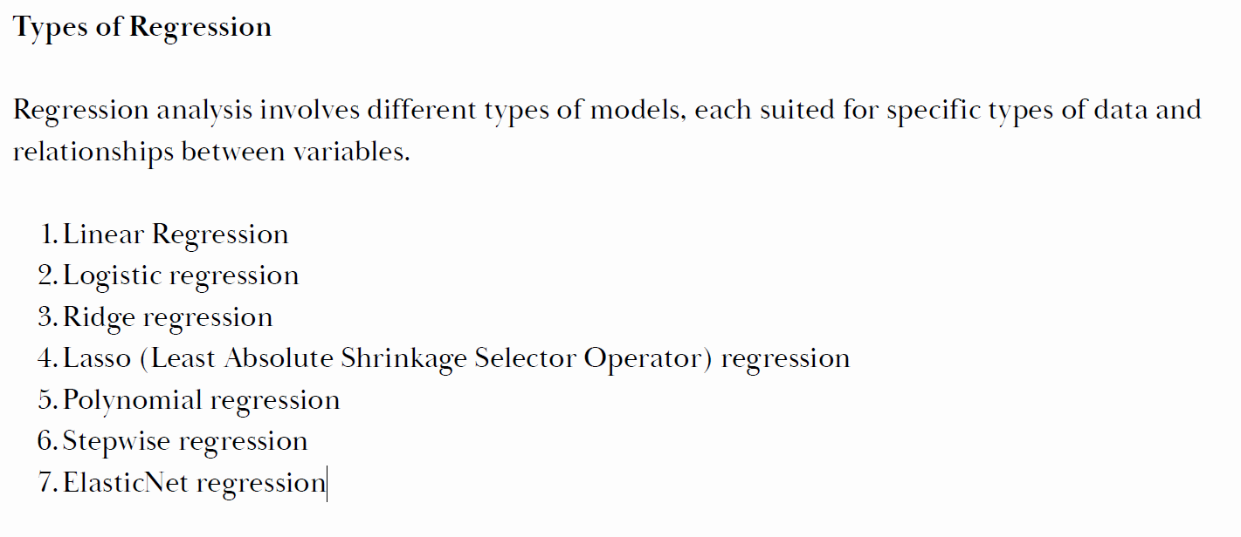
Machine Learning Model - Supervised Machine Learning Algorithms
Regression Analysis

Slide 18
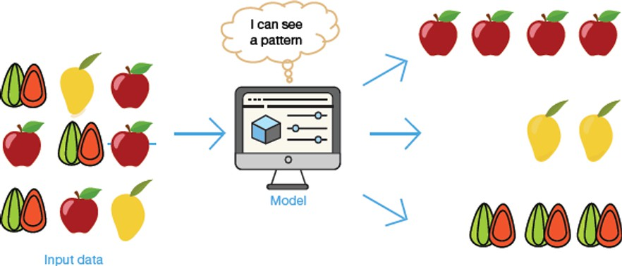
Machine Learning Model : Un-Supervised Machine Learning Algorithms
Unsupervised Learning is a type of machine learning where the model is trained using data that is neither labeled nor classified. This means the machine doesn’t have any predefined answers to learn from and must discover patterns or relationships in the data on its own.

Slide 19
Machine Learning Model : Un-Supervised Machine Learning Algorithms
How Unsupervised Learning Works:
No Labeled Data:
In unsupervised learning, there is no guidance or labels provided to the machine. It only has the data and must find patterns or groupings within it.
Example: If we give the machine images of fruits (like mangoes and oranges) without labels, it doesn't know what a mango or orange is. It must figure out how to group the fruits based on similarities like color, shape, or texture.
Finding Patterns and Grouping:
The machine looks for patterns, similarities, and differences in the data and creates groups or clusters.
Example: The machine might notice that all mangoes are yellow and oranges are orange, so it will group the images into two clusters based on color and shape.

Slide 20
Machine Learning Model : Un-Supervised Machine Learning Algorithms
Unsupervised Learning in Action:
Example: Clustering Fruits:
Imagine the machine receives pictures of mangoes and oranges, but it has no idea what fruits these are.
The model will analyze the features of the images (like color, shape, texture→ patterns) and group similar images together.
Result: It will create two clusters—one for mangoes and one for oranges—but it won’t label them as "mango" or "orange." The machine simply groups similar items together.
Example: In a dataset of customer behaviors, unsupervised learning could identify patterns and group customers with similar shopping habits, even if no labels (like “high spender” or “low spender”) are given.

Slide 21
Machine Learning Model : Un-Supervised Machine Learning Algorithms
What Unsupervised Learning Cannot Do: No Labels
Unlike supervised learning, unsupervised learning does not provide labels or categories. It can only group data based on patterns or similarities.
Example: The machine can group mangoes and oranges, but cannot label them as such. It just knows these items belong together in one group.
Applications of Unsupervised Learning:
  Customer Segmentation:
  Unsupervised learning can help businesses group customers with similar purchasing behaviors for targeted marketing campaigns.
  Image Segmentation:
  It can be used in image processing to automatically group pixels that form certain objects or regions in an image.
  Anomaly Detection:
  It helps detect outliers or unusual data points in a dataset, which can be useful for fraud detection or network security.

Slide 22
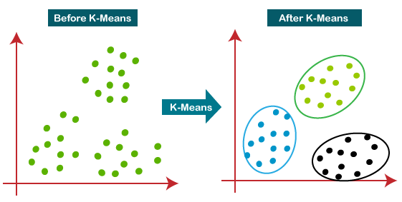
Machine Learning Model : Un-Supervised Machine Learning Algorithms
1. Clustering
Clustering is a technique in unsupervised machine learning where the goal is to group similar data points together into clusters. This technique helps to discover hidden patterns or inherent groupings in the data, which might not be obvious at first glance.

Slide 23
Machine Learning Model : Un-Supervised Machine Learning Algorithms
Clustering
How Clustering Works:
Grouping Data Based on Similarities:
The main idea of clustering is to group data points that are similar to each other.
Each group is called a cluster, and the goal is for data within the same cluster to be similar while data in different clusters is distinct or different.
Example: In a dataset of customer purchases, clustering might group customers who buy similar
products into the same cluster. One cluster might include people who buy tech gadgets, while another might include people who buy home appliances.
2. Finding Patterns in Data:
Clustering identifies patterns or relationships in the data by grouping similar points together. Example:
A cell phone company can use clustering to find where most of its customers live and use that information to decide the best locations to build new cell phone towers.
Some of the Key Clustering Algorithms are
K-means algorithm
Hierarchical algorithm

Slide 24
Machine Learning Model : Un-Supervised Machine Learning Algorithms
Clustering
Real-World Applications of Clustering:
Customer Segmentation:
Companies can use clustering to group customers based on purchasing behavior, allowing them to target marketing campaigns to specific groups.
Example: A retail store can identify one cluster of customers who frequently buy sportswear, while another cluster may buy formal clothing.
  Location-based Decisions (e.g., Cell Tower Placement):
Companies can use clustering to find the best locations for services like cell towers, based on where the most people are located.
Example: A mobile company could use clustering to identify cities with the highest customer density, helping them plan where to build more towers.
  Gene Sequence Analysis:
In biology, clustering is used to group similar gene sequences, helping researchers to understand genetic relationships and identify specific patterns.
Example: Researchers can analyze gene data to identify groups of genes that behave similarly across different species.

Slide 25
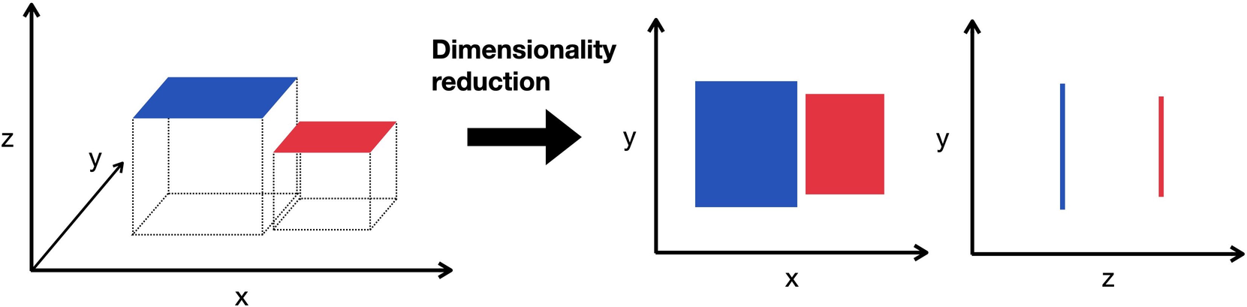
Machine Learning Model : Un-Supervised Machine Learning Algorithms
2. Dimensionality reduction
Dimensionality Reduction is a technique used to simplify a dataset by reducing the number of features (variables) without losing important information(or generality).
It takes a higher dimension data as input and outputs the data in lower dimension by taking advantage of the variance of the data.

Slide 26
Machine Learning Model : Un-Supervised Machine Learning Algorithms
2.Dimensionality reduction
Why is Dimensionality Reduction Important?
  Simplifies Data:
When datasets have too many features (variables), it can be overwhelming and computationally expensive to work with them.
Dimensionality reduction reduces the number of features, making the dataset more manageable.
  Reduces Complexity:
Fewer features make models easier to train, faster to process, and often lead to better performance.
Reducing features also helps to avoid problems like overfitting, where a model is too complex and doesn’t generalize well to new data.
  Improves Visualization:
With too many features, it's hard to visualize the data.
Dimensionality reduction makes it easier to visualize the dataset in 2D or 3D.

Slide 27
Machine Learning Model : Semi-Supervised Machine Learning Algorithms
Semi-Supervised Learning is a type of machine learning that combines the strengths of supervised and unsupervised learning. It uses both labeled data and unlabeled data to train the machine.
This approach helps to improve the accuracy of the model while requiring less labeled data than supervised learning alone.
How Semi-Supervised Learning Works: (Uses Labeled and Unlabeled Data)
The algorithm is provided with a small amount of labeled data (where the answers are known) and a large amount of unlabeled data (where the answers are unknown) but by assigning a pseudo-label for unlabeled data.
The algorithm learns from both the labeled and the unlabeled data to improve its predictions.
Two Approaches to Semi-Supervised Learning:
Supervised Model + Unsupervised Model Approach
Unsupervised Clustering + Annotation Approach

Slide 28
Machine Learning Model : Semi-Supervised Machine Learning Algorithms
Two Approaches to Semi-Supervised Learning:
1. Supervised Model + Unsupervised Model Approach:
Step 1: Start by building a supervised model using a small amount of labeled data.
Step 2: Apply the trained model to a large amount of unlabeled data to generate predictions.
Step 3: Use the predicted labels from the unlabeled data to add more labeled data.
Step 4: Iterate this process multiple times to improve the model's accuracy by generating more labeled data from the initial small set.
Example:
If you have a small dataset of labeled images (e.g., some images labeled as "cat" or "dog"), the model is first trained using these images.
Then, it can predict labels for a large set of unlabeled images,
and you can use the predicted labels to expand your training data.

Slide 29
Machine Learning Model : Semi-Supervised Machine Learning Algorithms
Two Approaches to Semi-Supervised Learning:
2. Unsupervised Clustering + Annotation Approach:
Step 1: Use unsupervised learning techniques to group similar unlabeled data into clusters.
Step 2: Annotate or label these clusters based on patterns observed.
Step 3: Use the labeled clusters to train the model.
Example:
In a set of unlabeled customer data, you can cluster customers with similar purchasing habits.
Then, based on the cluster characteristics, you can assign labels to these groups
and use that information to train the model.

Slide 30
Machine Learning Model : Reinforcement Learning (RL)
Reinforcement Learning (RL) is a type of machine learning where an agent learns
how to make decisions by interacting with an environment.
Unlike supervised learning, where the model is trained on labeled data, RL involves an agent that learns by trial and error, with the goal of maximizing rewards and minimizing penalties.

Slide 31
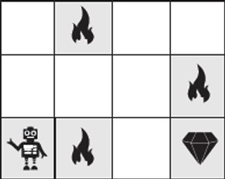
Machine Learning Model : Reinforcement Learning (RL)
How Reinforcement Learning Works:
Agent-Environment Interaction:
An agent interacts with its environment by taking actions (decisions) and receiving feedback in the form of rewards or penalties.
Example: In a game scenario, the agent might be a robot and the environment is the game world.
Rewards and Penalties:
Rewards are given for performing correct actions, while penalties are given for incorrect actions.
The agent’s goal is to maximize its total reward over time by learning from experience.
Example: If a robot picks the right path in the game (avoiding fire), it earns a reward (like a diamond). If it chooses the wrong path (touches fire), it loses some reward.
Trial and Error:
The agent starts with no knowledge and learns by trying different actions, observing the results, and adjusting its strategy.
Over time, the agent learns which actions lead to the highest rewards and which actions lead to penalties.

Slide 32
Machine Learning Model : Reinforcement Learning (RL)

Slide 33
Machine Learning Model : Reinforcement Learning (RL)
Key Features of Reinforcement Learning:
Input (State):
The initial state from which the agent begins its learning.
Example: In the game, the starting point of the robot is the initial state.
Output (Action):
The action the agent can take in response to the current state.
Example: The robot can choose to move forward, turn left, or turn right based on the environment.
Training Process (Learning from Experience):
The agent learns by interacting with the environment and getting feedback.
It keeps adjusting its actions based on whether it receives a reward or penalty.
Example: If the robot’s action leads to a reward, it will try to repeat that action next time; if it leads to a penalty, it will try to avoid it.
Maximizing Reward:
The agent’s goal is to maximize its total reward over time, finding the best path to reach the final goal.
Example: The robot tries to find the best path to reach the diamond with the least number of hurdles (fires).

Slide 34
Machine Learning Model : Reinforcement Learning (RL)
Reinforcement Learning vs. Supervised Learning:
Supervised Learning:
The model learns from labeled data, where the correct answers are already provided.
Example: In supervised learning, you train the model with a dataset where the correct answers (labels) are known.
Reinforcement Learning:
The agent learns from its own experience by receiving feedback in the form of rewards and penalties.
Example: The robot learns the best path to the diamond by experimenting
and learning from each step.

Slide 35
Machine Learning Model : Reinforcement Learning (RL)
Example: Reinforcement Learning in a Game Scenario:
A robot needs to reach a diamond (reward) while avoiding fires (penalties) in a game.
The robot starts at a random point and tries different paths. Right path = Reward (diamond), Wrong path = Penalty (fire).
The robot learns over time by repeating the process and adjusting its behavior to maximize rewards and avoid penalties.
Final Goal: The robot learns the best path to take in the game and successfully reaches the diamond, maximizing its total reward.

Slide 36
Machine Learning Model : Reinforcement Learning (RL)
Types of Reinforcement in Reinforcement Learning
In Reinforcement Learning (RL), reinforcement refers to the process of giving feedback to an agent based on its actions to encourage or discourage certain behaviors.
There are two types of reinforcement:
Positive Type
Negative Type

Slide 37
Machine Learning Model : Reinforcement Learning (RL)
Positive Reinforcement:
Positive Reinforcement is when a reward is given to the agent for performing a desired action.
This increases the strength and frequency of the behavior, motivating the agent to repeat that action in the future.
How It Works:
When the agent does something right, it receives a positive reward (like points, praise, or a desirable outcome), encouraging the agent to continue performing that action.
Example:
Imagine a robot in a game. If the robot successfully avoids a fire and reaches the diamond (goal), it gets a reward (like 10 points or a success message). This positive feedback makes the robot more likely to avoid fires in future attempts.

Slide 38
Machine Learning Model : Reinforcement Learning (RL)
2. Negative Reinforcement:
Negative Reinforcement is when a negative condition is removed or avoided after the agent performs the desired action.
The removal of the negative condition strengthens the behavior and encourages the agent to repeat the action.
How It Works:
The agent performs an action to avoid a negative outcome or to stop an unpleasant event from happening.
Example:
In a driving simulator, if the agent (car) drives safely and avoids crashing into objects, it avoids a penalty (like losing points or a time delay). The removal of the penalty encourages the agent to drive safely in the future.

Slide 39
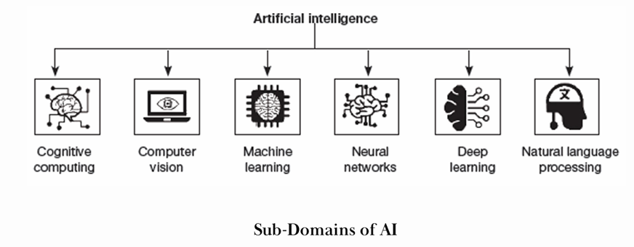
Techniques in AI
Machine learning
Deep learning
Natural language processing
Neural Networks
Computer vision
Cognitive Computing

Slide 40
Machine Learning Model
Machine Learning (ML) involves teaching a computer program to improve its performance at a specific task through experience (data). A widely accepted definition by Professor Mitchell describes it as:
“A computer program is said to learn from experience E with respect to some class of tasks T and performance measure P, if its performance at tasks in T, as measured by P, improves with experience E.”
This definition leads to understanding Machine Learning Models in three key components:
Task (T),
Experience (E)
Performance (P).

Slide 41
Machine Learning
Key Components of a Machine Learning Model:
1. Task (T):
This is the real-world problem that we want the machine to solve. Examples of tasks (T):
Predicting sales of a product.
Classifying emails as spam or not spam.
Other examples: classification, regression, clustering, and recognition.
Task (T) defines what the machine is trying to learn or predict.

Slide 42
Machine Learning
Key Components of a Machine Learning Model:
Experience (E):
Experience refers to the data that the machine learns from.
Just like humans learn from past experiences, machines learn from data. The more data the model is exposed to, the better it can learn and improve.
Example:
If you want the model to classify emails, you provide it with a set of labeled emails (spam and non-spam). This is its experience (E).
Experience (E) can be gained through different types of learning:
  Supervised Learning (with labeled data),
  Unsupervised Learning (with unlabeled data),
  Reinforcement Learning (through trial and error, receiving rewards or penalties).

Slide 43
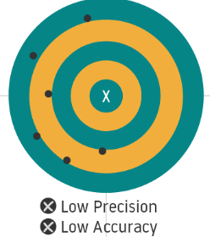
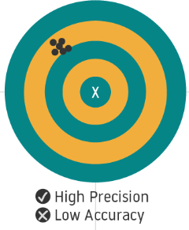
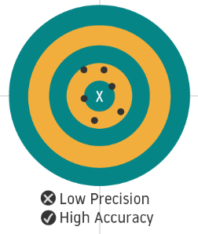
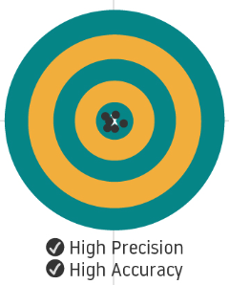
Machine Learning
Key Components of a Machine Learning Model:
3. Performance (P):
Performance is how well the model performs a task after learning from the data. It’s a measure of the accuracy or effectiveness of the model’s predictions.
Metrics to measure performance (P):
Accuracy: How many predictions were correct.
Precision: How many predicted positive outcomes were actually positive.

Slide 44
Machine Learning
How the Machine Learning Model Works:
Task (T): Define the problem (e.g., classifying emails).
Experience (E): Provide data for the model to learn from (e.g., labeled emails).
Performance (P): Measure the model’s effectiveness using metrics (e.g., accuracy or precision).
Example of the ML Model:
Let’s say we want to build a model to predict house prices (Task T):
Task (T): Predict the price of a house based on features like size, location, and number of rooms.
Experience (E): We provide the model with historical data on house sales (e.g., size, location, price).
Performance (P): The model’s performance is measured by how accurately it predicts the price of new houses, which we evaluate using metrics like mean squared error or R*.

Slide 45
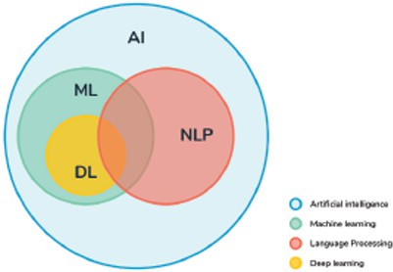
Machine learning:
Relationship Between AI, ML, DL, and NLP
Machine Learning is a sub-domain of Artificial Intelligence (AI). AI refers to the broad concept of creating machines that can think and act intelligently. Within AI, we have specific areas like Machine Learning (ML), Deep Learning (DL), and Natural Language Processing (NLP).
AI: The broad field of creating intelligent machines.
ML: Focuses on teaching machines to learn from data.
DL: A deeper level of ML that uses neural networks to process
large datasets, especially useful for tasks like image recognition.
NLP: A branch of AI that enables machines to understand, interpret,
and respond to human language.

Slide 46
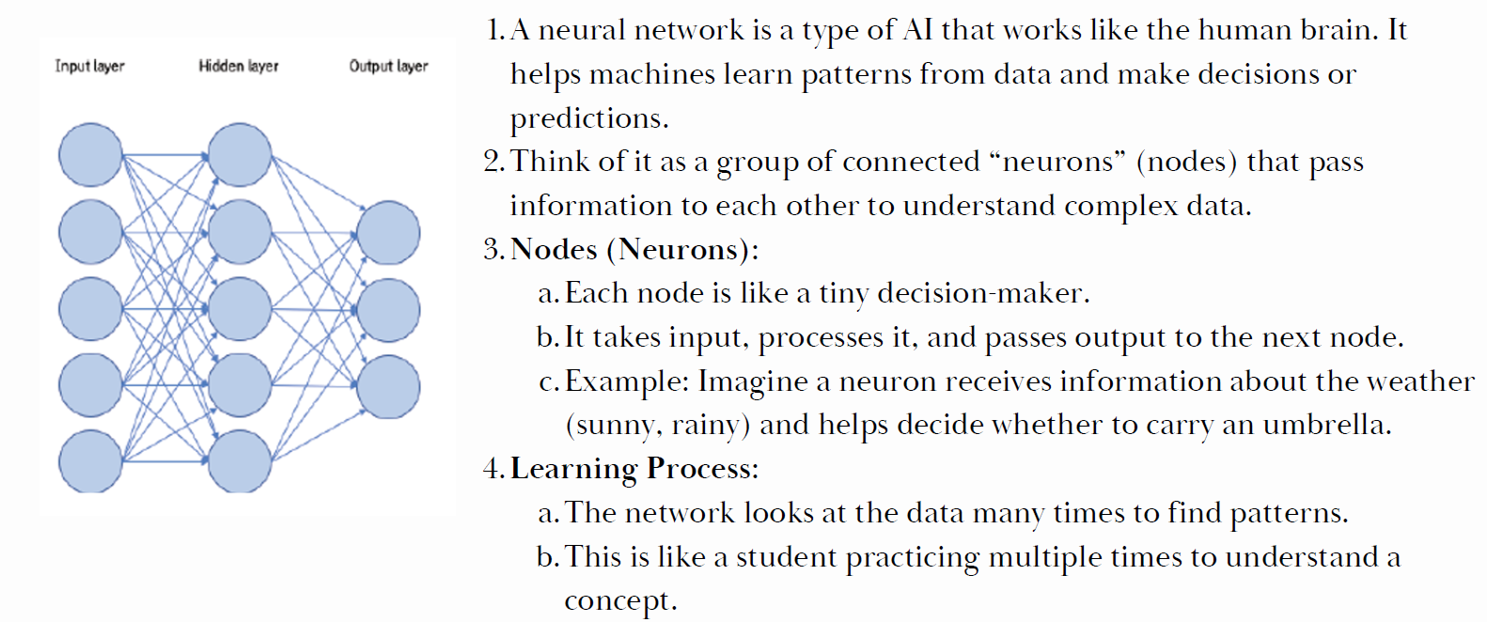
Techniques in AI
2. Neural Network:

Slide 47
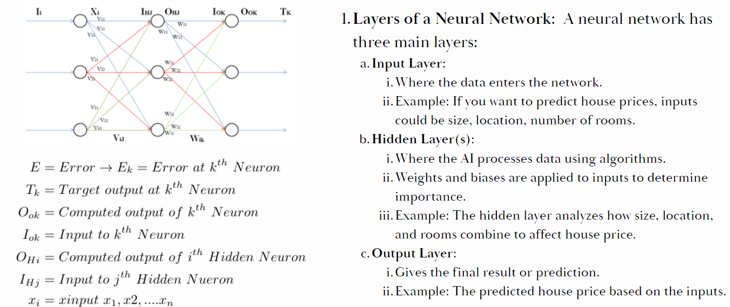
Techniques in AI
2. Neural Network:

Slide 48
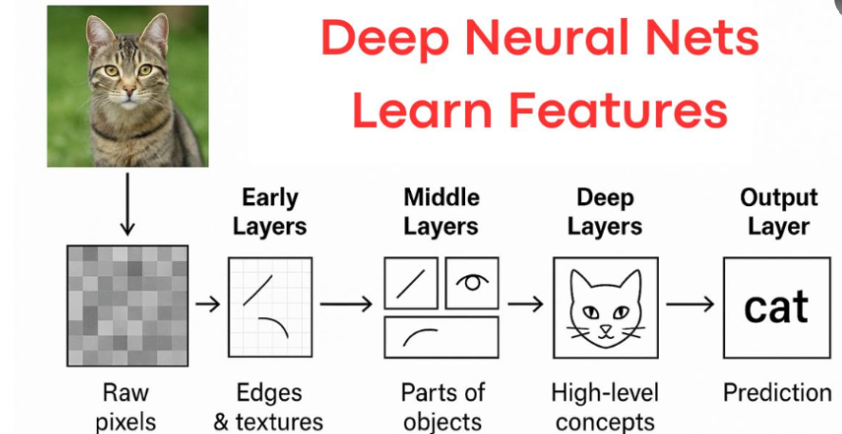
Techniques in AI
3. Deep learning:
Deep Learning (DL) is a powerful technique within Machine Learning (ML) that uses neural networks with many layers to process and learn from data.
It is especially good at handling complex patterns in large datasets.
How Deep Learning Works:
      The network has multiple layers that identify different features.
      For example, when identifying a cat, it may first
      learn edges, then shapes, and finally features like ears,
      eyes and whiskers.
Applications of DL:
1. Image Recognition:
Deep learning is excellent at identifying objects, faces, and scenes in images.
Example: Face recognition systems in smartphones.
2. Speech Recognition: Deep learning models can process audio data to convert speech into text.
Example: Virtual assistants like Siri or Google Assistant that understand spoken commands.

Slide 49
Techniques in AI
2. Neural Network:

Slide 50
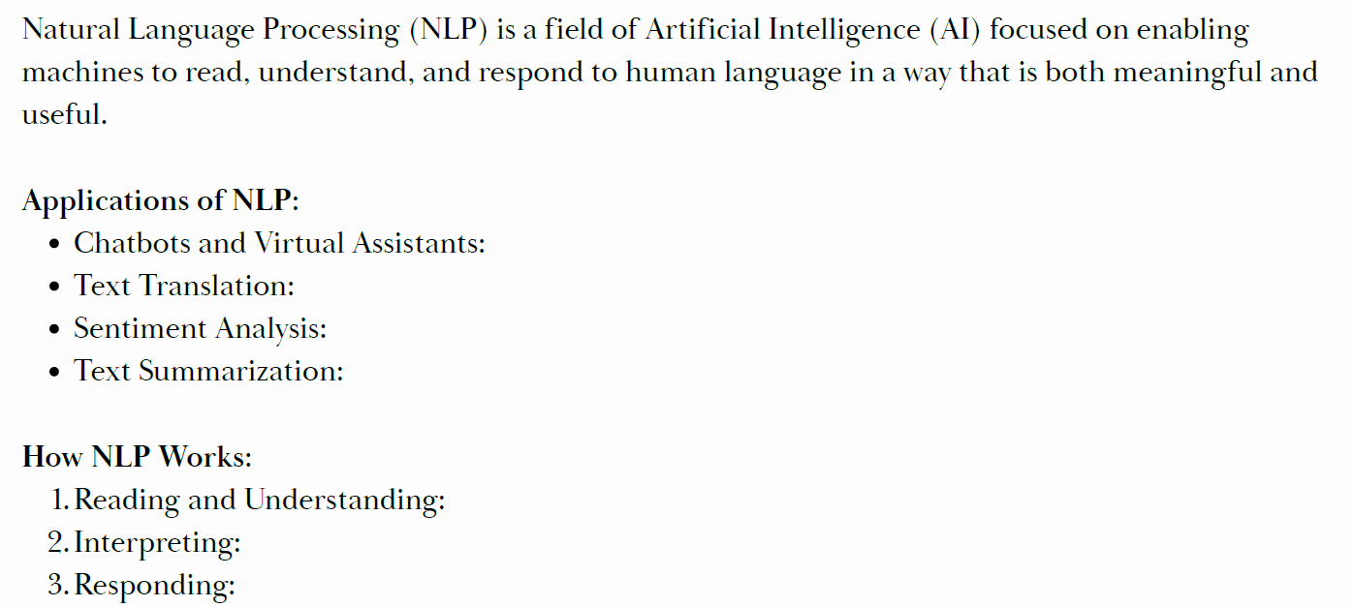
Techniques in AI
4. Natural Language Processing:

Slide 51
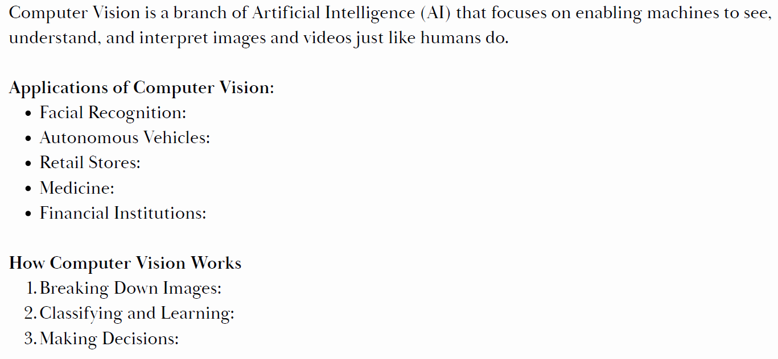
Techniques in AI
5. Computer Vision:

Slide 52
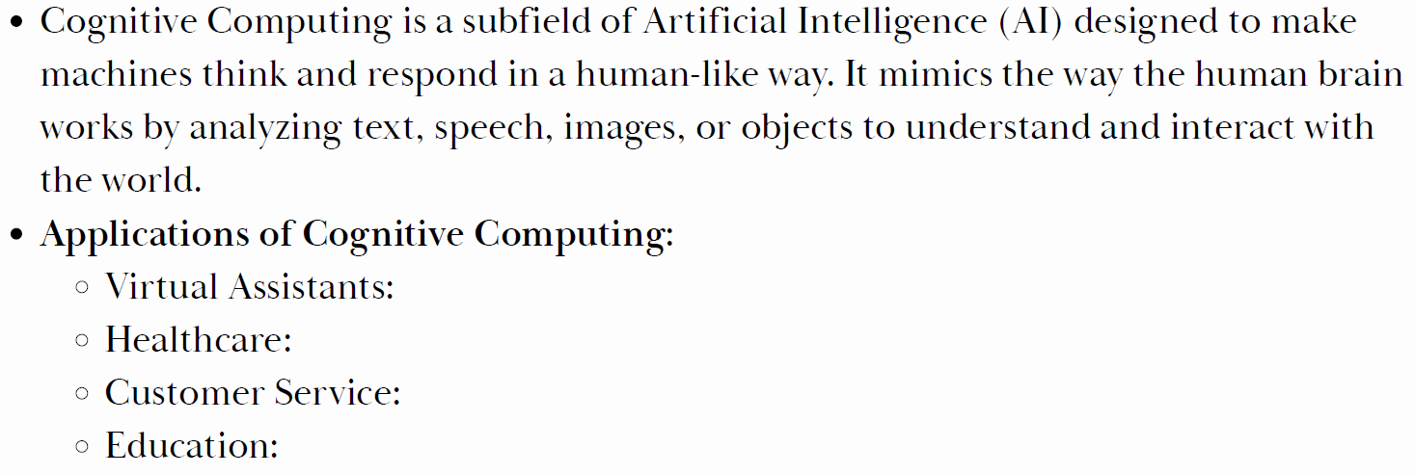
Techniques in AI
6. Cognitive Computing:

Slide 53
Techniques in AI
2. Neural Network:

